Slide 1
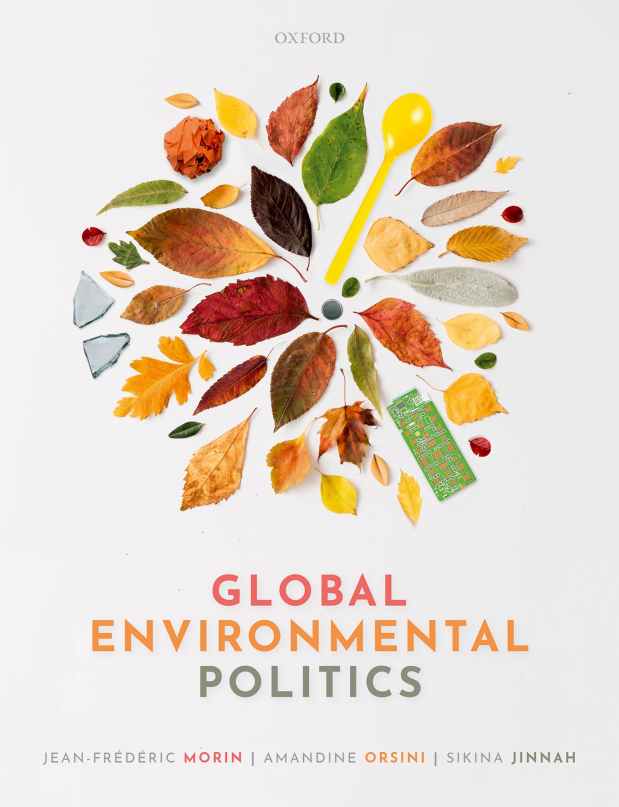
Global Environmental Politics
by Jean-Frédéric Morin, Amandine Orsini and Sikina Jinnah

Slide 2
Part 01
Defining global environmental issues
Chapter 02
Ideas about environmental protection

Slide 3
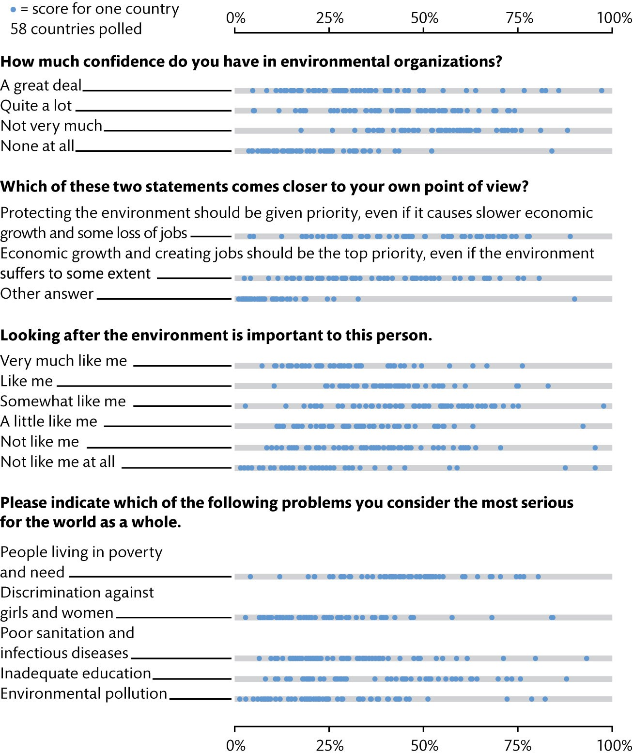
Figure 2.1 The environment in the opinion polls

Slide 4
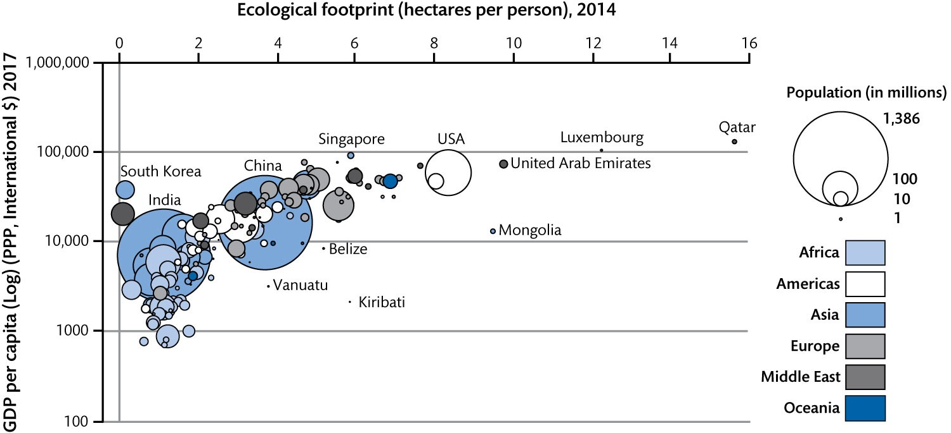
Figure 2.2 Ecological footprint and per capita GDP

Slide 5
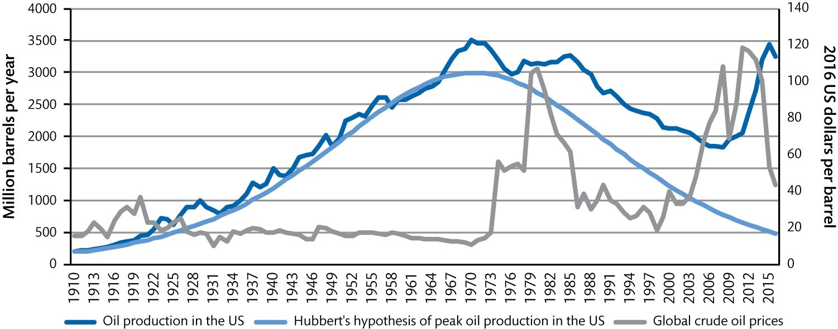
Figure 2.3 Oil production, oil price, and forecasts 1910–2016

Slide 6
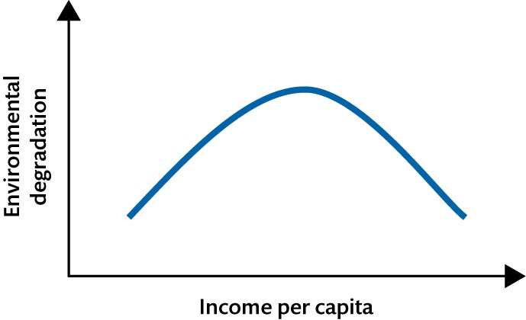
Figure 2.4 The environmental Kuznets curve

Slide 7
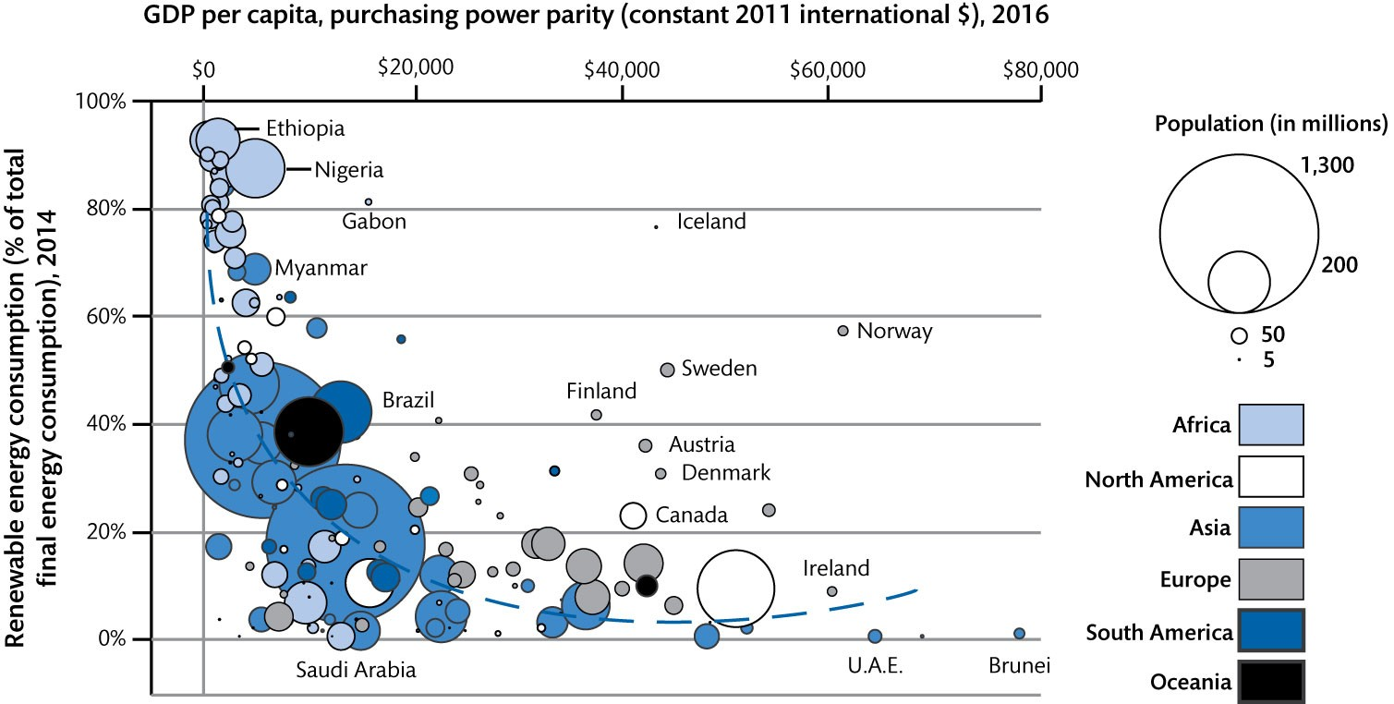
Figure 2.5 Renewable energy as a function of GDP per capita

Slide 8
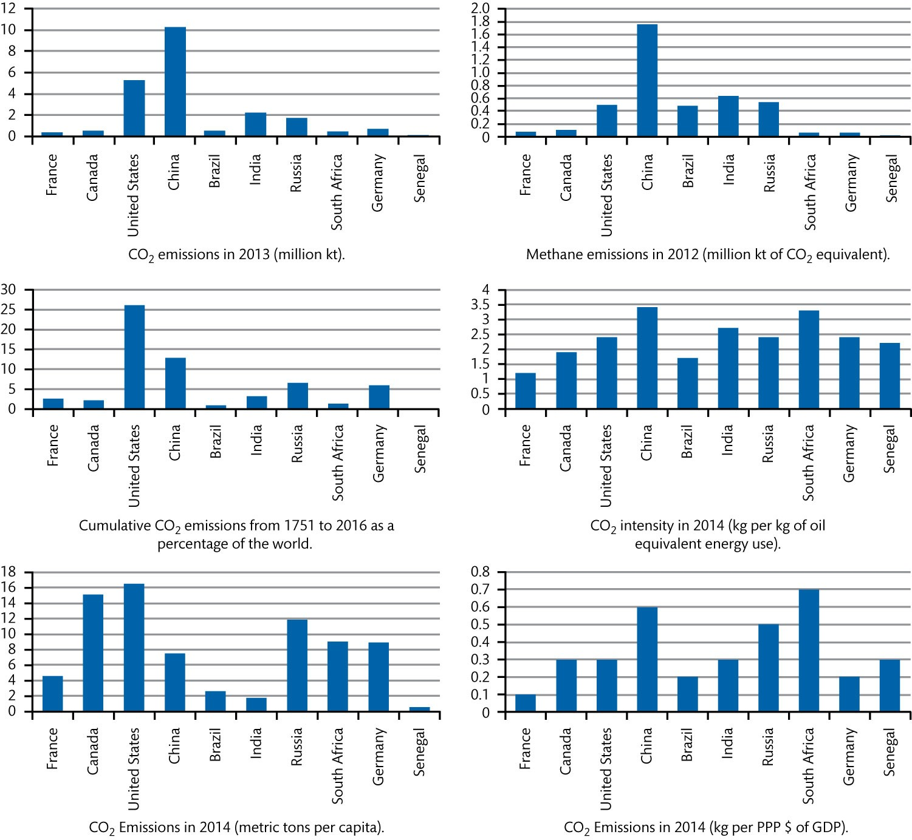
Figure 2.6 Comparison of greenhouse gas emissions

