Slide 1

Global Environmental Politics
by Jean-Frédéric Morin, Amandine Orsini and Sikina Jinnah

Slide 2
Part 03
Bargaining over the environment
Chapter 06
Development and the environment: From the Stockholm Summit to the Sustainable Development Goals

Slide 3
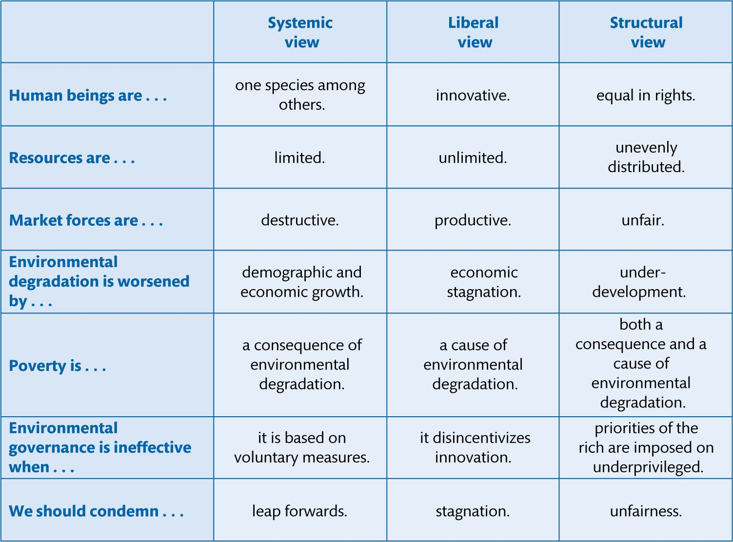
Figure 6.1 Three ideal-type views on environment and development

Slide 4
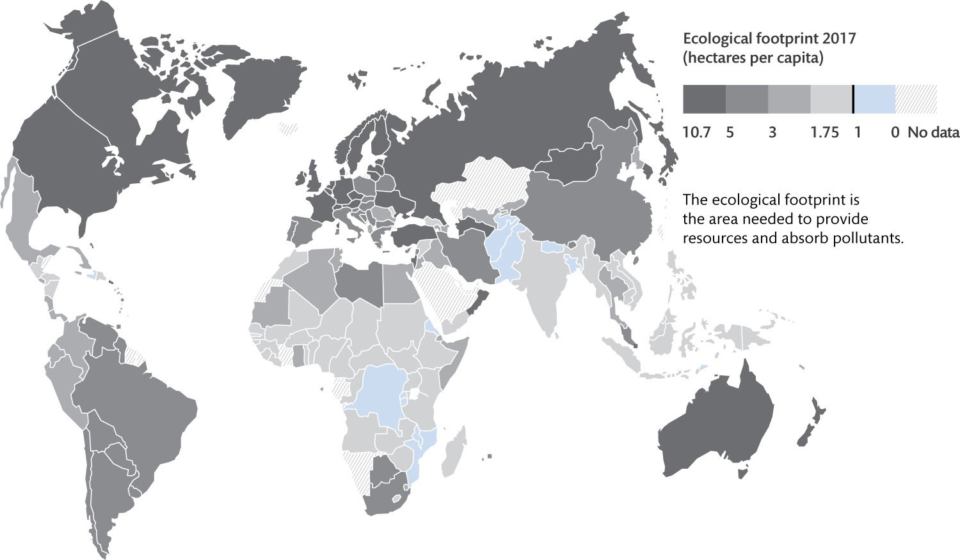
Figure 6.2 World map of ecological footprint of consumption per country (2017)

Slide 5
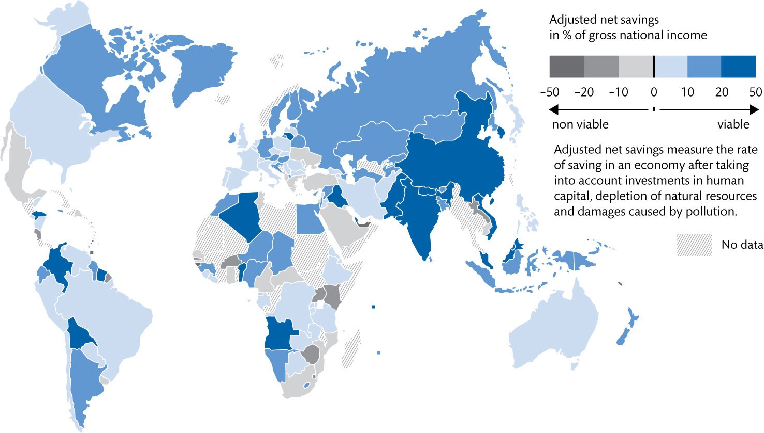
Figure 6.3 World map of adjusted net savings per country (2015)

Slide 6
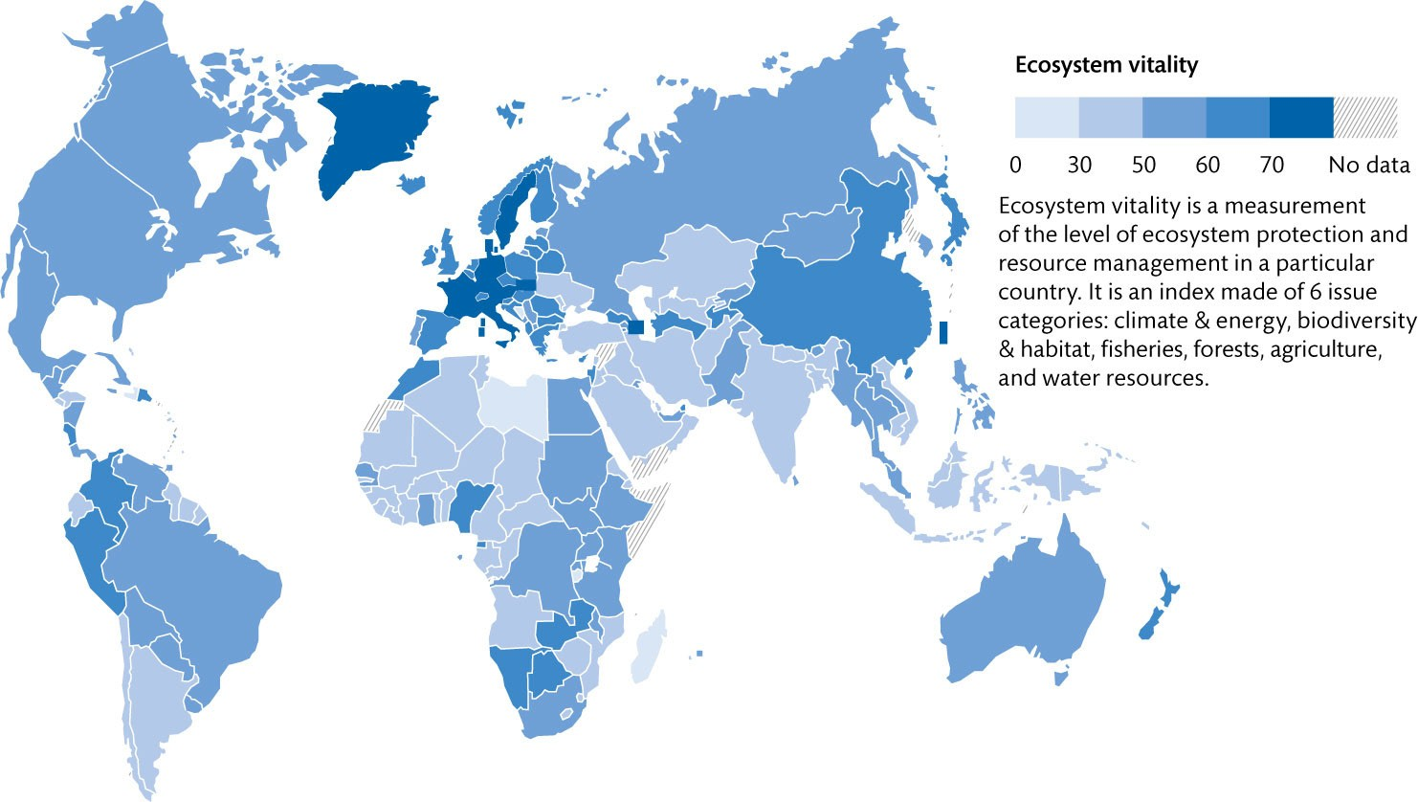
Figure 6.4 World map of ecosystem vitality per country (2018)

Slide 7
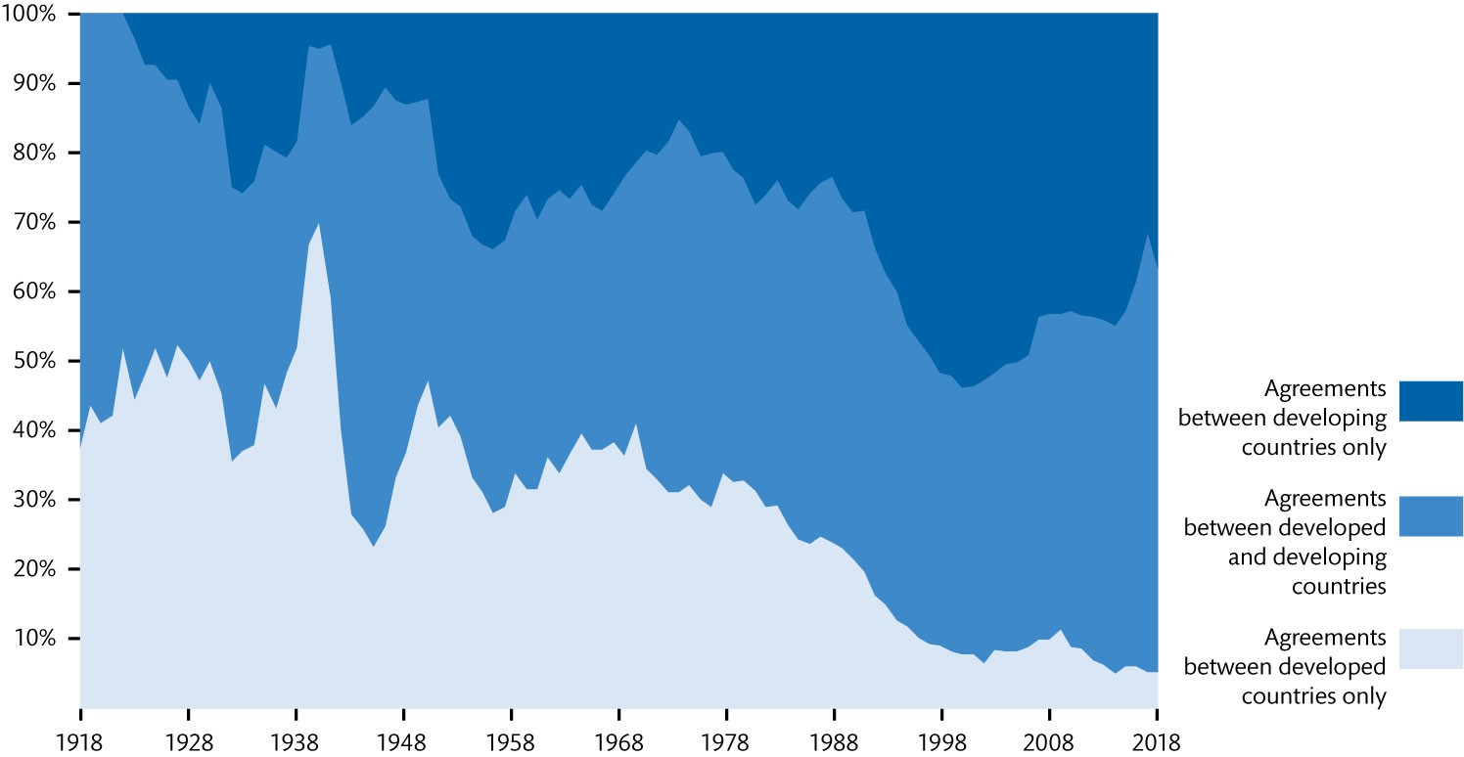
Figure 6.5 Distribution of cross-national environmental agreements by level of development (1918–2018)

Slide 8
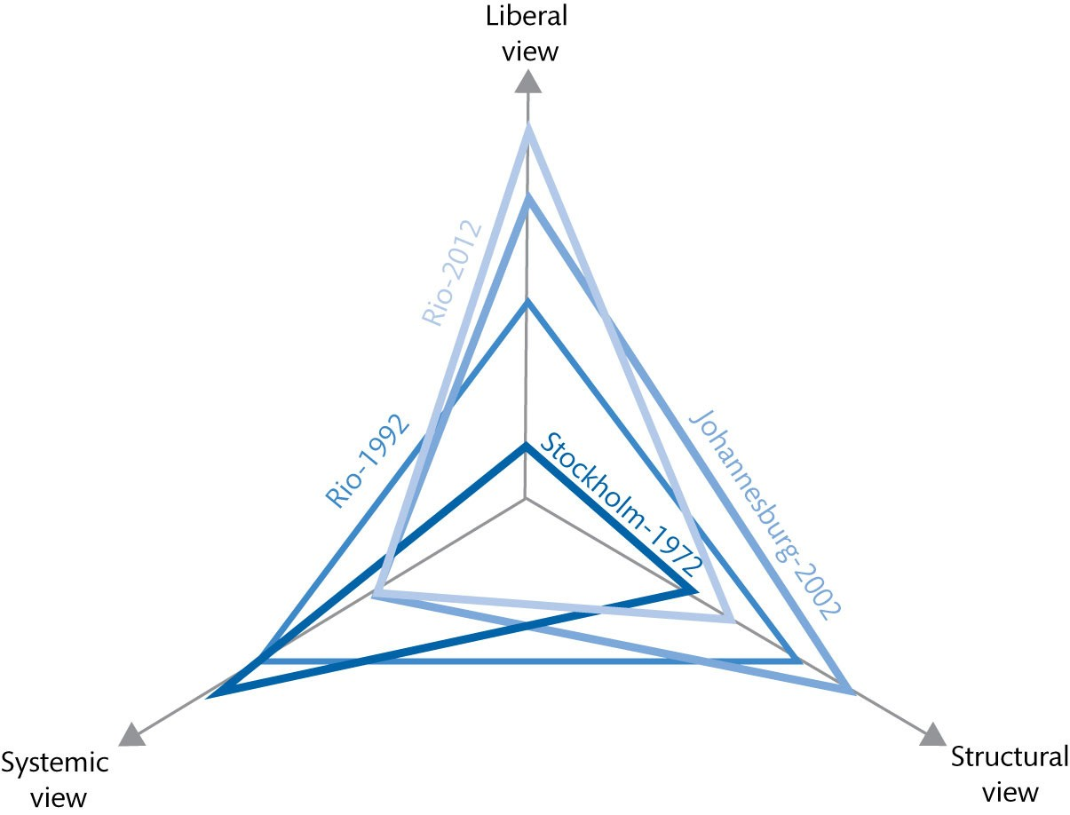
Figure 6.6 Four summits, three views

Slide 9
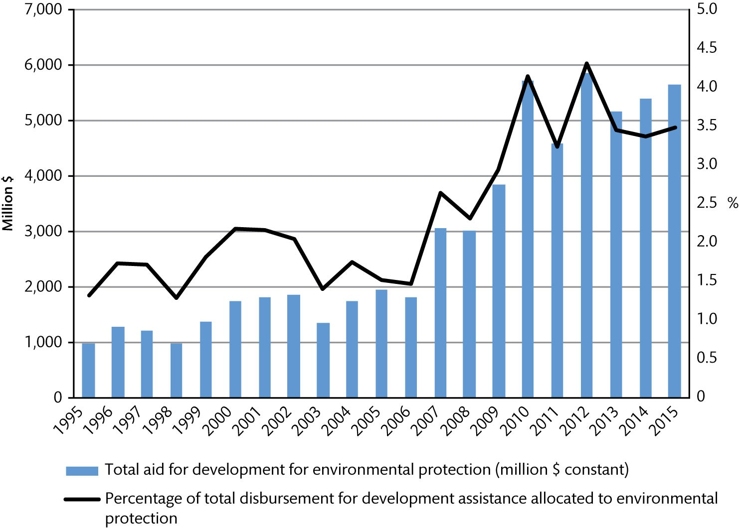
Figure 6.7 Public development aid for environmental protection (1995–2015)

