Slide 1

Global Environmental Politics
by Jean-Frédéric Morin, Amandine Orsini and Sikina Jinnah

Slide 2
Part 05
Cross-cutting issues
Chapter 09
Natural resources, security, and conflicts

Slide 3
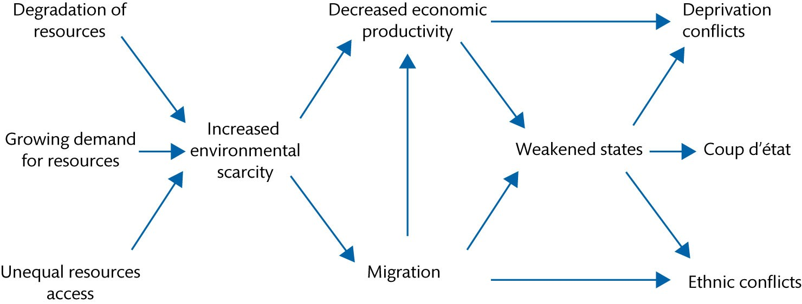
Figure 9.1 The Homer-Dixon model

Slide 4
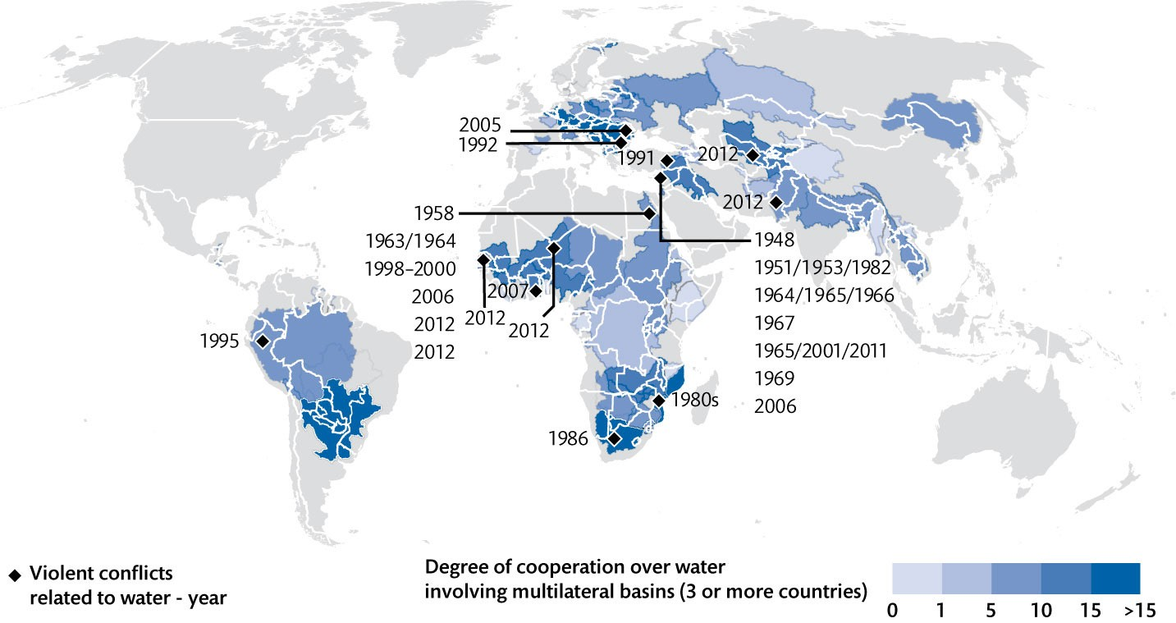
Figure 9.2 Cooperation and conflicts over water

Slide 5
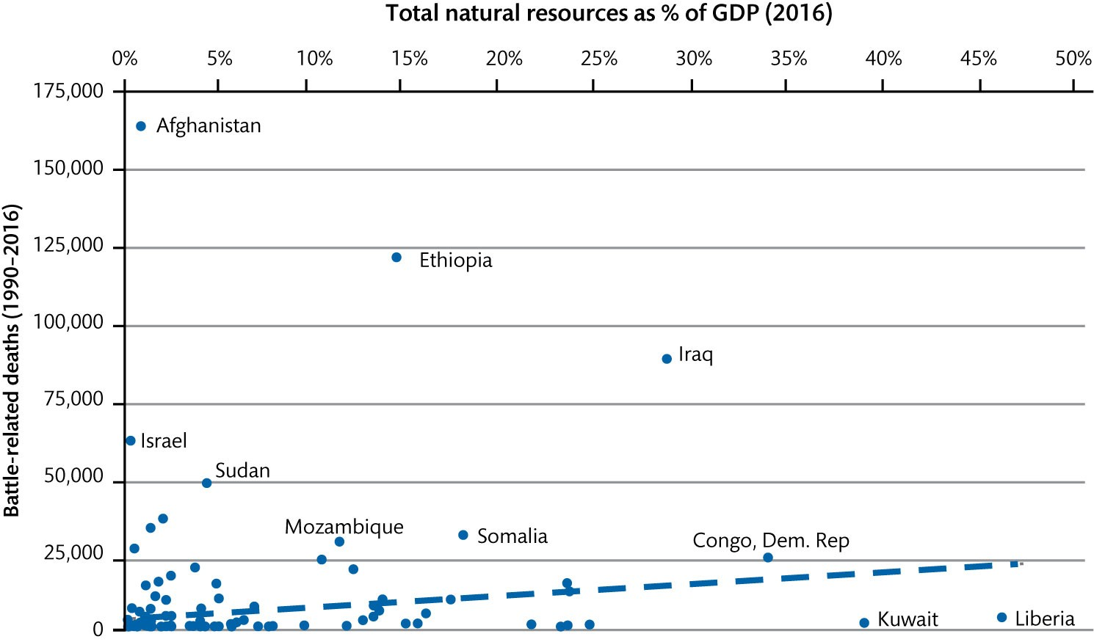
Figure 9.3 The resource curse?

Slide 6
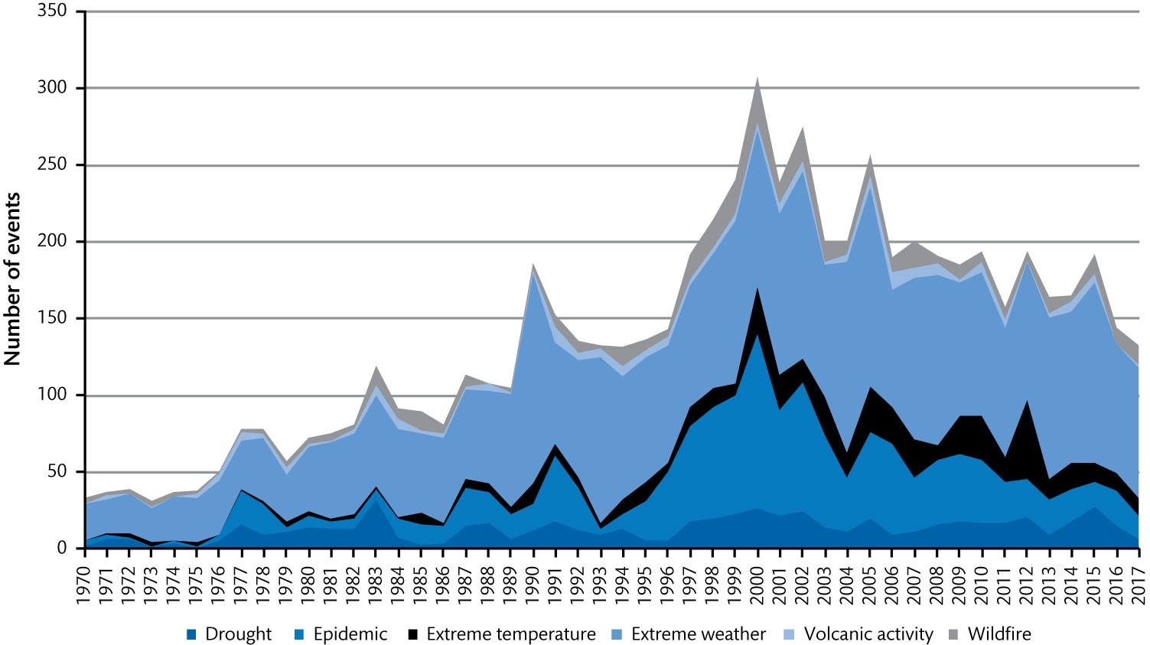
Figure 9.4 Number of natural disaster events (1970–2017)

