Slide 1
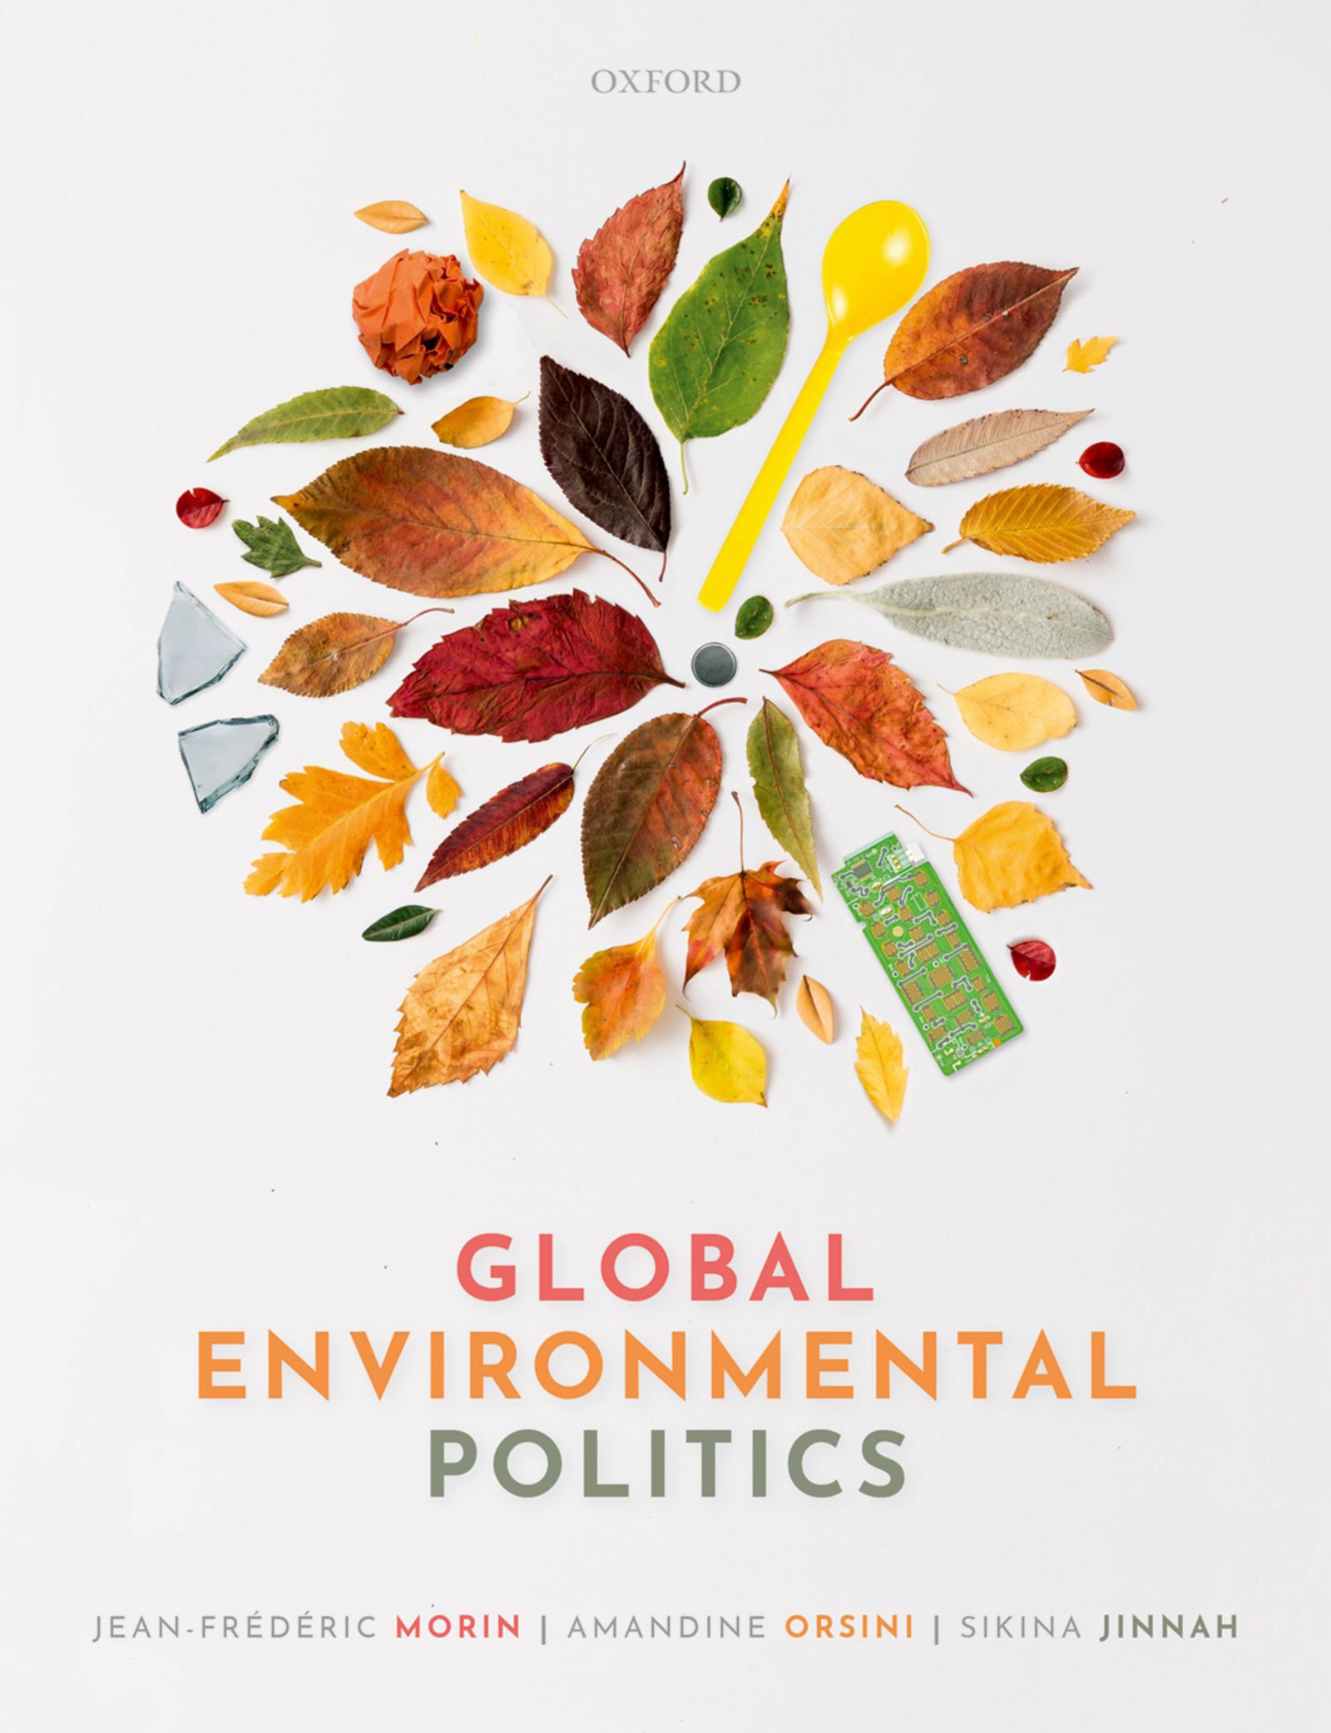
Global Environmental Politics
by Jean-Frédéric Morin, Amandine Orsini and Sikina Jinnah

Slide 2
Part 04
Institutions and policies
Chapter 07
International institutions

Slide 3
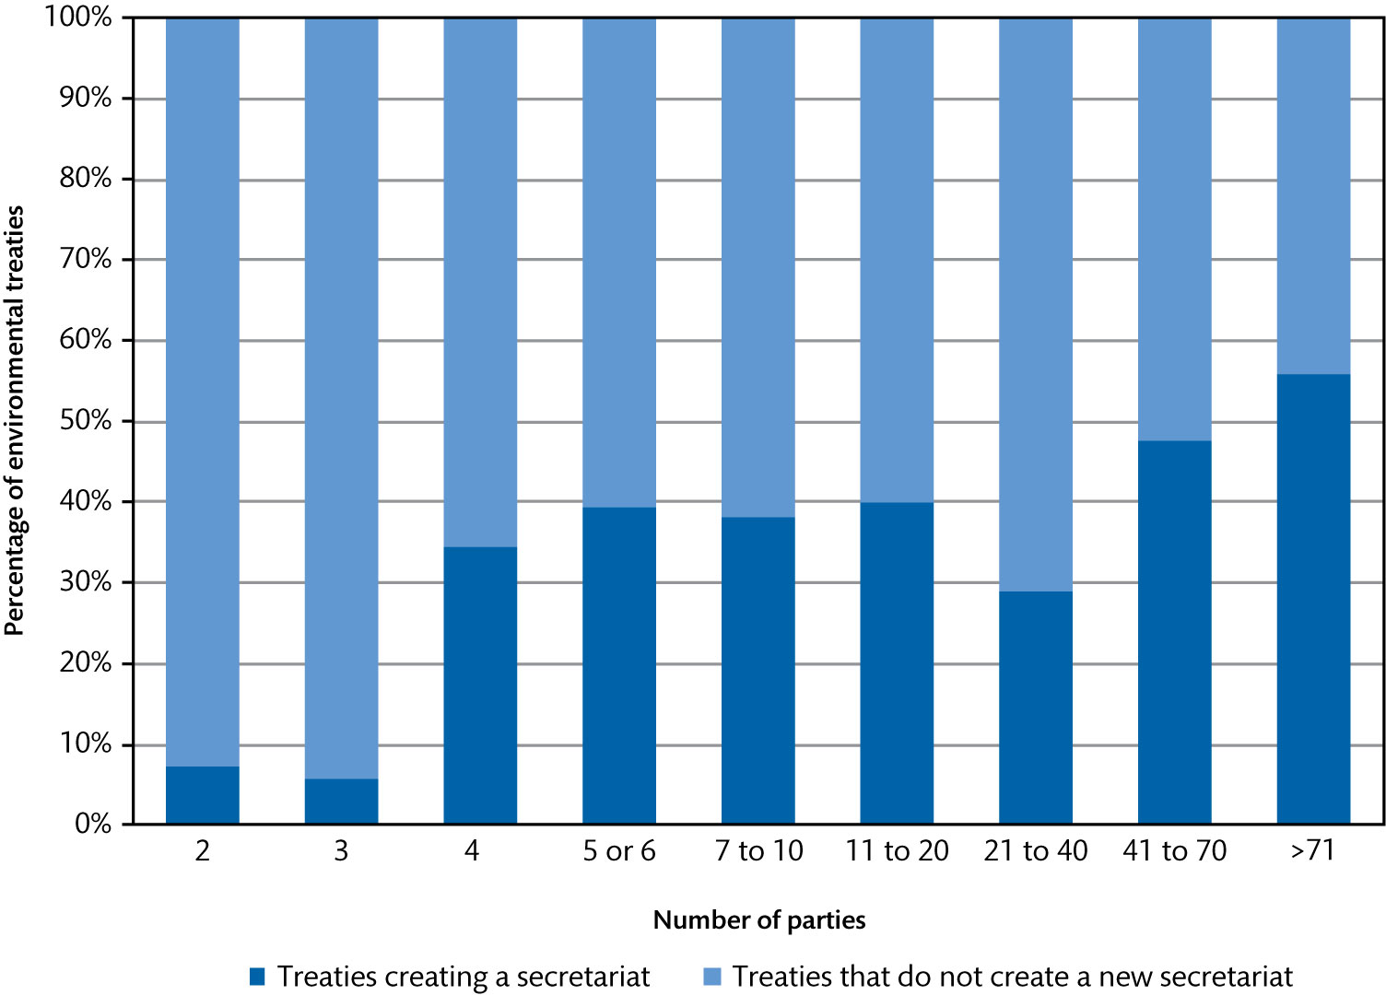
Figure 7.1 Relationship between the number of parties to an environmental treaty and the creation of a secretariat

Slide 4
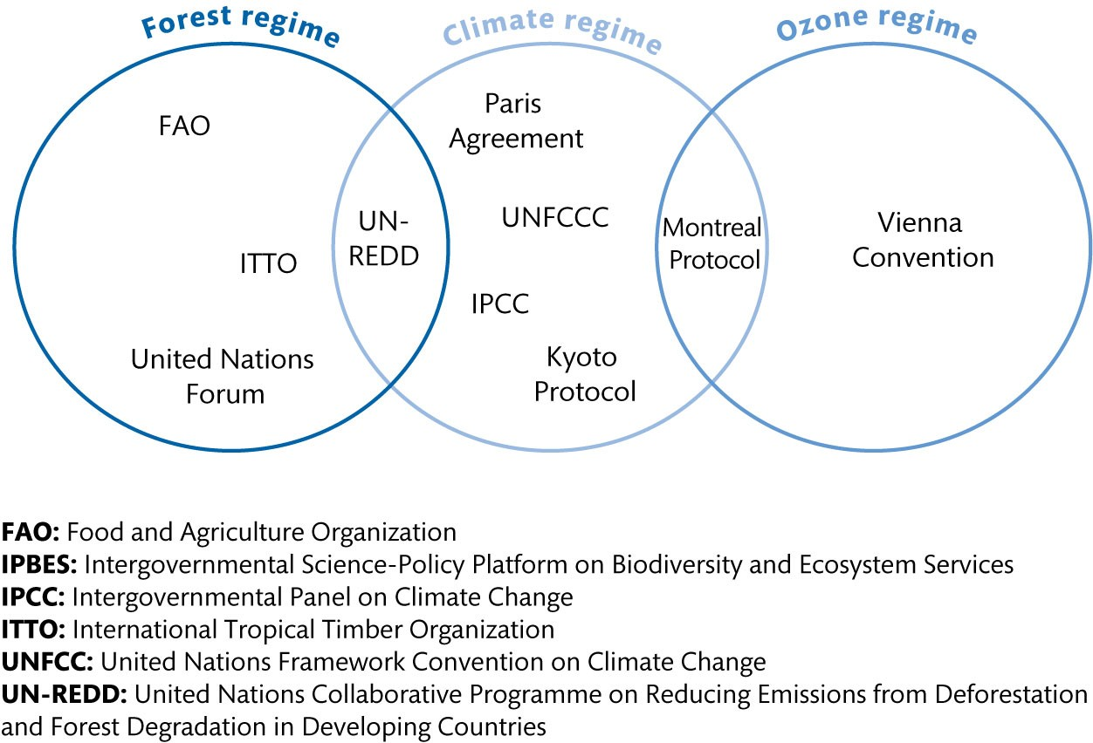
Figure 7.2 Environmental regime complexes centred on biodiversity and climate change (Continued)

Slide 5
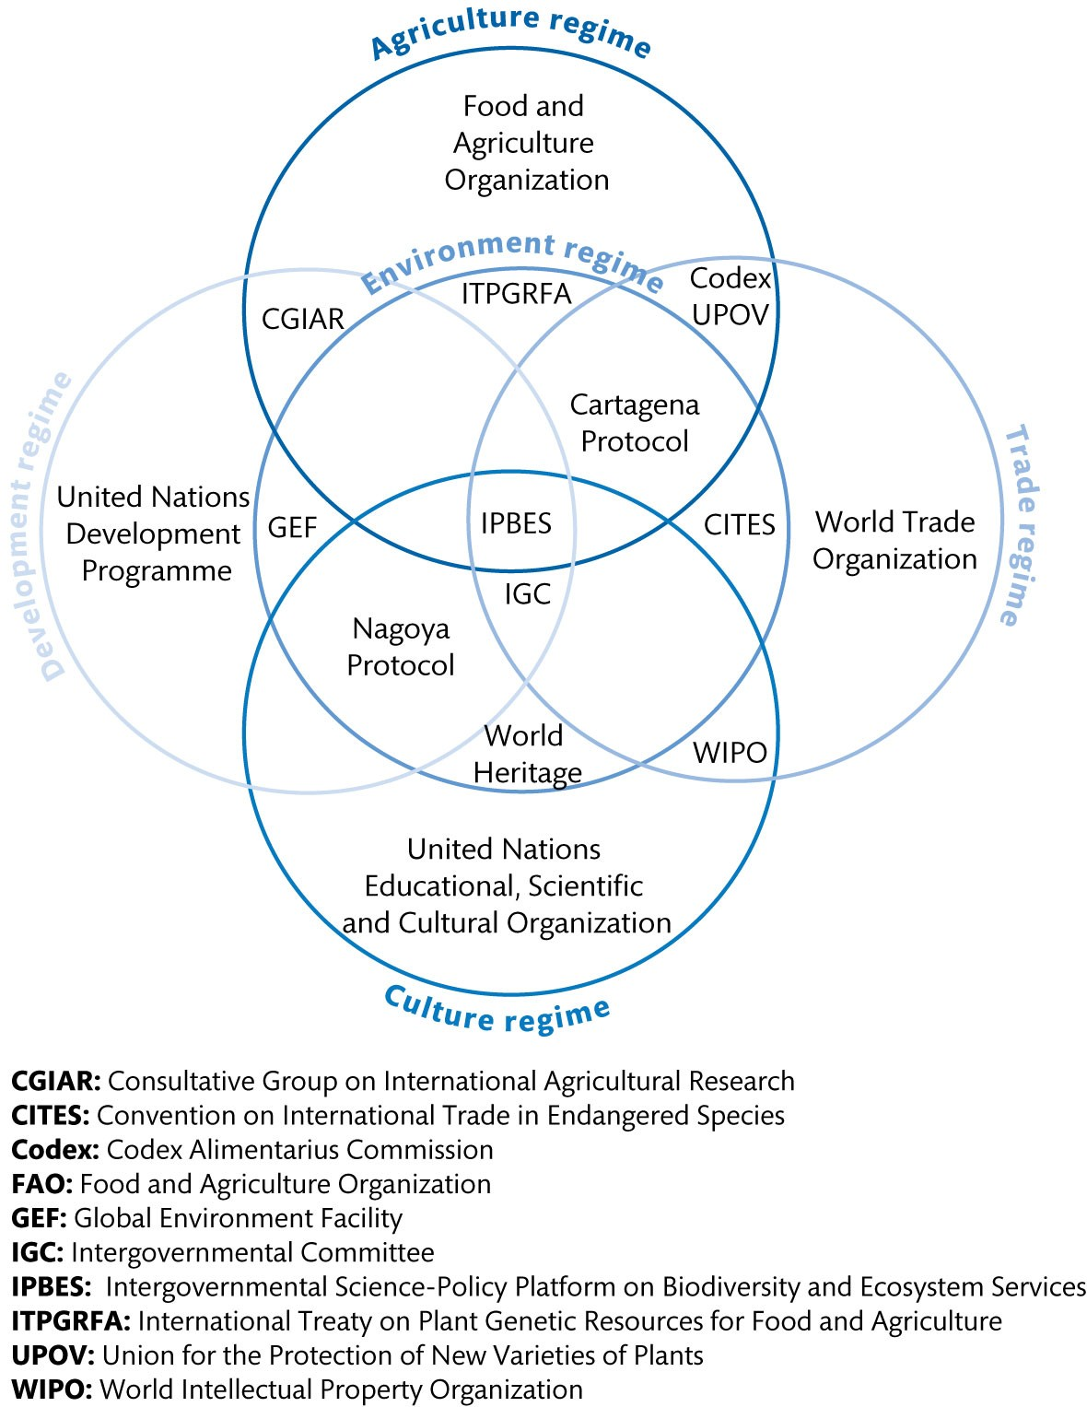
Figure 7.2 Environmental regime complexes centred on biodiversity and climate change

Slide 6
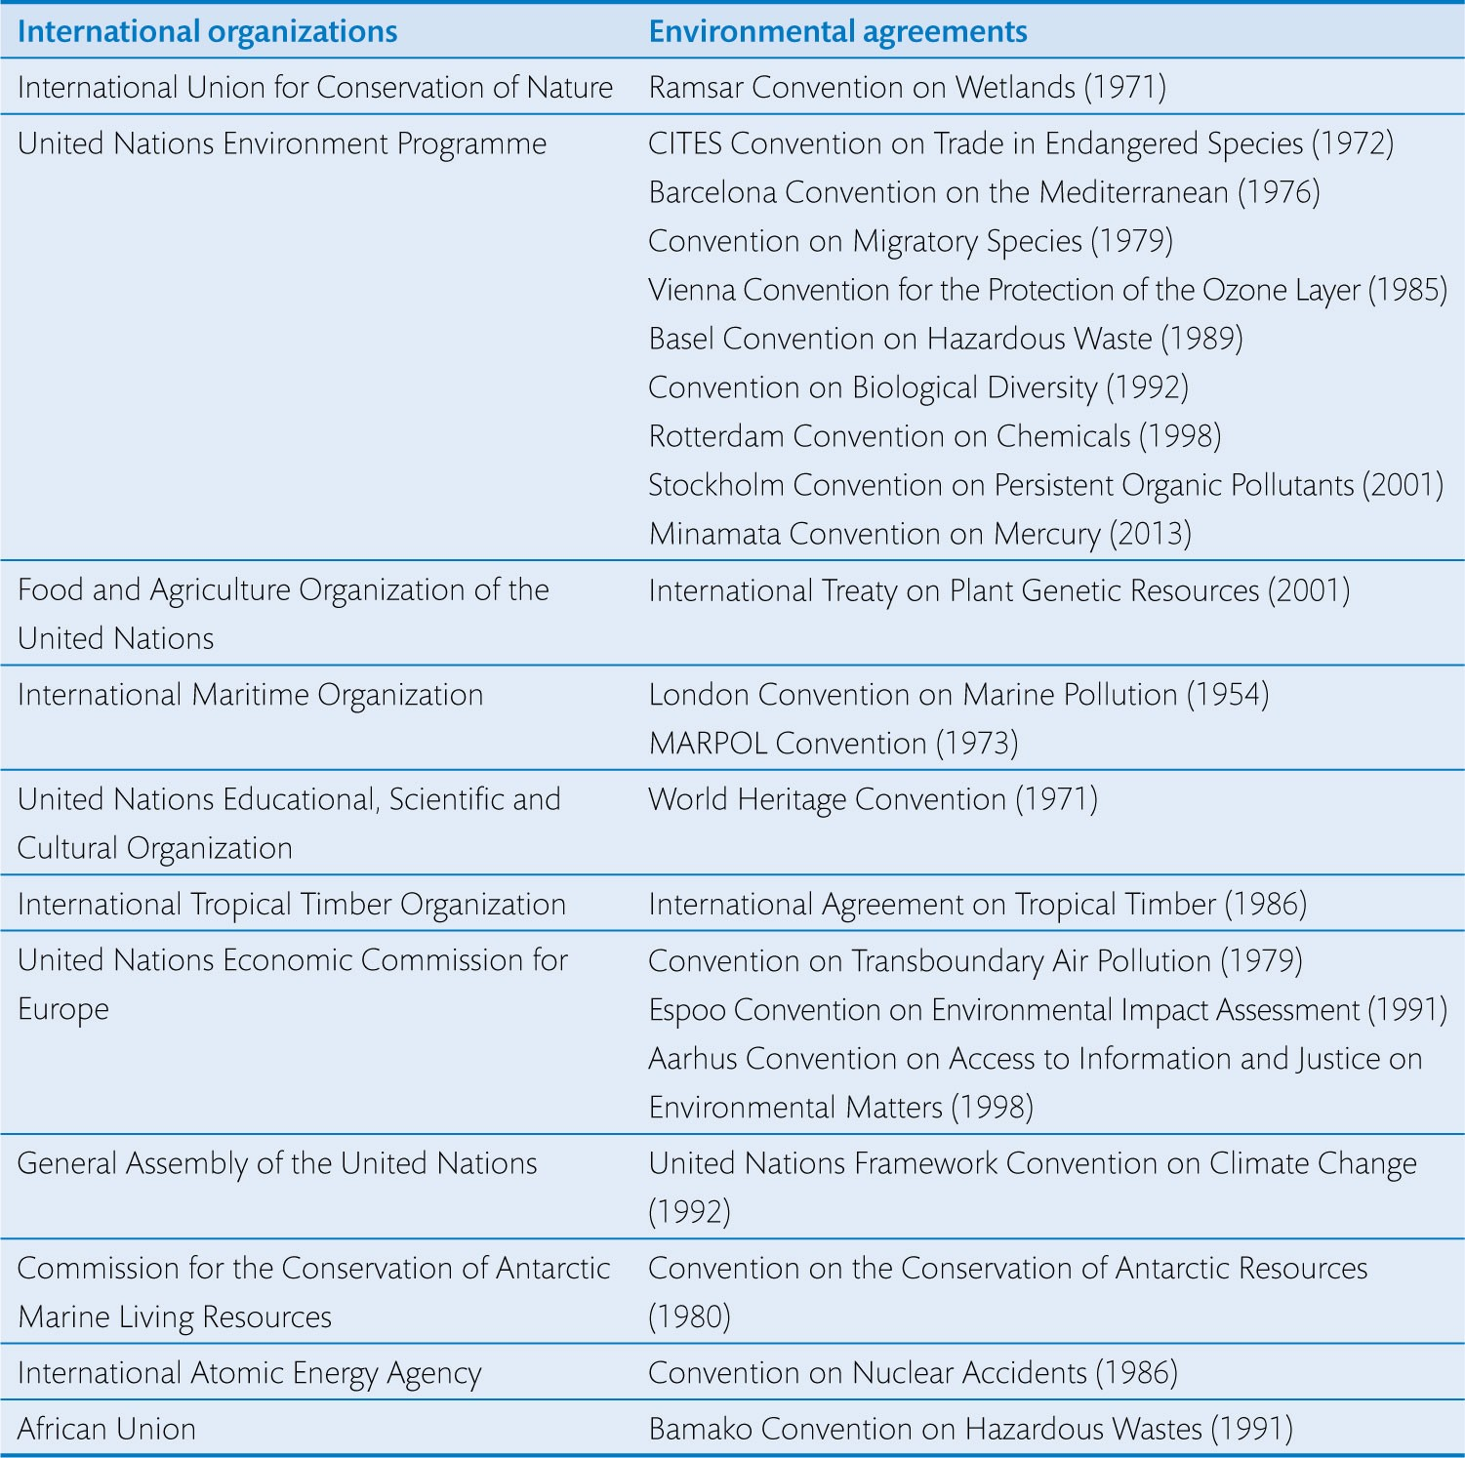
Table 7.1 A few intergovernmental organizations and the treaties associated with them

Slide 7
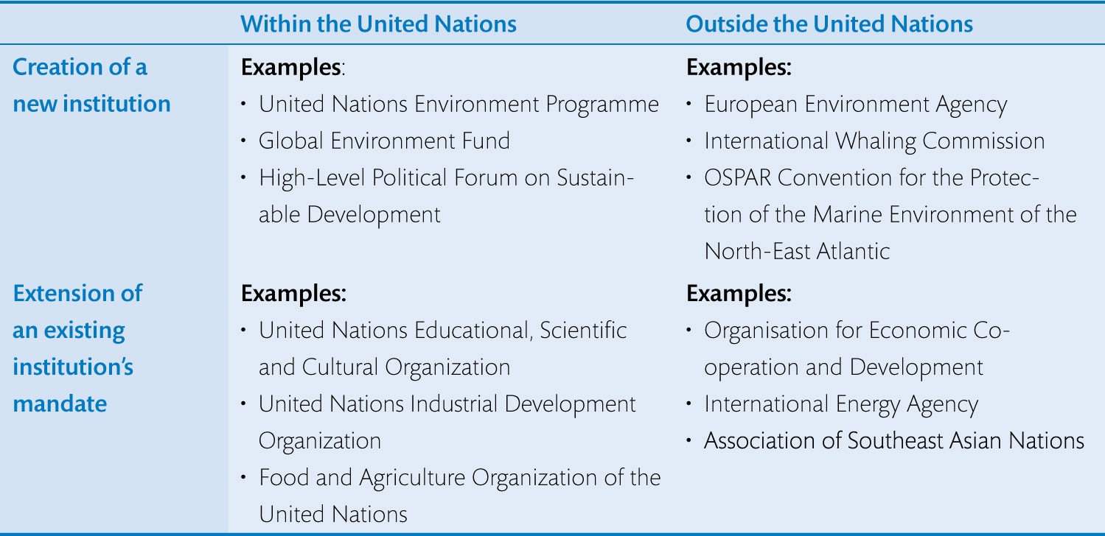
Table 7.2 The emergence of environmental issues in the organizational landscape

Slide 8
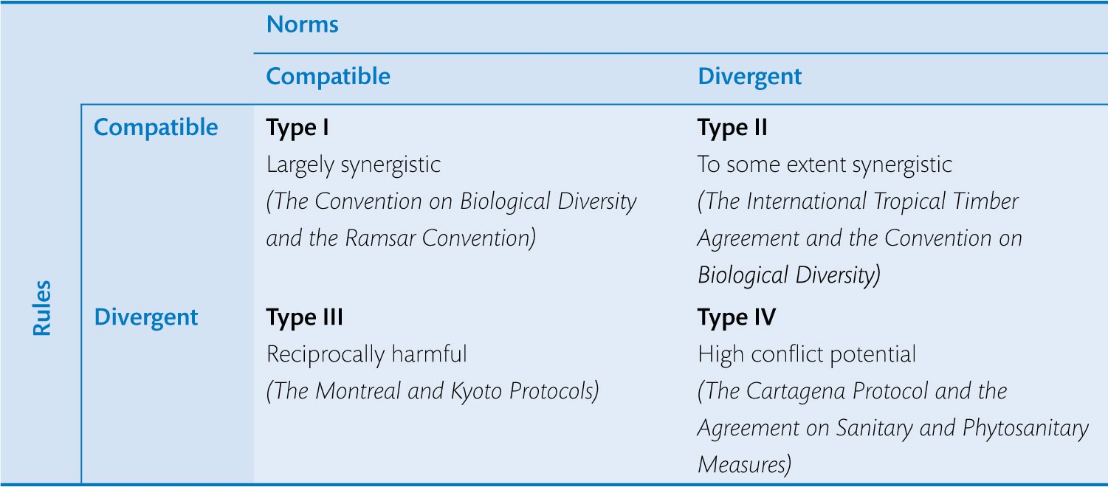
Table 7.3 Modes of interaction between regimes

