Slide 1

Global Environmental Politics
by Jean-Frédéric Morin, Amandine Orsini and Sikina Jinnah

Slide 2
Part 05
Cross-cutting issues
Chapter 10
Trade and the environment

Slide 3
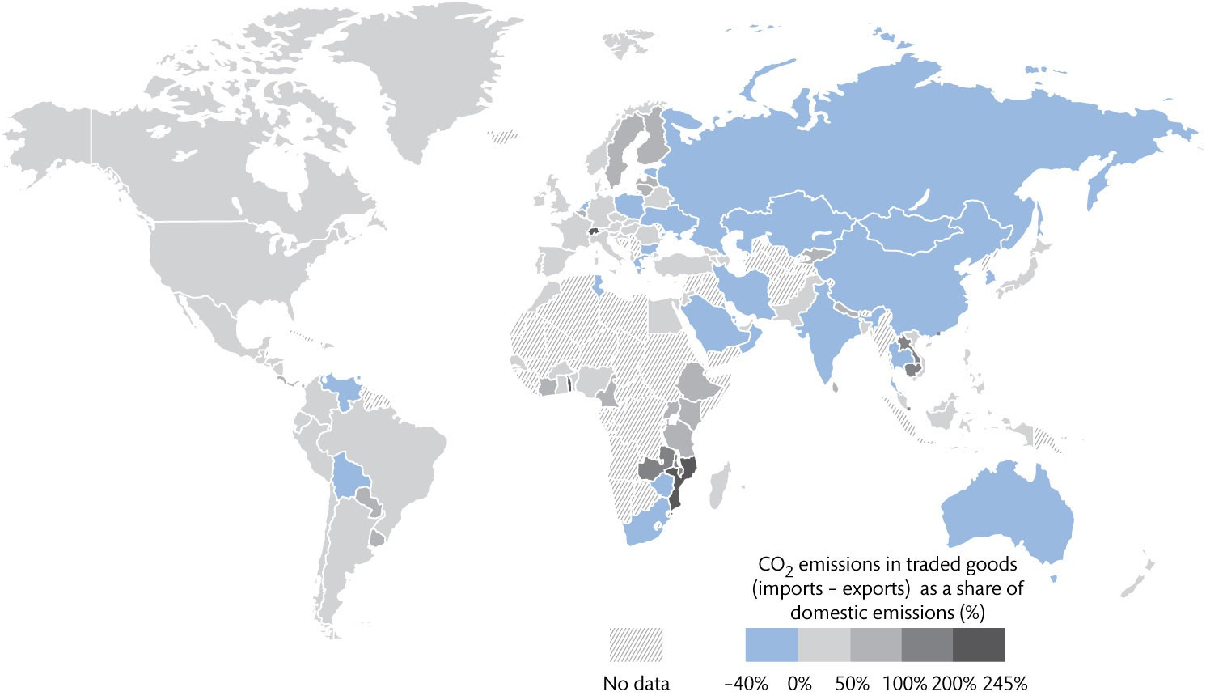
Figure 10.1 CO₂ emissions in traded goods as a share of domestic emissions

Slide 4
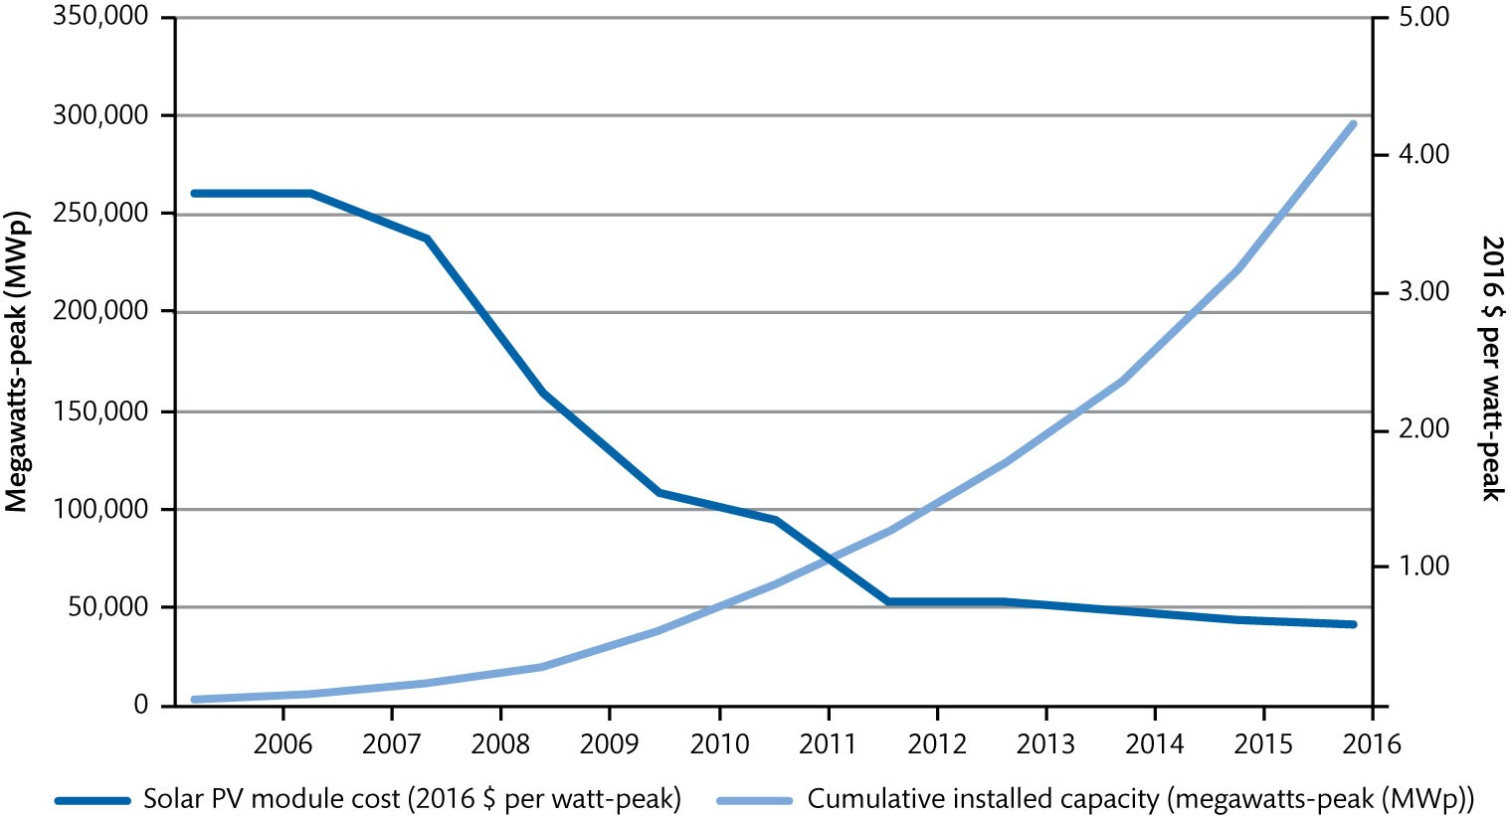
Figure 10.2 Solar prices vs cumulative capacity worldwide 2006–2016

Slide 5
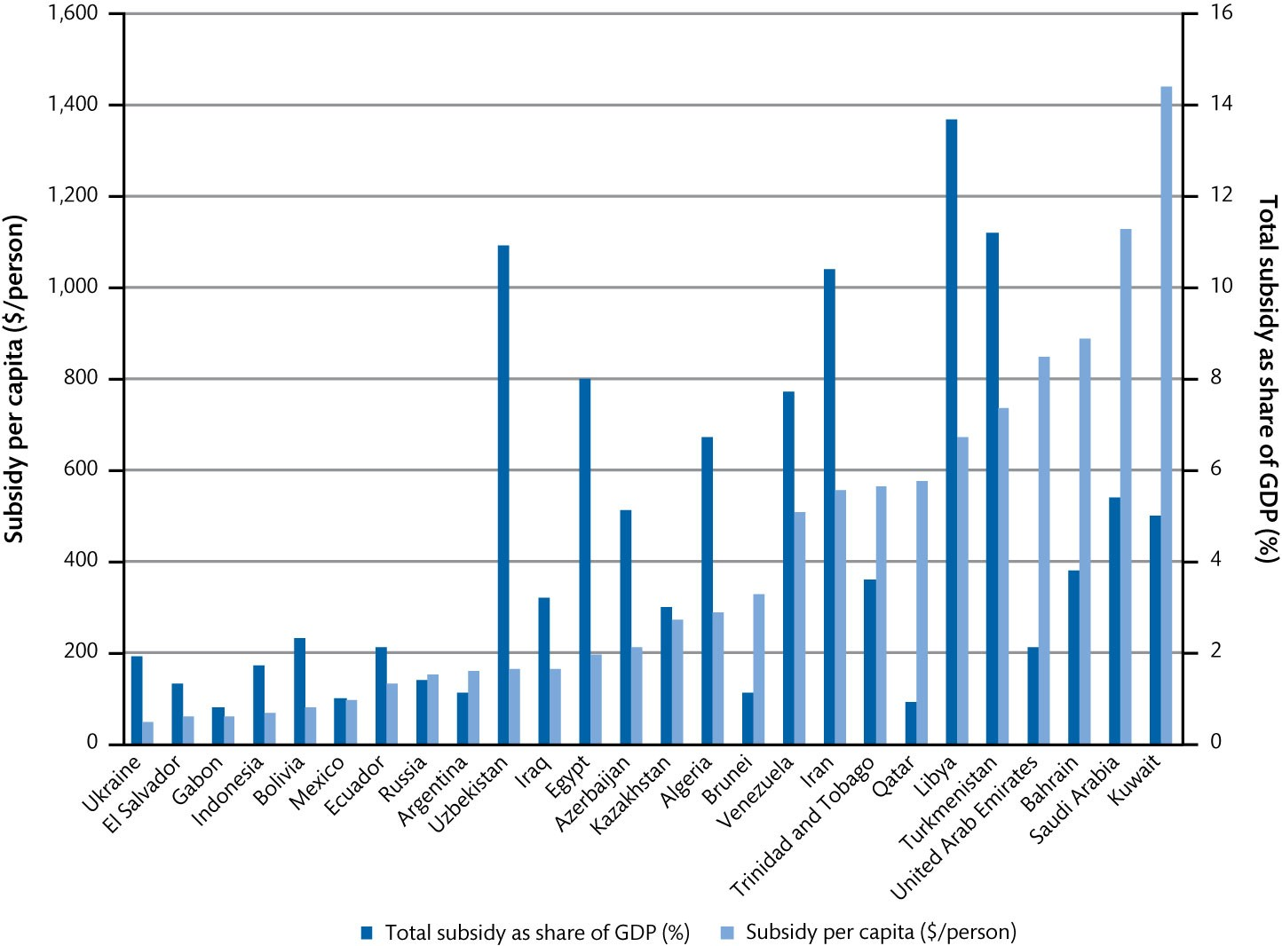
Figure 10.3 Fossil fuel consumption subsidies in selected countries, 2017

Slide 6
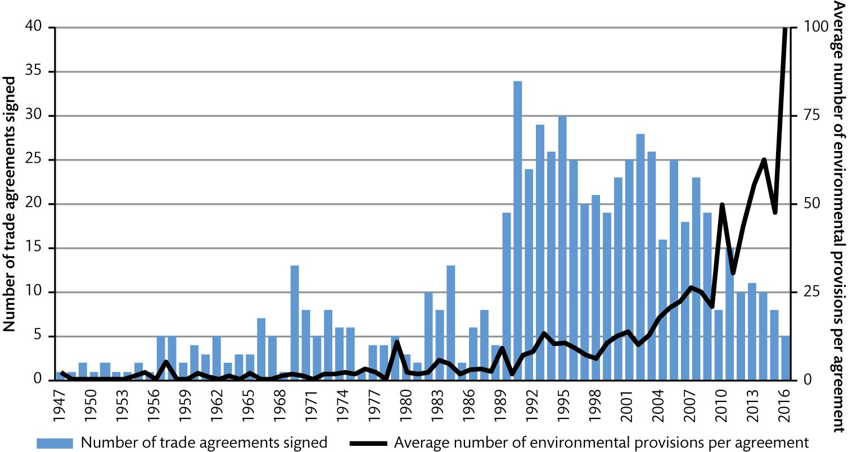
Figure 10.4 Environmental provisions in preferential trade agreements 1947–2016

Slide 7
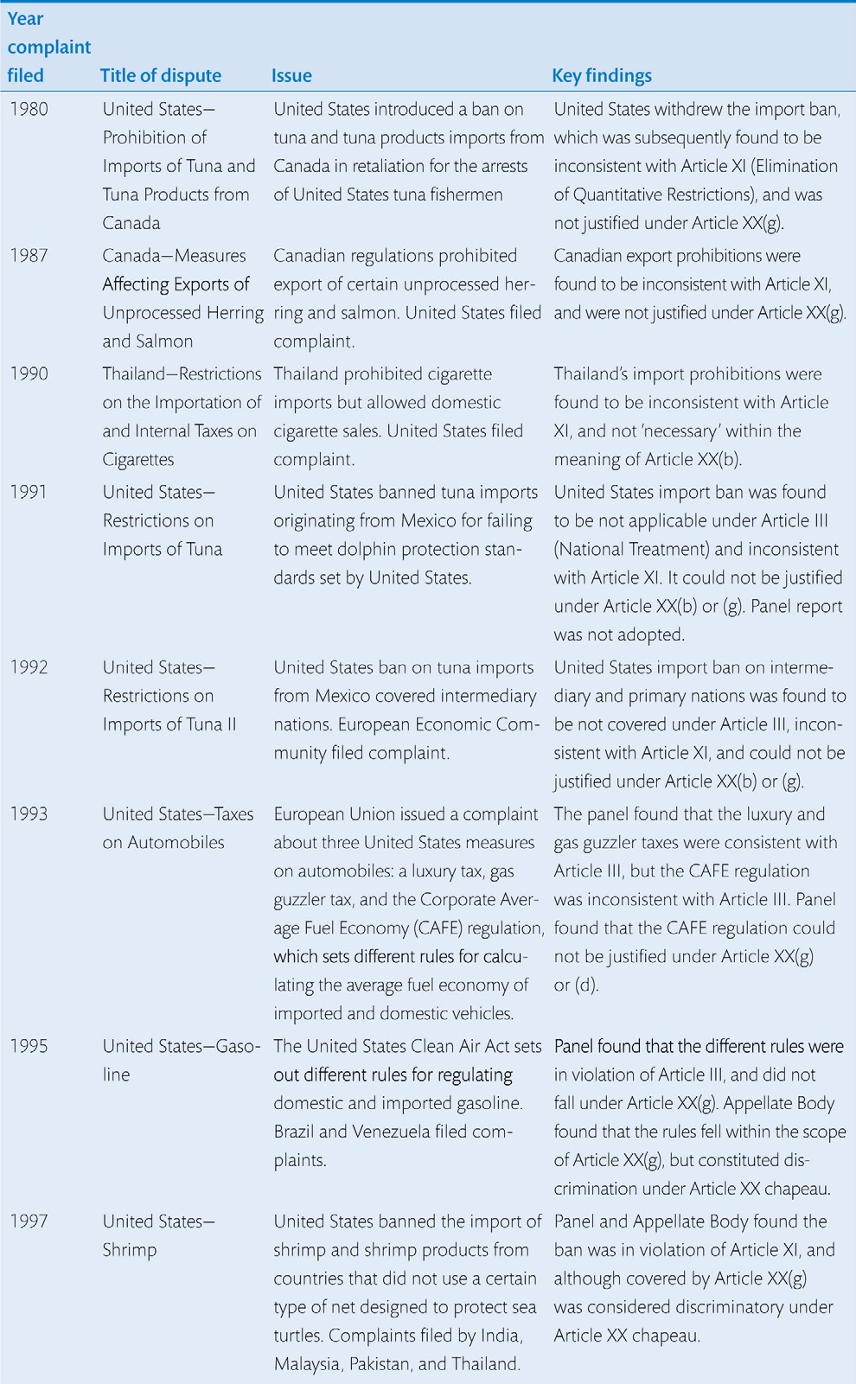
Table 10.1 Disputes involving Article XX(b) and (g) of the General Agreement on Tariffs and Trade (1980–2018) (Continued)

Slide 8
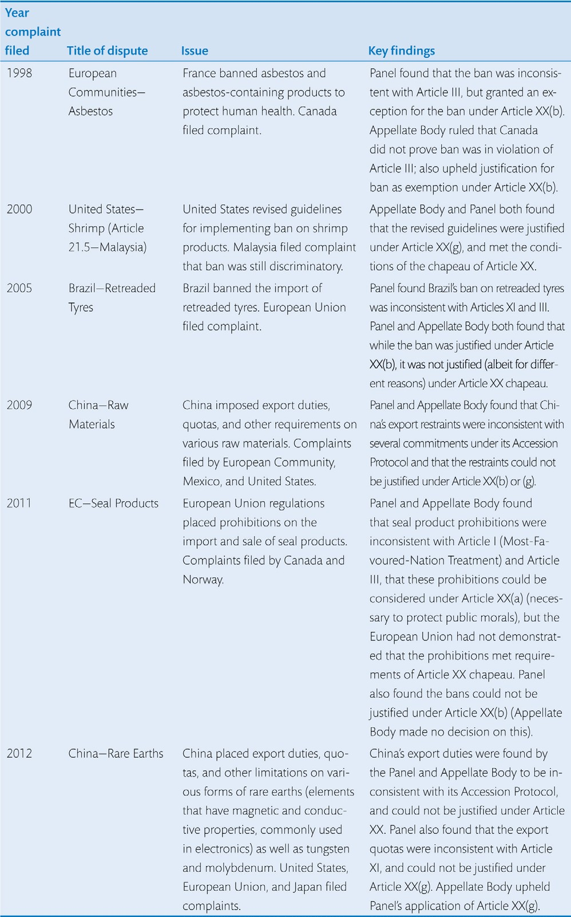
Table 10.1 Disputes involving Article XX(b) and (g) of the General Agreement on Tariffs and Trade (1980–2018)

Slide 9
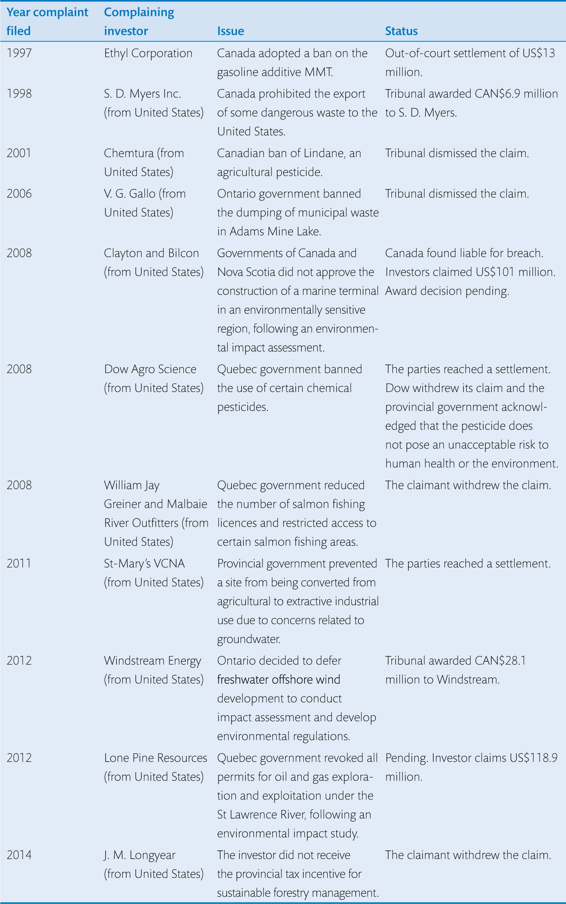
Table 10.2 Canada’s environmental disputes under the NAFTA Investment Chapter (1993–2018)

