Slide 1
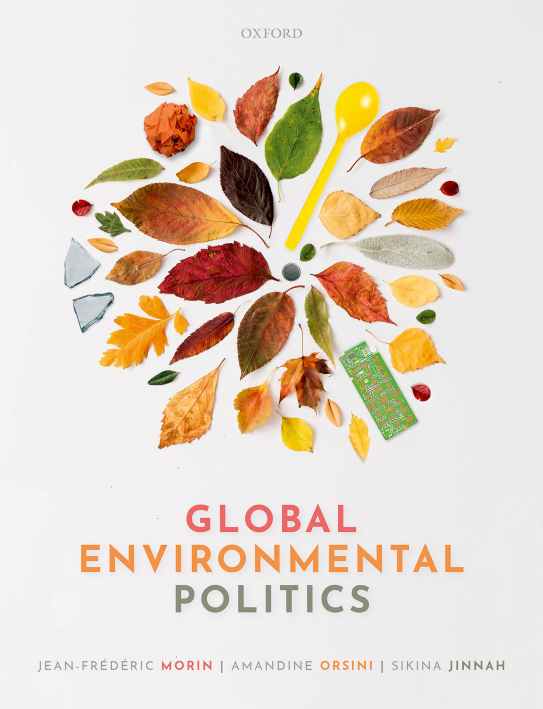
Global Environmental Politics
by Jean-Frédéric Morin, Amandine Orsini and Sikina Jinnah

Slide 2
Part 04
Institutions and policies
Chapter 08
Policy instruments and effectiveness

Slide 3
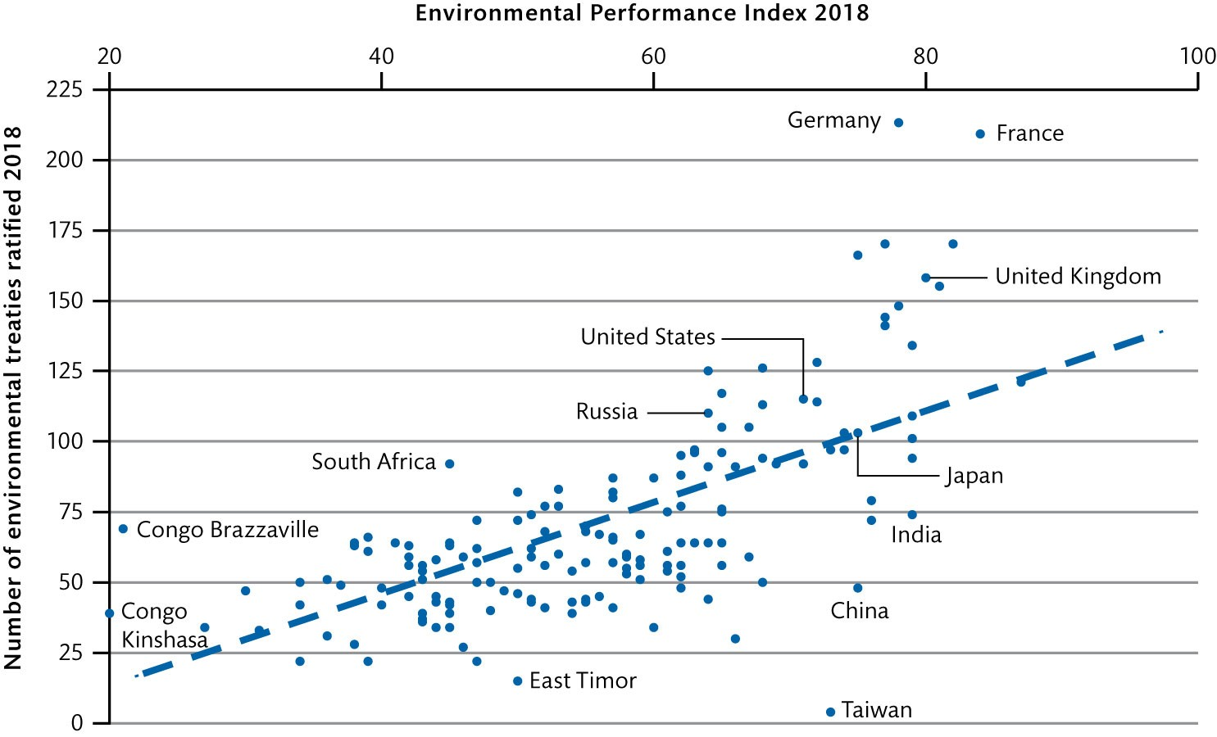
Figure 8.1 Number of treaties ratified and environmental performance

Slide 4
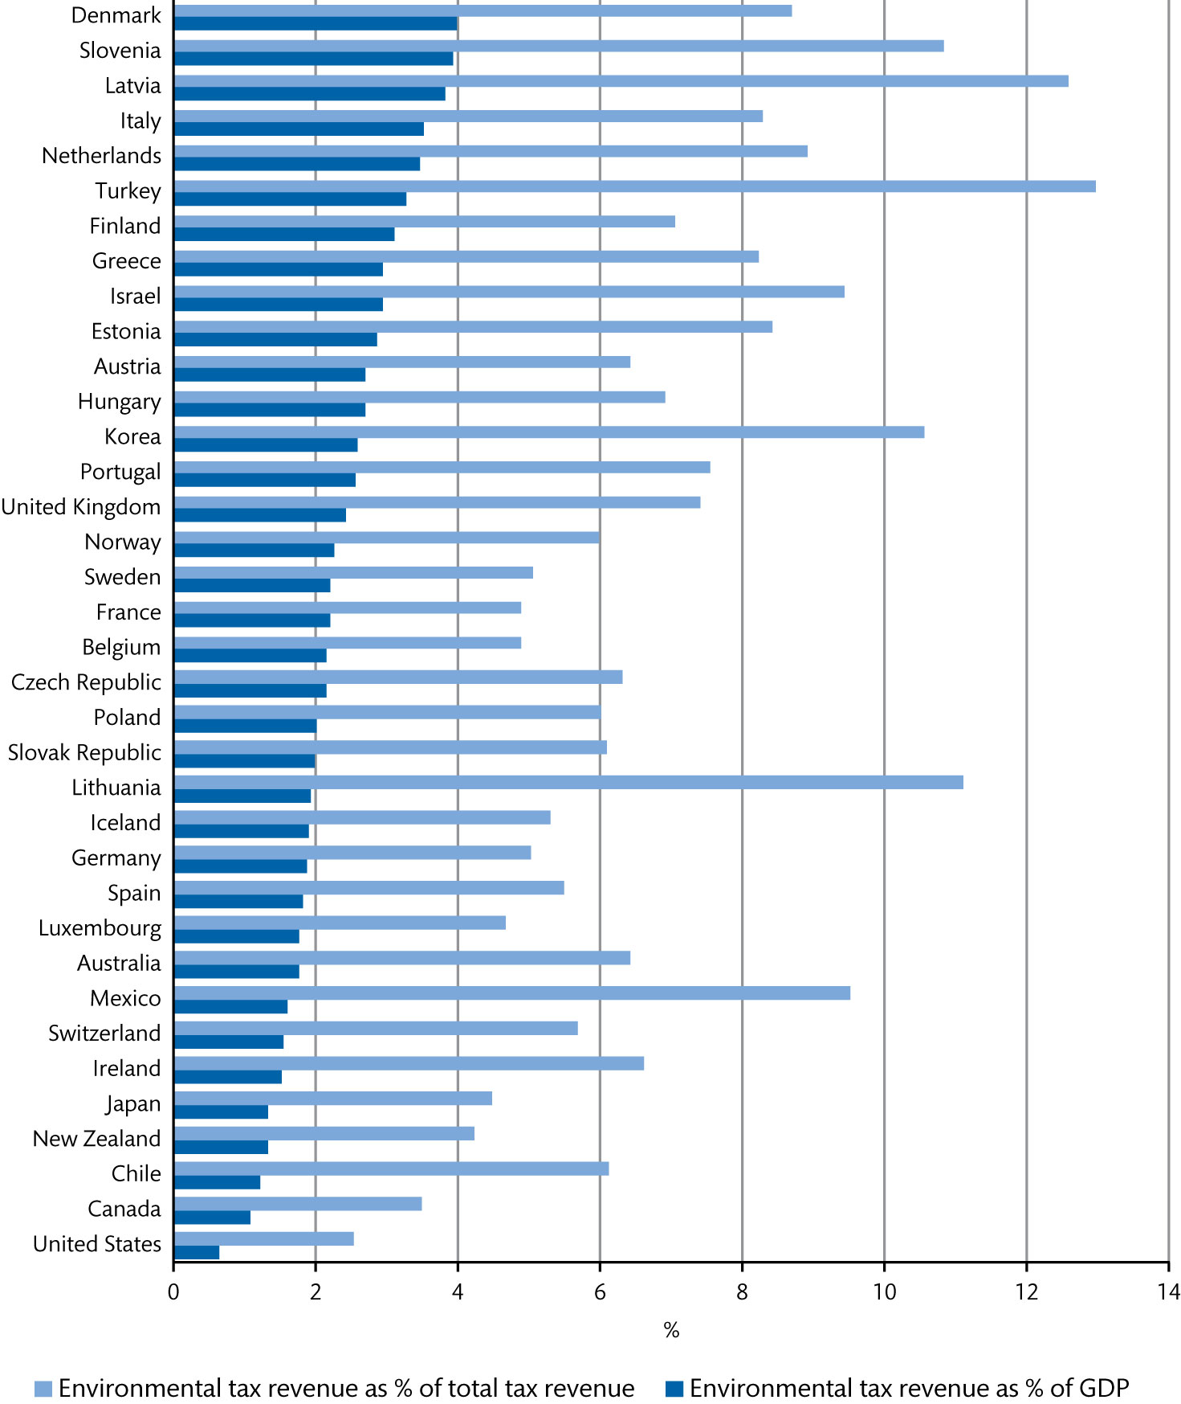
Figure 8.2 Environmentally related tax revenue (2018)

Slide 5
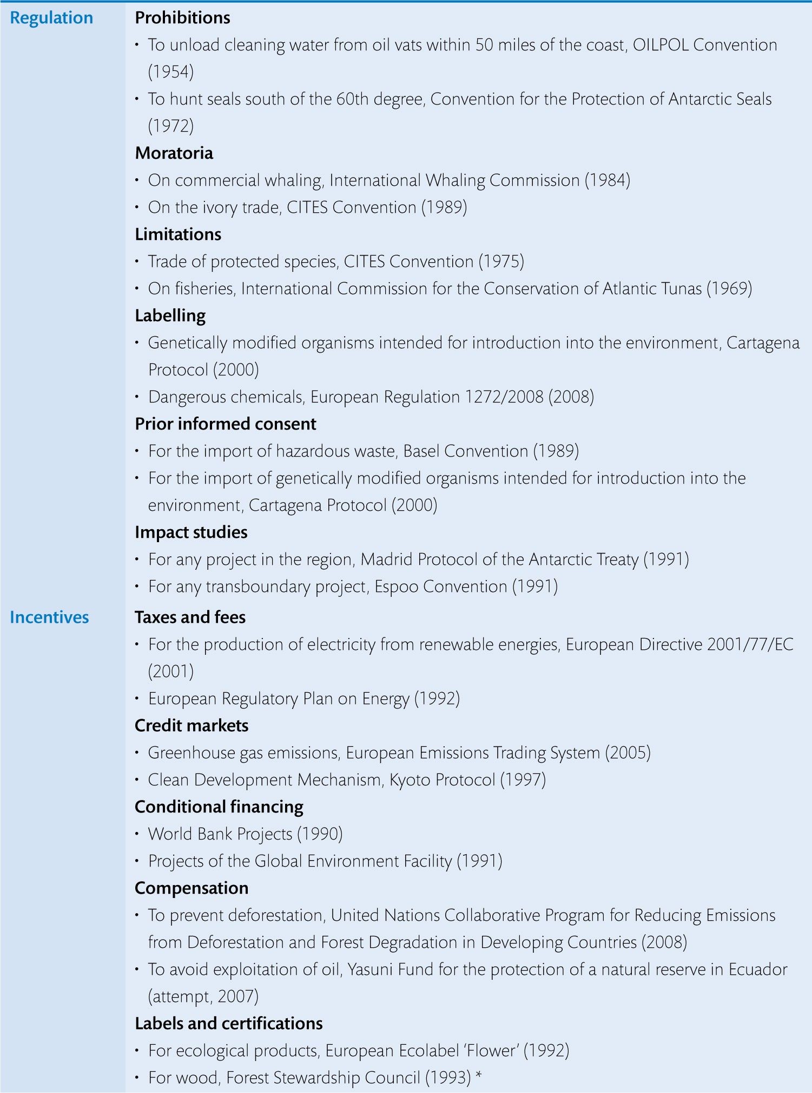
Table 8.1 Implementation instruments (Continued)

Slide 6
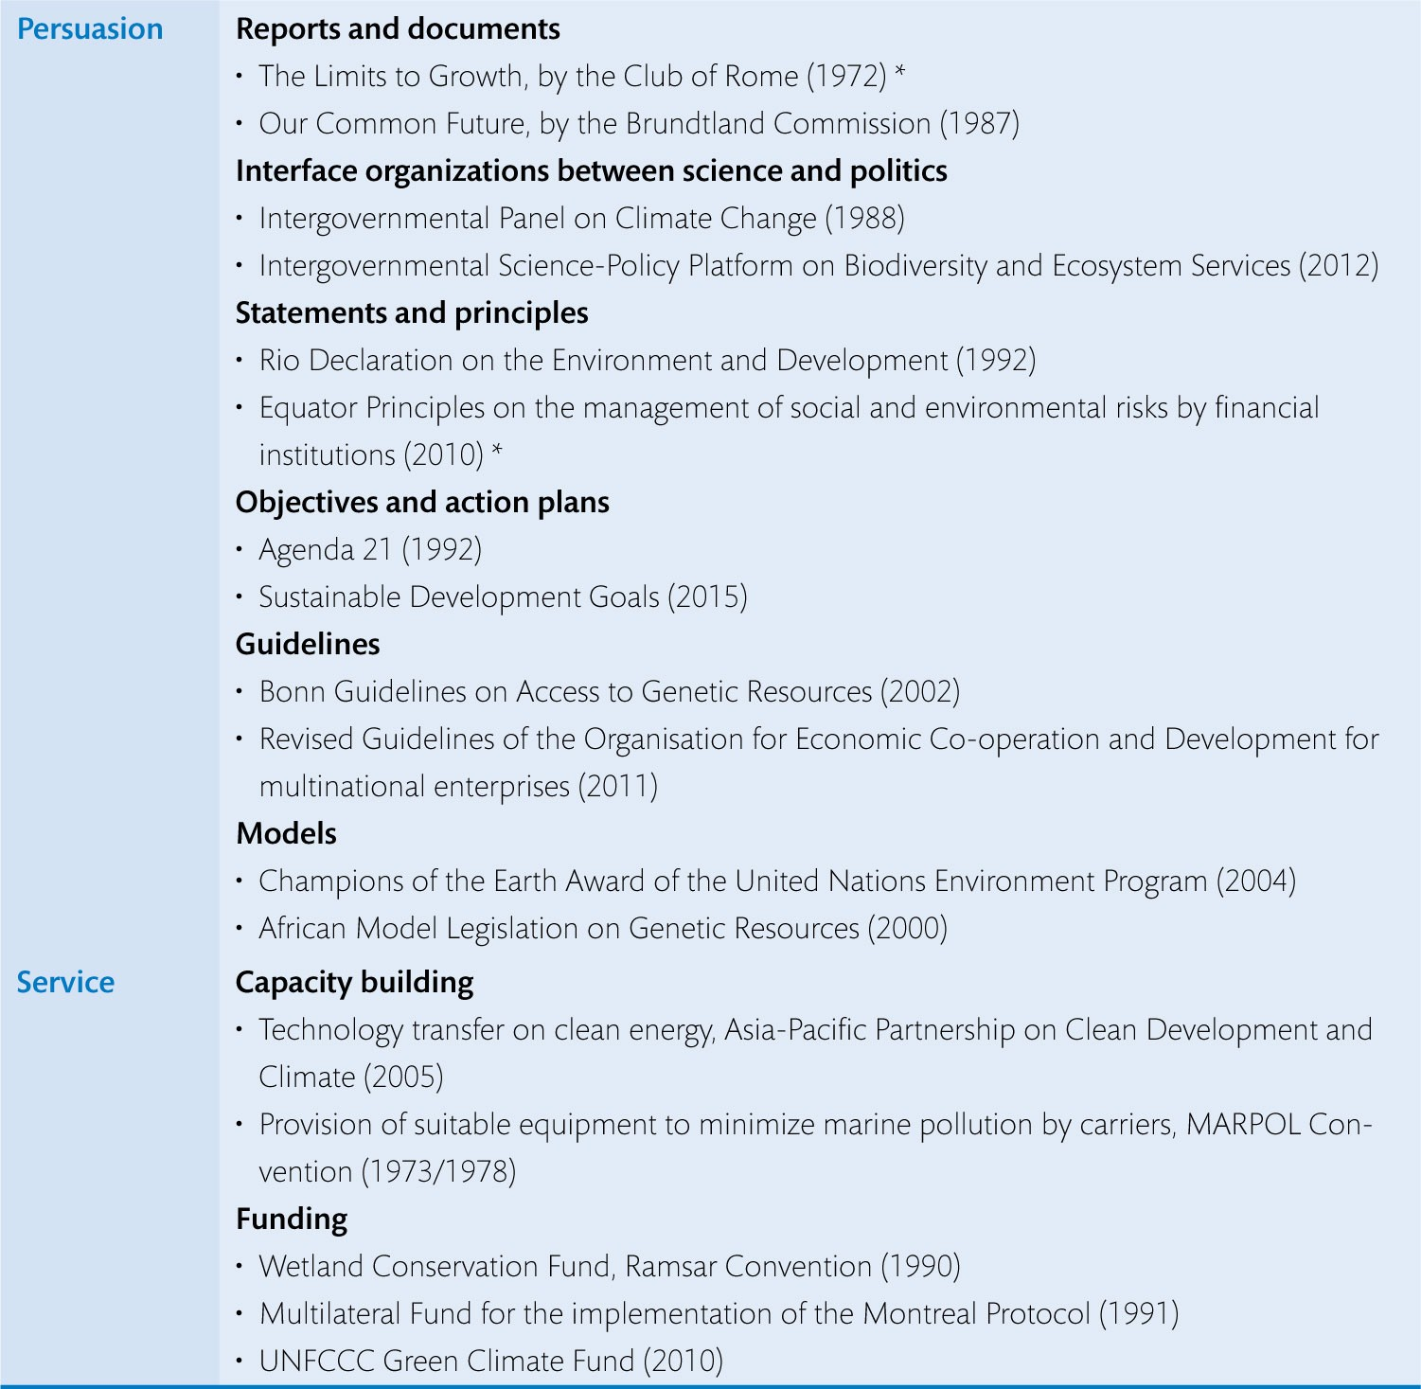
Table 8.1 Implementation instruments

Slide 7
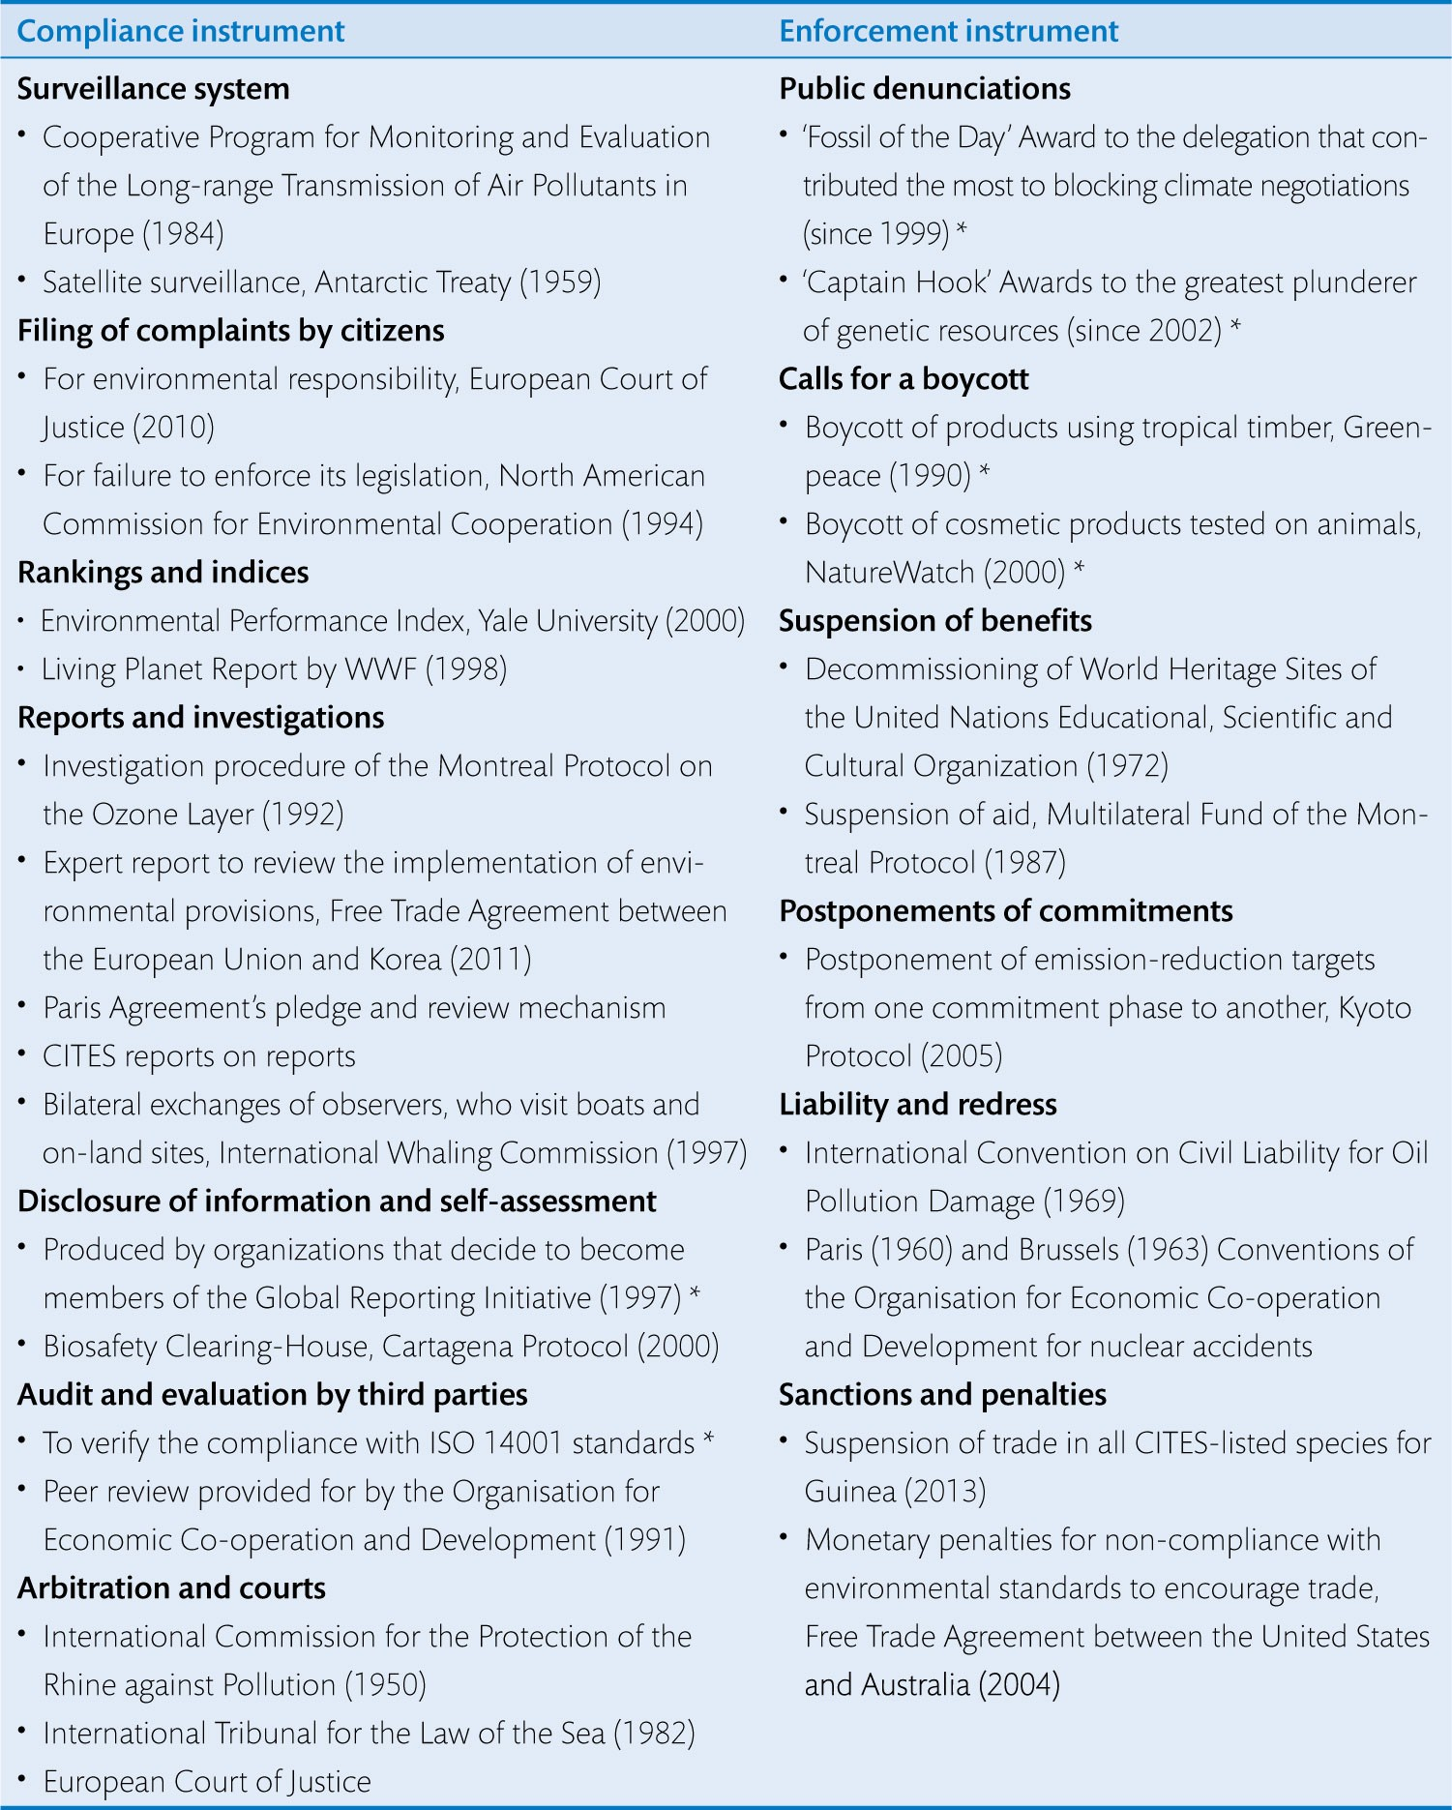
Table 8.2 Verification instruments

Slide 8
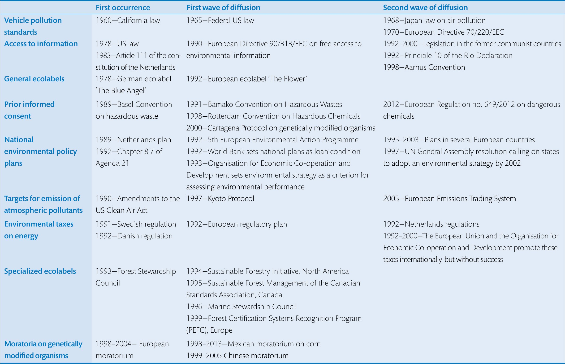
Table 8.3 Examples of instrument diffusion

