Slide 1

Global Environmental Politics
by Jean-Frédéric Morin, Amandine Orsini and Sikina Jinnah

Slide 2
Part 02
Actors and interests
Chapter 03
States

Slide 3
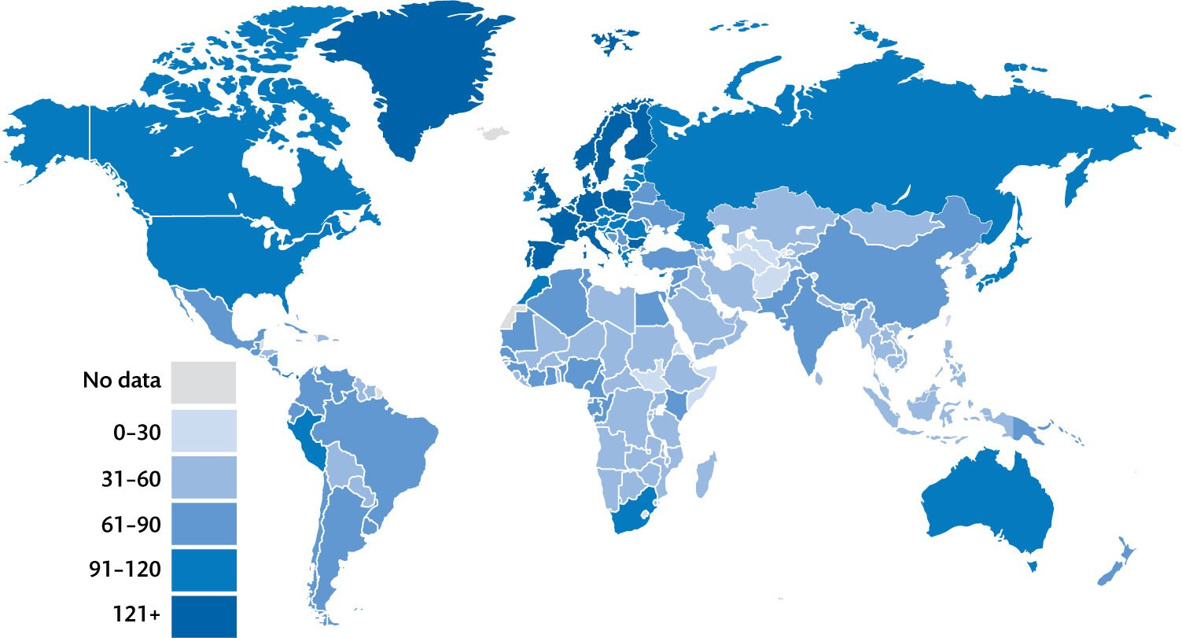
Figure 3.1 Number of environmental agreements ratified 1945–2018

Slide 4
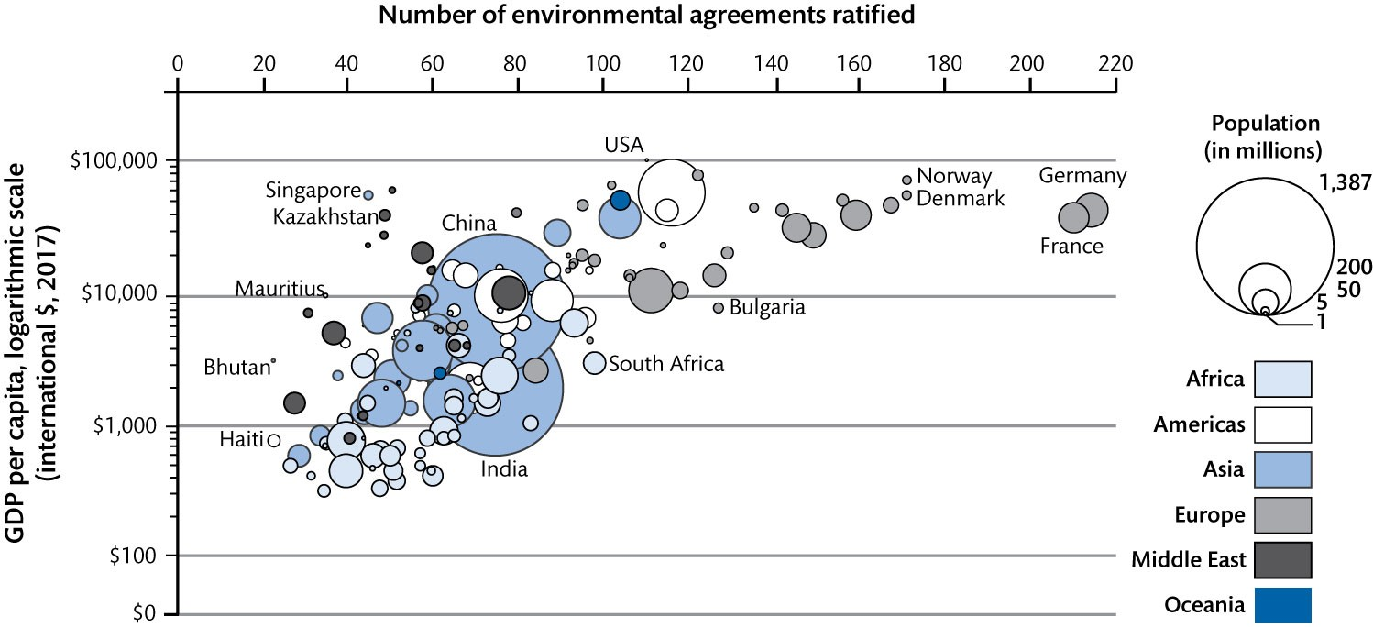
Figure 3.2 Wealth and the ratification of environmental agreements as of 1 January 2019

Slide 5
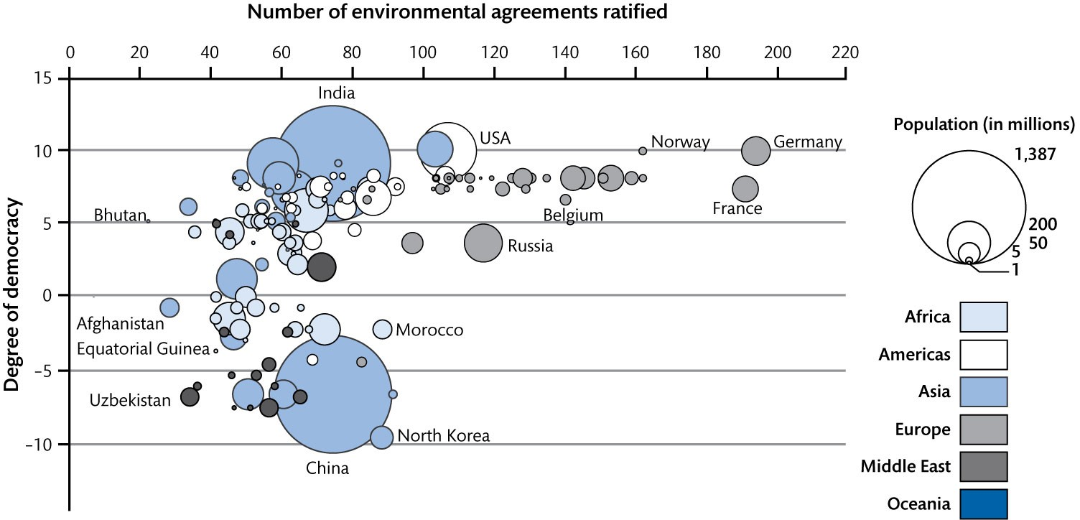
Figure 3.3 Democracy and the ratification of environmental agreements as of 1 January 2019

Slide 6
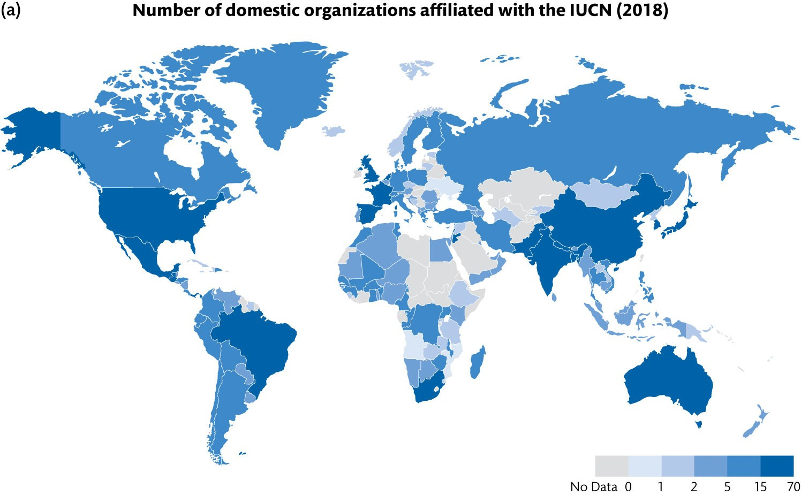
Figure 3.4 Indicators of national groups’ environmental activism (Continued)

Slide 7
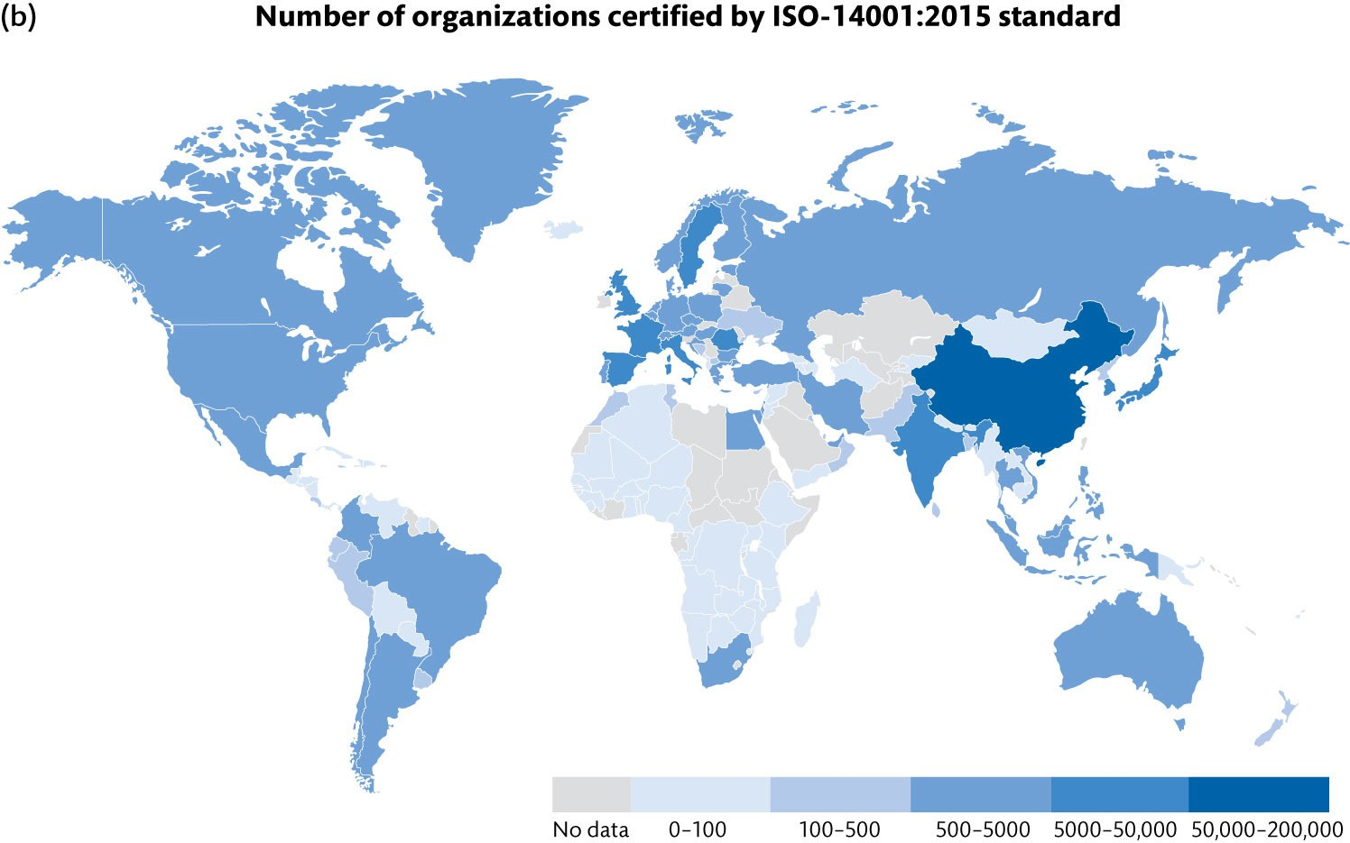
Figure 3.4 Indicators of national groups’ environmental activism

Slide 8
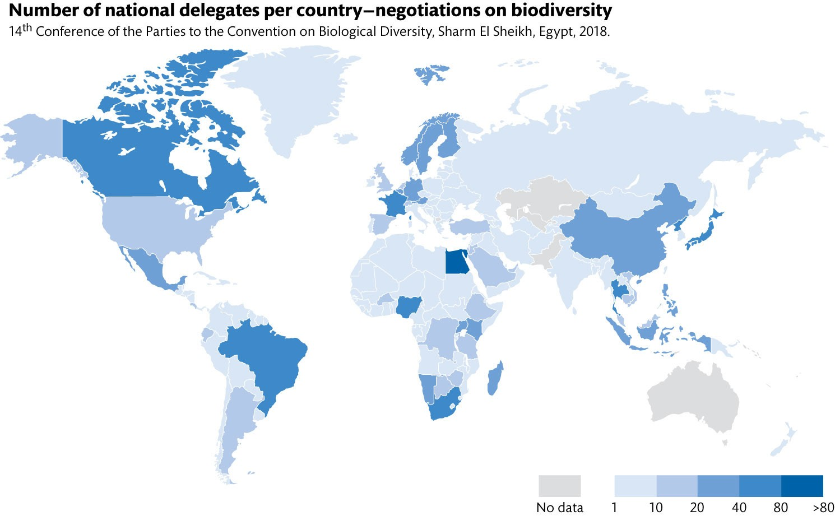
Figure 3.5 Number of national delegates per country—negotiations on climate and biodiversity 2018 (Continued)

Slide 9
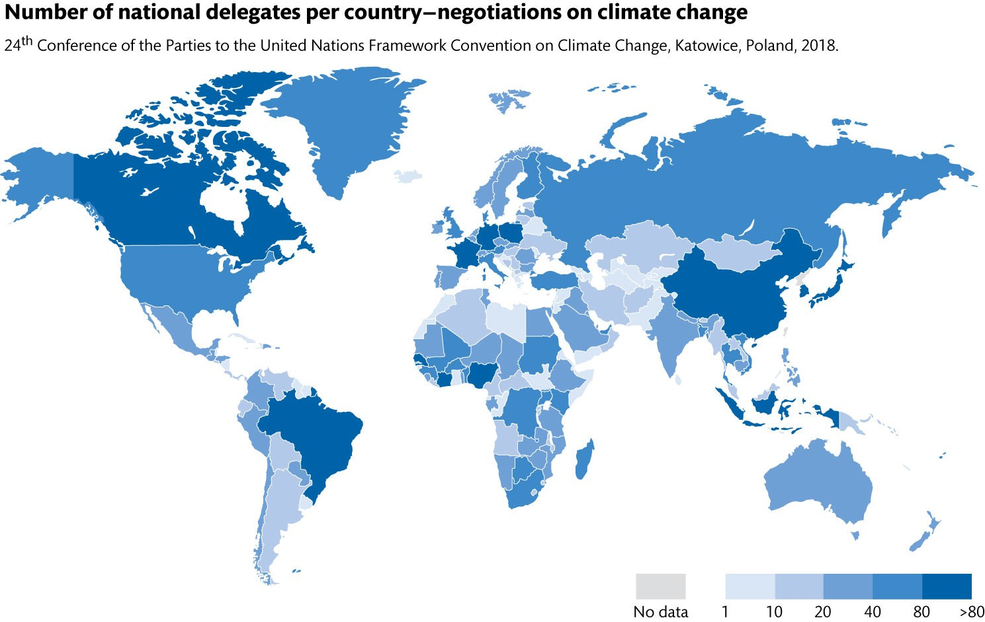
Figure 3.5 Number of national delegates per country—negotiations on climate and biodiversity 2018

Slide 10
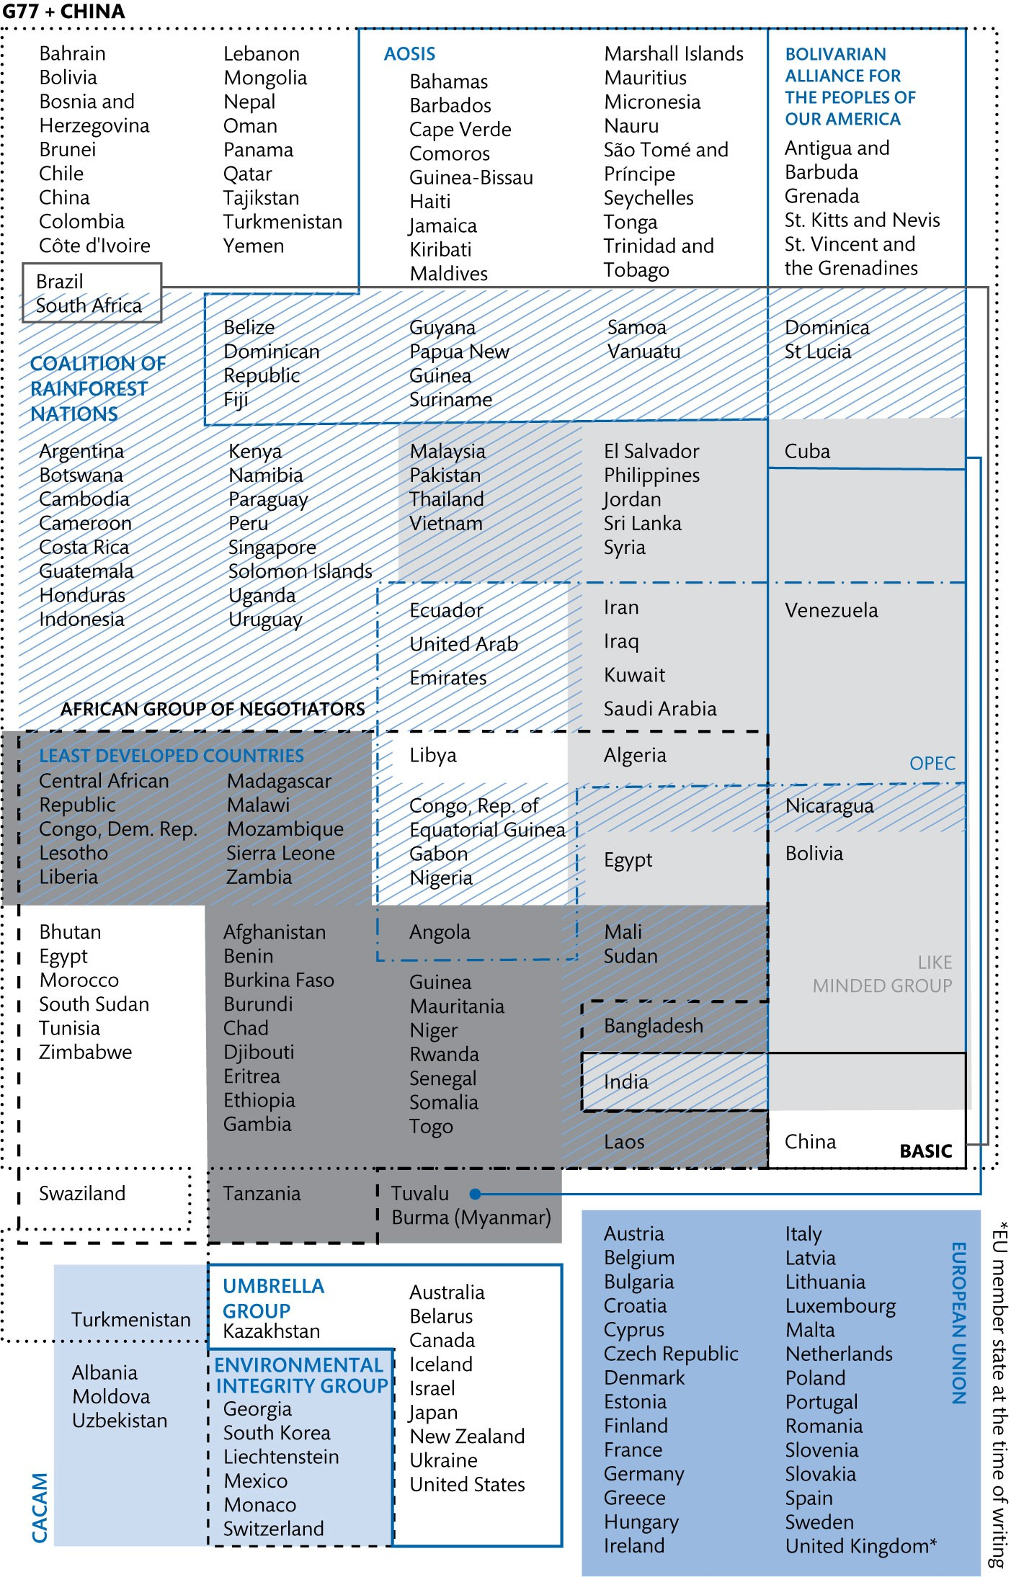
Figure 3.6 Overlap between the main coalitions in climate negotiations

Slide 11
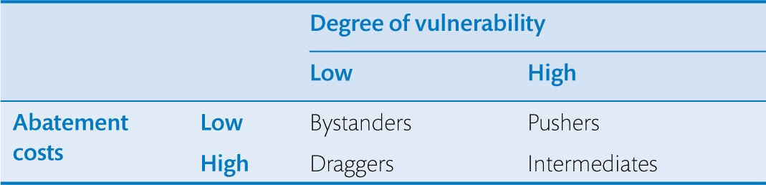
Table 3.1 Expected behaviour of states according to their interests

