Slide 1
Cultural Exchange

Slide 2
2
Notes:
Travel on the Silk Road, by Yu Ming
Fan depicts elements of the story of Lady Wenji (A.D. 2nd–3rd century, as related in the cycle of poems The Eighteen Sons of the Nomad flute).
Metropolitan Museum of Art, 1986.267.146
http://www.metmuseum.org/art/collection/search/49627

Slide 3
3
Notes:
Buddha Maitreya (Mile fo)
China (Northern Wei dynasty), 486
Metropolitan Museum of Art, 26.123
http://www.metmuseum.org/toah/works-of-art/26.123/

Slide 4
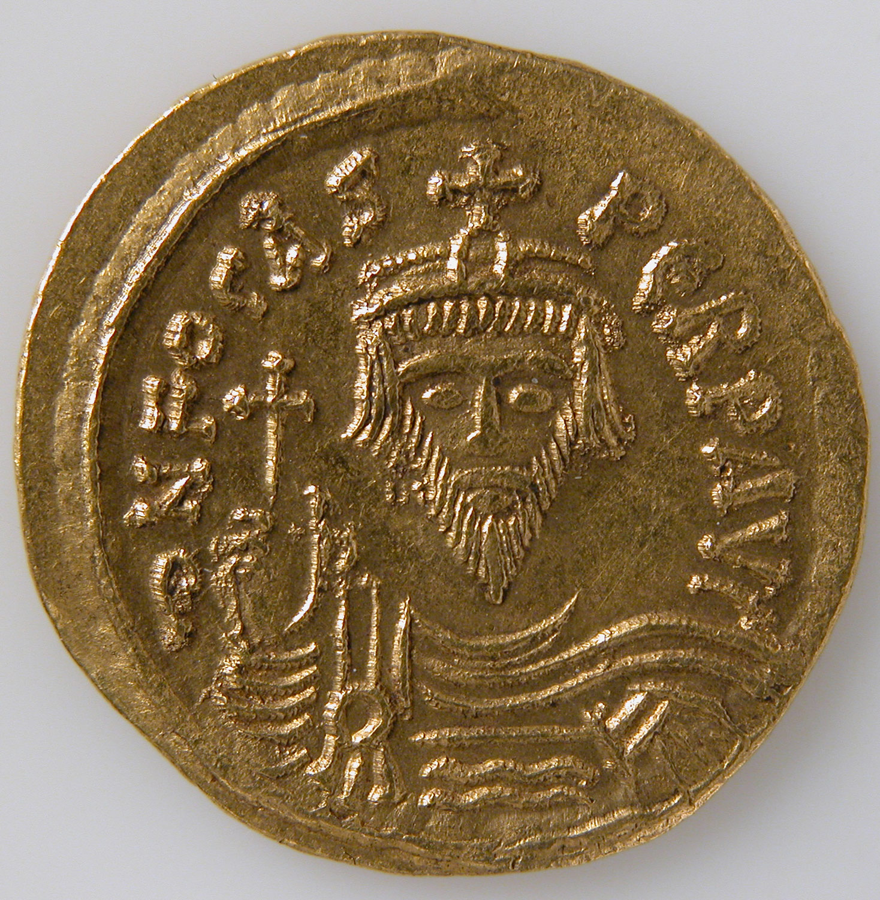
4
Notes:
Solidus
Date: 602–610
Culture: Early Byzantine
Medium: Gold
Source: The Metropolitan Museum of Art http://www.metmuseum.org/toah/works-of-art/04.35.3356/

Slide 5
5
Notes:
Lobed cup with lion, foliage, and a ring of raised dots
Central Asia, Sogdiana, probably Uzbekistan, late 6th–early 7th century; found in China
Freer Gallery of Art F1997.13
http://www.asia.si.edu/explore/asia/silkroad/cup.asp

Slide 6
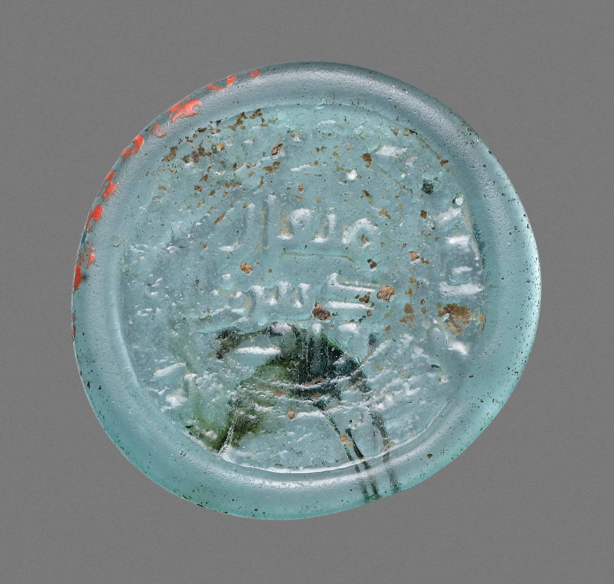
6
Notes:
Coin Weight
Object Name: Coin weight
Date: 808–810
Geography: Attributed to Egypt
Culture: Islamic
Source: The Metropolitan Museum of Art http://www.metmuseum.org/toah/works-of-art/08.256.20/

Slide 7
7
Notes:
Lewis chessmen, ivory
Scotland, 1150-1175
British Museum, 1831,1101.136
http://www.britishmuseum.org/research/collection_online/collection_object_details.aspx?objectId=6229&partId=1

Slide 8
8
Notes:
Lotus Sutra, Chapters 20-23
Japan, 1180
Freer|Sackler F1980.199
http://www.asia.si.edu/collections/edan/object.php?q=fsg_F1980.199

Slide 9
9
Notes:
Portrait of Marco Polo (1254-1324)
Engraving by Paolo Caronni
British Museum, 1878,1214.496
http://www.britishmuseum.org/research/collection_online/collection_object_details.aspx?objectId=3757160&partId=1

Slide 10
10
Notes:
Christopher Columbus seated and meeting with Nicolas Perrenot, Chancellor to Emperor Charles V
Anonymous engraving, 1530-1560 (c.)
British Museum, 1868,0328.839
http://www.britishmuseum.org/research/collection_online/collection_object_details.aspx?objectId=1590843&partId=1

Slide 11
11
Notes:
Horn plantains (bananas) on the stalk
John White, 1585-1593
British Museum, 1906,0509.1.39
http://www.britishmuseum.org/research/collection_online/collection_object_details.aspx?objectId=753525&partId=1

Slide 12
12
Notes:
Oba flanked by two kneeling supporters. Head and torso of two small European figures flank either side of Oba's crown
Nigeria (Edo), 16thC-17thC
British Museum, Af1898,0115.23
http://www.britishmuseum.org/research/collection_online/collection_object_details.aspx?objectId=610486&partId=1

Slide 13
13
Notes:
Pair of model elephants, porcelain, made for Europe
Japan (Edo period), 1655-1670
British Museum, 1980,0325.1-2
http://www.britishmuseum.org/research/collection_online/collection_object_details.aspx?objectId=766883&partId=1

Slide 14
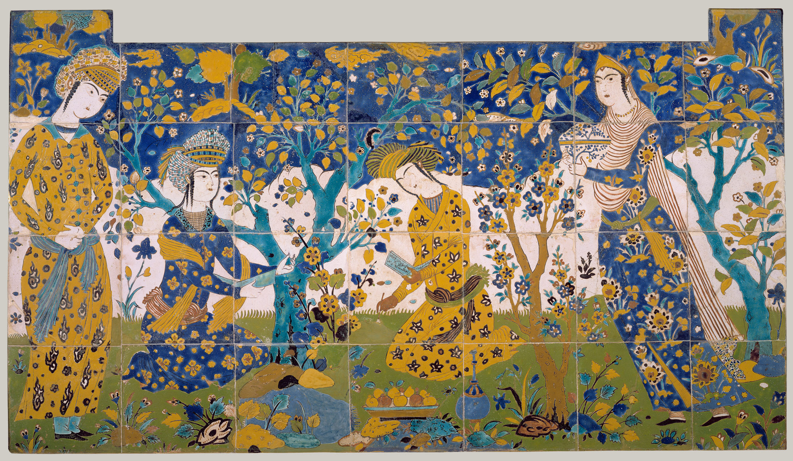
14
Notes:
Reciting Poetry in a Garden
Object Name: Tile panel
Date: first quarter 17th century
Geography: Attributed to Iran, probably Isfahan
Culture: Islamic
Source: The Metropolitan Museum of Art http://www.metmuseum.org/toah/works-of-art/03.9b/

Slide 15
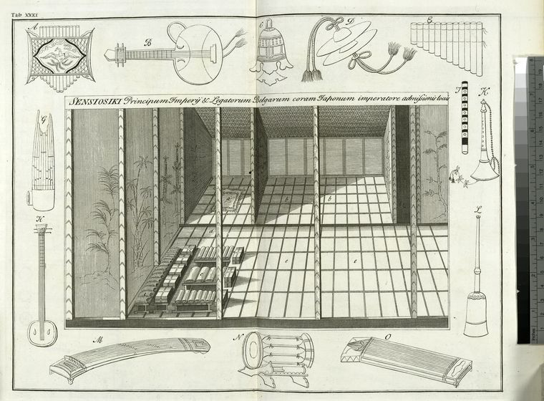
15
Notes:
"The hall of hundred mats, where the Princes of the Empire and the Dutch Ambassadors are admitted to an audience of the Emperor ; Musical instruments of Japanese.“
Source: The New York Public Library Digital Collections, 1727
http://digitalcollections.nypl.org/items/510d47d9-4872-a3d9-e040-e00a18064a99

Slide 16
16
Notes:
Porcelain dish with cobalt pigment under clear glaze, metal rim
China, Qing dynasty, 1662-1722
Freer|Sackler F1991.63
http://www.asia.si.edu/collections/edan/object.php?q=fsg_F1991.63

Slide 17
17
Notes:
Meissen underglaze blue platter, in imitation of the Chinese and Japanese style
German, 1775-1800
National Museum of American History, 1984.1140
http://americanhistory.si.edu/collections/search/object/nmah_1406003

Slide 18
18
Notes:
The Foreigners' Quarter at Canton. View of the 'hongs' in Guangzhou with flags of several nations flying from posts along the quayside; the Union flag is prominent; small boats in the river manned by Chinese
Illustration to Dr John Trusler's 'The Habitable World Described'. 1789
British Museum, 1877,1013.230
http://www.britishmuseum.org/research/collection_online/collection_object_details.aspx?objectId=3682742&partId=1

Slide 19
19
Notes:
Dejima, the Dutch factory at Nagasaki.
Japan, 1800
British Museum, 1980,0325,0.3.2
http://www.britishmuseum.org/research/collection_online/collection_object_details.aspx?objectId=782692&partId=1

Slide 20
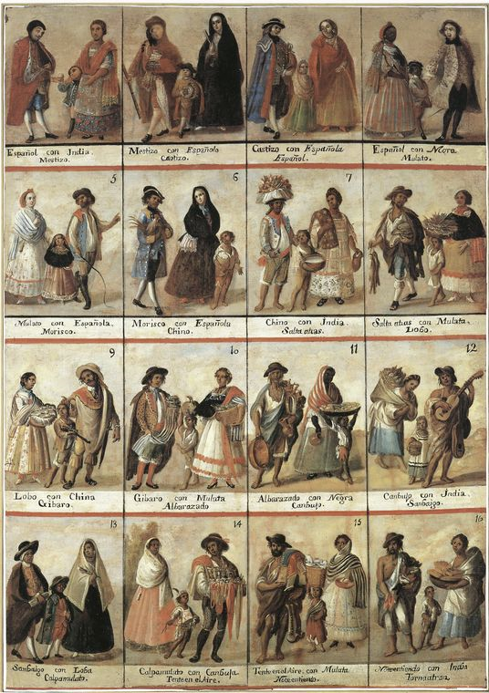
20
Notes:
"Racial mixture in eighteenth-century Mexico.“
Source: The New York Public Library Digital Collections. 1989. http://digitalcollections.nypl.org/items/510d47db-b78c-a3d9-e040-e00a18064a99

Slide 21
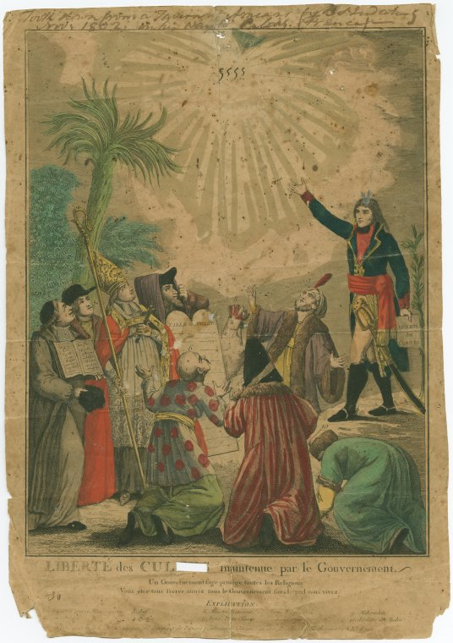
21
Notes:
"Scenes in his [Napoleon’s] life: diplomacy & politics”
Source: The New York Public Library Digital Collections.
https://digitalcollections.nypl.org/items/6d1df996-998e-f6b6-e040-e00a18063a3f

Slide 22
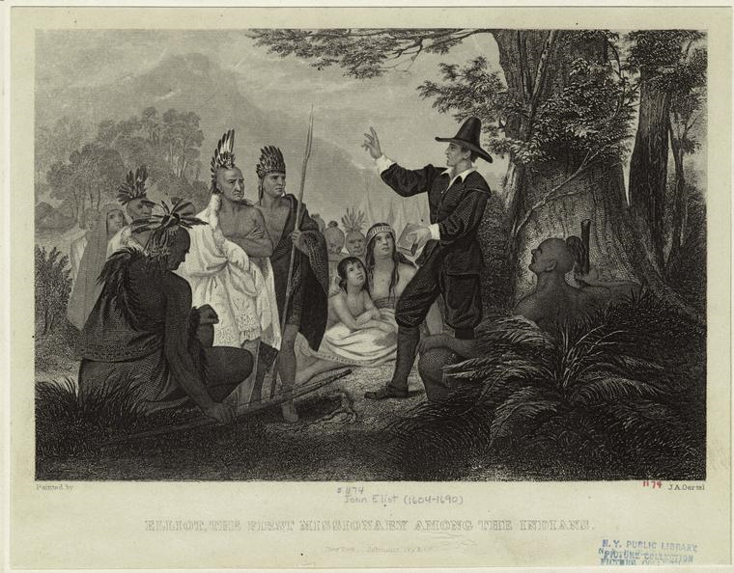
22
Notes:
"Elliot, the first missionary among the Indians.“
Source: The New York Public Library Digital Collections. 1858.
http://digitalcollections.nypl.org/items/510d47e0-f3e4-a3d9-e040-e00a18064a99

Slide 23
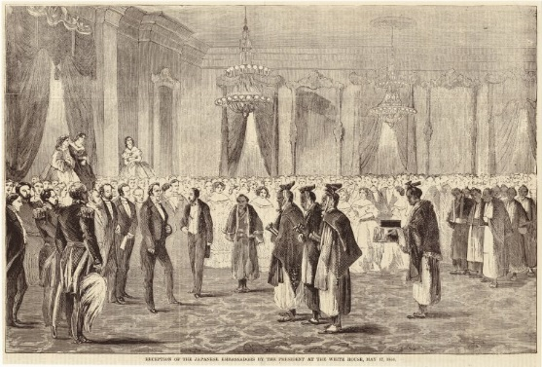
23
Notes:
"Reception of the Japanese embassadors [i.e. ambassadors] by the President at the White House.“
Source: The New York Public Library Digital Collections. 1860-05-26.
http://digitalcollections.nypl.org/items/510d47e0-f882-a3d9-e040-e00a18064a99

Slide 24
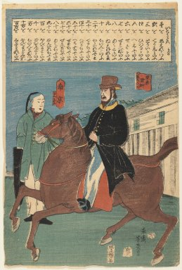
24
Notes:
An American and a Chinese (Nankingese), 1860
Source: Brooklyn Museum, Gift of William and Doris Navin, 1998.13.4 (Photo: Brooklyn Museum, 1998.13.4_IMLS_PS3.jpg)

Slide 25
25
Notes:
Cross: Saint Anthony of Padua
Congo, Pendant figure, 16th–18th century; cross, 19th century
Metropolitan Museum of Art, 1999.295.14
http://www.metmuseum.org/toah/works-of-art/1999.295.14/

Slide 26
26
Notes:
Double Diptych Icon Pendant
Ethiopia, early 18th century
Metropolitan Museum of Art, 1997.81.1
http://www.metmuseum.org/toah/works-of-art/1997.81.1/

Slide 27
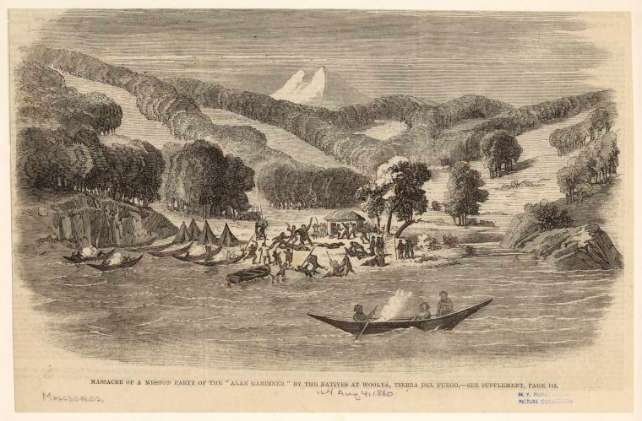
27
Notes:
"Massacre of a mission party of the "Alan [i.e. Allen] Gardiner" by the natives at Woolya, Tierra del Fuego.“
Source: The New York Public Library Digital Collections. 1860.
http://digitalcollections.nypl.org/items/510d47e1-3851-a3d9-e040-e00a18064a99

Slide 28
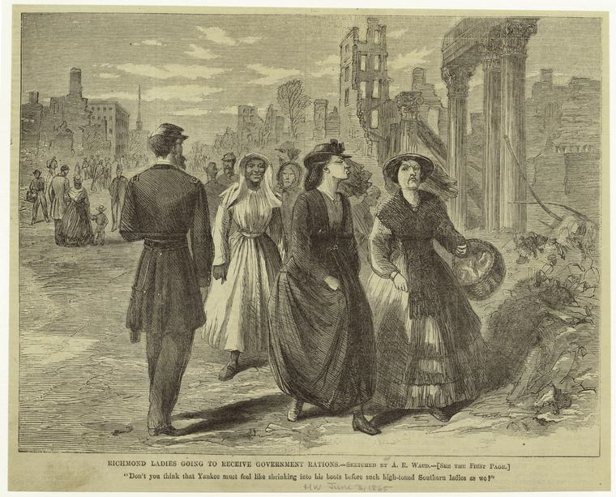
28
Notes:
"Richmond ladies going to receive government rations: "Don't you think that Yankee must feel like shrinking into his boots before such high-toned Southern ladies as we?"“
Source: The New York Public Library Digital Collections. 1865-06-03.
http://digitalcollections.nypl.org/items/510d47e0-fee7-a3d9-e040-e00a18064a99

Slide 29
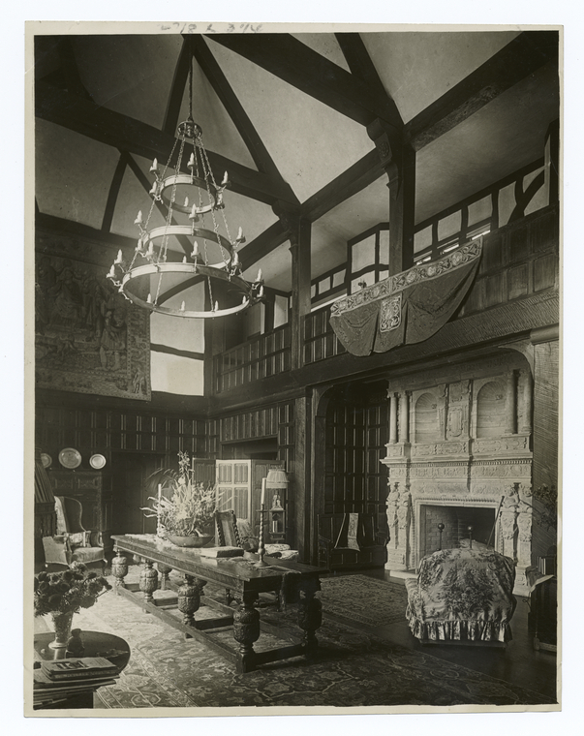
29
Notes:
"The Climax of English Tradition in America“
Source: The New York Public Library Digital Collections. 1860 - 1920.
http://digitalcollections.nypl.org/items/510d47d9-b098-a3d9-e040-e00a18064a99

Slide 30
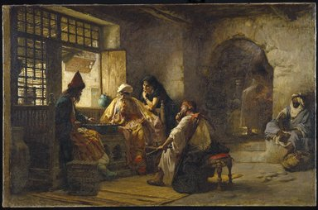
30
Notes:
An Interesting Game, 1881
Source: Brooklyn Museum, Gift of George D. Pratt in memory of Mrs. Charles Pratt, 08.220 (Photo: Brooklyn Museum, 08.220_SL1.jpg) https://www.brooklynmuseum.org/opencollection/objects/231

Slide 31
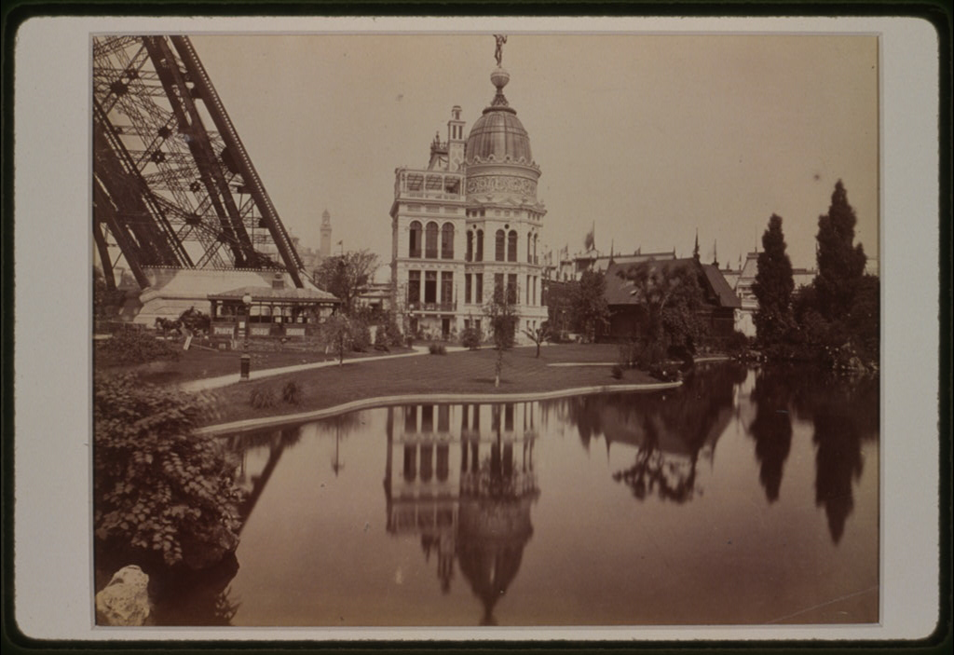
31
Notes:
Exposition universelle de 1889--Pavillon de l'industrie du gaz / ND Phot.
Source: Library of Congress, LC-USZC2-3659
https://www.loc.gov/item/90709853/

Slide 32
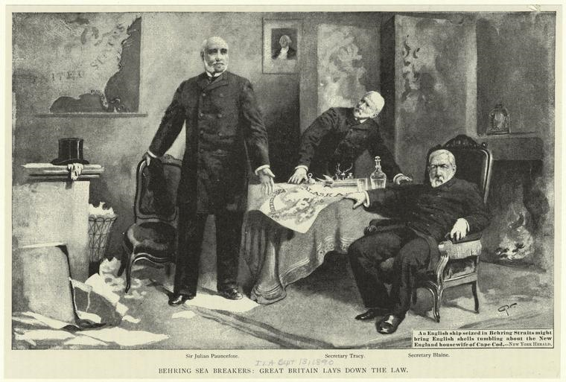
32
Notes:
"Behring sea breakers: Great Britain lays down the law.“
Source: The New York Public Library Digital Collections. 1890-09-13.
http://digitalcollections.nypl.org/items/510d47e0-ffa5-a3d9-e040-e00a18064a99

Slide 33
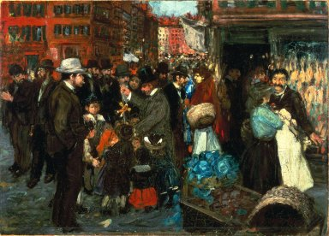
33
Notes:
Street Scene (Hester Street), 1905
Source: Brooklyn Museum, Dick S. Ramsay Fund, 40.339 (Photo: Brooklyn Museum https://www.brooklynmuseum.org/opencollection/objects/609

Slide 34
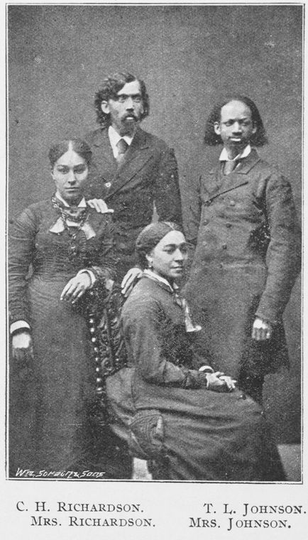
34
Notes:
"C. H. Richardson; Mrs. Richardson; T. L. Johnson; Mrs. Johnson; [Group of Missionaries; The African Mission.]“
Source: The New York Public Library Digital Collections. 1909.
http://digitalcollections.nypl.org/items/510d47df-a275-a3d9-e040-e00a18064a99

Slide 35
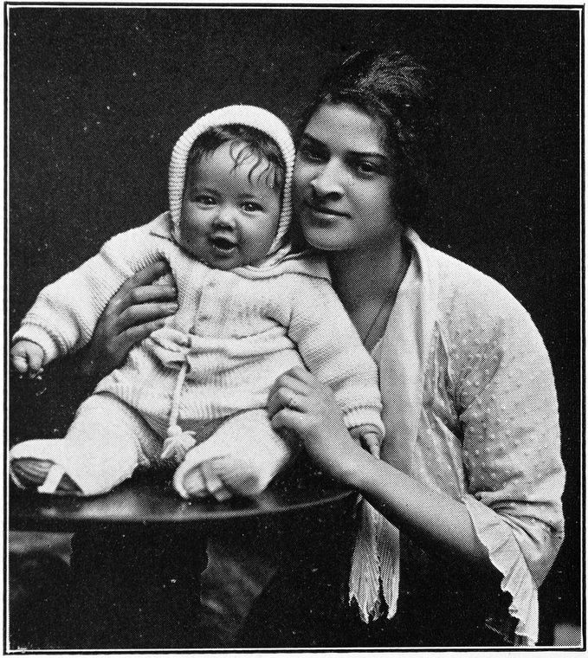
35
Notes:
"Mixed-blood types.“
Source: The New York Public Library Digital Collections. 1916.
http://digitalcollections.nypl.org/items/510d47df-1f52-a3d9-e040-e00a18064a99

Slide 36
36
Notes:
Waseda University team from Japan (baseball)
Bain News Service, 1916
Library of Congress, LC-DIG-ggbain-21500
https://www.loc.gov/item/ggb2005021497/

Slide 37
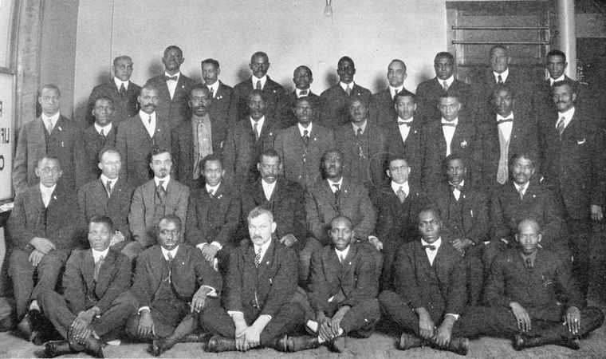
37
Notes:
"Officers of the Railway Men's International Benevolent Industrial Association.“
Source: The New York Public Library Digital Collections. 1922.
http://digitalcollections.nypl.org/items/510d47de-1a4e-a3d9-e040-e00a18064a99

Slide 38
38
Notes:
"Americana Print: Mayan" Textile
Designed by Charles B. Falls, 1925
Metropolitan Museum of Art, 27.150.7
http://www.metmuseum.org/art/collection/search/487543

Slide 39
39
Notes:
Evening dress worn by Chinese-American actress Anna May Wong, which evokes the traditional Chinese cheongsam, althought its construction is along the lines of high-necked form-fitting Western gowns from the Belle-Epoque period, 1934
Metropolitan Museum of Art, 2009.300.1507
http://www.metmuseum.org/art/collection/search/156230

Slide 40
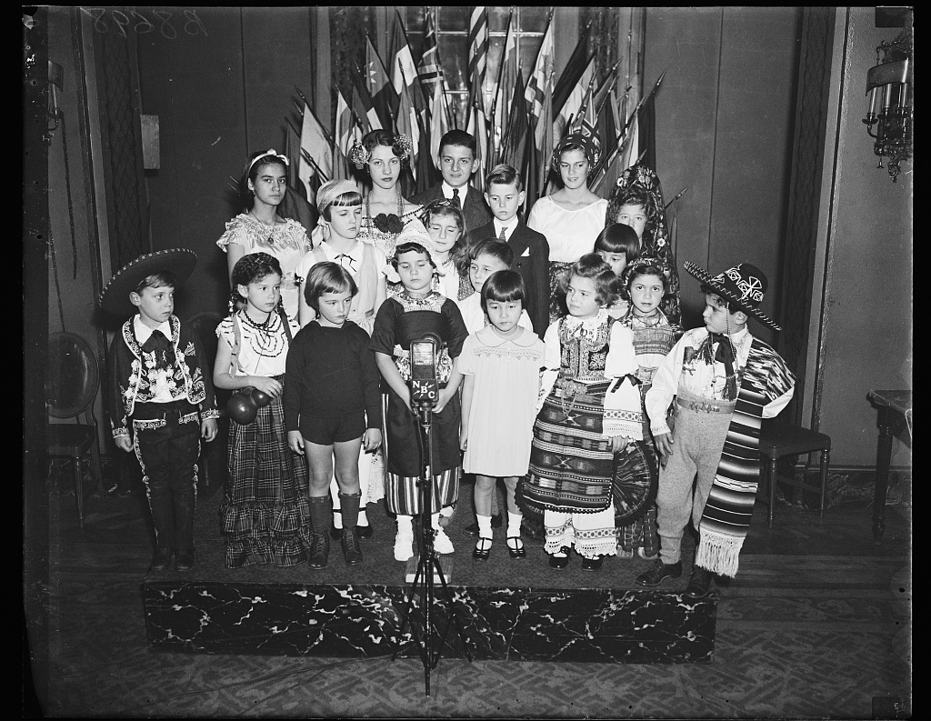
40
Notes:
Children wearing international costumes, 1935
Harris & Ewing, photographer
Source: Library of Congress, LC-DIG-hec-39733
https://www.loc.gov/item/hec2013009758/.

Slide 41
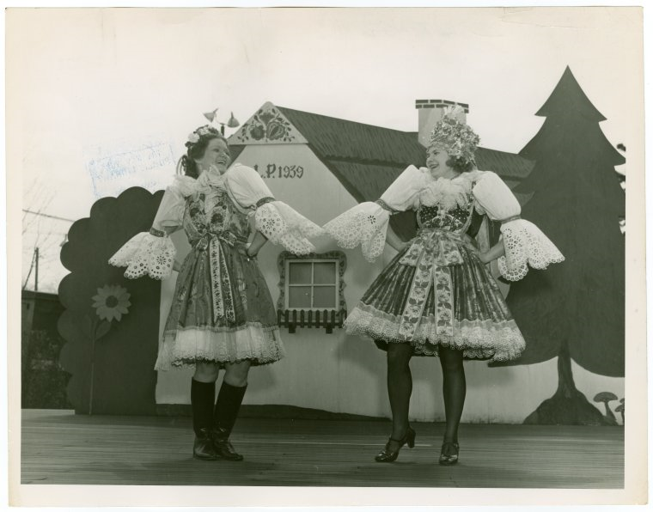
41
Notes:
"Czechoslovakia Participation - Czechs in traditional dress - On set“
Source: The New York Public Library Digital Collections. 1935 - 1945.
http://digitalcollections.nypl.org/items/5e66b3e9-1187-d471-e040-e00a180654d7

Slide 42
42
Notes:
“Leaning Tower of Pizza”
Photographer John Margolies, 1984
Library of Congress, LC-MA05- 90
https://www.loc.gov/item/2017702206/

Slide 43
43
Notes:
Ensemble, Japanese aesthetic influenced by Paul Poiret's harem and lampshade ensembles, which reflected both the elegance of French fashion and the regionally inspired folksiness of Léon Bakst's designs for the Ballets Russes
By Issey Miyake (Japanese, born 1938)
Metropolitan Museum of Art, 1996.335.10a–c
http://www.metmuseum.org/art/collection/search/79193

