Slide 1

Accounting by Mary Carey and Cathy Knowles

Slide 2
Part I
Financial Accounting
Chapter 01
The Cash Budget

Slide 3


Slide 4
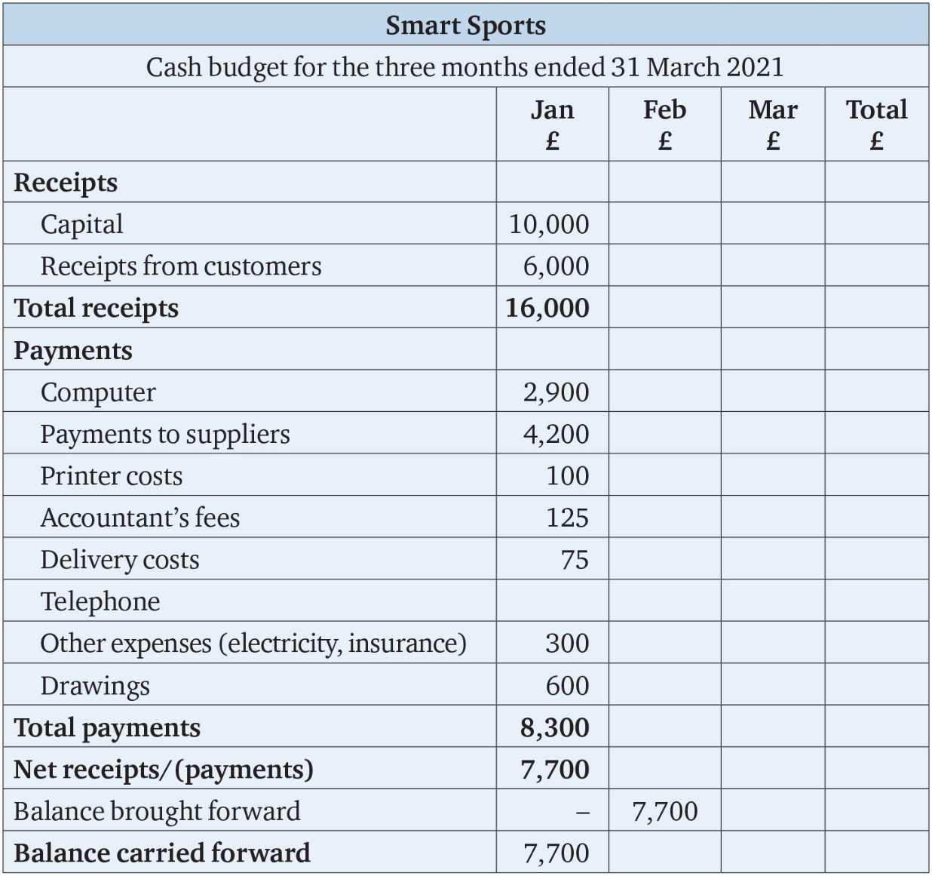
Table 1.1

Slide 5
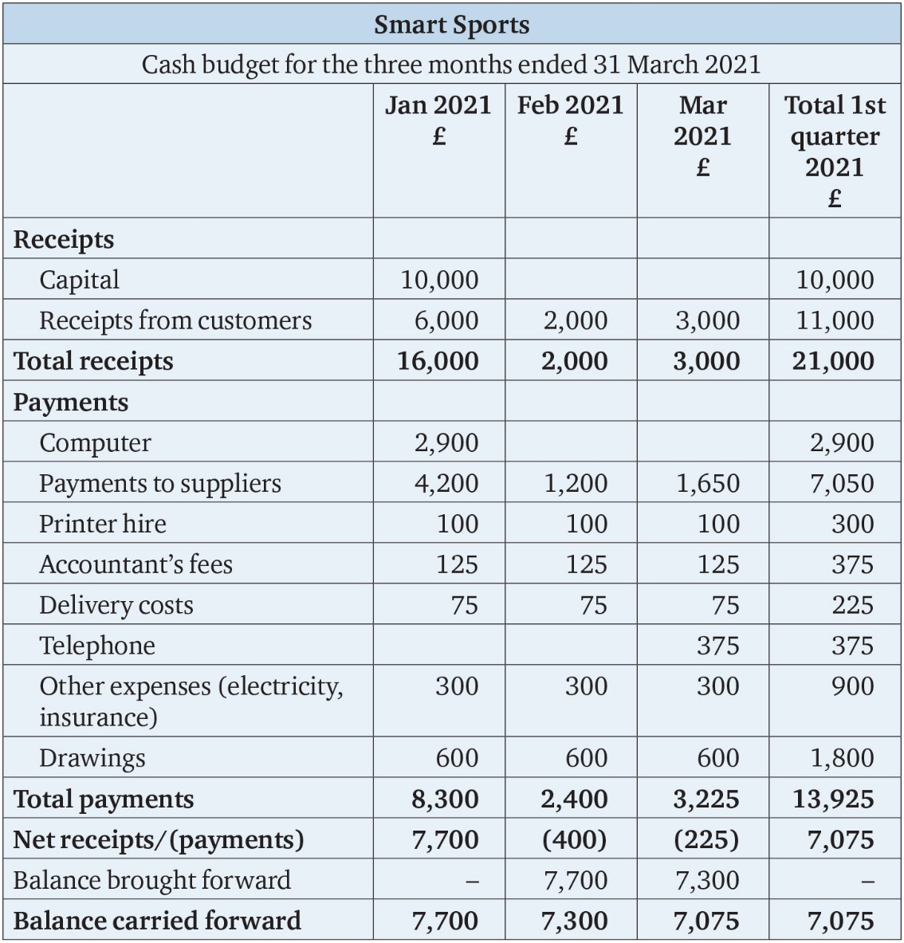
Table 1.2

Slide 6
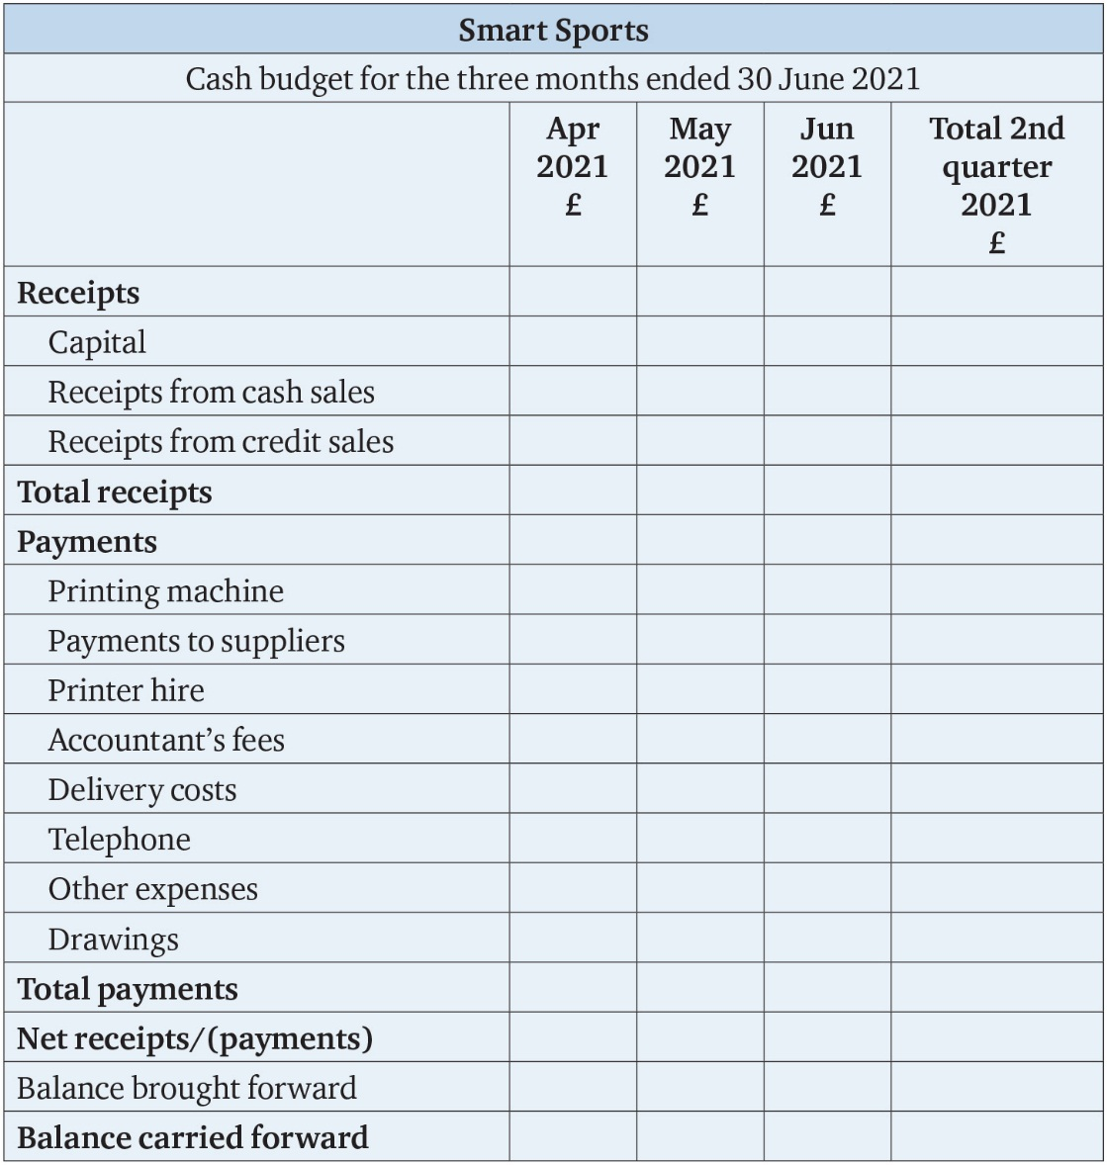
Table 1.3

