Slide 1

Accounting by Mary Carey and Cathy Knowles

Slide 2
Part I
Financial Accounting
Chapter 02
Introduction to the Statement of Profit or Loss

Slide 3


Slide 4
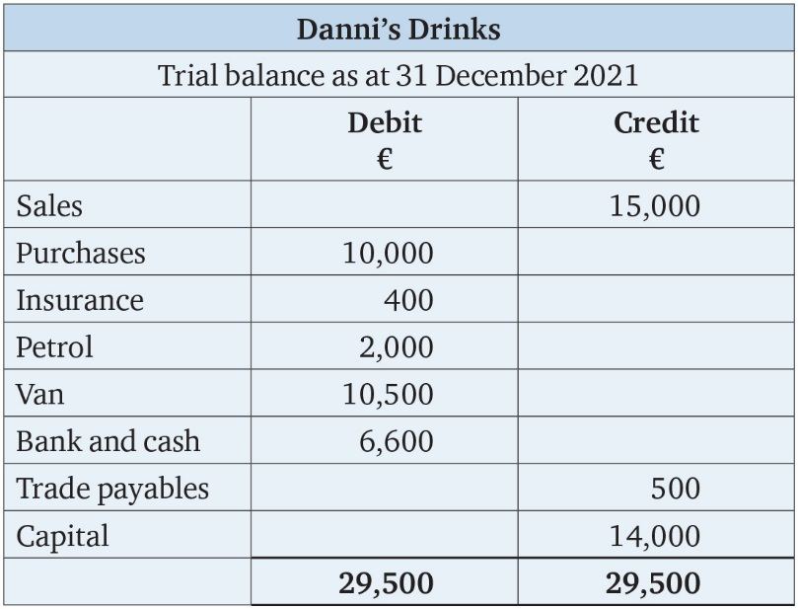
Table 2.1

Slide 5
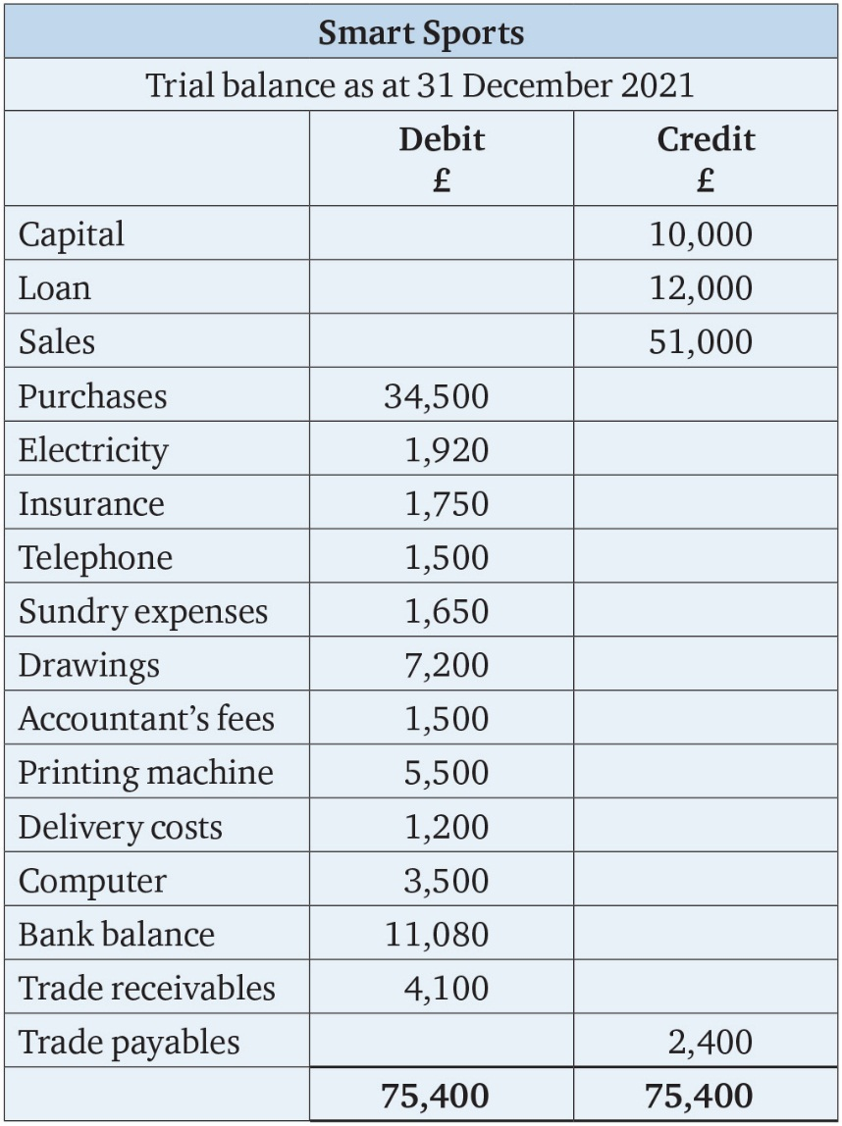
Table 2.2

Slide 6
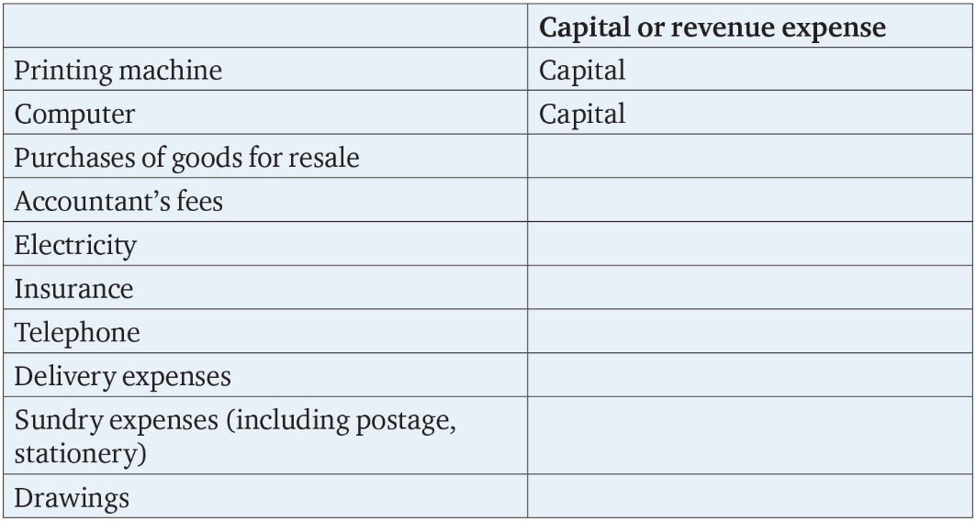
Table 2.3

Slide 7
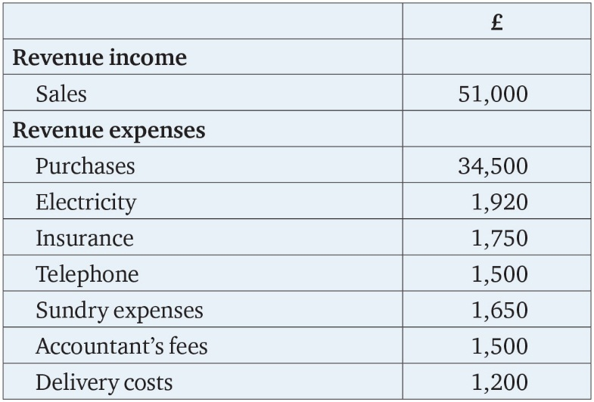
Table 2.4

Slide 8
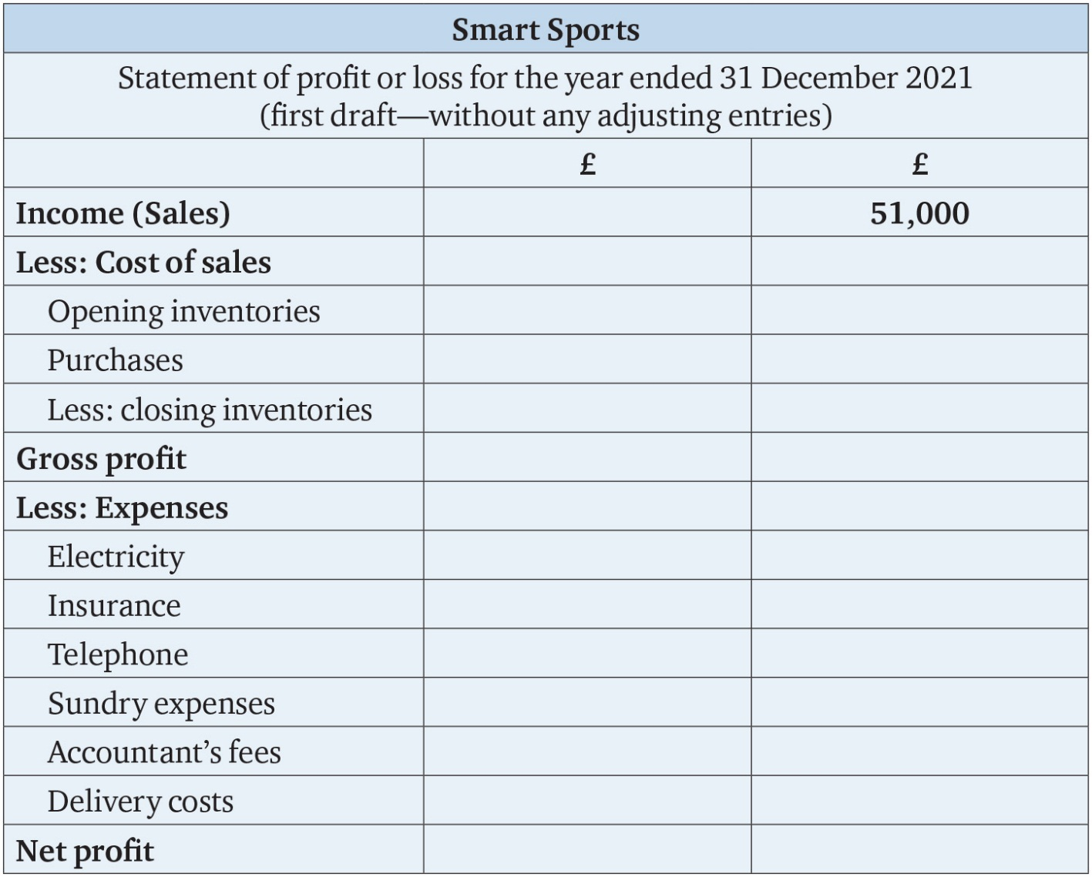
Table 2.5

Slide 9
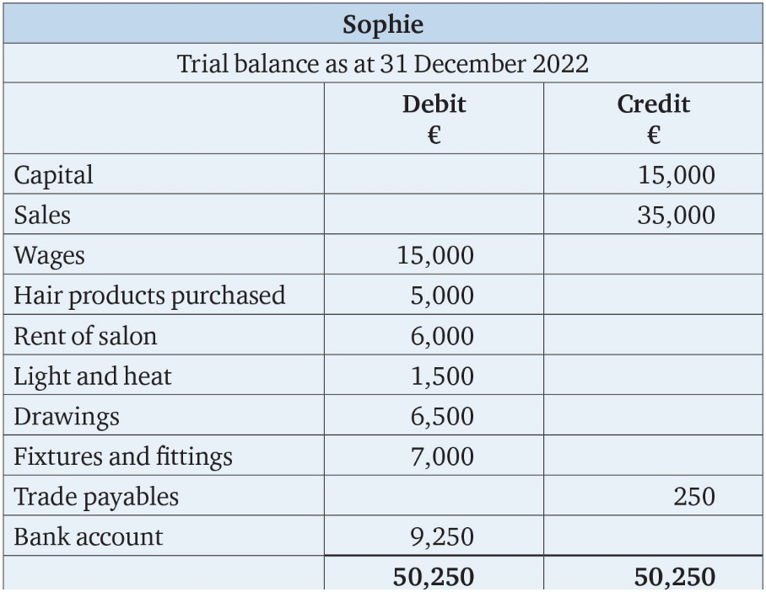
Table 2.6

Slide 10
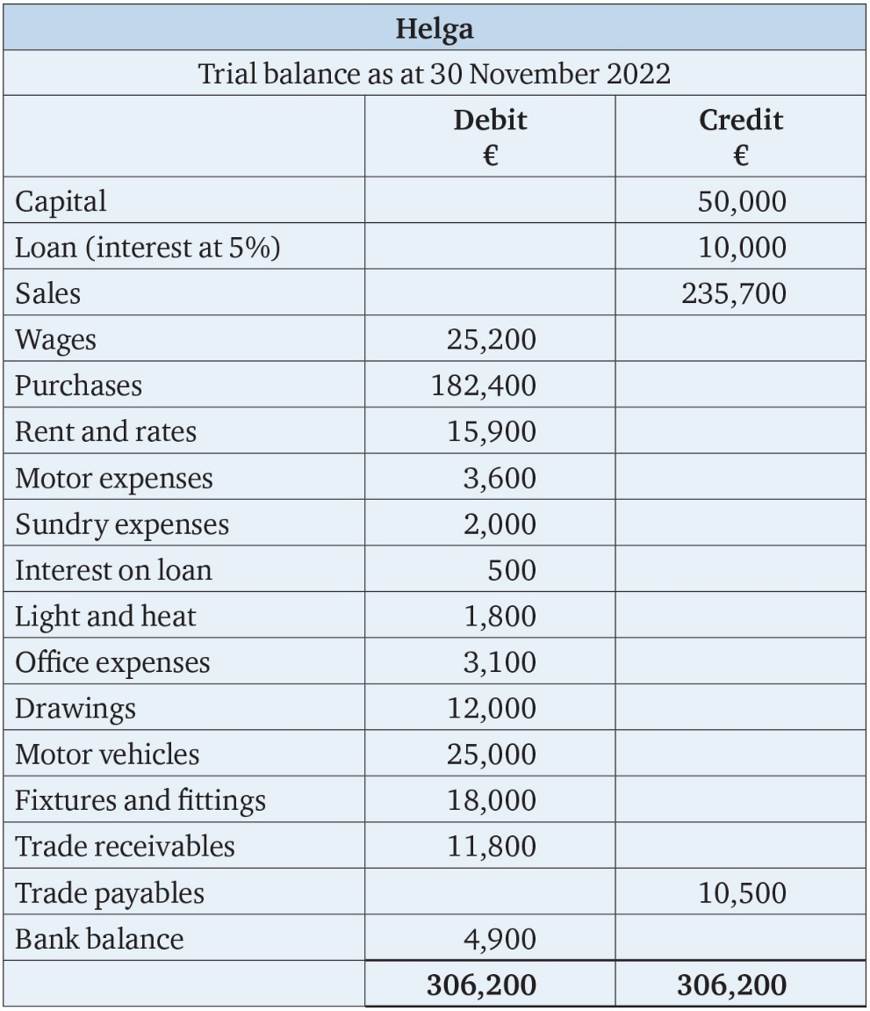
Table 2.7

Slide 11
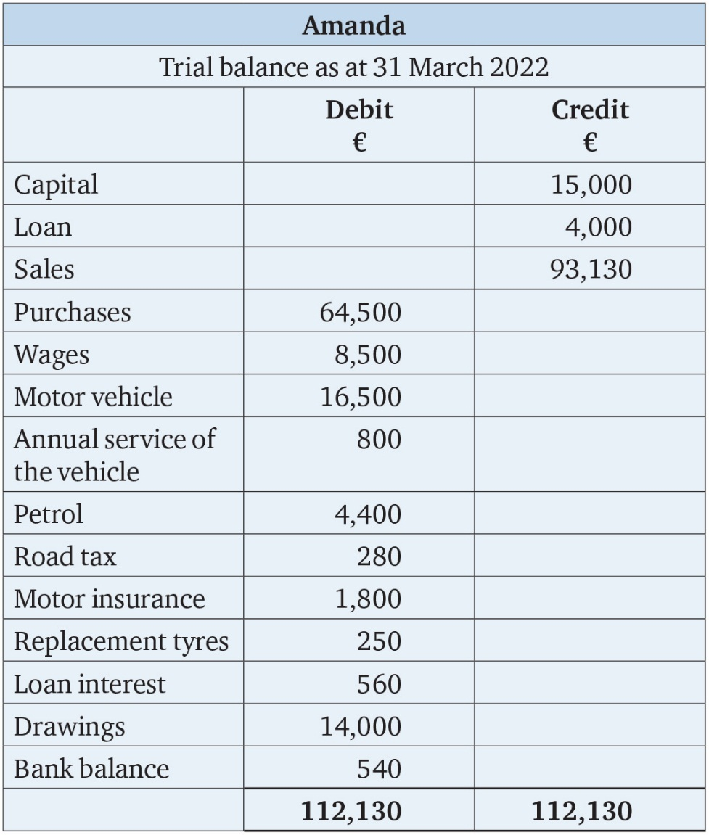
Table 2.8

