Slide 1

Accounting by Mary Carey and Cathy Knowles

Slide 2
Part I
Financial Accounting
Chapter 04
Accounting for Depreciation and Bad Debts

Slide 3


Slide 4
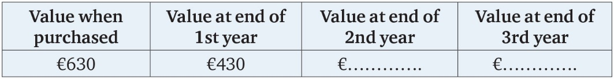
Table 4.1

Slide 5
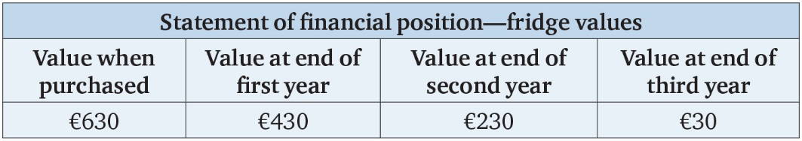
Table 4.2

Slide 6
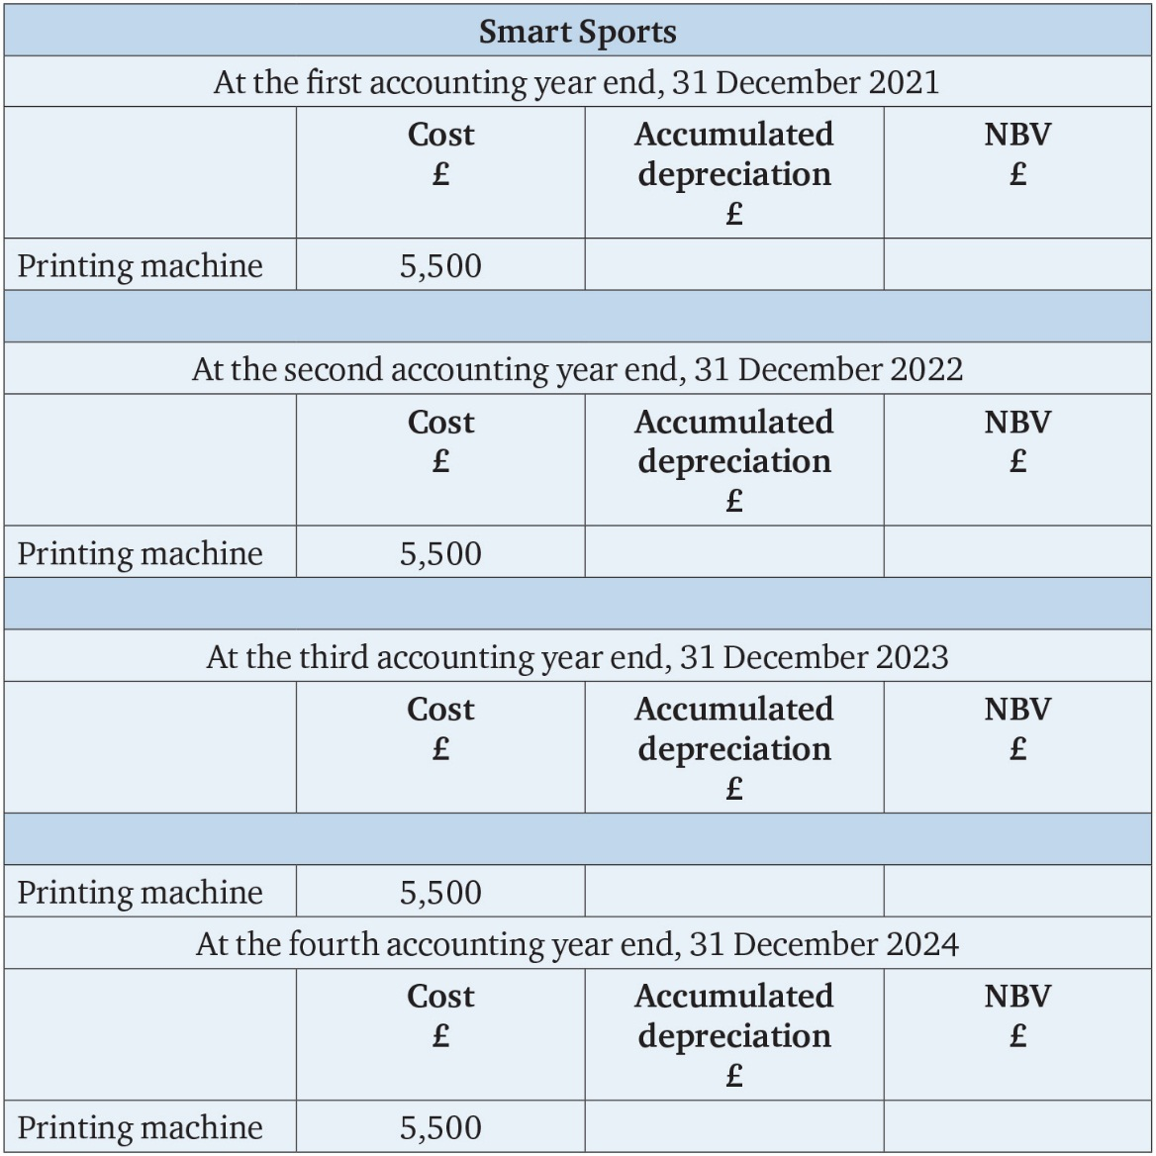
Table 4.3

Slide 7
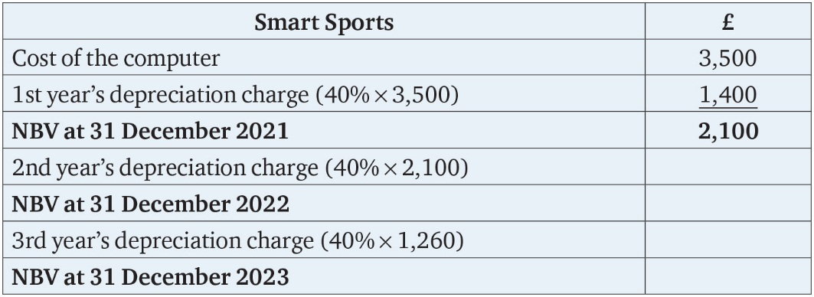
Table 4.4

Slide 8
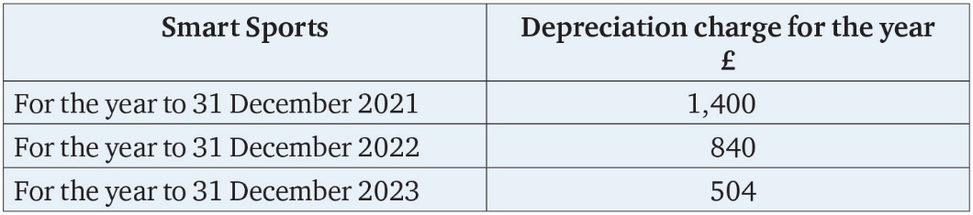
Table 4.5

Slide 9
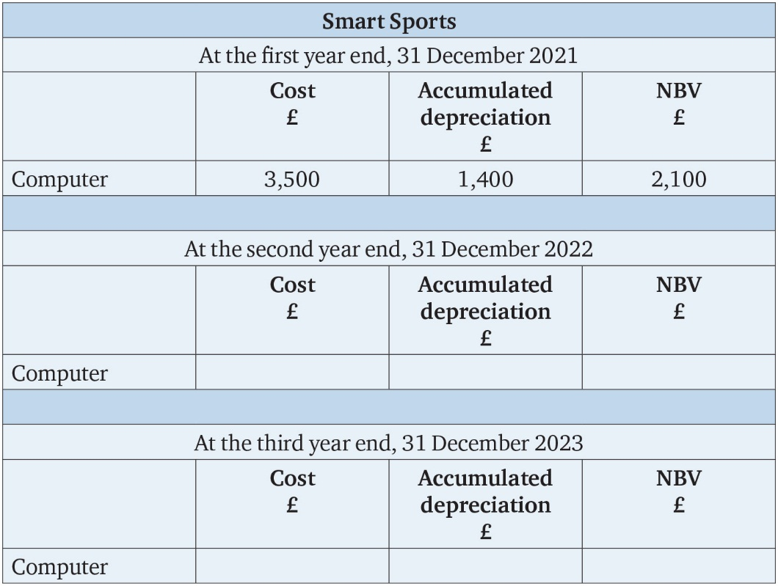
Table 4.6

Slide 10
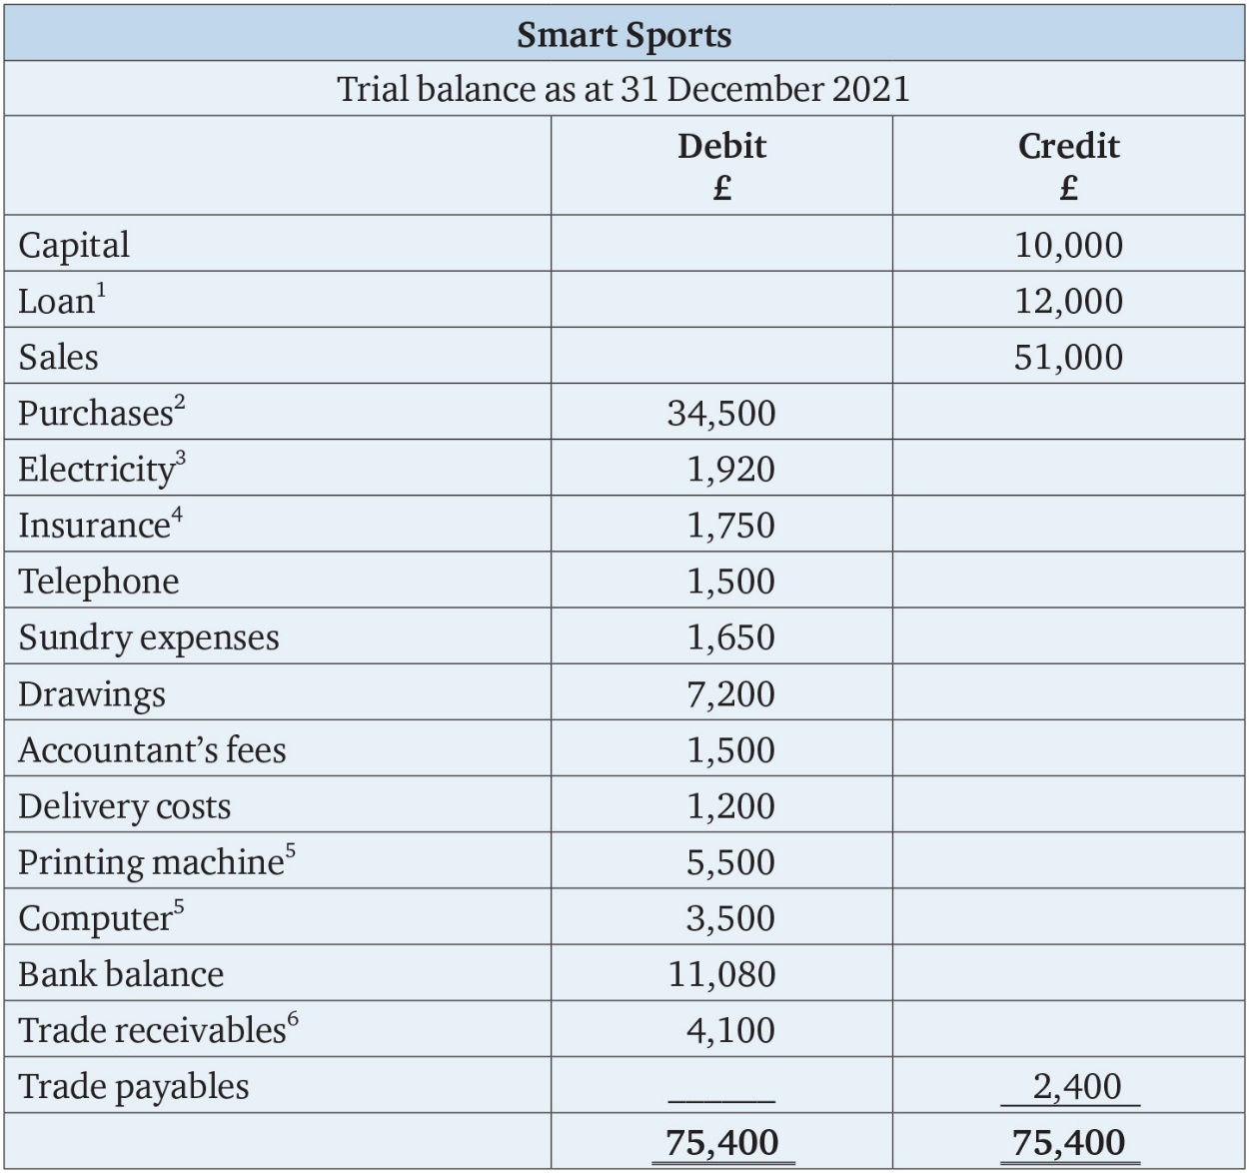
Table 4.7

Slide 11
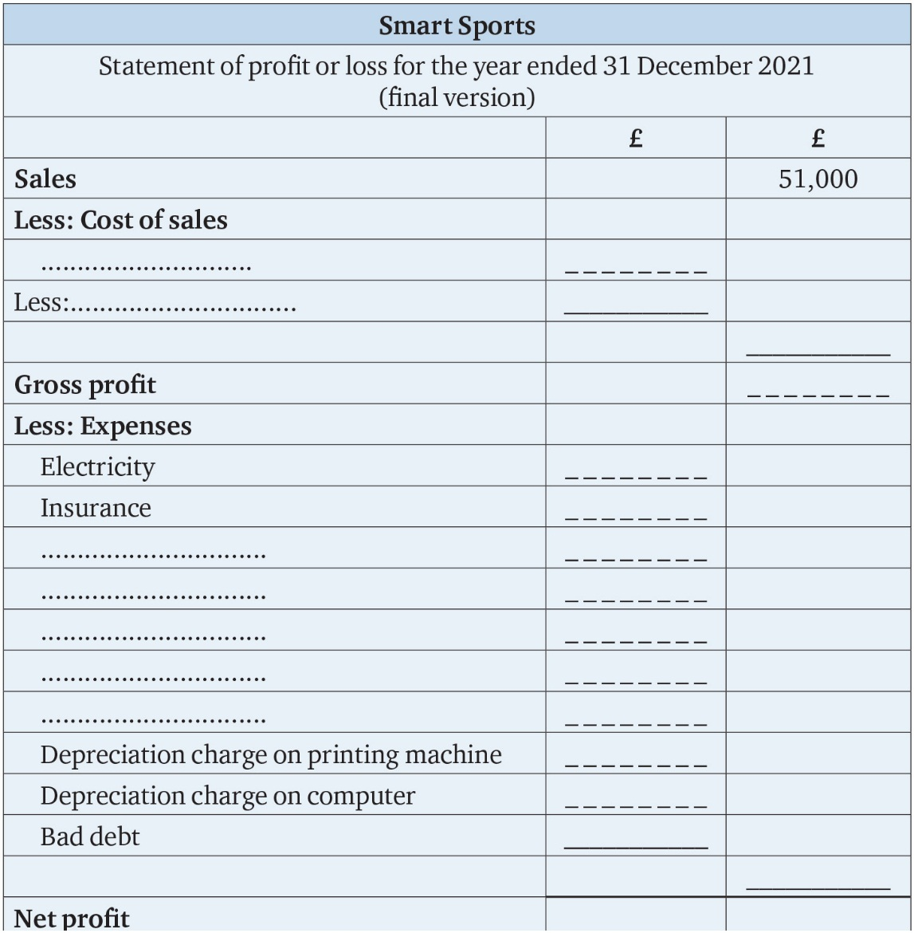
Table 4.8

Slide 12
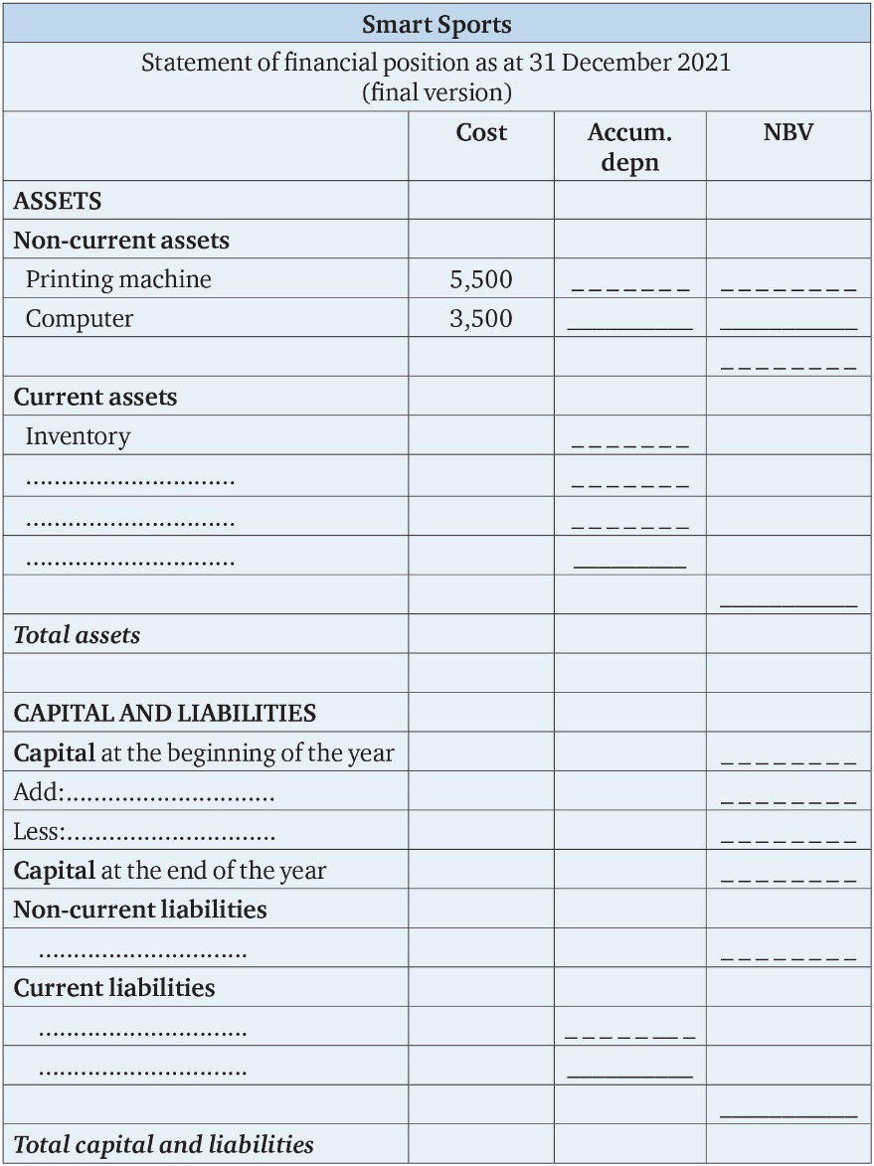
Table 4.9

Slide 13
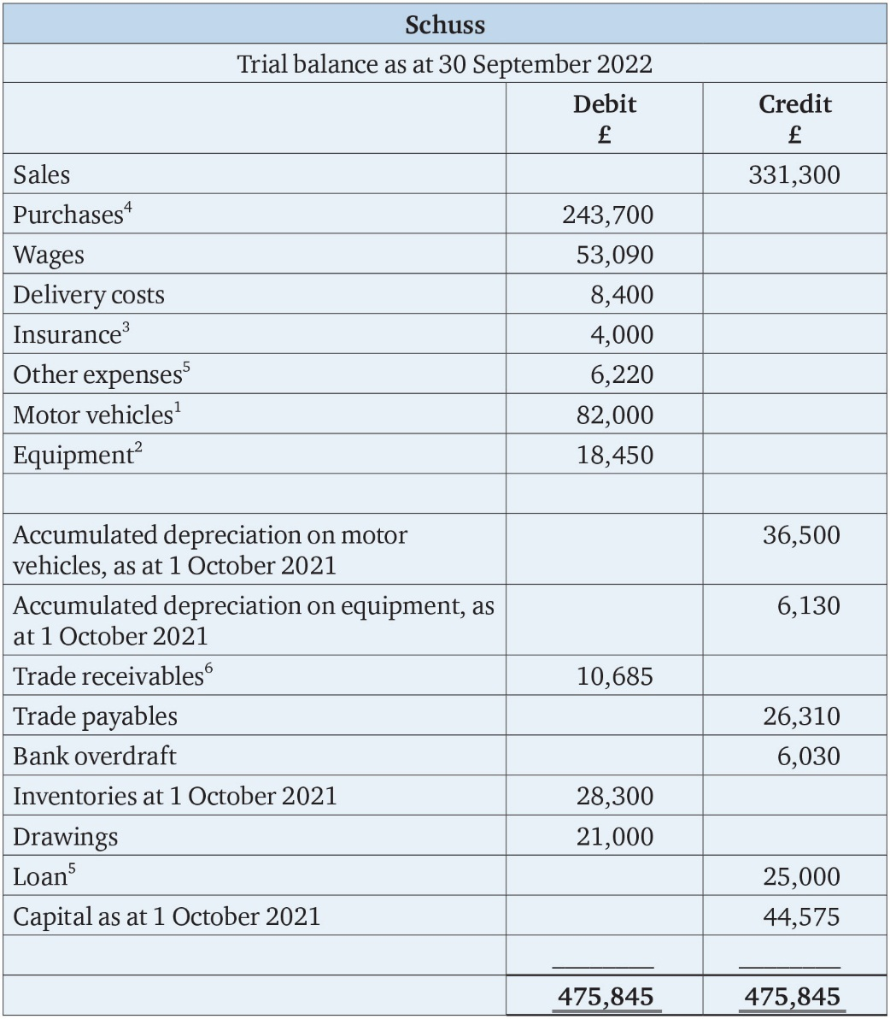
Table 4.10

