Slide 1

Accounting by Mary Carey and Cathy Knowles

Slide 2
Part I
Financial Accounting
Chapter 07
The Statement of Cash Flows

Slide 3
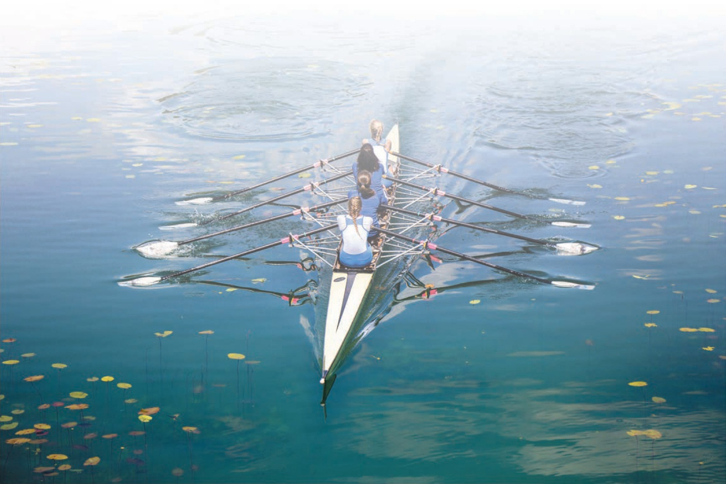

Slide 4
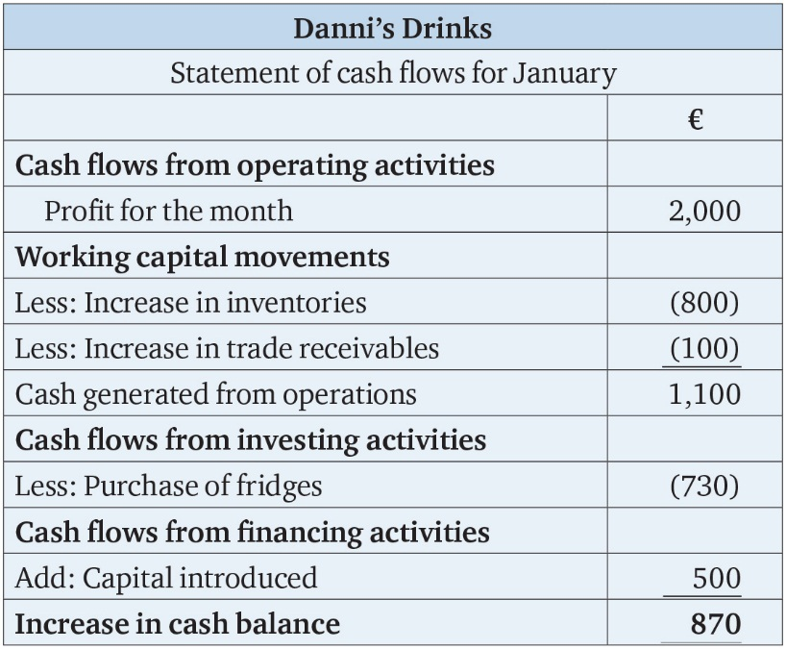
Table 7.1

Slide 5
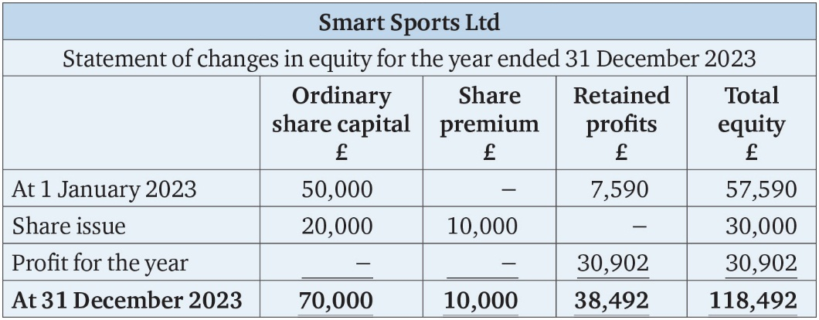
Table 7.2

Slide 6
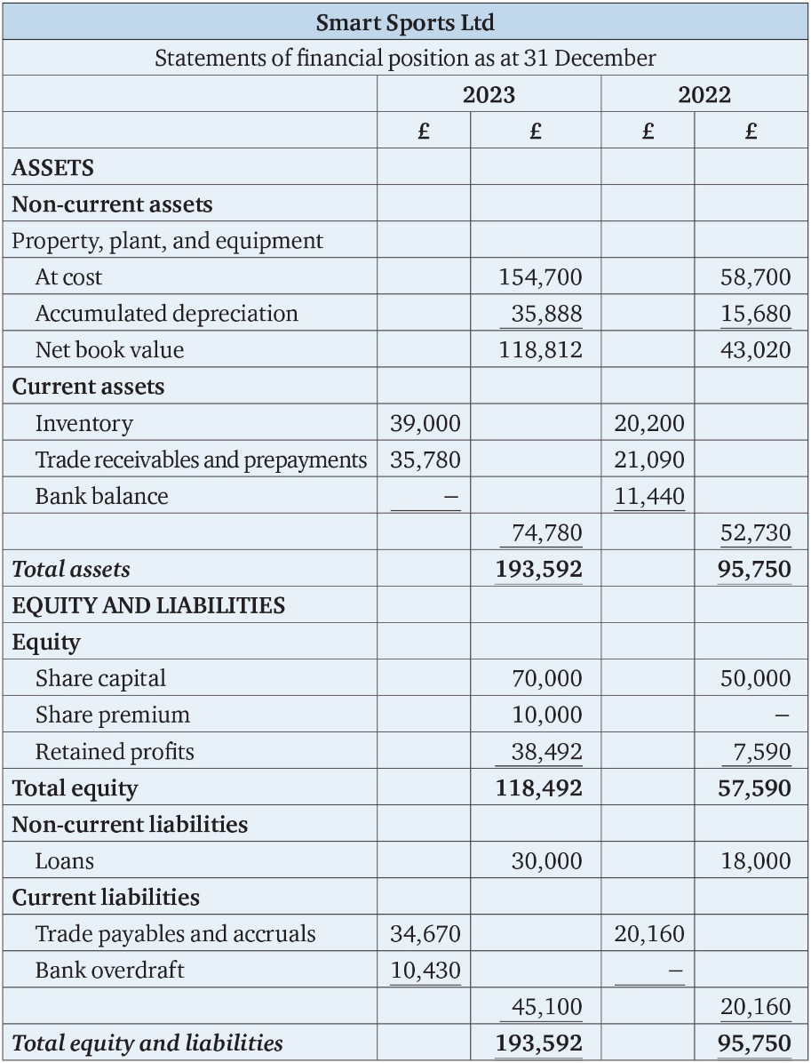
Table 7.3

Slide 7
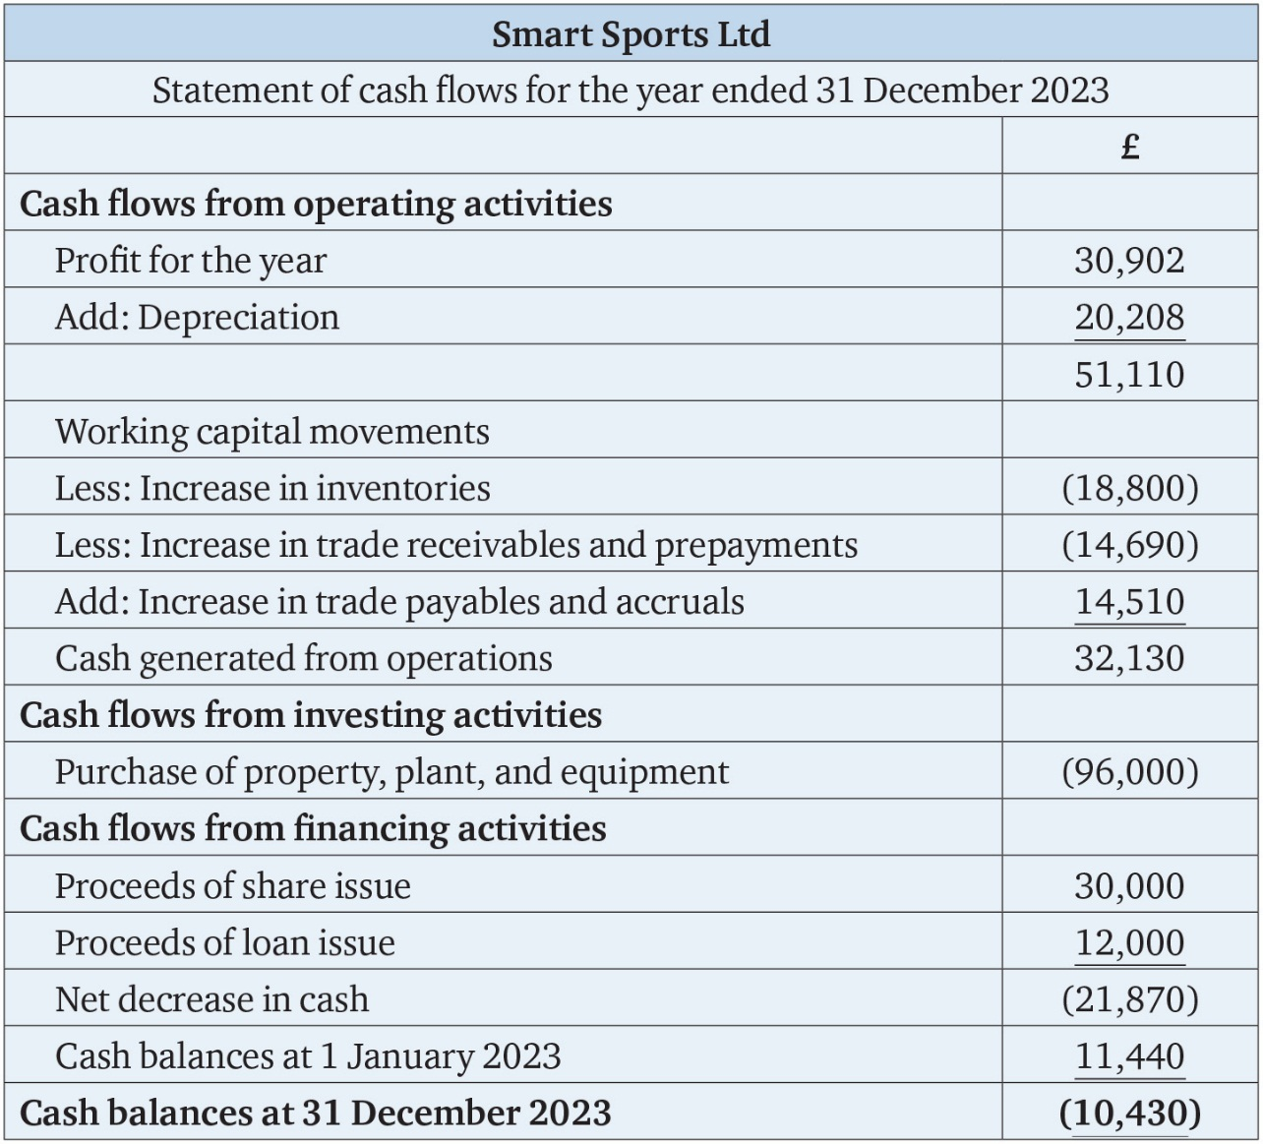
Table 7.4

Slide 8
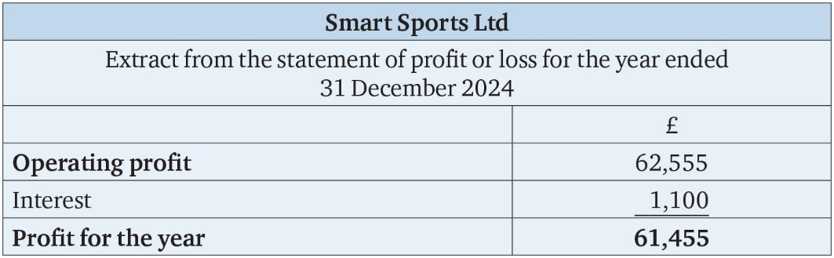
Table 7.5

Slide 9
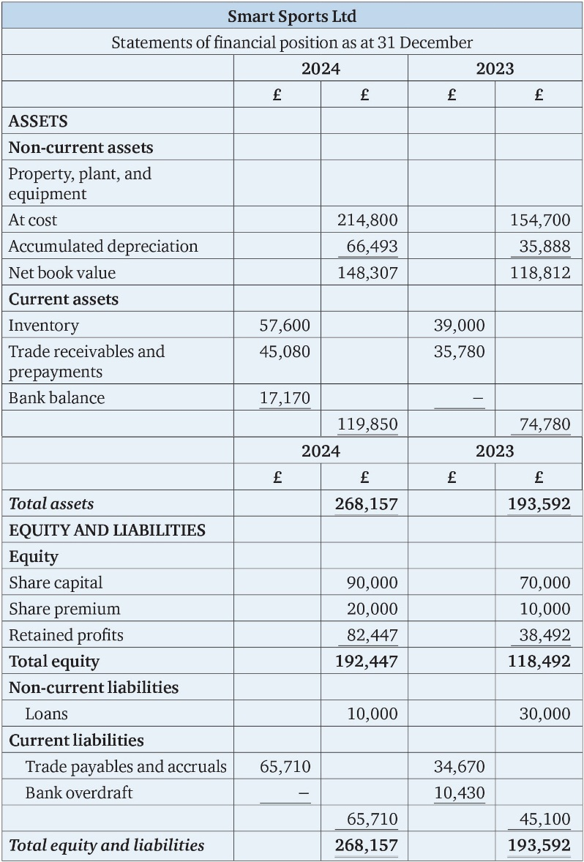
Table 7.6

Slide 10
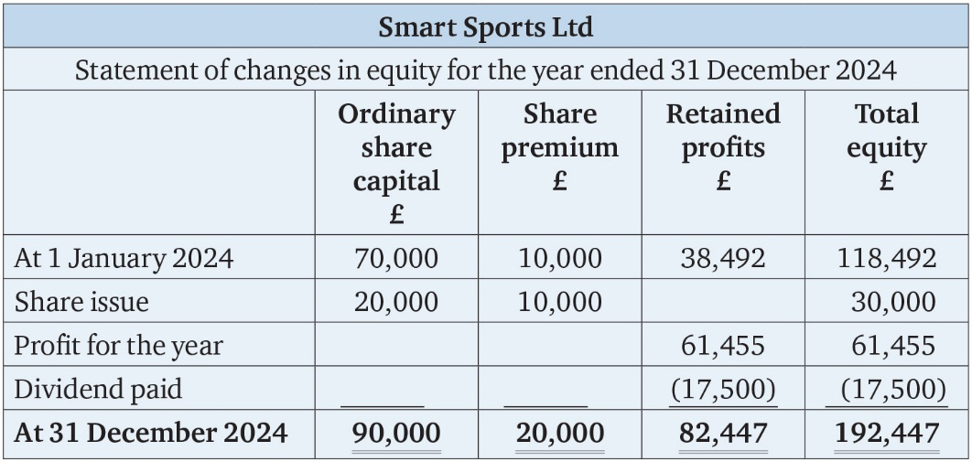
Table 7.7

Slide 11
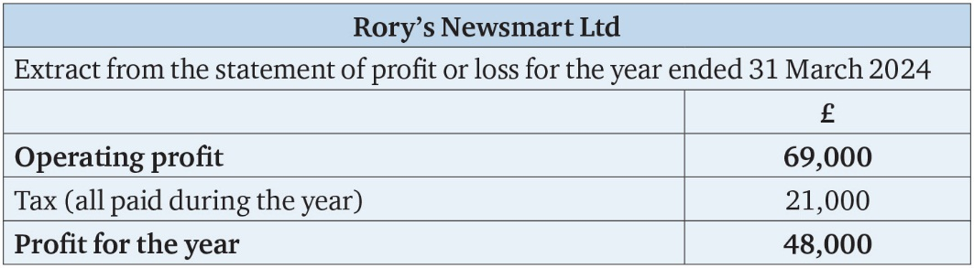
Table 7.8

Slide 12
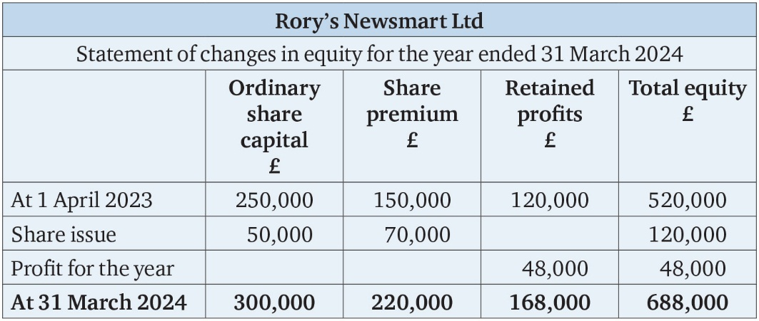
Table 7.9

Slide 13
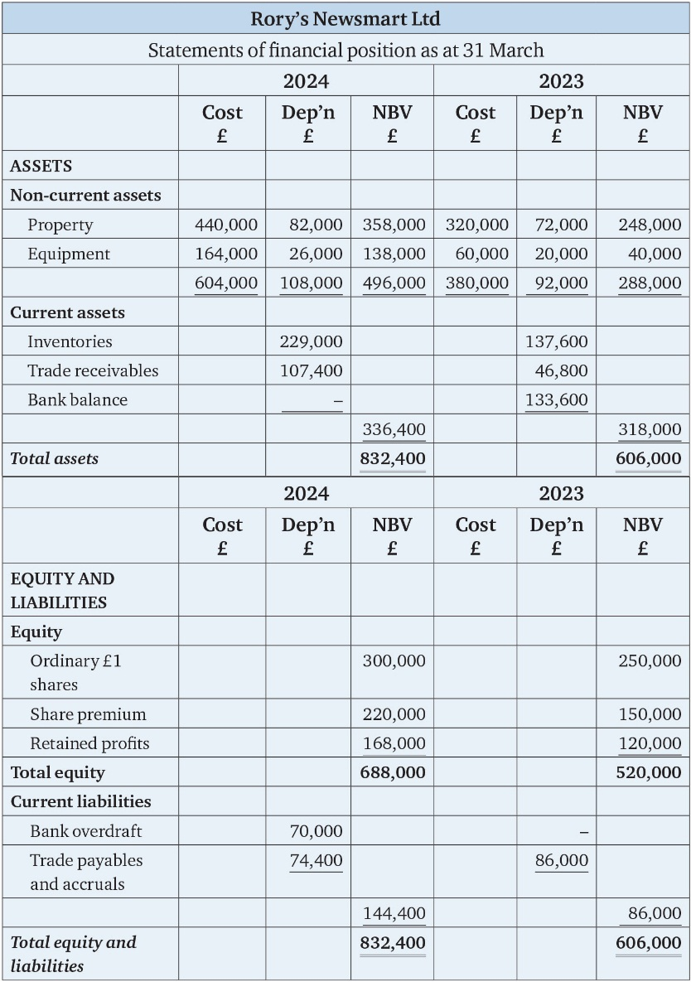
Table 7.10

Slide 14
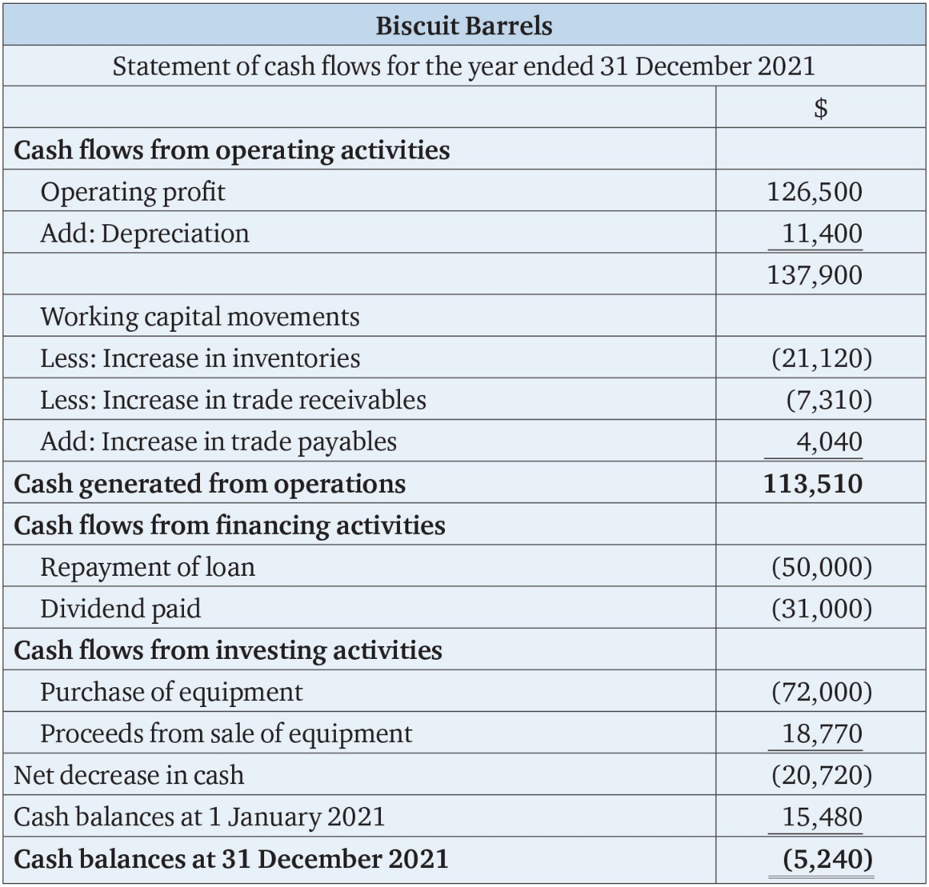
Table 7.11

Slide 15
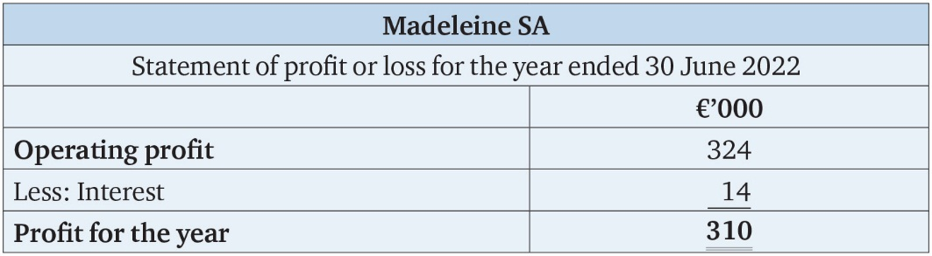
Table 7.12

Slide 16
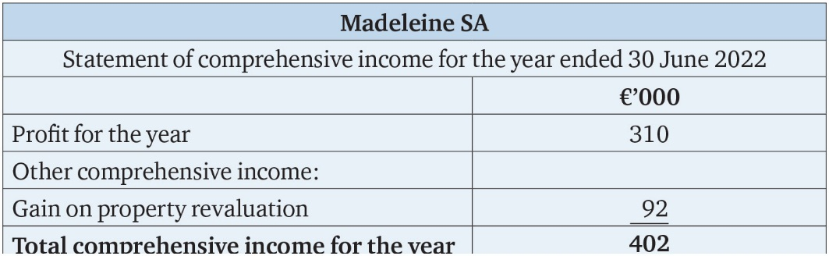
Table 7.13

Slide 17
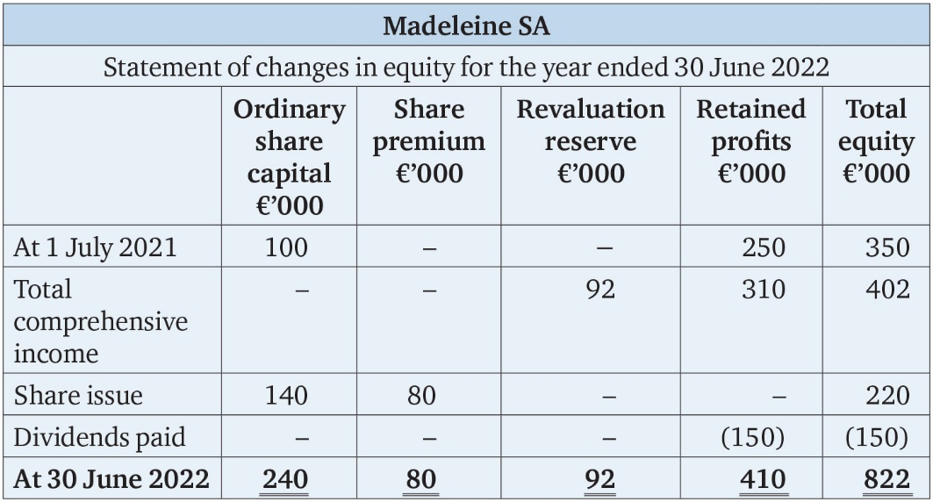
Table 7.14

Slide 18
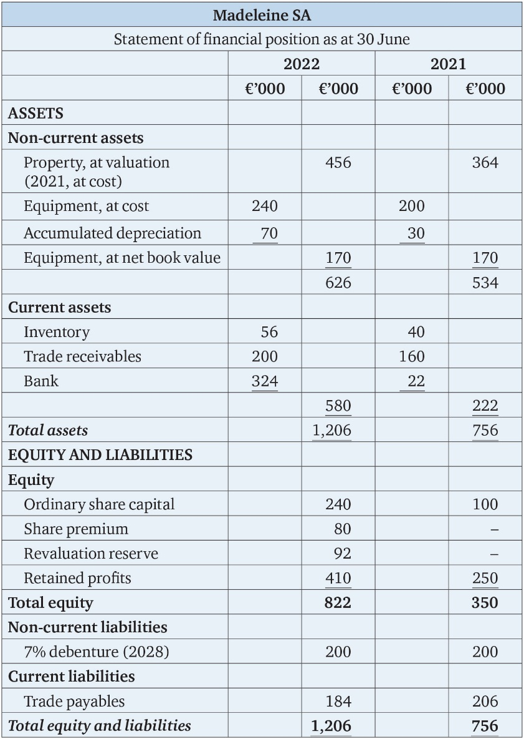
Table 7.15

