Slide 1

Accounting by Mary Carey and Cathy Knowles

Slide 2
Part I
Financial Accounting
Chapter 08
Interpreting Financial Statements

Slide 3


Slide 4
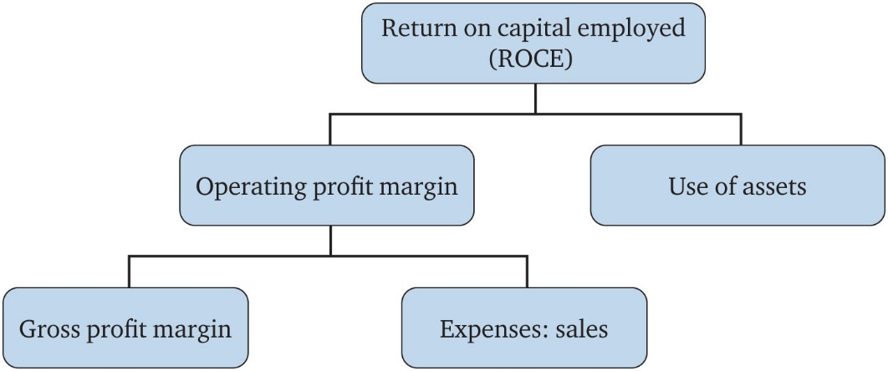
Figure 8.1 The pyramid of ratios

Slide 5
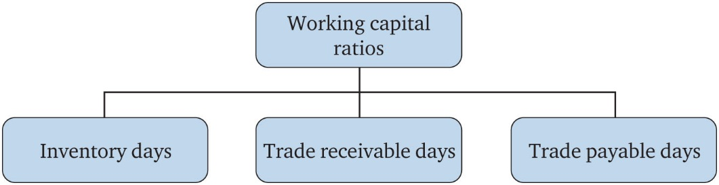
Figure 8.2 Working capital

Slide 6
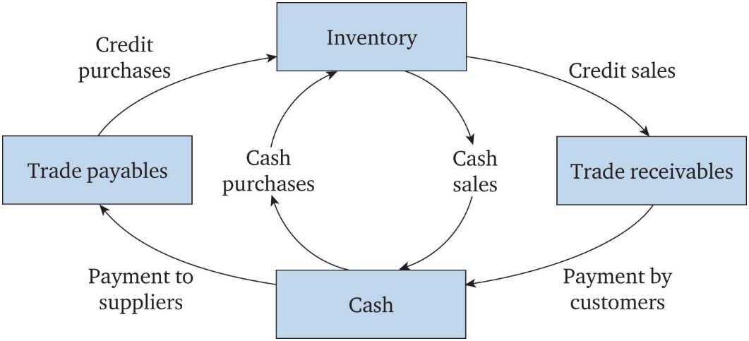
Figure 8.3 The working capital cycle

Slide 7
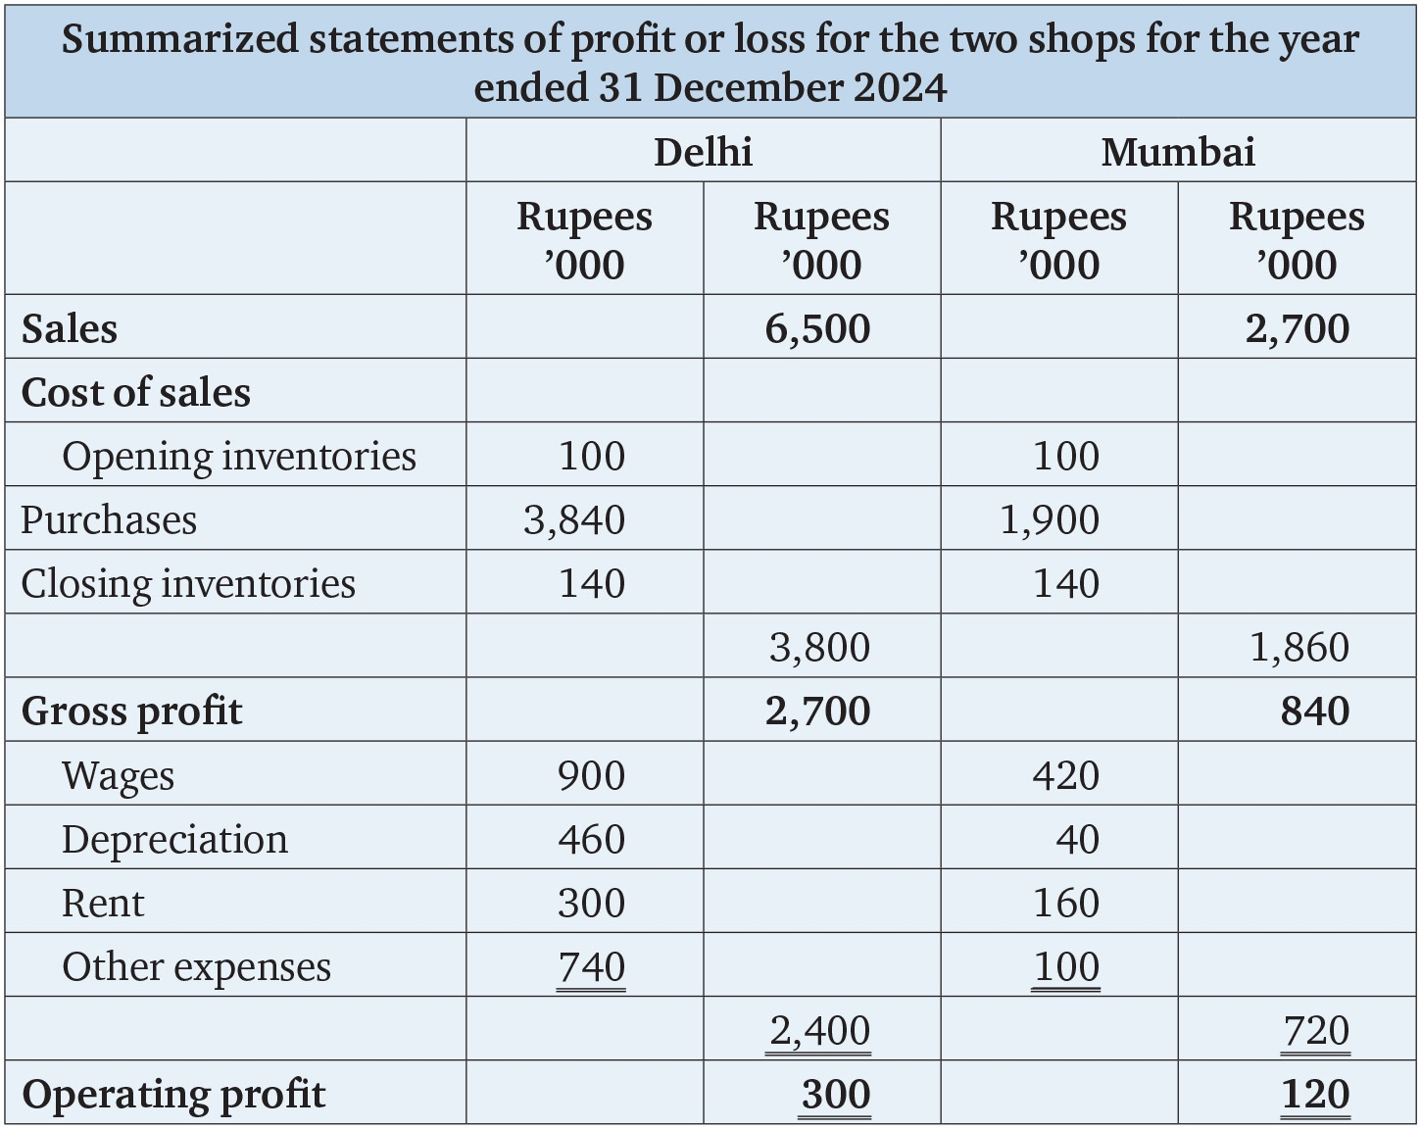
Table 8.1

Slide 8
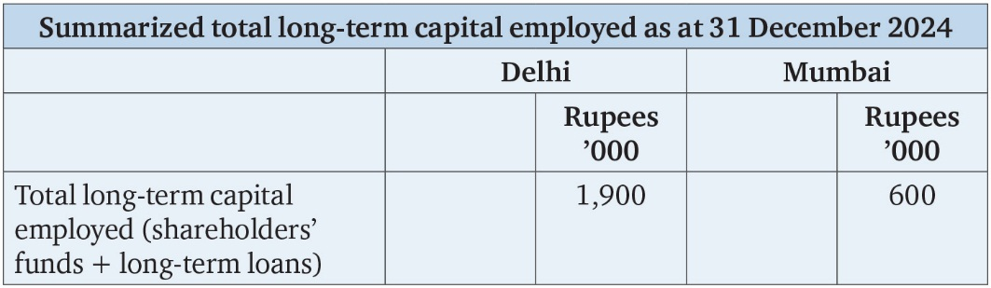
Table 8.2

Slide 9
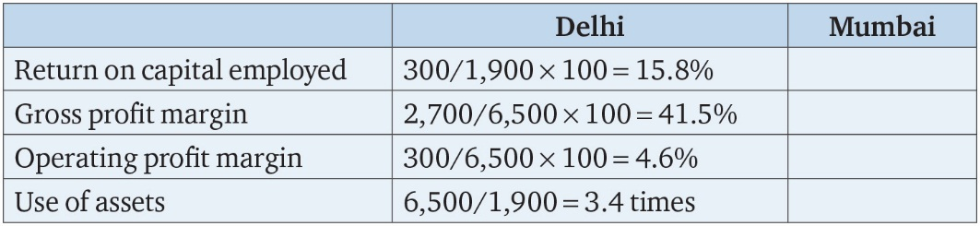
Table 8.3

Slide 10
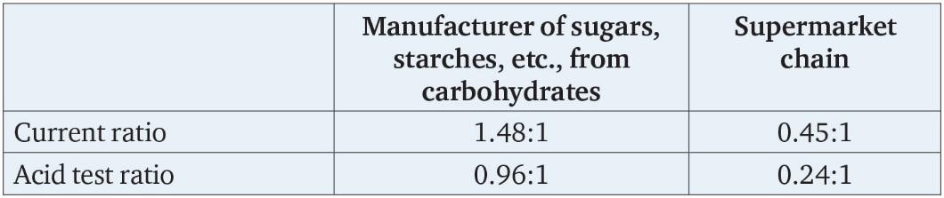
Table 8.4

Slide 11
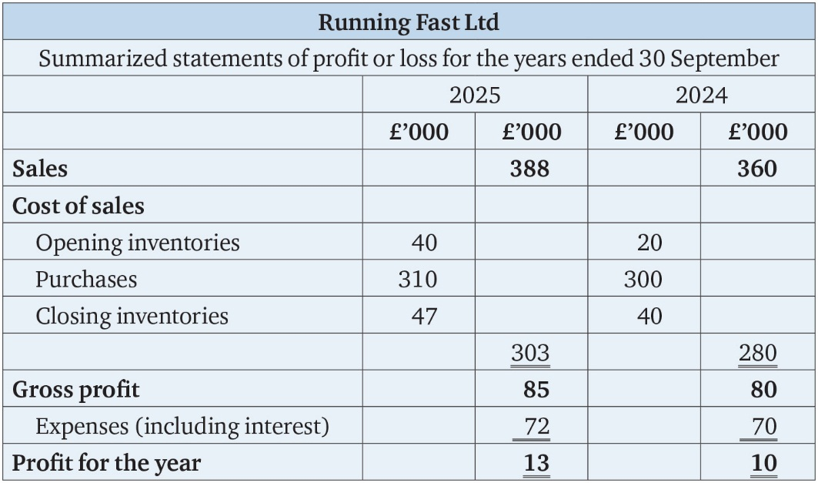
Table 8.5

Slide 12
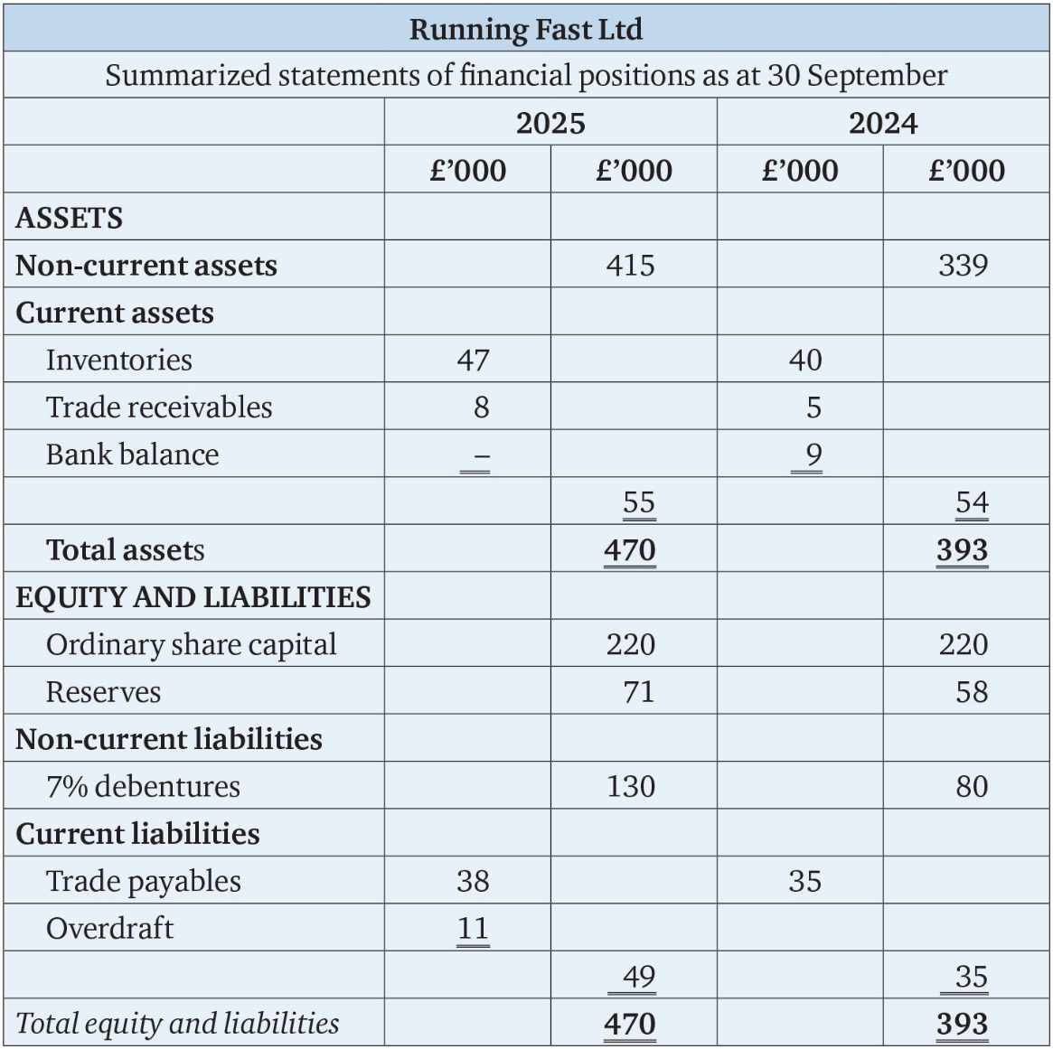
Table 8.6

Slide 13
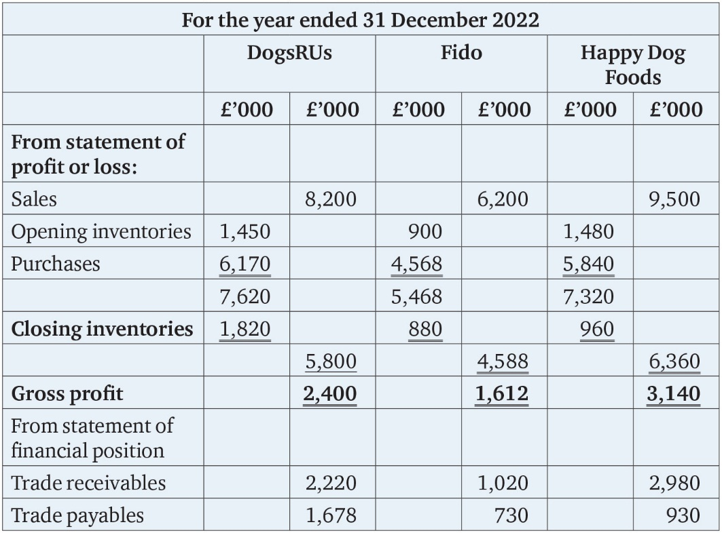
Table 8.7

Slide 14
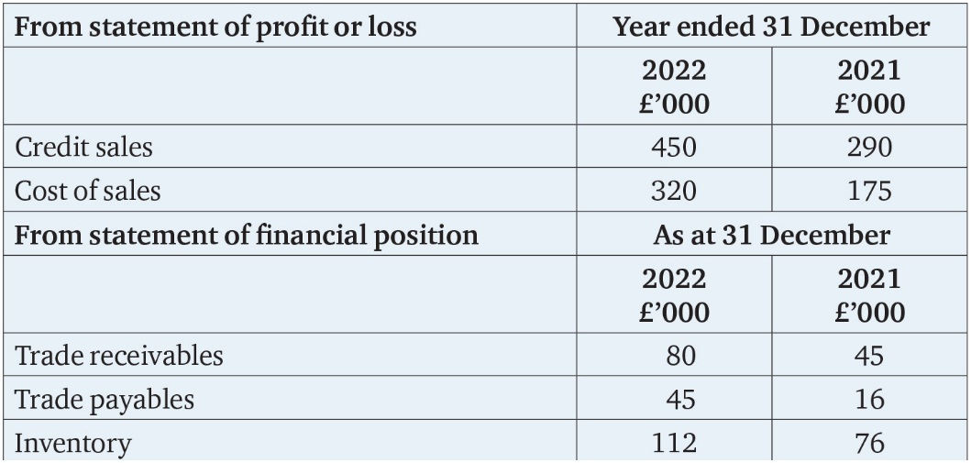
Table 8.8

