Slide 1

Accounting by Mary Carey and Cathy Knowles

Slide 2
Part I
Financial Accounting
Chapter 09
Capital Structure and Investment Ratios

Slide 3


Slide 4
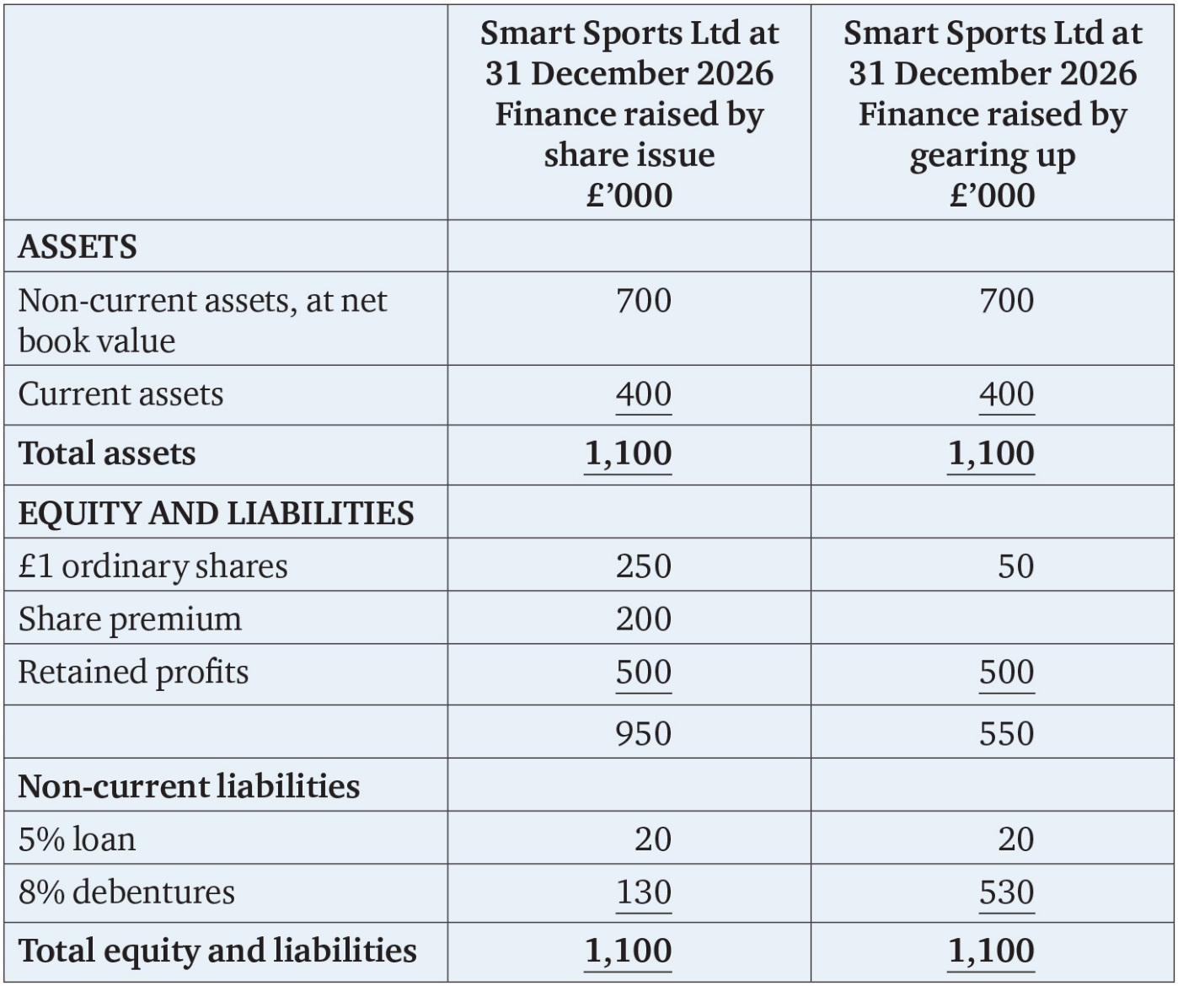
Table 9.1

Slide 5
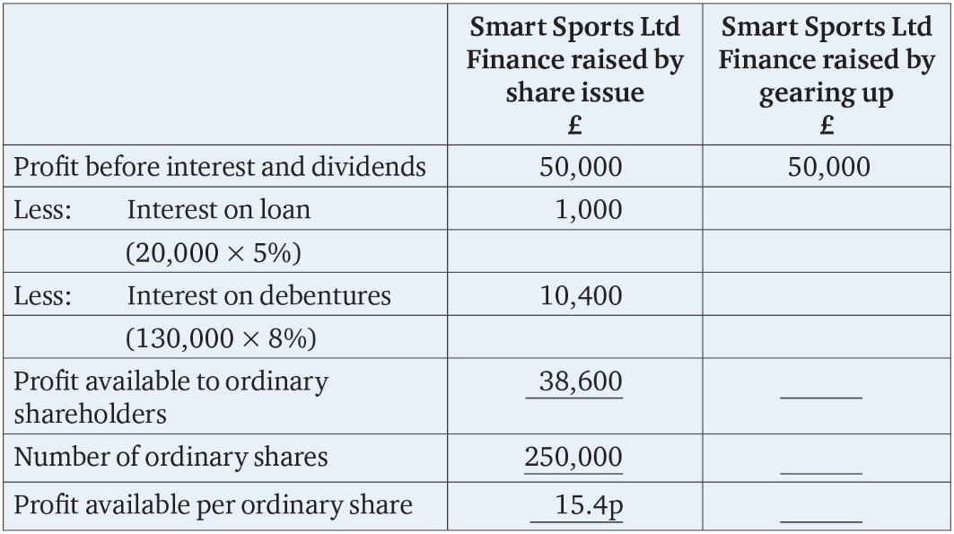
Table 9.2

Slide 6
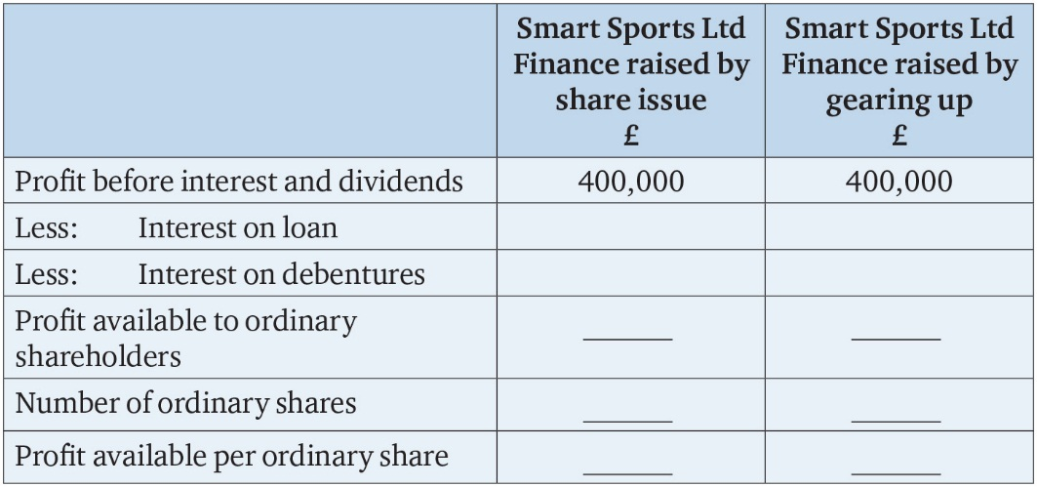
Table 9.3

Slide 7
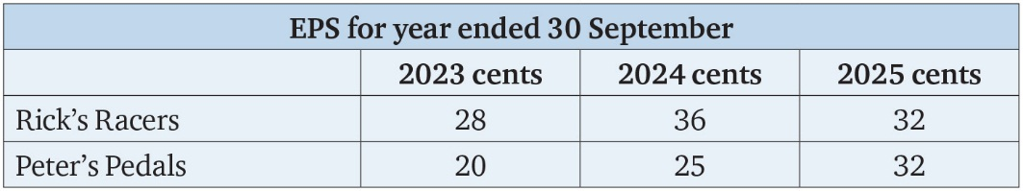
Table 9.4

Slide 8
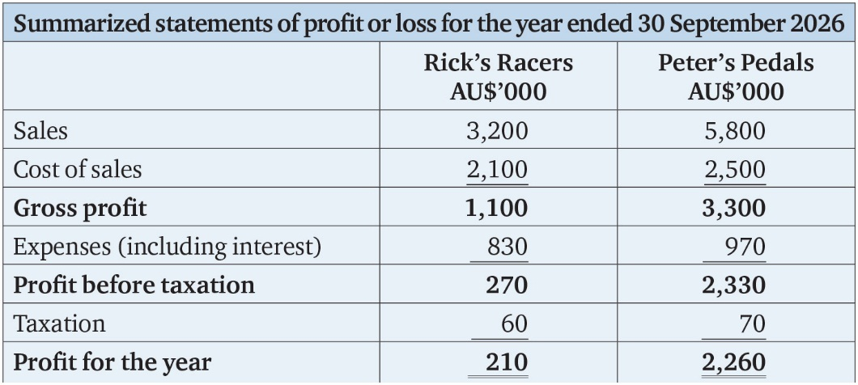
Table 9.5

Slide 9
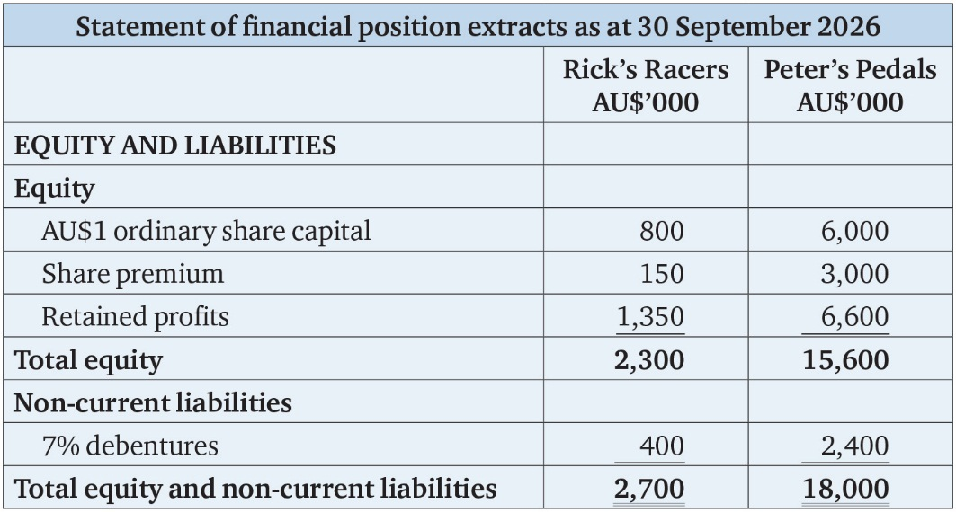
Table 9.6

Slide 10
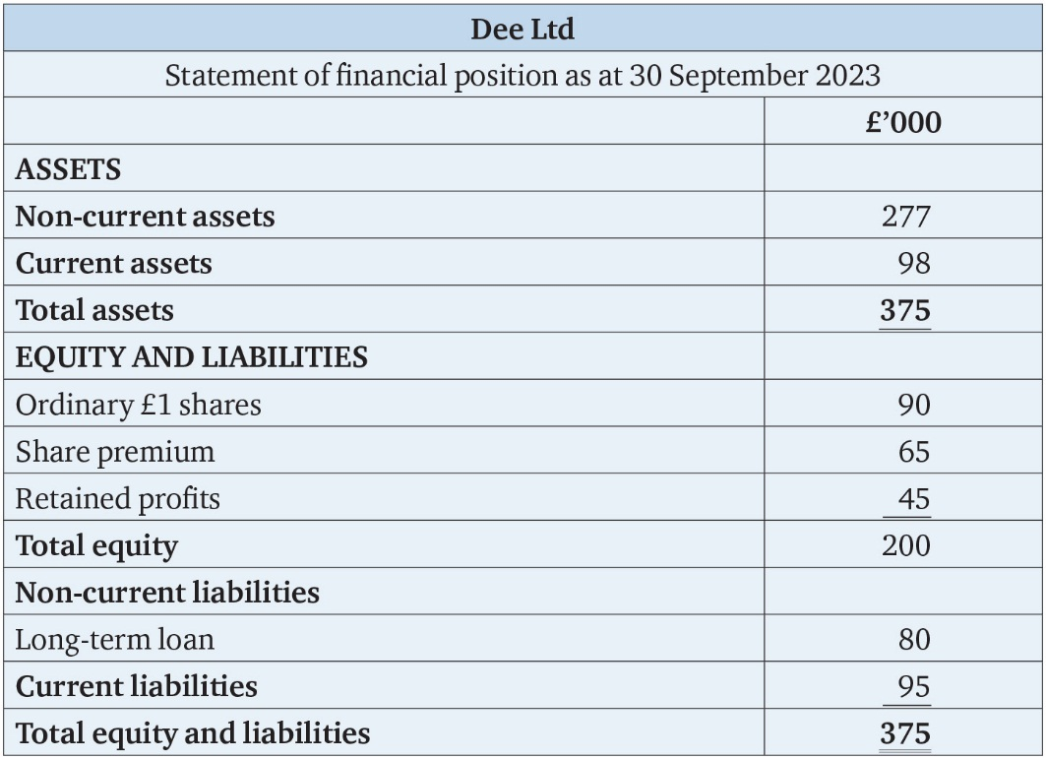
Table 9.7

Slide 11
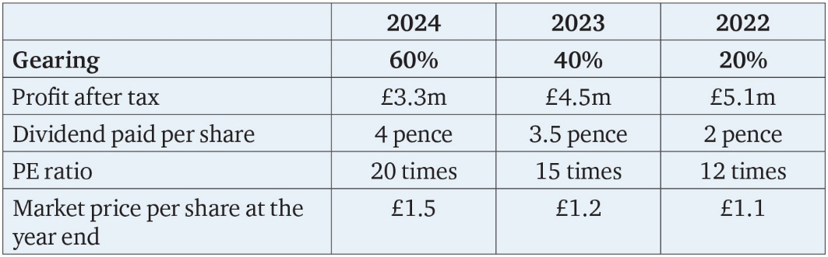
Table 9.8

Slide 12
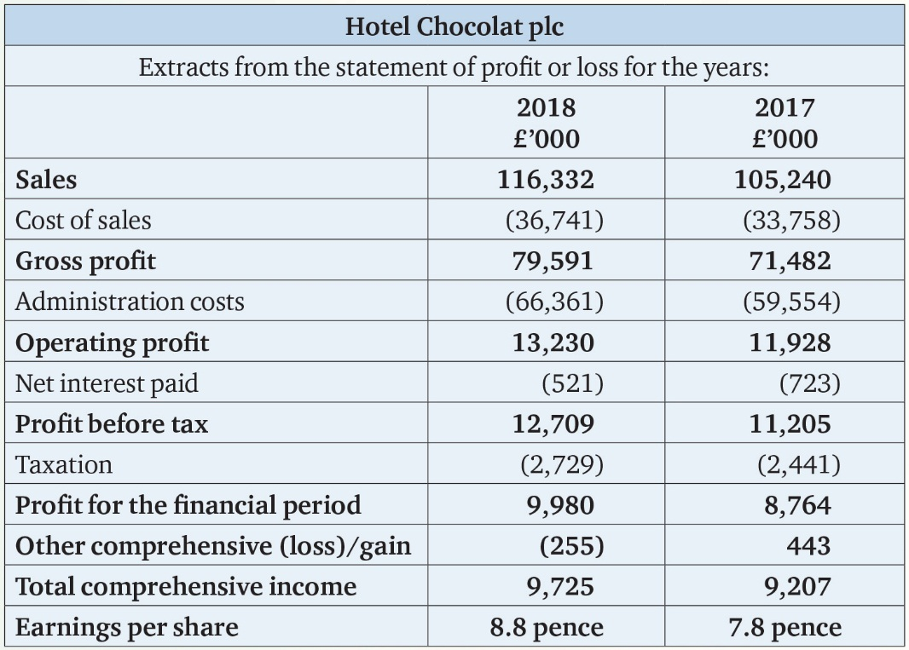
Table FA.1

Slide 13
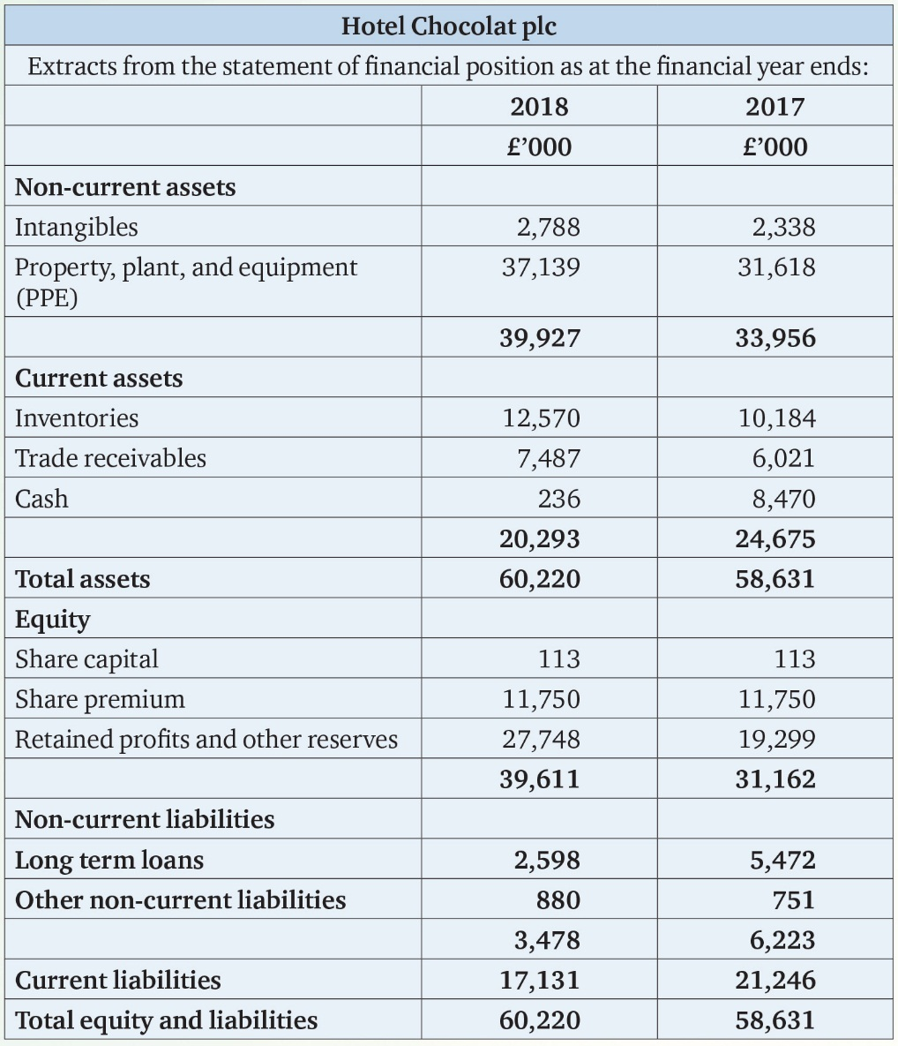
Table FA.2

Slide 14
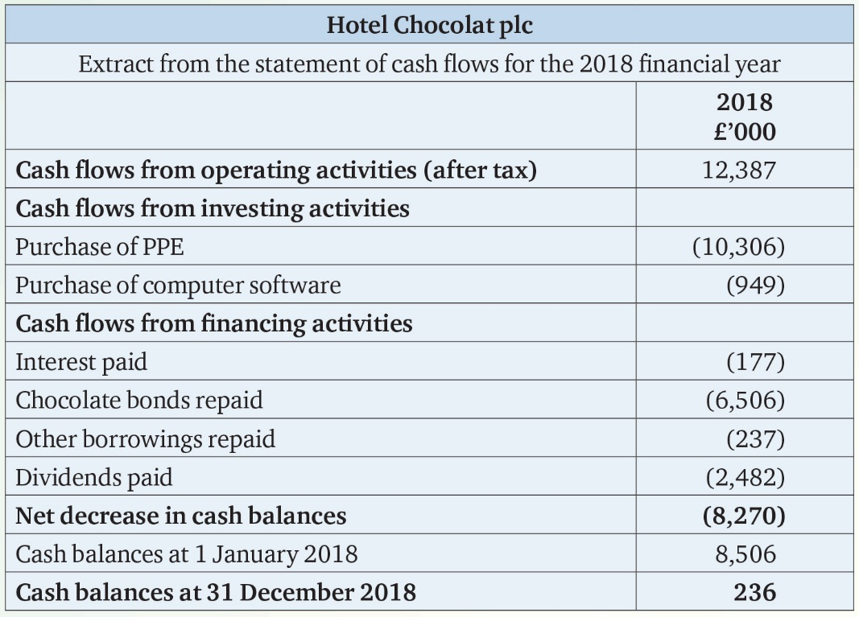
Table FA.3

Slide 15
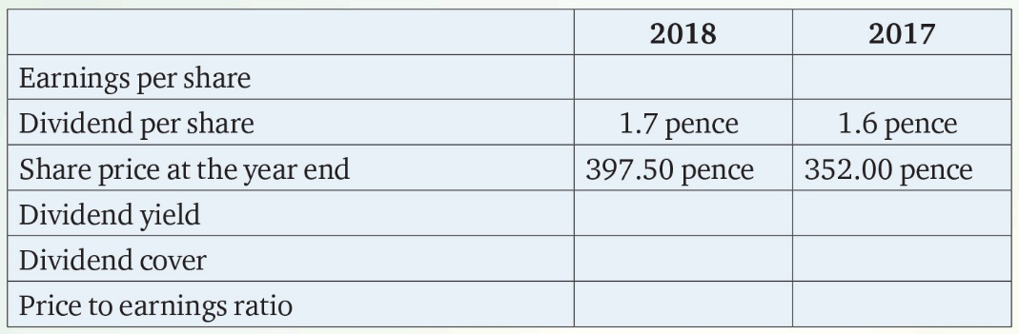
Table FA.4

