Slide 1

Accounting by Mary Carey and Cathy Knowles

Slide 2
Part II
Management Accounting
Chapter 13
Pricing and Costs

Slide 3


Slide 4
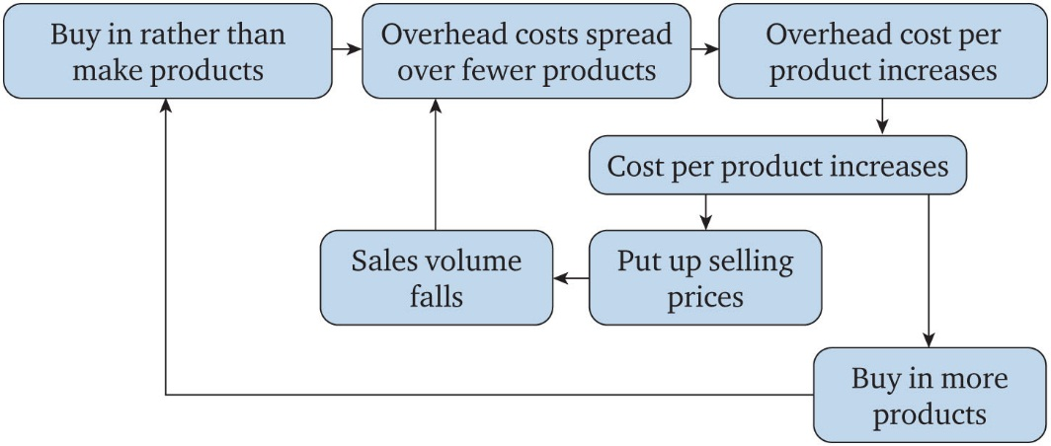
Figure 13.1 The cost spiral

Slide 5
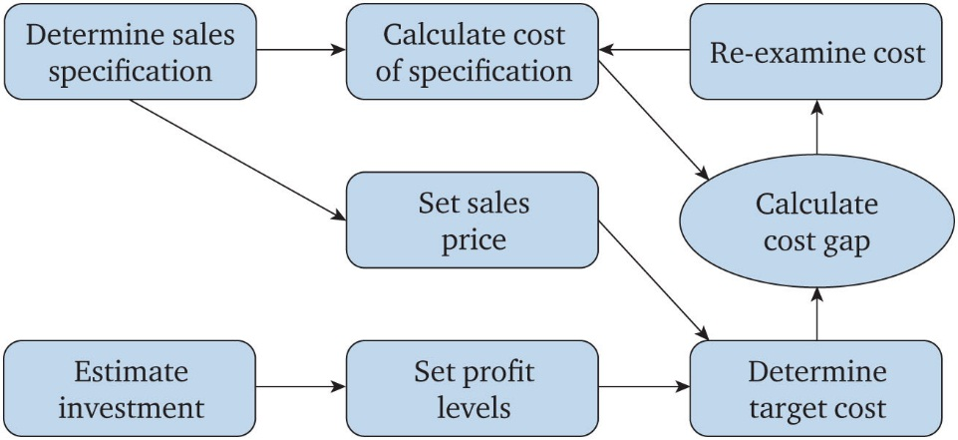
Figure 13.2 Target costing

Slide 6
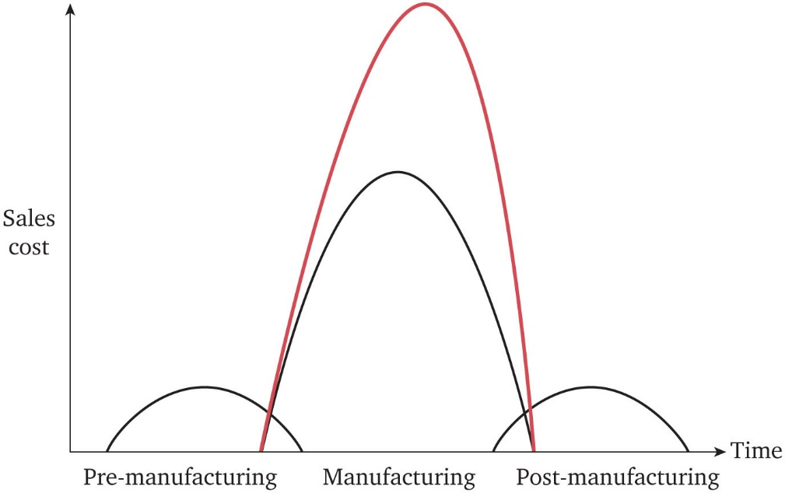
Figure 13.3 Life-cycle costing

Slide 7
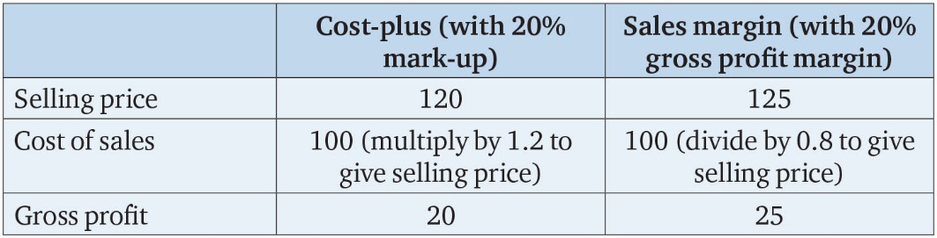
Table 13.1

Slide 8
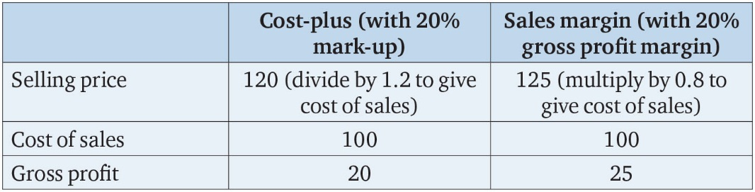
Table 13.2

Slide 9
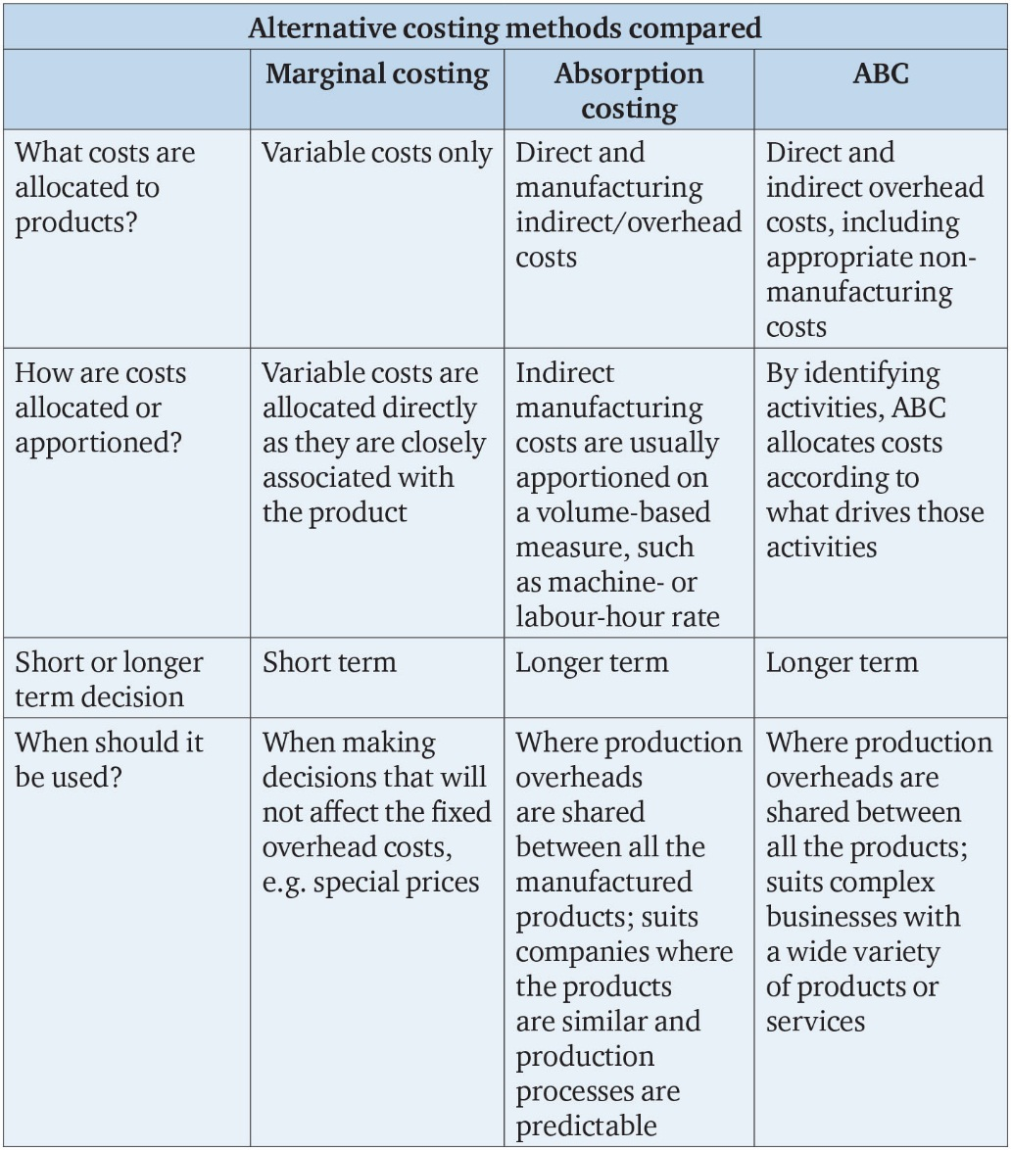
Table 13.3

Slide 10
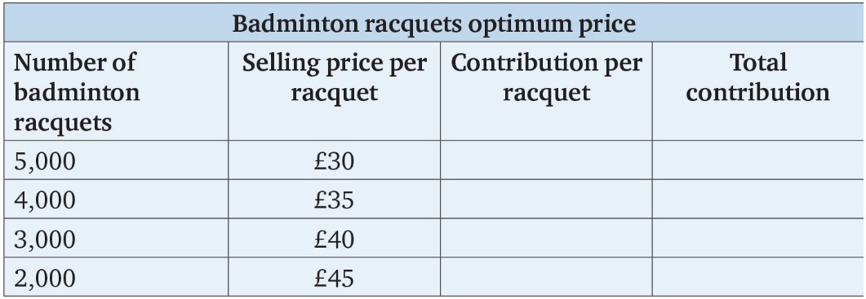
Table 13.4

