Slide 1

Accounting by Mary Carey and Cathy Knowles

Slide 2
Part II
Management Accounting
Chapter 14
Short-term Decision Making

Slide 3


Slide 4
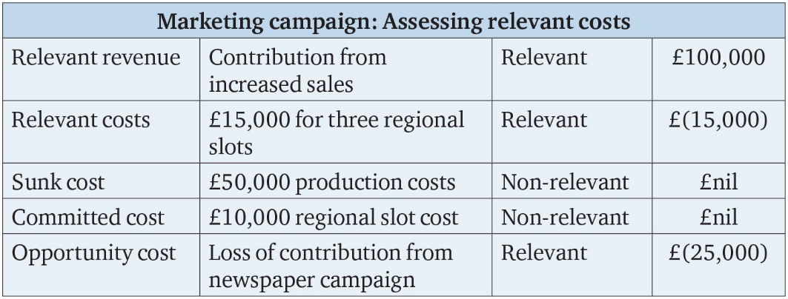
Table 14.1

Slide 5
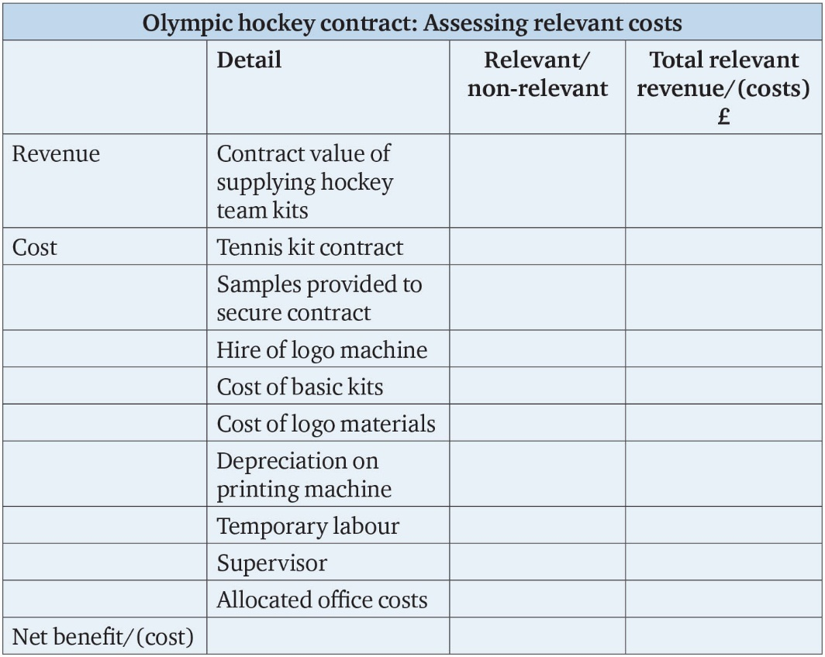
Table 14.2

Slide 6
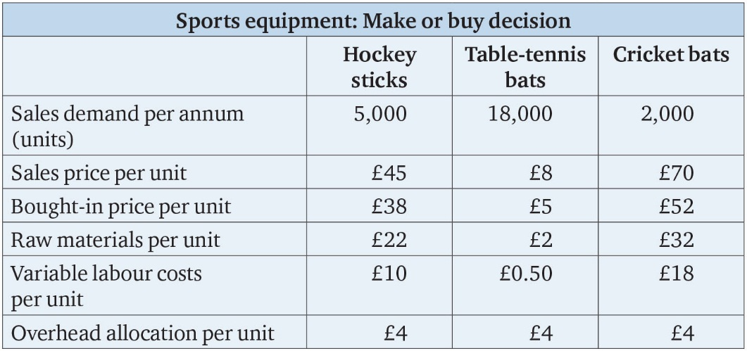
Table 14.3

Slide 7
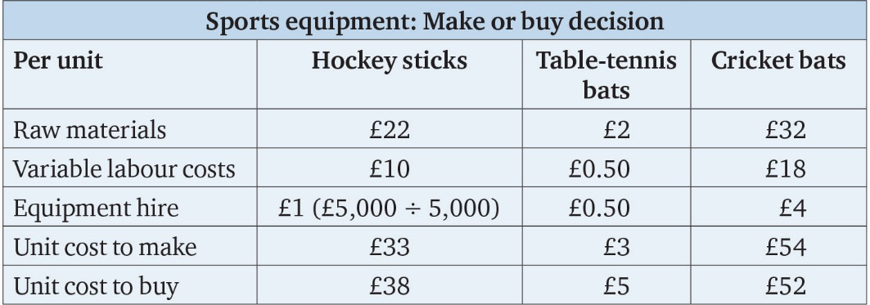
Table 14.4

Slide 8
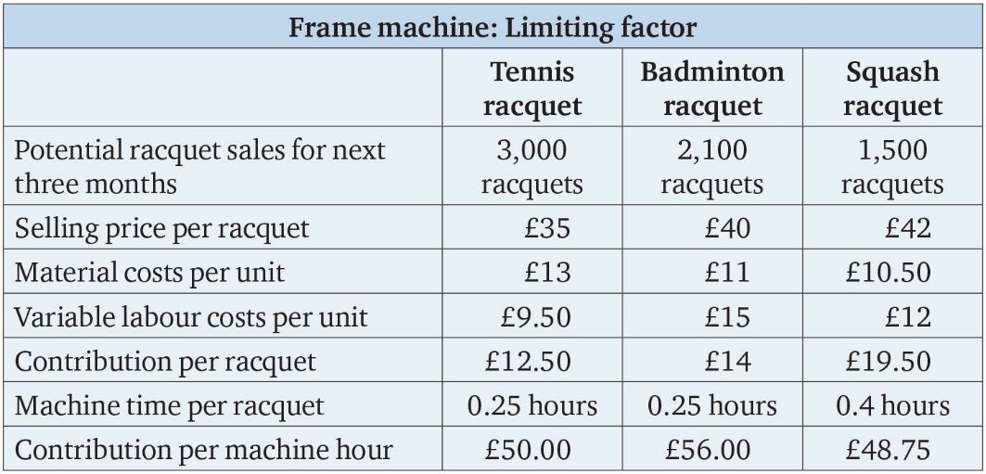
Table 14.5

Slide 9
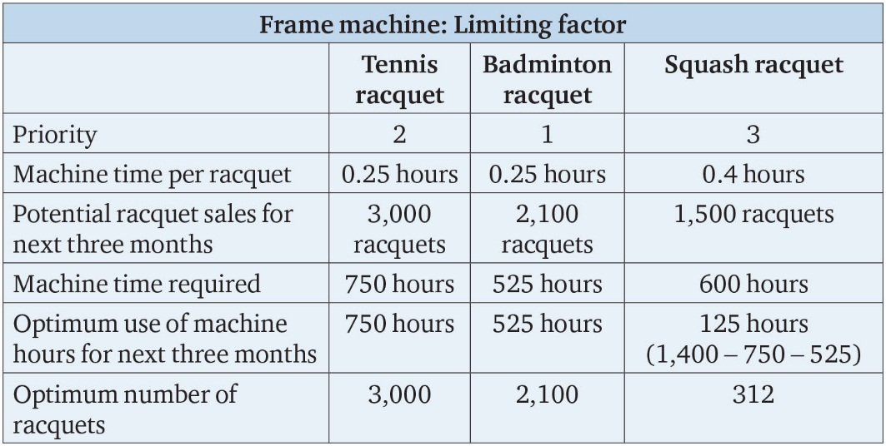
Table 14.6

Slide 10
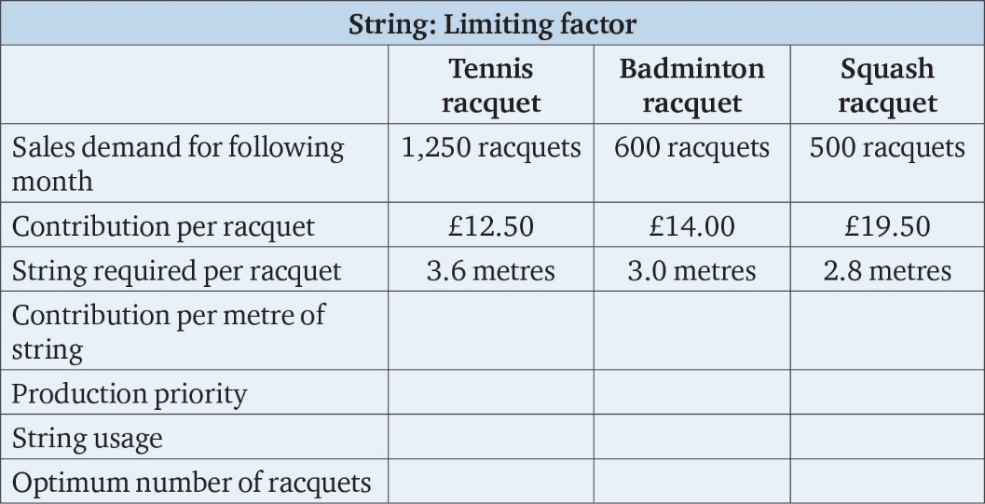
Table 14.7

Slide 11
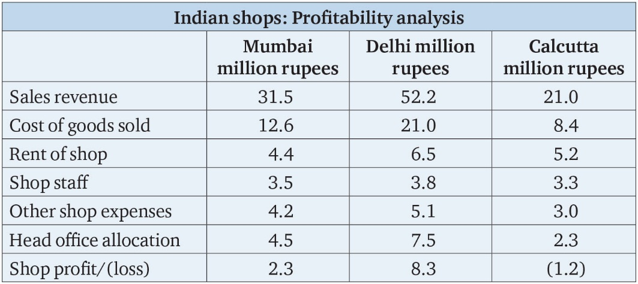
Table 14.8

Slide 12
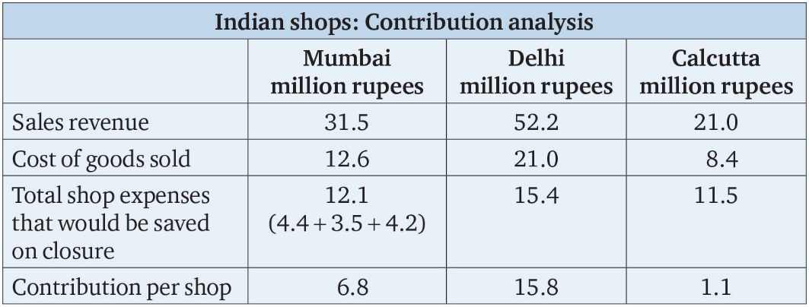
Table 14.9

Slide 13
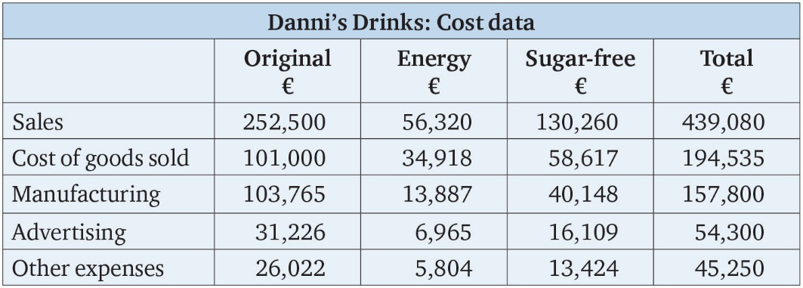
Table 14.10

Slide 14
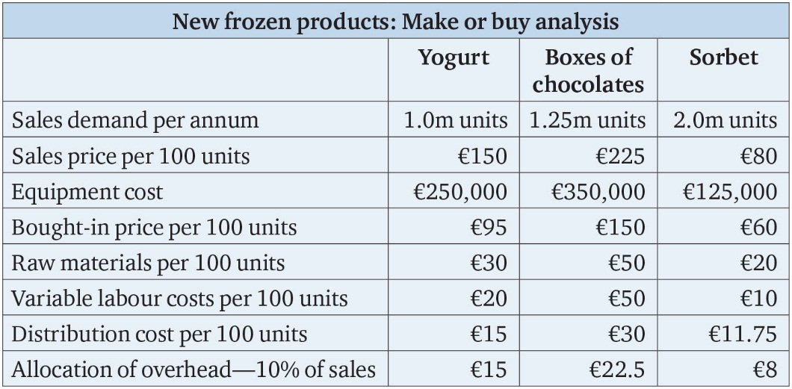
Table 14.11

Slide 15
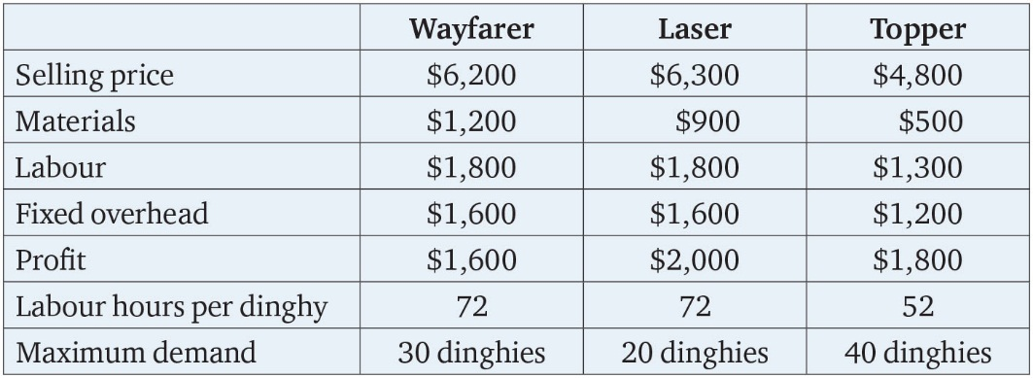
Table 14.12

