Slide 1

Accounting by Mary Carey and Cathy Knowles

Slide 2
Part II
Management Accounting
Chapter 12
Budgeting

Slide 3


Slide 4
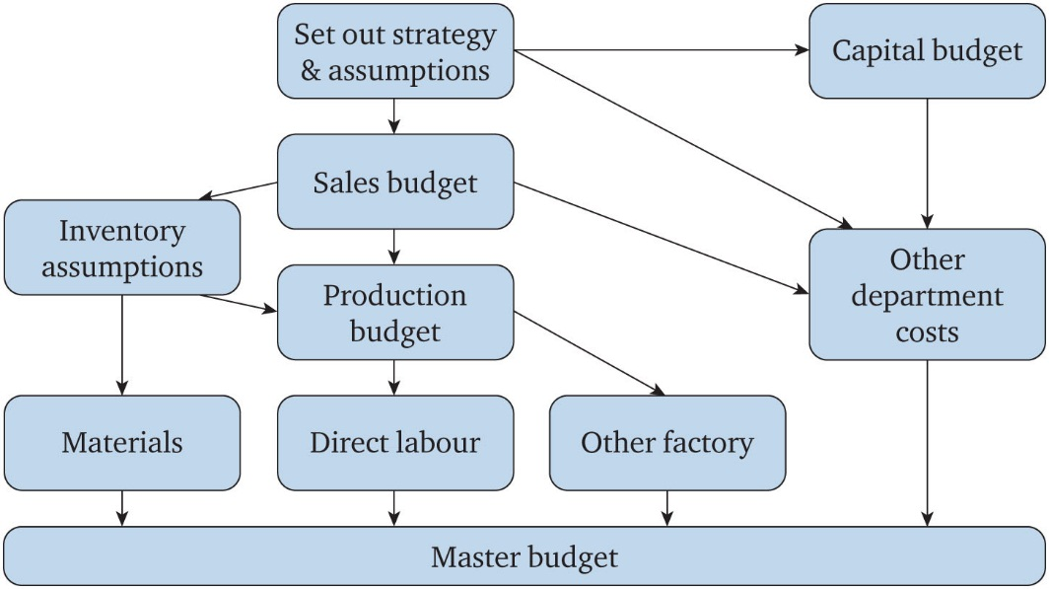
Figure 12.1 Budget process diagram

Slide 5
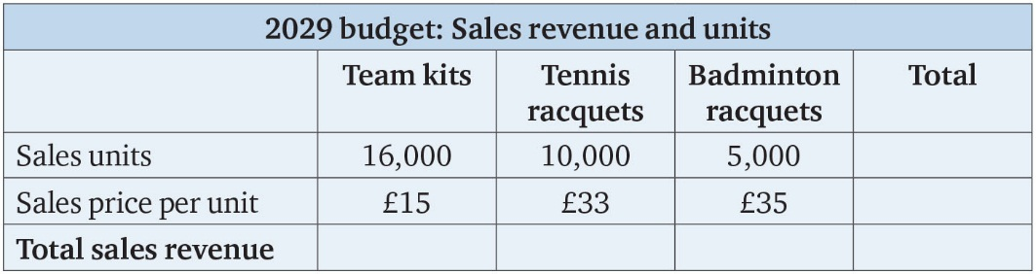
Table 12.1

Slide 6
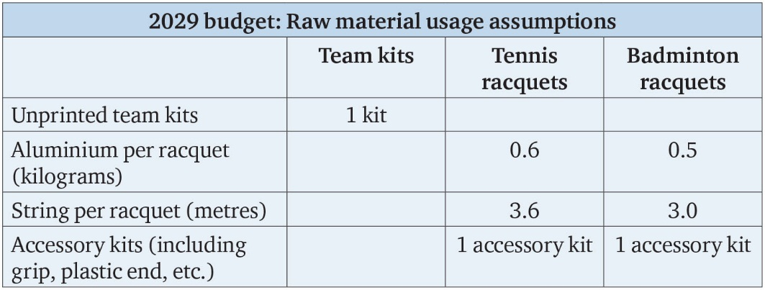
Table 12.2

Slide 7
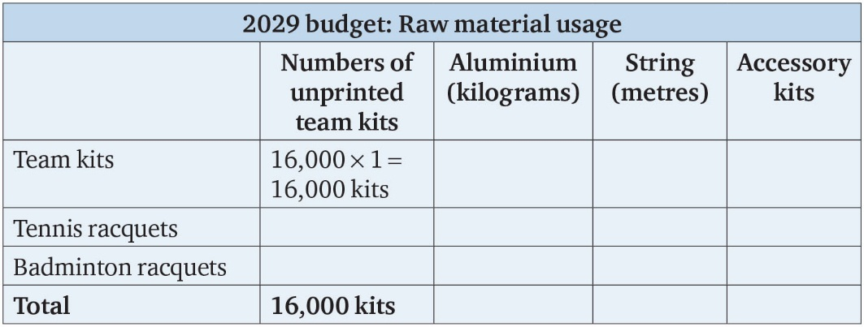
Table 12.3

Slide 8
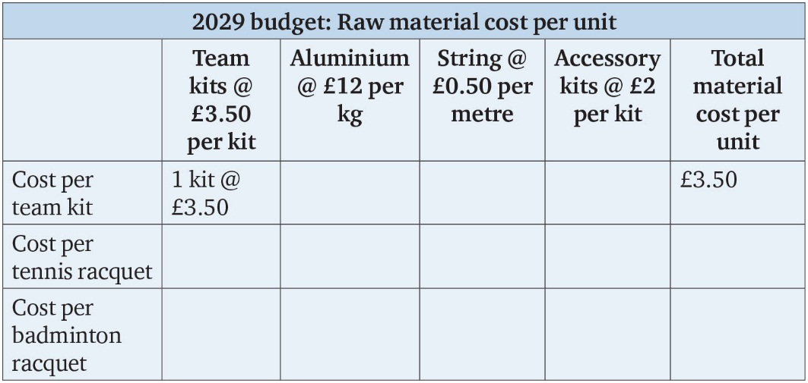
Table 12.4

Slide 9
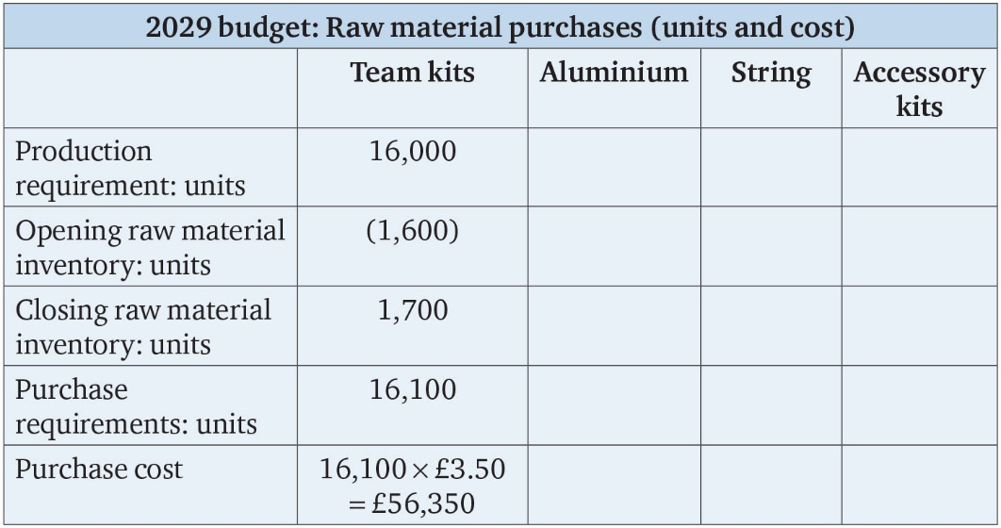
Table 12.5

Slide 10
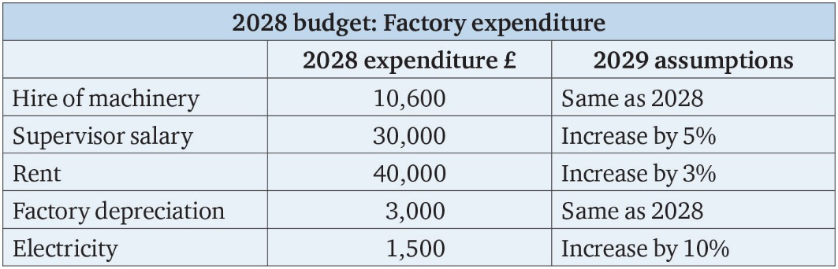
Table 12.6

Slide 11
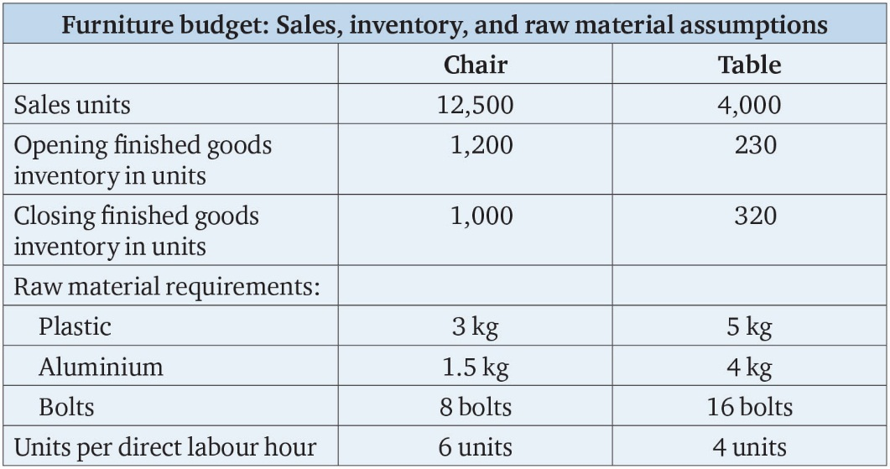
Table 12.7

Slide 12
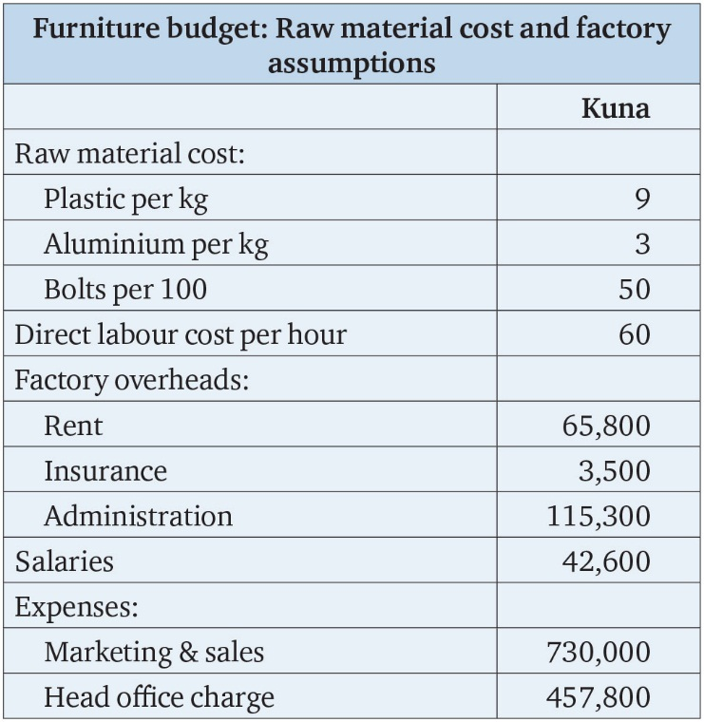
Table 12.8

Slide 13
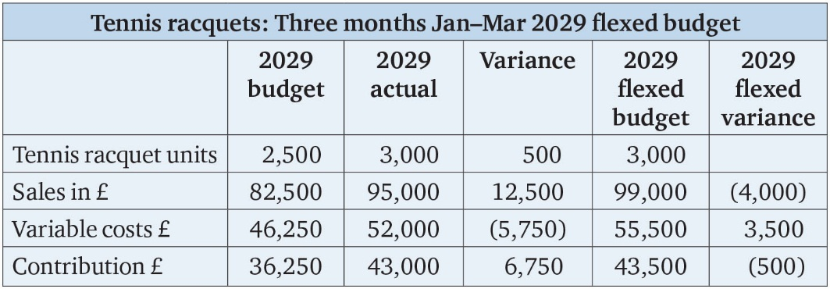
Table 12.9

Slide 14
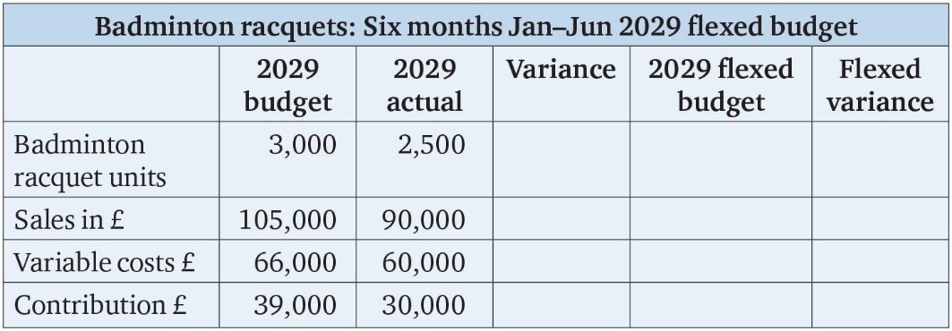
Table 12.10

Slide 15
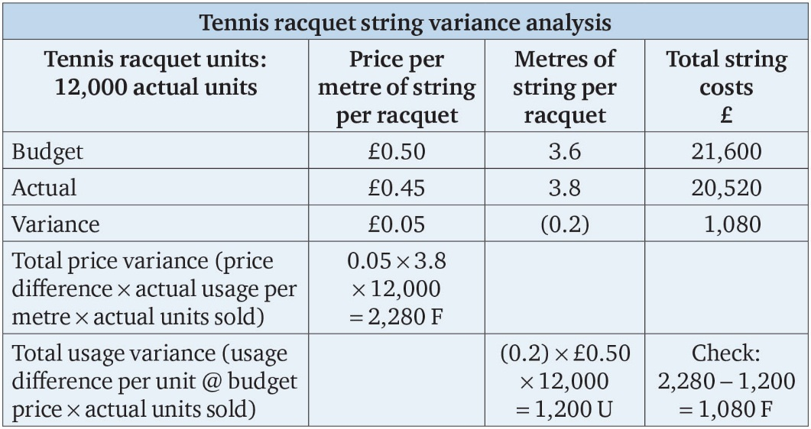
Table 12.11

Slide 16
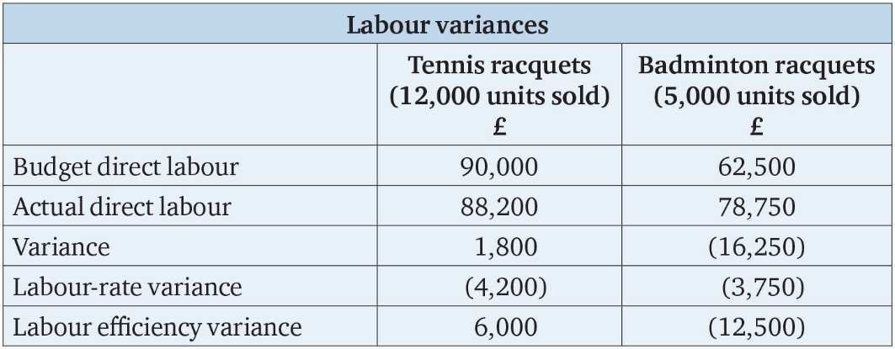
Table 12.12

Slide 17
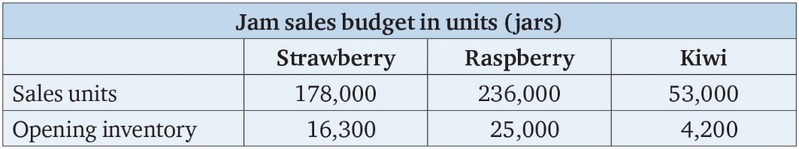
Table 12.13

Slide 18
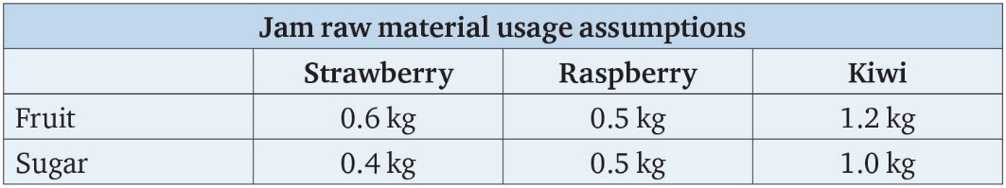
Table 12.14

