Slide 1

Accounting by Mary Carey and Cathy Knowles

Slide 2
Part II
Management Accounting
Chapter 16
Measuring and Reporting Performance

Slide 3


Slide 4
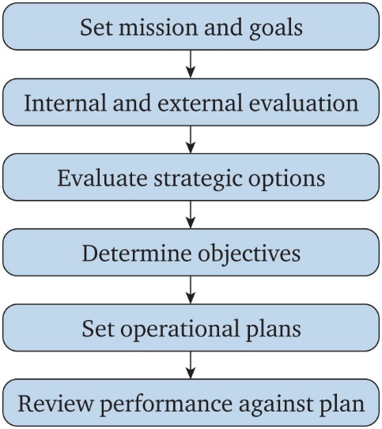
Figure 16.1 Corporate planning process

Slide 5
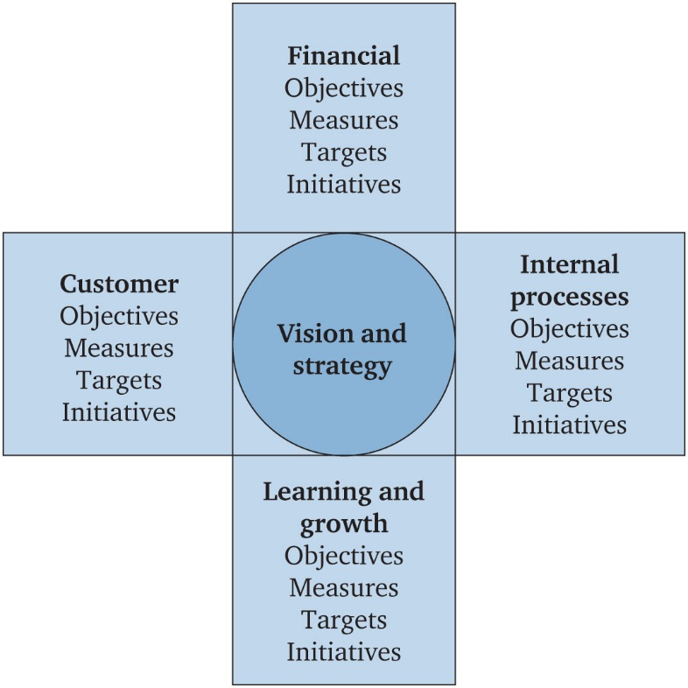
Figure 16.2 Balanced scorecard format

Slide 6
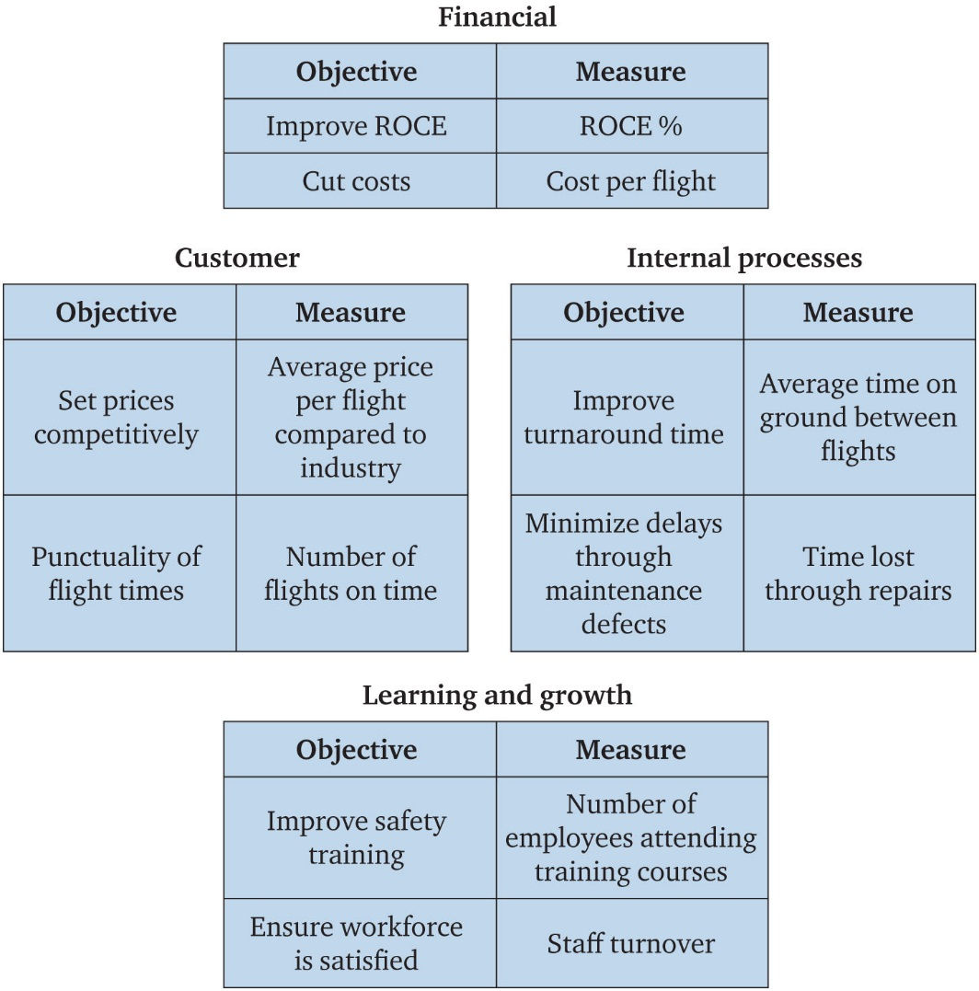
Figure 16.3 Example of a balanced scorecard for an airline

Slide 7
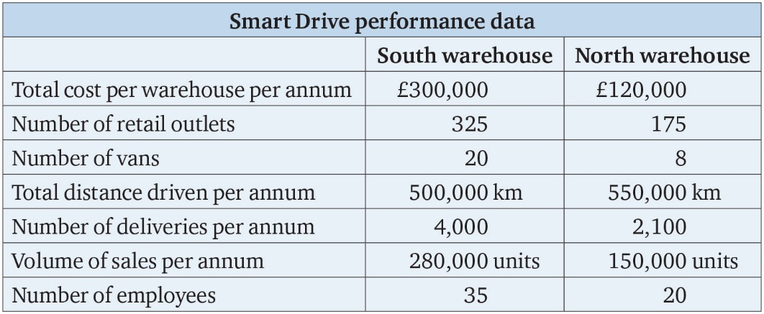
Table 16.1

Slide 8
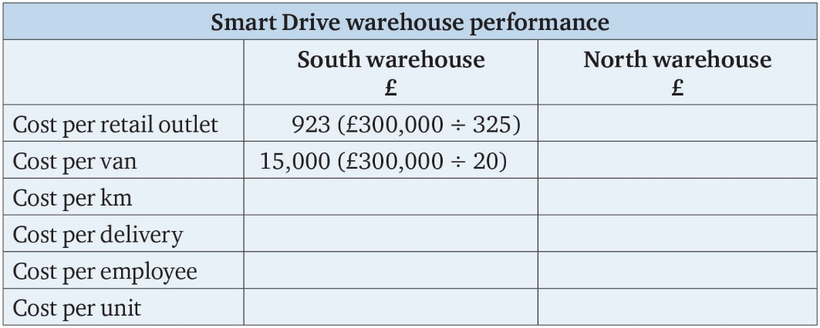
Table 16.2

Slide 9
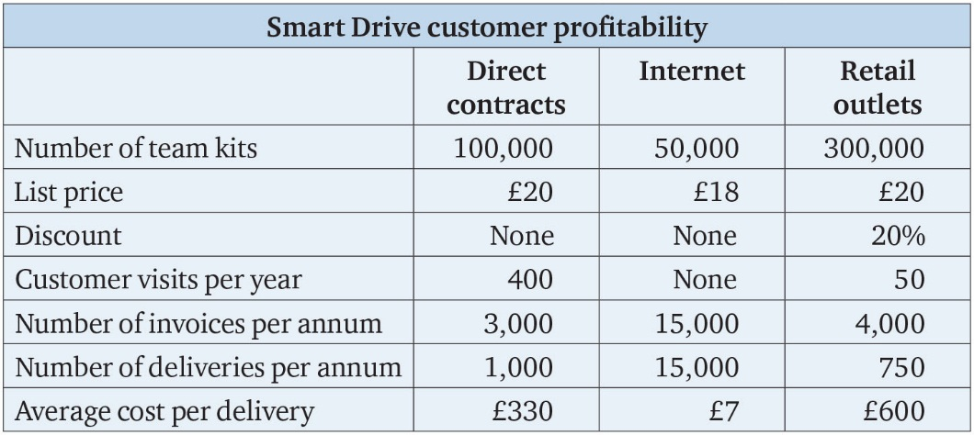
Table 16.3

Slide 10
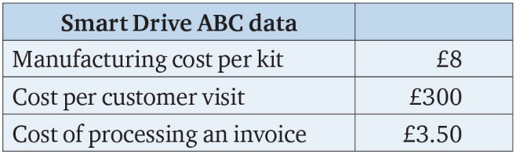
Table 16.4

Slide 11
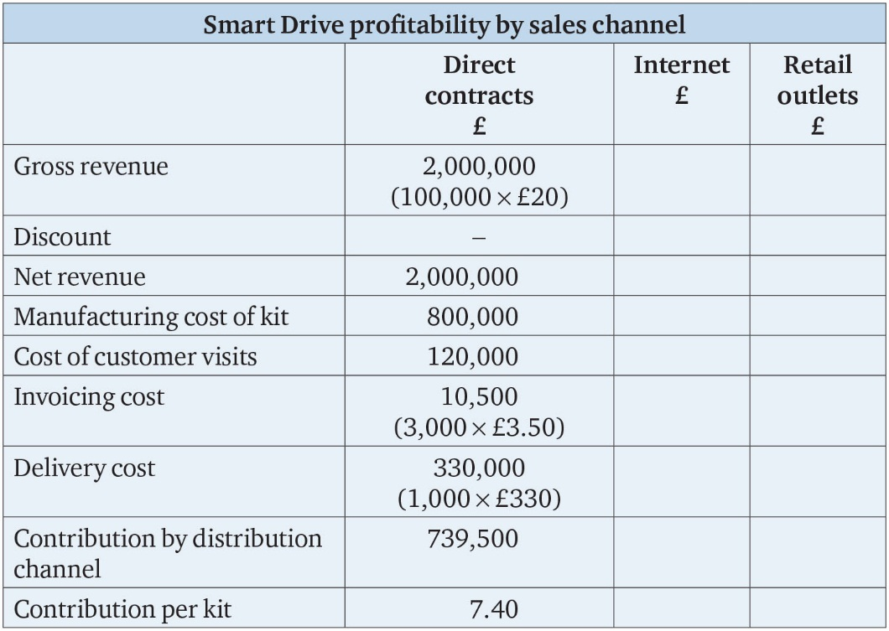
Table 16.5

Slide 12
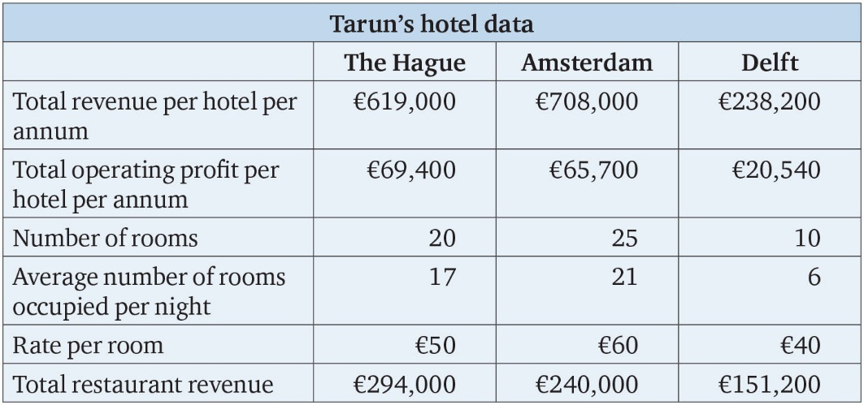
Table 16.6

Slide 13
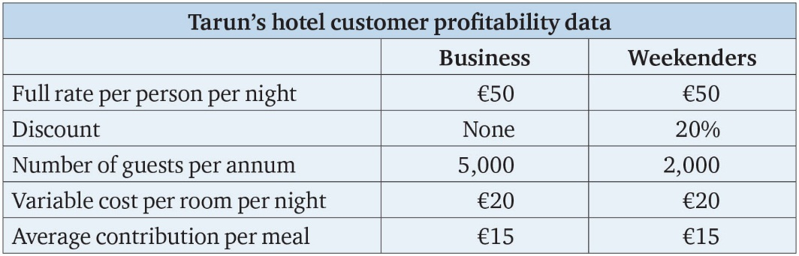
Table 16.7

Slide 14
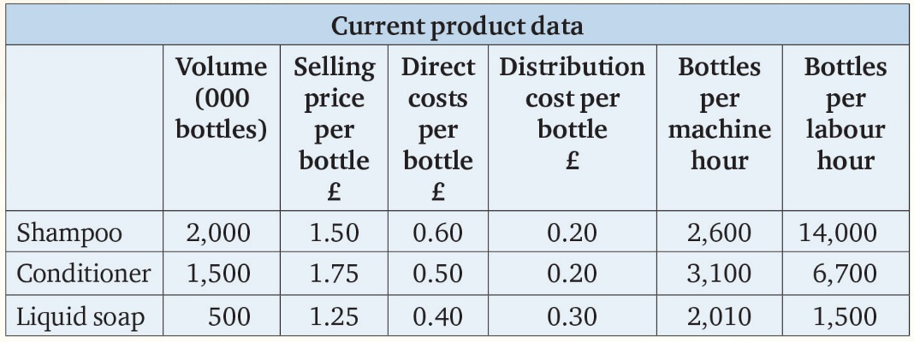
Table MA.1

Slide 15
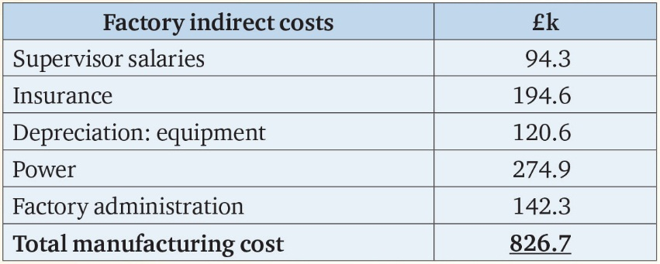
Table MA.2

Slide 16
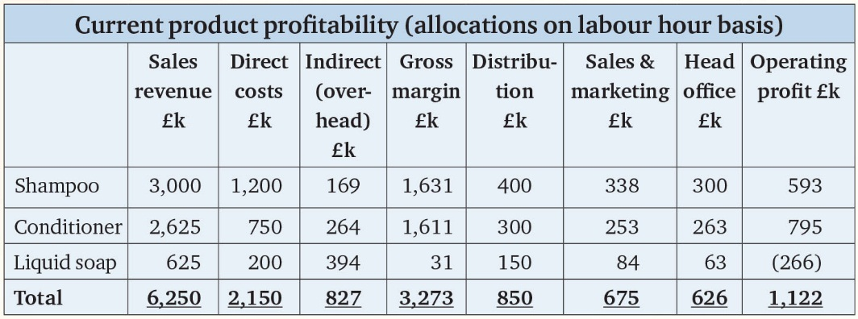
Table MA.3

Slide 17
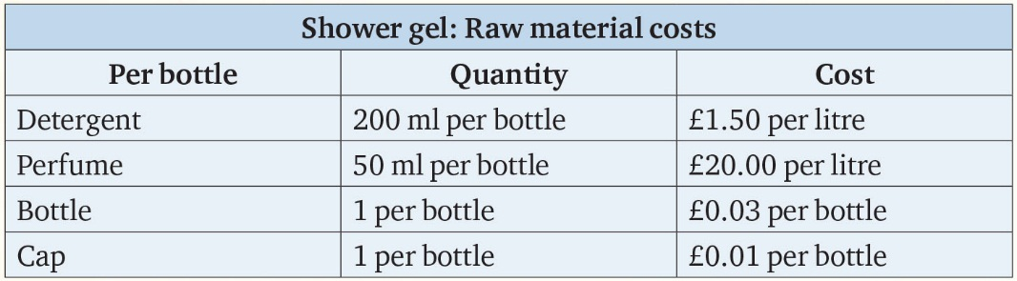
Table MA.4

Slide 18
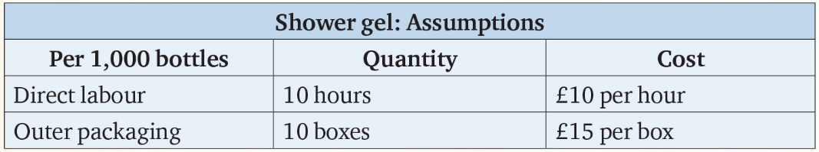
Table MA.5

