Slide 1

Accounting by Mary Carey and Cathy Knowles

Slide 2
Part II
Management Accounting
Chapter 15
Investment Appraisal Techniques

Slide 3


Slide 4
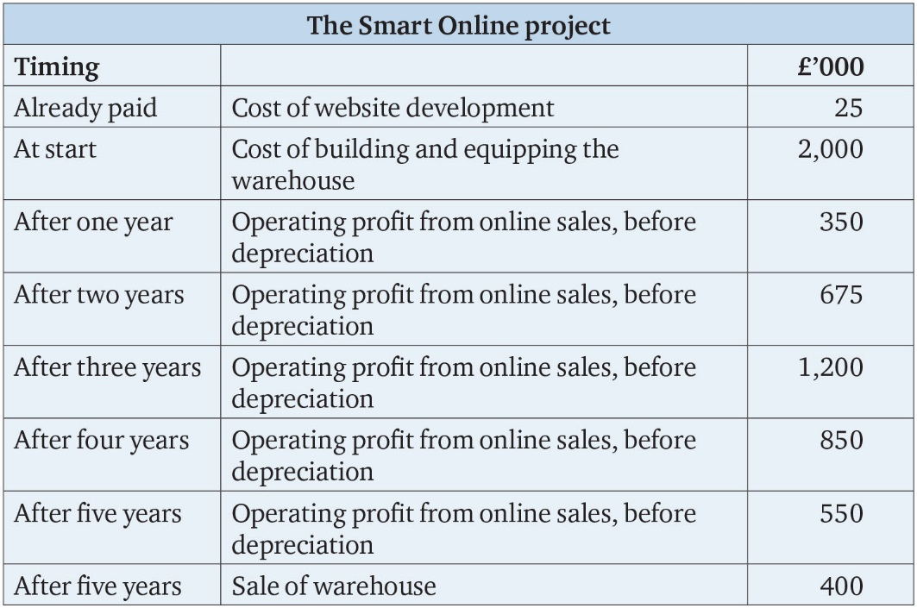
Table 15.1

Slide 5
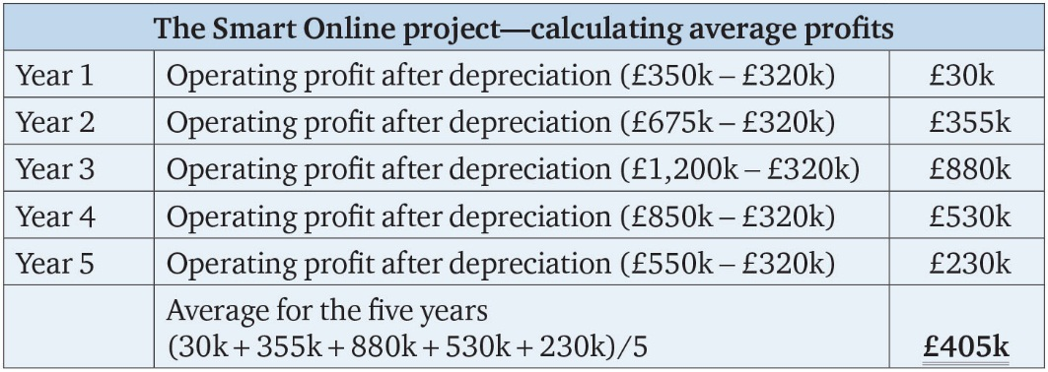
Table 15.2

Slide 6
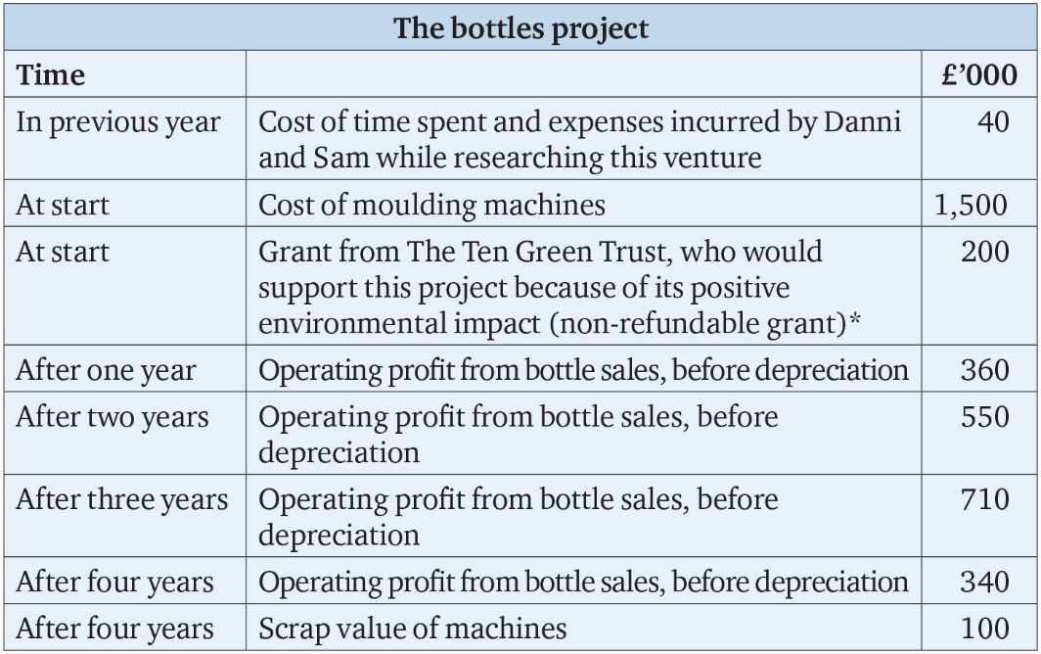
Table 15.3

Slide 7
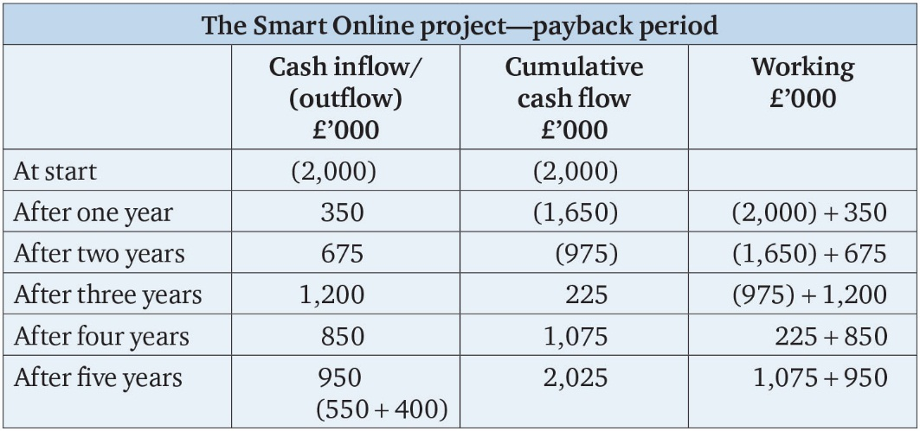
Table 15.4

Slide 8
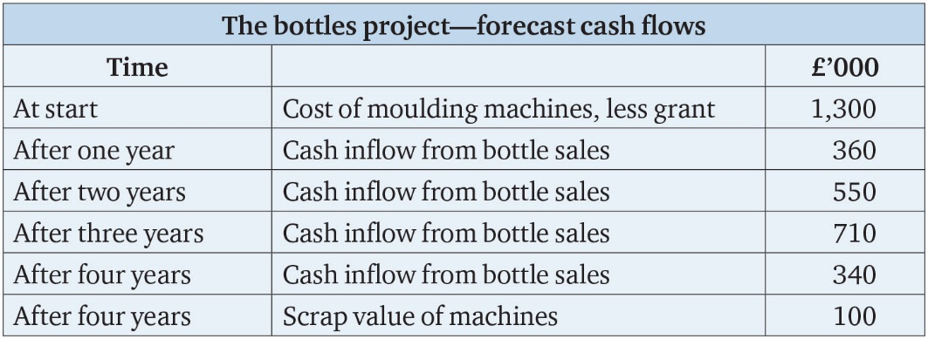
Table 15.5

Slide 9
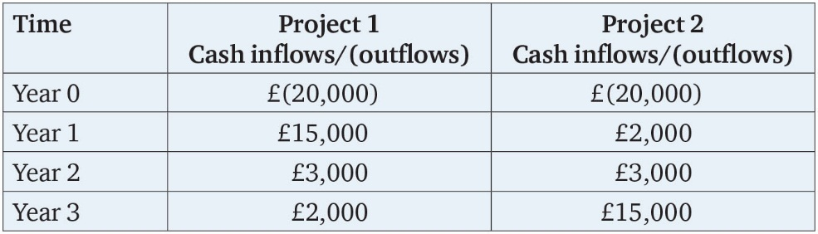
Table 15.6

Slide 10
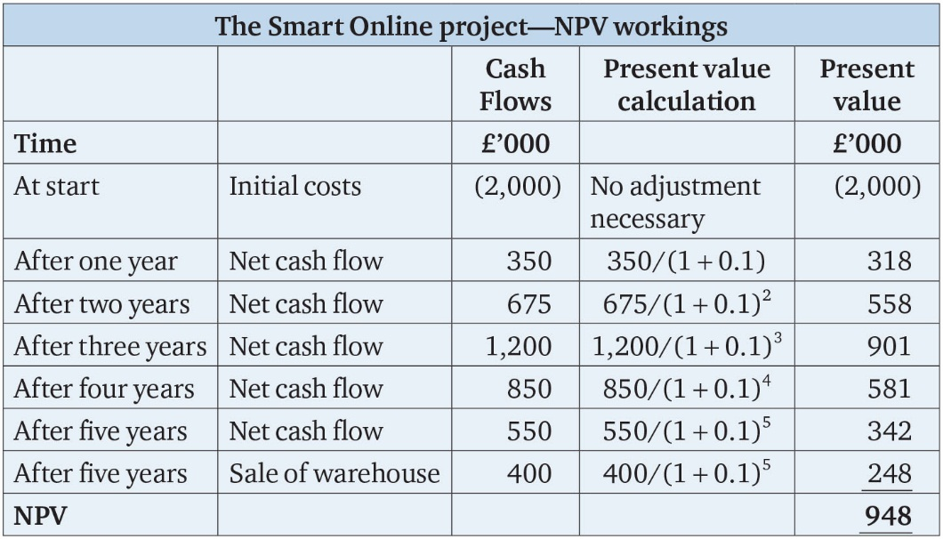
Table 15.7

Slide 11
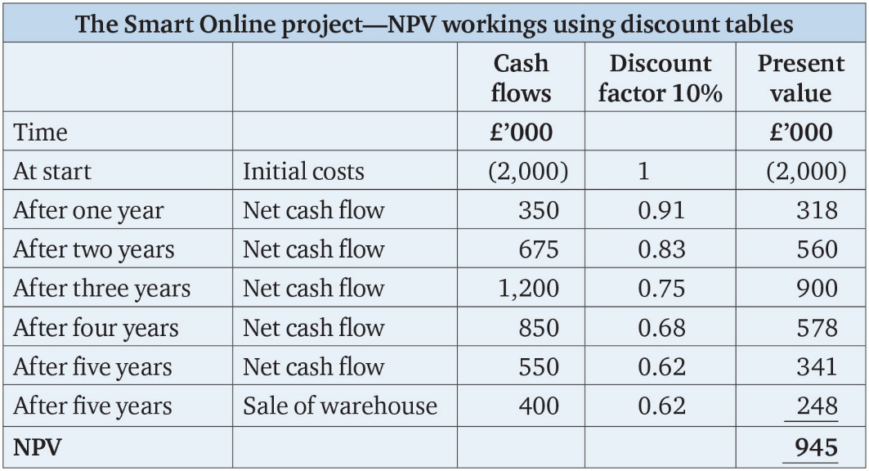
Table 15.8

Slide 12
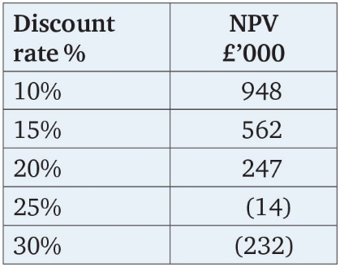
Table 15.9

Slide 13
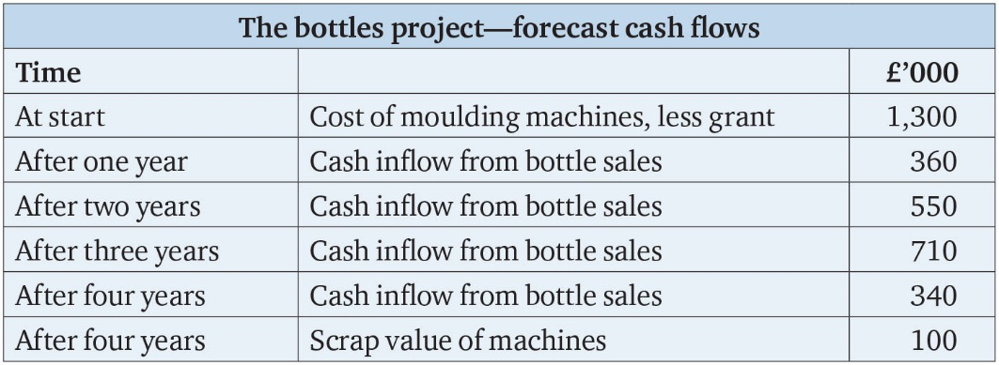
Table 15.10

Slide 14
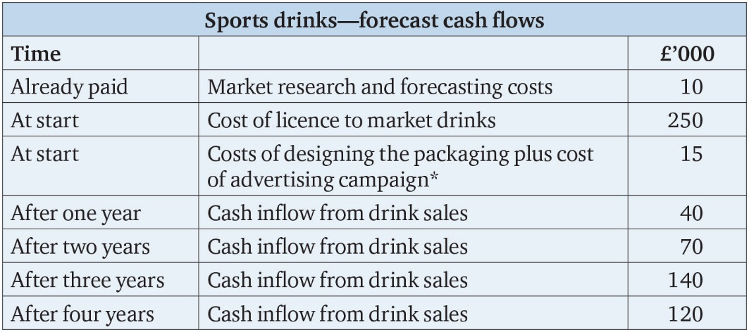
Table 15.11

Slide 15
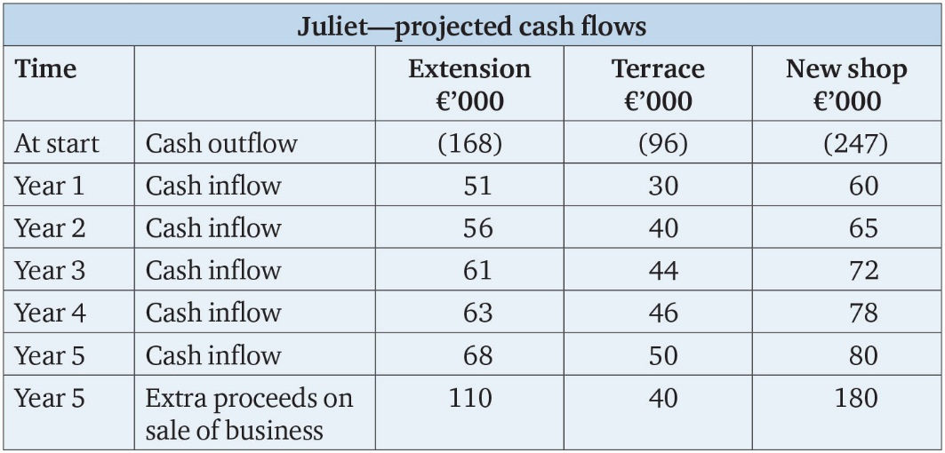
Table 15.12

Slide 16
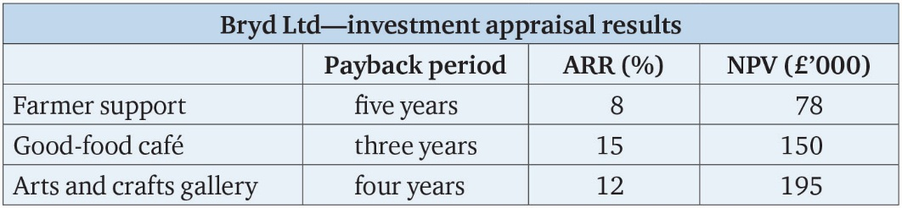
Table 15.13

Slide 17
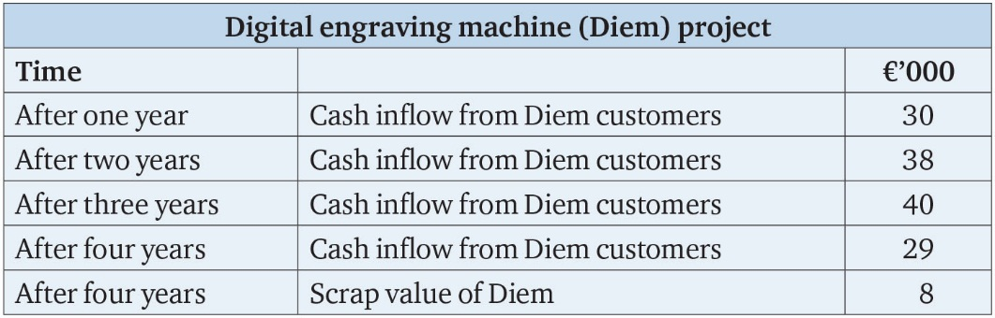
Table 15.14

Slide 18
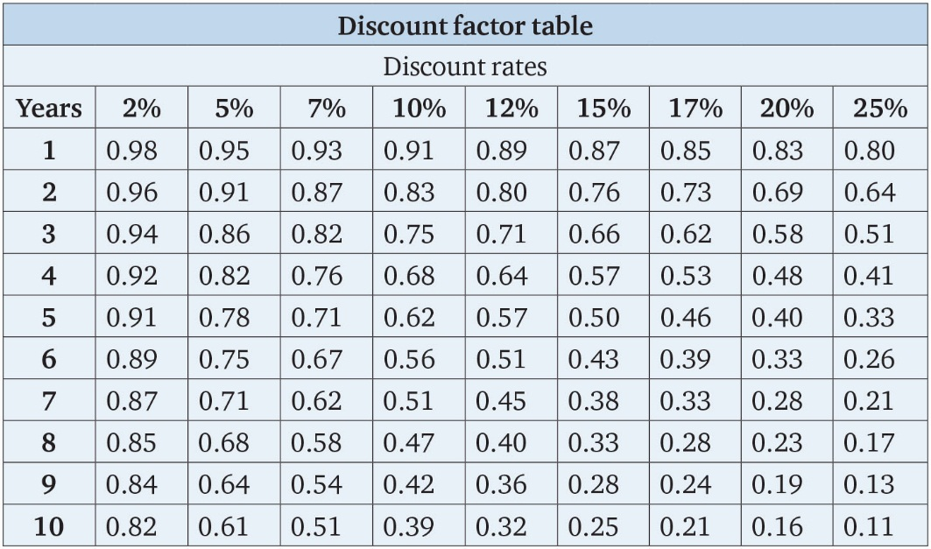
Table 15.15

