Slide 1
Business Research Methods
6th edition
Chapter 2
Business research strategies

Slide 2
Chapter overview
This chapter explores:
  the nature of the relationship between theory and research);
  epistemological issues;
  ontological issues;
  how these issues relate to the widely used types of research strategy, quantitative and qualitative research;
  the ways in which values and practical issues are also central to business research

Slide 3
Research strategy
‘Research strategy’ refers to the overall approach taken in your research project
‘Theory’ is the most common meaning as a way of explaining observed patterns of association between phenomena

Slide 4
Theory and Research
Business research does not exist in isolation
  Link between social reality and research
  Link between business research methods and practice connect with wider social relations
Understanding the link between theory and research
  There are two key issues here:
    What form of theory is being referred to?
    Is data collected to test theories or build them?

Slide 5
Theories come at two levels
Grand theories, e.g.:
Structural functionalism
Symbolic Interactionism
Critical theory
Poststructuralism
Structuration theory
Middle-range theories, e.g.:
Strategic choice
Trait theory
Contingency theory
Labour Process theory
Middle-range theories typically guide business research.
e.g. Merton (1967) suggests these consist of explanation of social phenomena which can be explored using empirical data of various kinds

Slide 6
Deductive and Inductive Theory
Deductivism:
  Theory → data
  Explicit hypothesis to be confirmed or rejected
  Quantitative research
Inductivism:
  Data → theory
  Generalizable inferences from observations
  Qualitative research /grounded theory

Slide 7
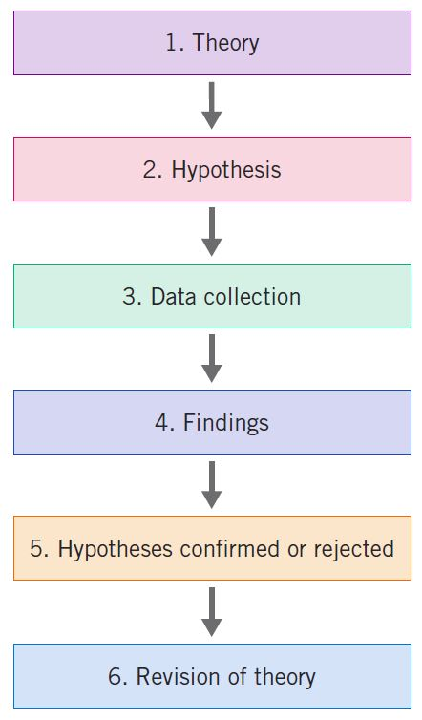
The process of deduction

Slide 8
Types of reasoning
There are three types of reasoning in organizational research:
  Theory-testing research: this involves developing hypotheses from a priori theoretical considerations, enabling them to be confirmed or disconfirmed through statistical inference
  Inductive case research: this involves theory being developed in a ‘data-driven manner’ using qualitative data, often taking a grounded theory approach
  Interpretive research: while this also involves qualitative data, theory is developed in quite a different way involving a dialogical process between theory and the empirical phenomenon; this results in the production of ‘reflexive narratives, not explanatory models or theoretical propositions’ (Mantere and Ketokivi, 2013: 75)

Slide 9
Abduction
An increasingly popular approach
Neither inductive nor deductive: abductive as a third way
Based on pragmatist approach
Starts with a puzzle or surprise and then seeks to explain it
Involves the researcher selecting the ‘best’ explanation from competing explanations or interpretations of the data (Mantere and Ketokivi, 2013)

Slide 10
Philosophical assumptions in business research
Despite sometimes being an applied subject solving practical problems in organizations, a basic understanding of philosophy remains essential
Important for generating valuable knowledge about reality

Slide 11
Epistemological considerations
What is (or should be) considered acceptable knowledge?
Can the social world be studied ‘scientifically’?
Is it appropriate to apply the methods of the natural sciences to social science research?
Positivism and interpretivism are contrasting approaches

Slide 12
Positivism
Only phenomena and hence knowledge confirmed by the senses can genuinely be warranted as knowledge (phenomenalism)
The purpose of theory is to generate hypotheses that can be tested and that will allow explanations of laws to be assessed (deductivism)
Knowledge is arrived at by gathering facts that provide the basis for laws (inductivism)
Science must (and can) be conducted in a way that is value-free (i.e. objective)
There is a clear distinction between scientific statements and normative statements and the former are the true domain of the scientist

Slide 13
Interpretivism
Interpretivism is taken to denote an alternative to positivism
It is predicated upon the view that a strategy is required that respects the differences between people and the objects of the natural sciences and therefore requires the social scientist to grasp the subjective meaning of social action
Derives from:
  Weber's notion of Verstehen;
  the hermeneutic-phenomenological tradition;
  symbolic interactionism

Slide 14
Realism
Realism shares two features with positivism:
  a belief that the natural and the social sciences can and should apply the same approach to data collection and explanation;
  a commitment to the view that there is an external reality to which scientists direct their attention (in other words, there is a reality that is separate from our descriptions of it)
There are two forms of realism:
  Empirical realism simply asserts that, through use of appropriate methods, reality can be understood
  Critical realism is a specific form of realism which recognizes the reality of the natural order and the events and discourses of the social world

Slide 15
Ontological considerations
Social ontology: the nature of social entities
What kind of objects exist in the social world?
Do social entities exist independently of our perceptions of them?
Is social reality external to social actors or constructed by them?

Slide 16
What is objectivism?
Objectivism is an ontological position that asserts that social phenomena and their meanings have an existence that is independent of social actors
It implies that social phenomena and the categories that we use in everyday discourse have an existence that is independent or separate from actors

Slide 17
What is constructionism?
Constructionism is an ontological position which asserts that social phenomena and their meanings are continually being accomplished by social actors
It implies that:
  social phenomena and categories are produced through social interaction
  social phenomena and categories are in a constant state of revision
  researchers' own accounts of the social world are constructions
  knowledge is indeterminate
Also referred to as constructivism

Slide 18
What is the role of a paradigm?
A paradigm is a cluster of beliefs and dictates that influences:
  what should be studied;
  how research should be conducted;
  how results should be interpreted.
Social science consists of competing paradigms

Slide 19
Social paradigms
Radical
Radical humanist Individuals need emancipation from the social arrangement of organizations | Radical structuralist Structural power relationships result in conflict
Interpretative Organizations do not exist apart from the perceptions of people working in them – study their experiences | Functionalist Problem-solving orientation leading to rational explanation
Subjectivist
Objectivist
Regulatory

Slide 20
Research strategy: quantitative research
Quantitative research is a research strategy that emphasizes quantification in the collection and analysis of data and that:
  entails a deductive approach to the relationship between theory and research, in which the emphasis is on the testing of theories;
  has incorporated the practices and norms of the natural scientific model and of positivism in particular; and
  takes a view of social reality as an external, objective reality.

Slide 21
Features of quantitative research
A measurement of social variables
Common research designs: surveys and experiments
Numerical and statistical data
Deductive theory testing
Positivist epistemology
Objectivist view of reality as external to social actors

Slide 22
Research strategy: qualitative research
Qualitative research is a research strategy that emphasizes words rather than quantification in the collection and analysis of data and that:
predominantly emphasizes an inductive approach to the relationship between theory and research, in which the emphasis is placed on the generation of theories;
has rejected the practices and norms of the natural scientific model and of positivism in particular preference for an emphasis on the ways in which individuals interpret their social world; and
takes a view of social reality as a constantly shifting emergent property of individuals’ creation.

Slide 23
Features of qualitative research
Understanding the subjective meanings held by actors (interpretivist epistemology)
Common methods: interviews, ethnography
Data are words, texts, and stories
Inductive approach: theory emerges from data
Social constructionist ontology

Slide 24
Mixed methods research
It is possible to combine quantitative and qualitative strategies within a research project
Abildgaard et al. (2020): work is an exemplar mixed methods study investigating participatory organisational interventions. Argued for the benefit and addition of qualitative research to explore the 3 company's contexts.

Slide 25
Factors influencing researchers’ choice of methods
Organizational
Historical
Political
Ethical
Evidential
Personal

Slide 26
Practical considerations
May influence or determine choices on:
  research strategy
  design
  method
  resources and costs
May be influenced or determined by:
  nature of the topic
  people being investigated
  political acceptability

Slide 27
Key points
Relevance to practitioners and the fundamental purpose of business research
Quantitative and qualitative research constitute different approaches to social investigation
Theory can be depicted as something that precedes research or as something that emerges out of it
Epistemological considerations influence research strategy

Slide 28
Reminder: online resources
Check out more on business research strategies at:
www.oup.com/uk/brm6e

