Slide 1
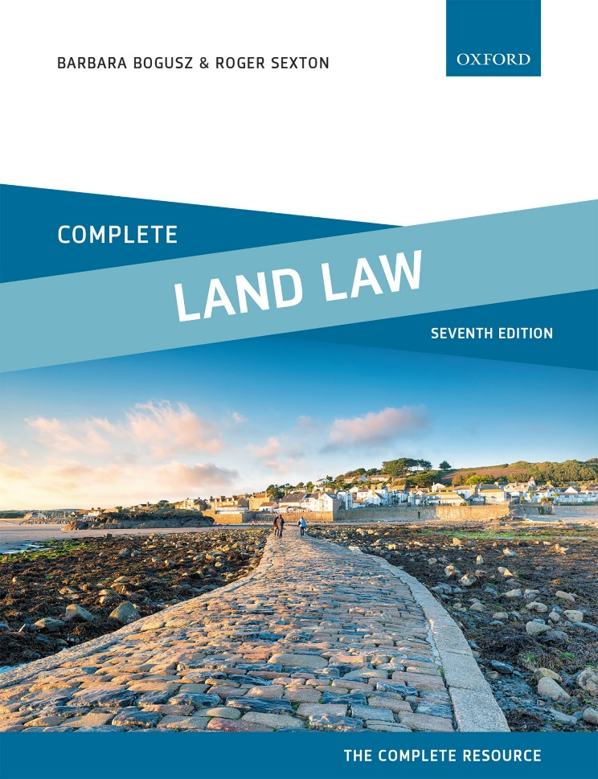
COMPLETE LAND LAW
Text, Cases, and Materials by Barbara Bogusz and Roger Sexton

Slide 2
Part 1
Introduction: Estates and Interests In Land
Chapter 01
Introduction to the Types of Property Rights in Land

Slide 3
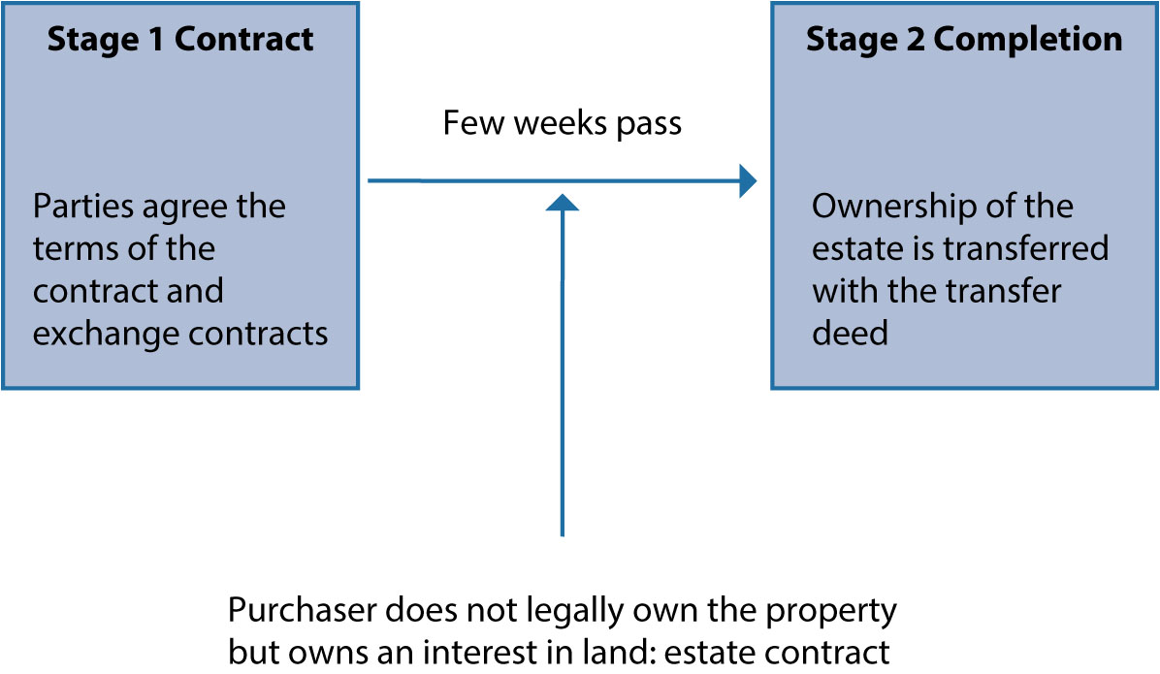
Diagram 1.1 Buying property

Slide 4
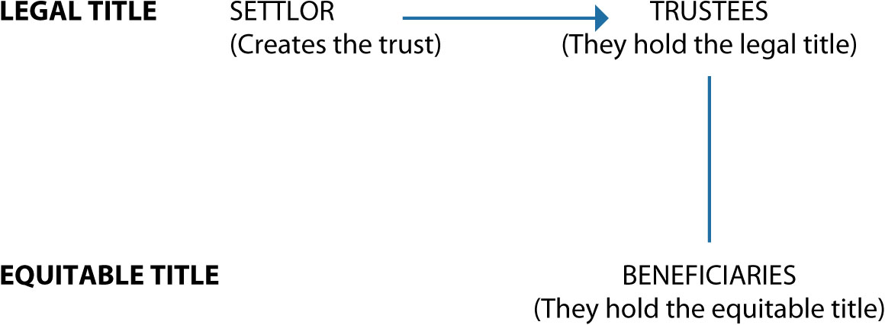
Diagram 1.2 Structure of a trust

Slide 5
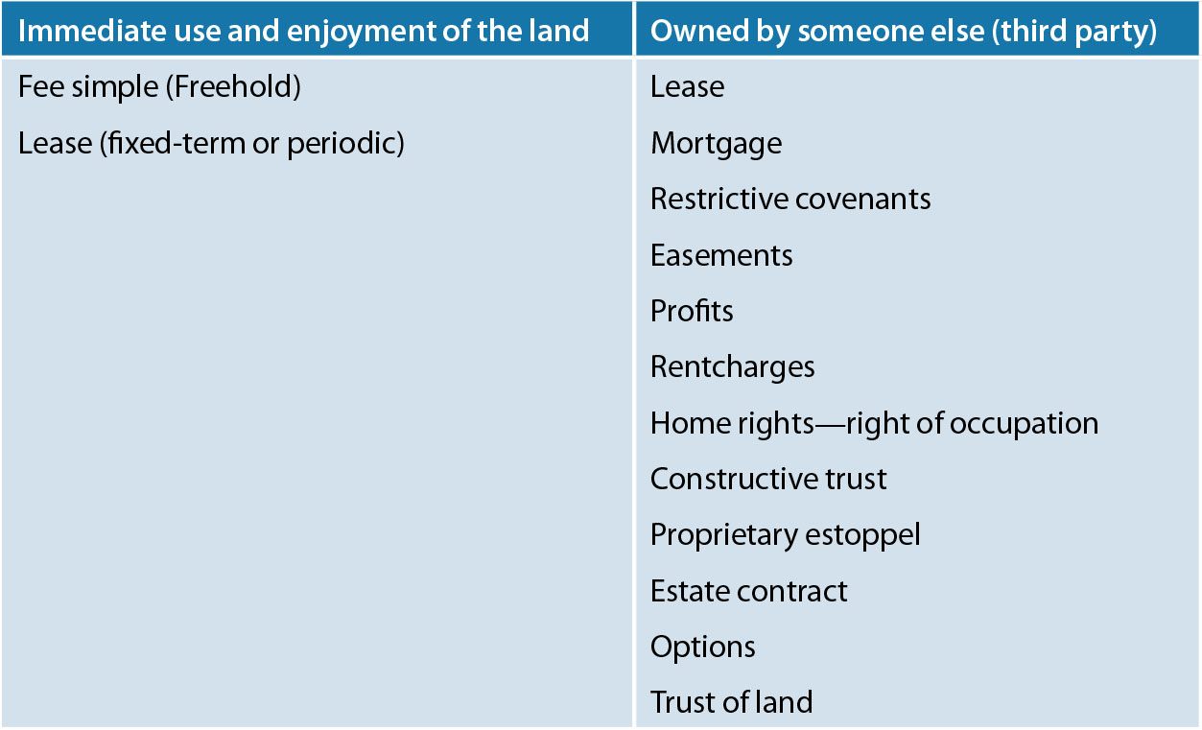
Table 1.1 Taxonomy of property rights

Slide 6
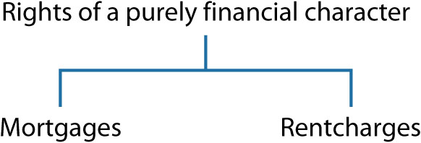
Diagram 1.3 Rights of a purely financial character

Slide 7
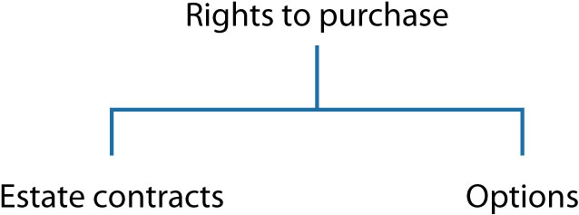
Diagram 1.4 Rights to purchase

Slide 8

Diagram 1.5 Rights to use or restrict servient land

Slide 9
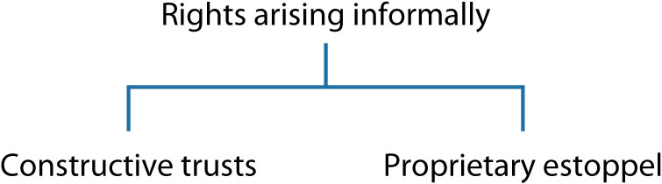
Diagram 1.6 Rights arising informally

