Slide 1
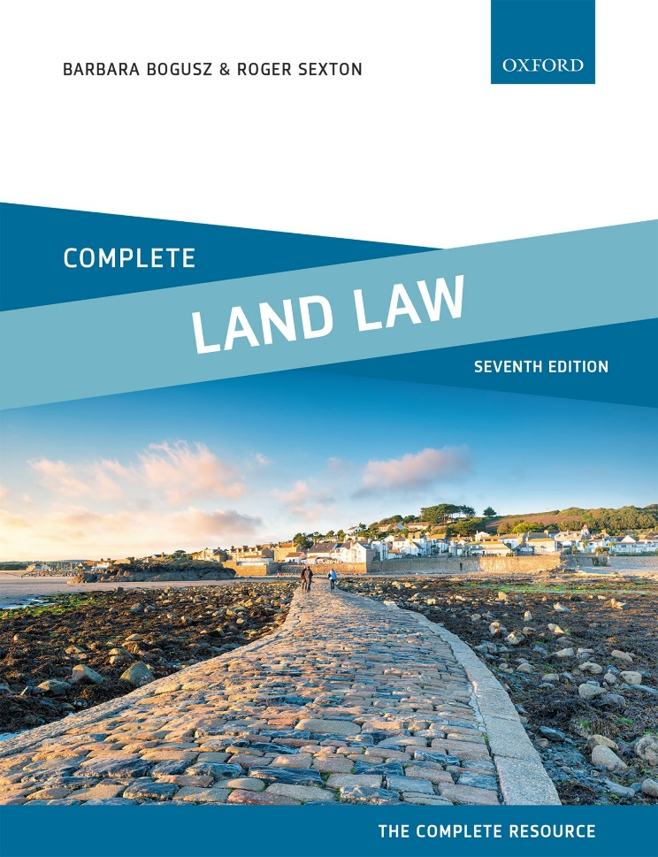
COMPLETE LAND LAW
Text, Cases, and Materials by Barbara Bogusz and Roger Sexton

Slide 2
Part 2
Unregistered Land
Chapter 04
Protection of Legal and Equitable Property Rights in Unregistered Land

Slide 3
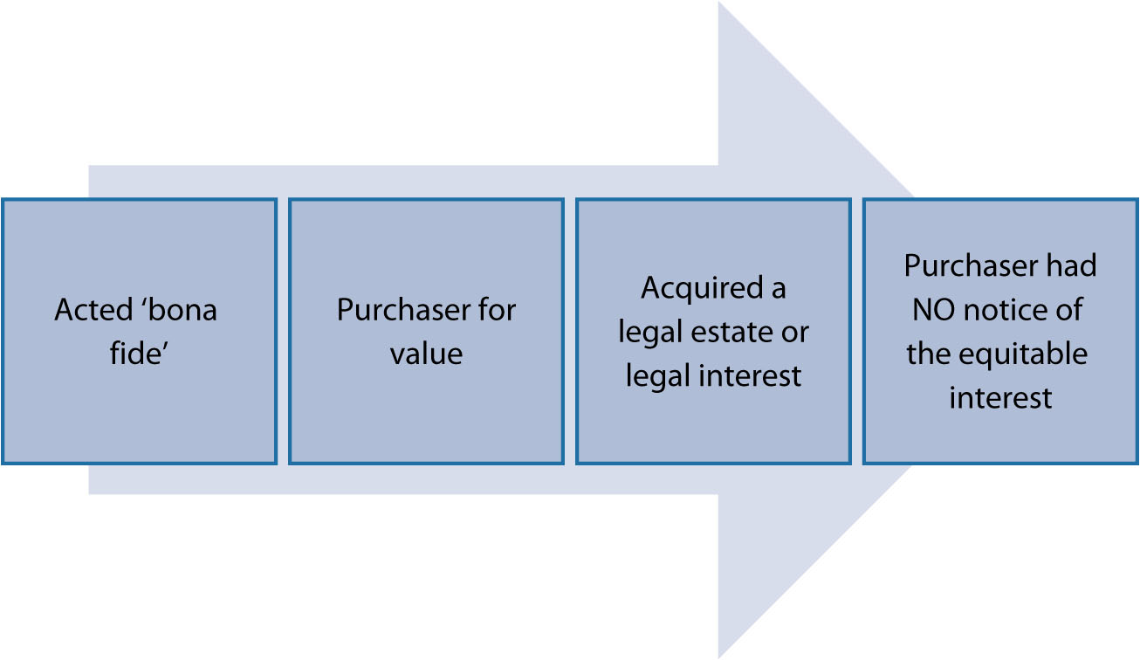
Diagram 4.1 Elements of the doctrine of notice

Slide 4


Slide 5


Slide 6
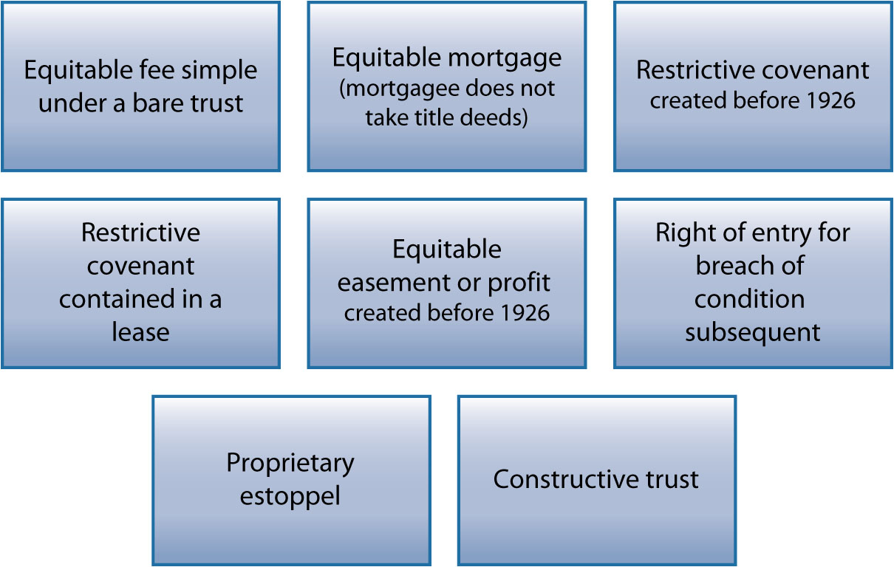
Diagram 4.2 List of equitable interests subject to the doctrine of notice

Slide 7
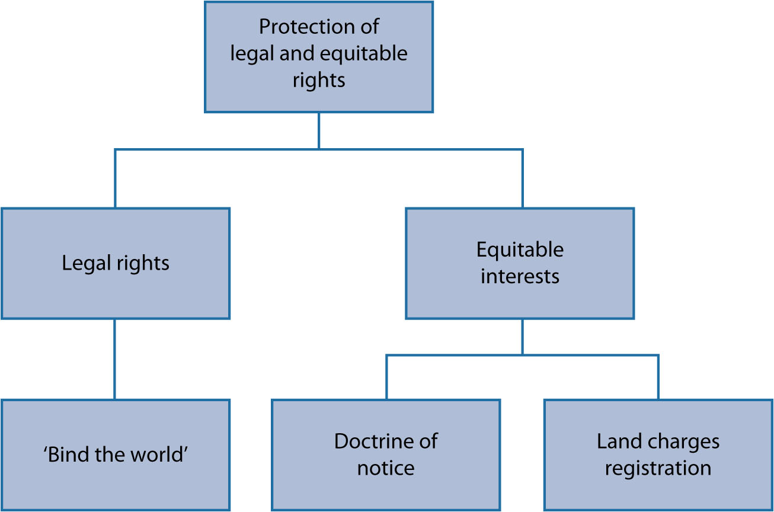
Diagram 4.3 Overview of legal and equitable rights in unregistered land

Slide 8
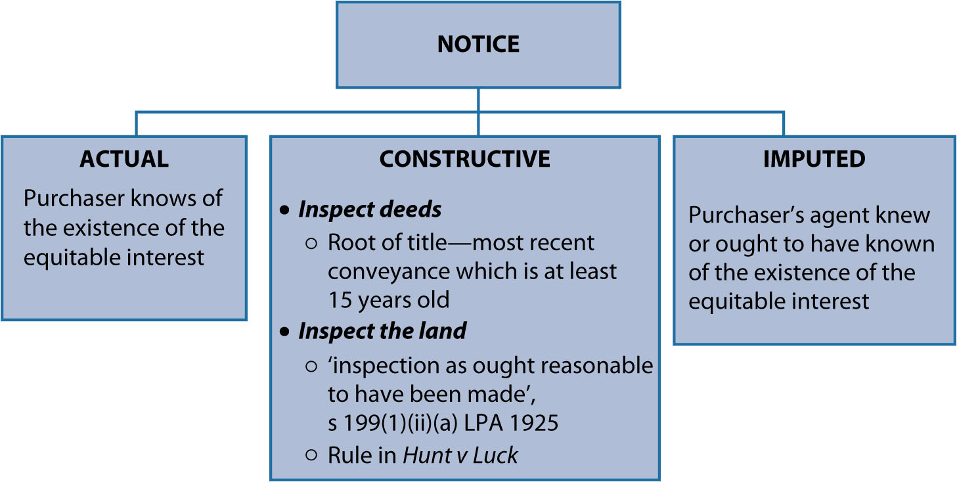
Diagram 4.4 Three forms of notice under the doctrine of notice

