Slide 1
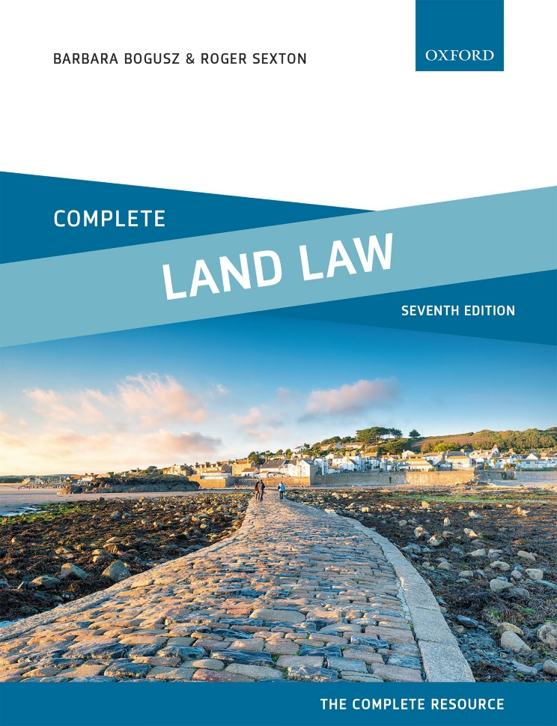
COMPLETE LAND LAW
Text, Cases, and Materials by Barbara Bogusz and Roger Sexton

Slide 2
Part 3
Registered Land
Chapter 05
Registration of Title—the Basic Principles

Slide 3
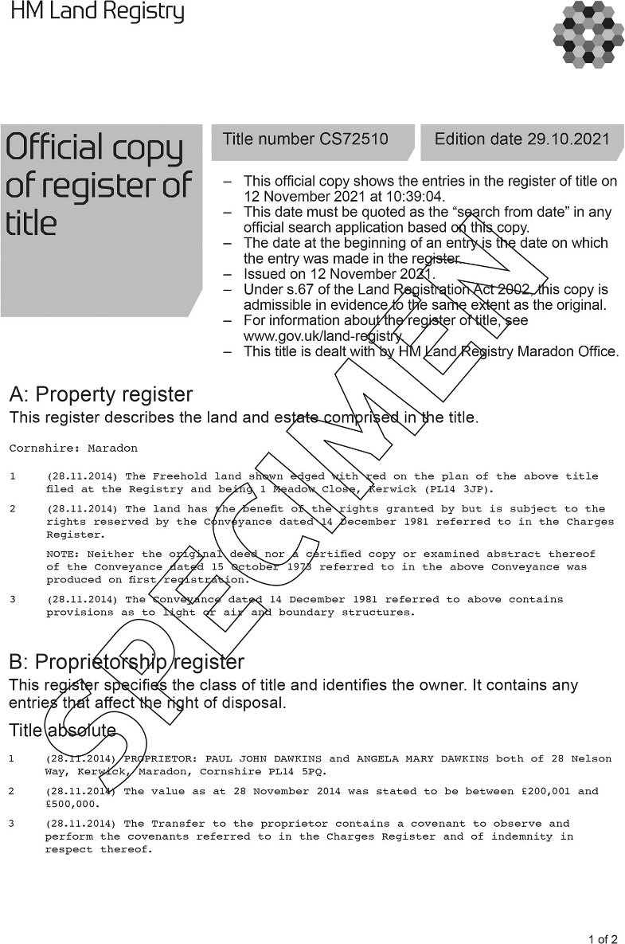
Form 5.1 Official copy of register of title and title plan

Slide 4
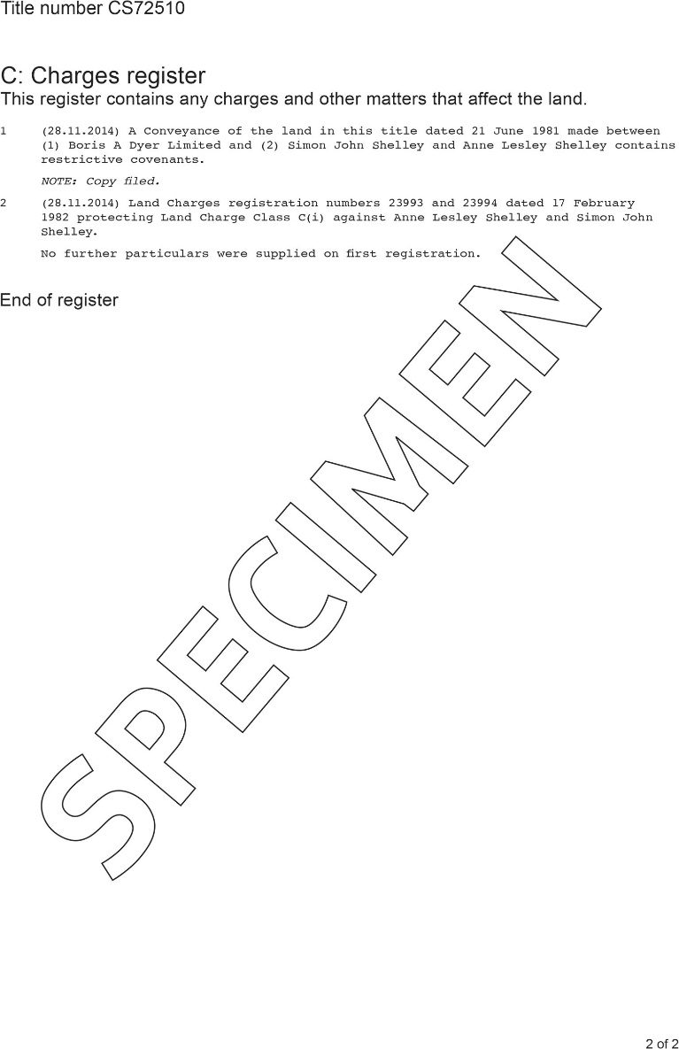
Form 5.1 (Continued)

Slide 5
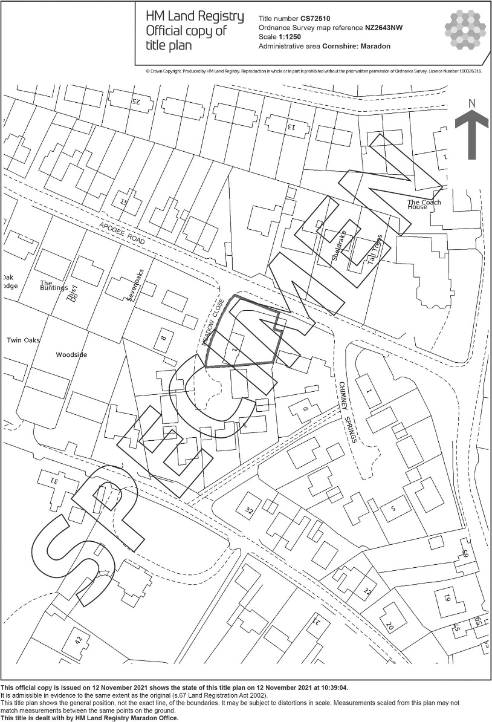
Form 5.1 (Continued)

Slide 6
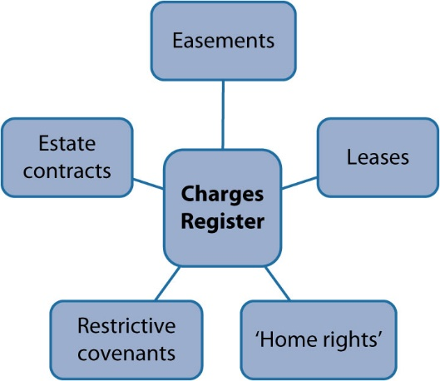
Diagram 5.1 Burdens entered on to the Charges Register of the Register of Title

Slide 7
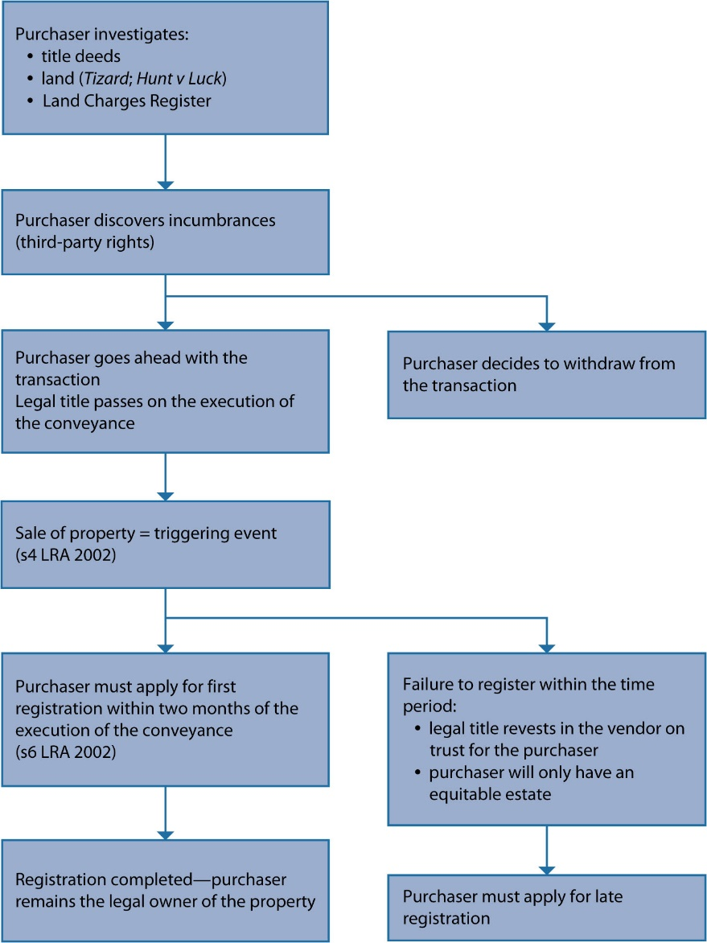
Diagram 5.2 Procedure for first registration of title

Slide 8
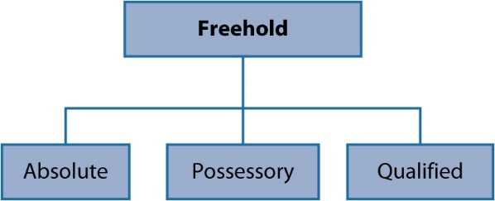
Diagram 5.3 Grade of title—freeholds

Slide 9
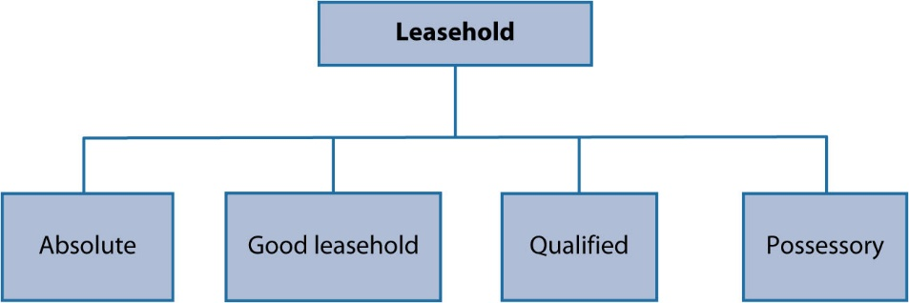
Diagram 5.4 Grade of title—leaseholds

Slide 10
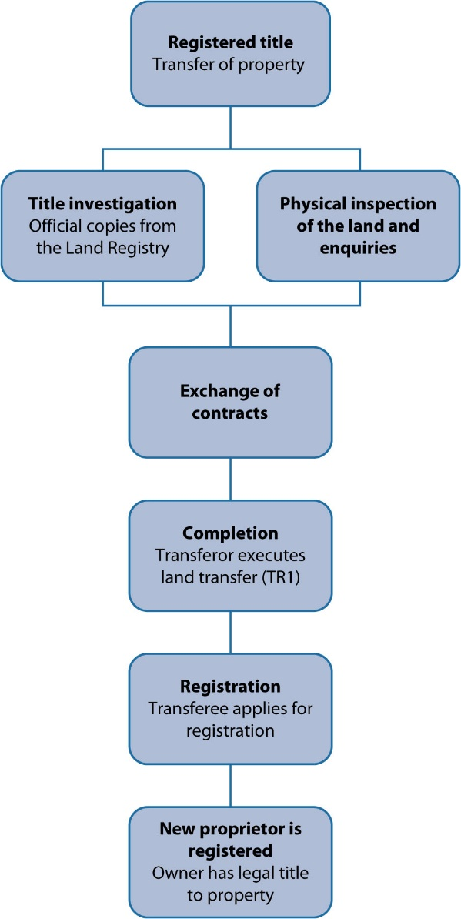
Diagram 5.5 transfer of a property in registered land

Slide 11
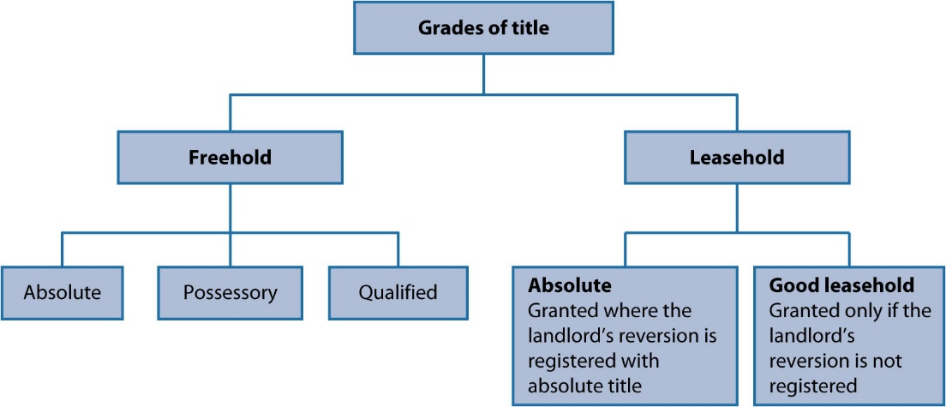
Diagram 5.6 Grades of title

