Slide 1
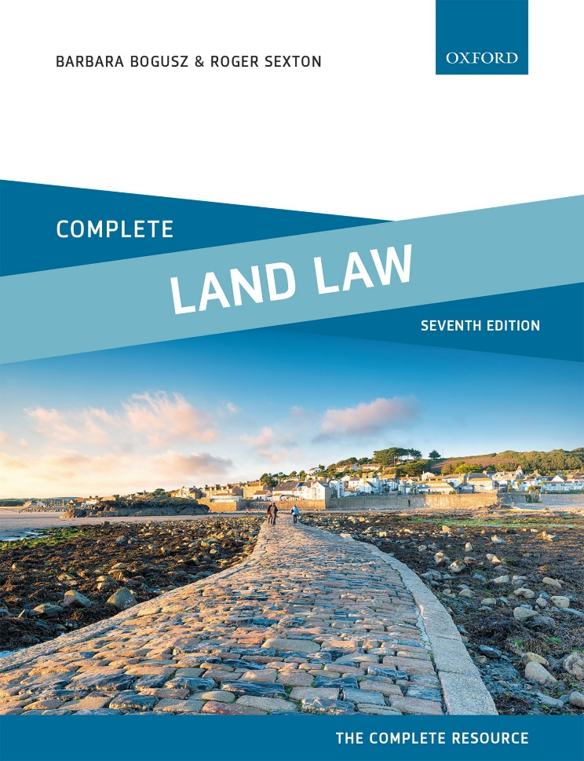
COMPLETE LAND LAW
Text, Cases, and Materials by Barbara Bogusz and Roger Sexton

Slide 2
Part 3
Registered Land
Chapter 06
Interests Protected by Registration and Overriding Interests

Slide 3
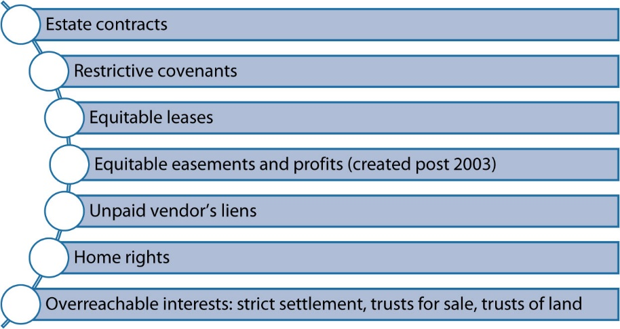
Diagram 6.1 third-party interests which require registration

Slide 4
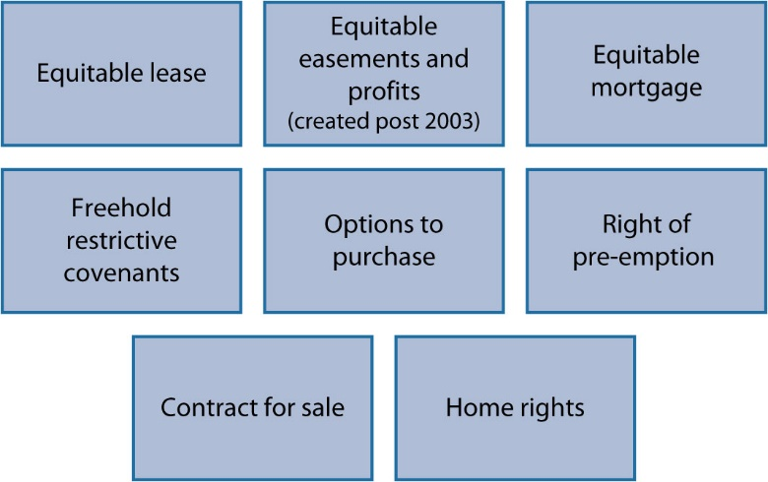
Diagram 6.2 types of interest which require registration as a ‘notice’

Slide 5
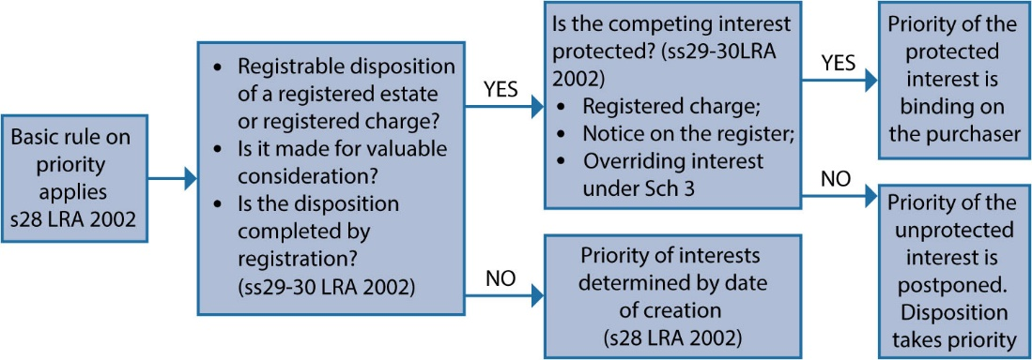
Diagram 6.3 Priorities of interests under ss28–30 Lra 2002

Slide 6
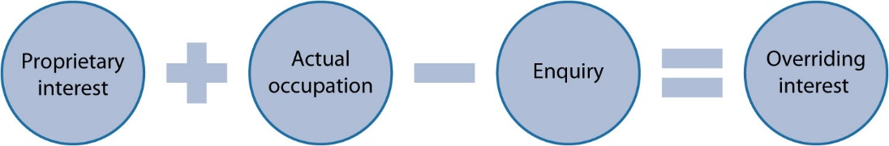
Diagram 6.4 Key points to consider under Sch 3 para 2 LRA 2002

Slide 7
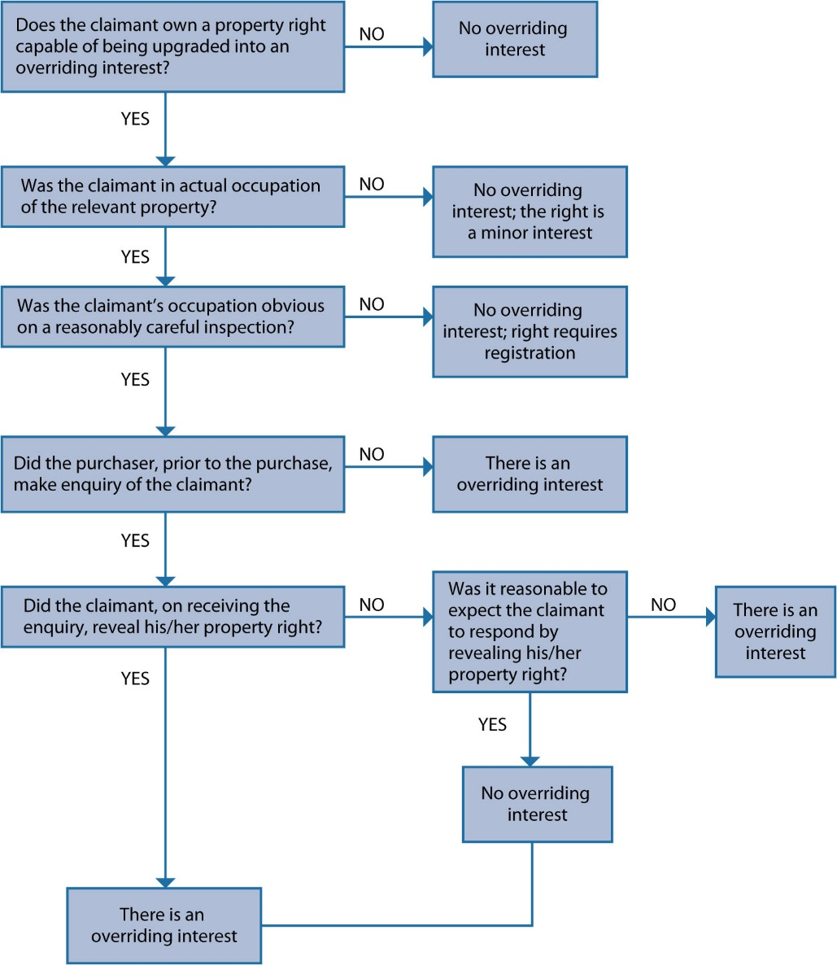
Diagram 6.5 Sch 3 para 2 LRA 2002—the multistage process

