Slide 1
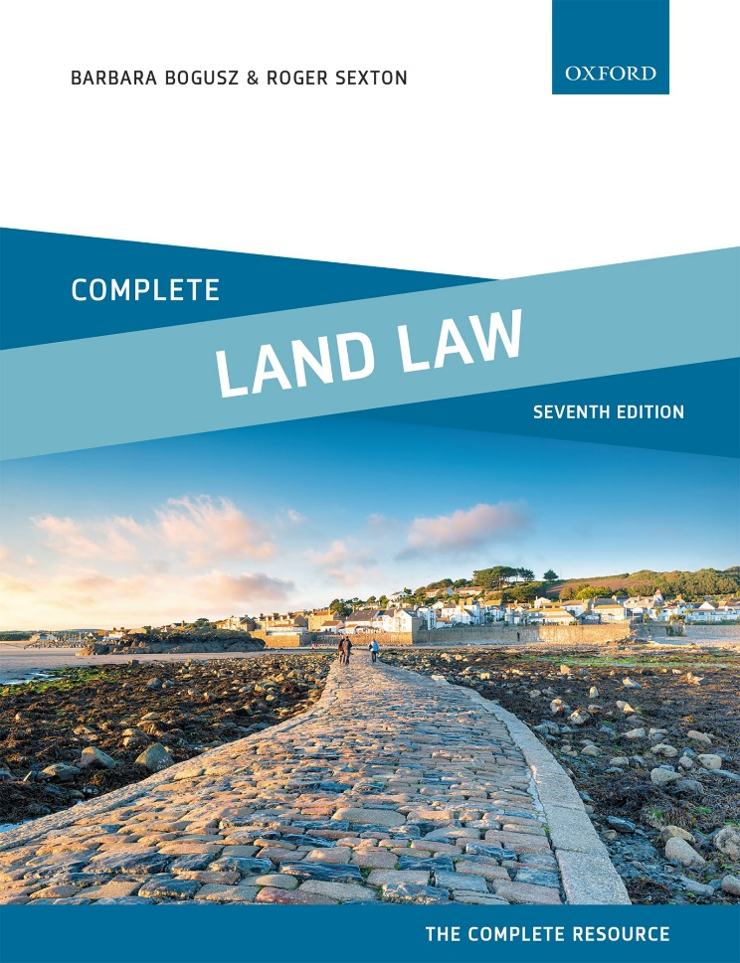
COMPLETE LAND LAW
Text, Cases, and Materials by Barbara Bogusz and Roger Sexton

Slide 2
Part 6
Leases
Chapter 11
Leases—the Basic Requirements

Slide 3
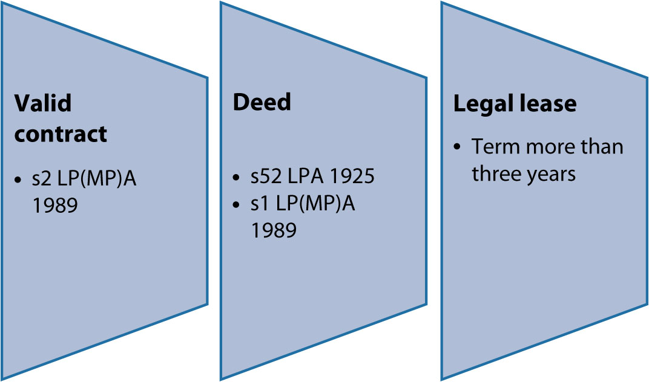
Diagram 11.1 Formalities—creation of a legal lease

Slide 4
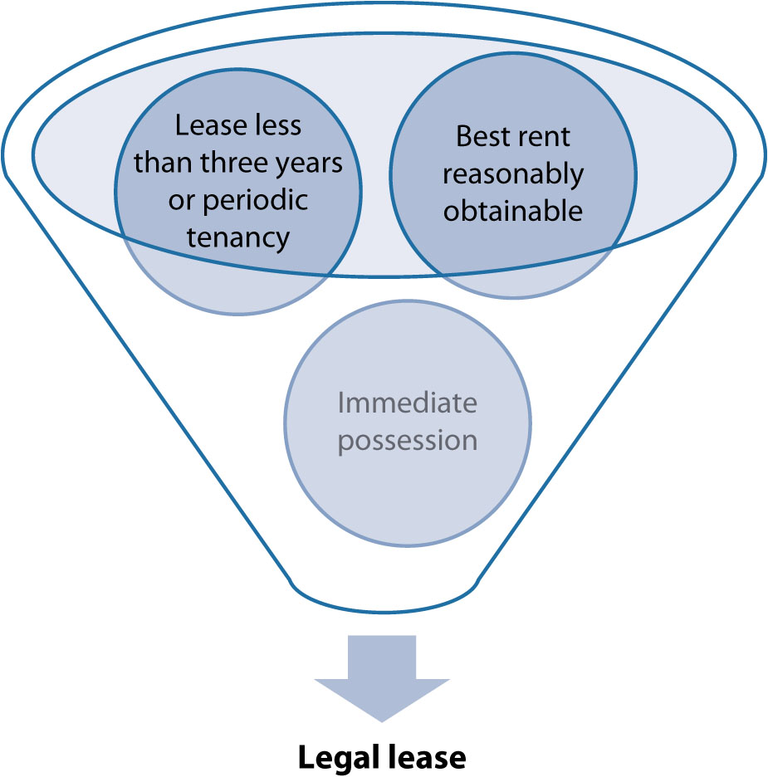
Diagram 11.2 Creation of a legal lease of less than three years under s54(2) LPa 1925

Slide 5
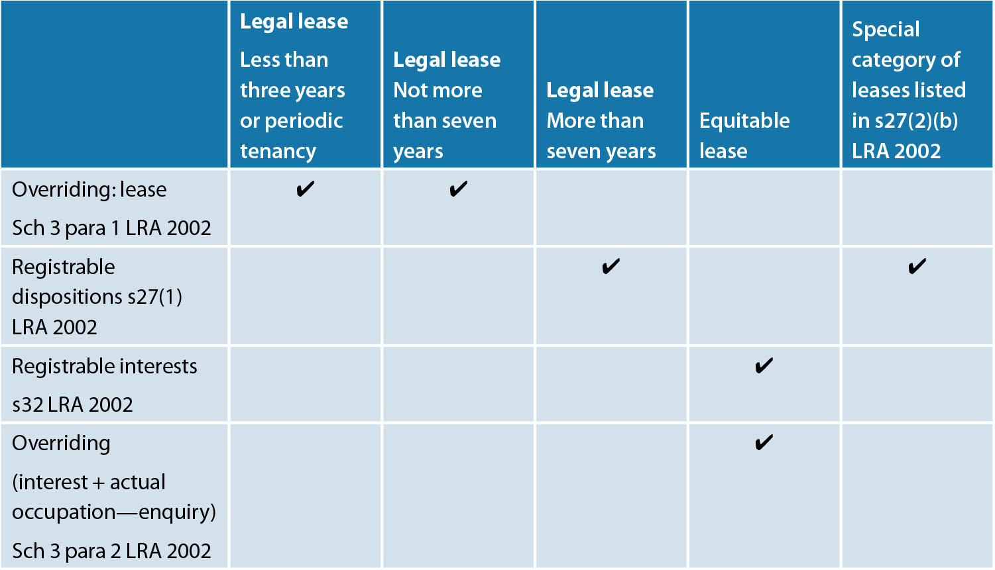
Table 11.1 Priorities of legal and equitable leases in registered land

