Slide 1
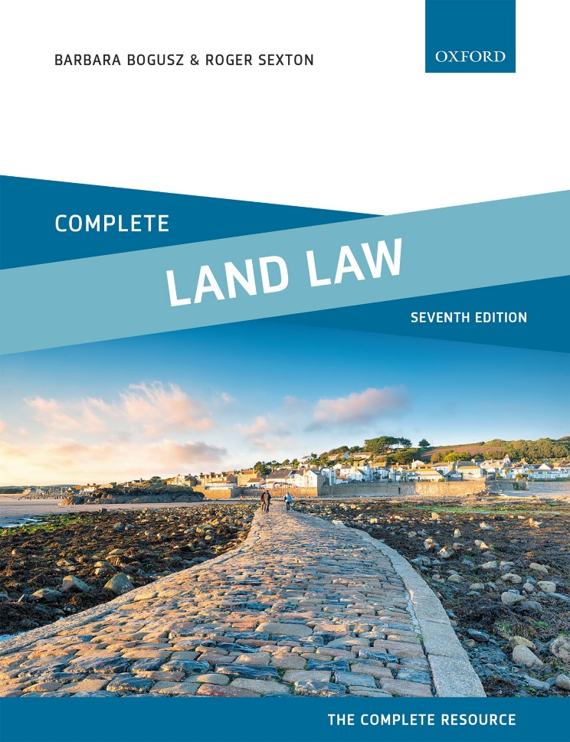
COMPLETE LAND LAW
Text, Cases, and Materials by Barbara Bogusz and Roger Sexton

Slide 2
Part 9
Easements
Chapter 17
The Essential Characteristics of Easements

Slide 3
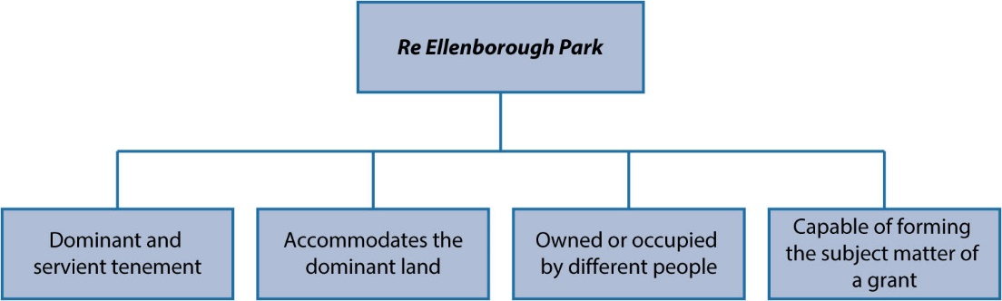
Diagram 17.1 Re Ellenborough Park characteristics

Slide 4
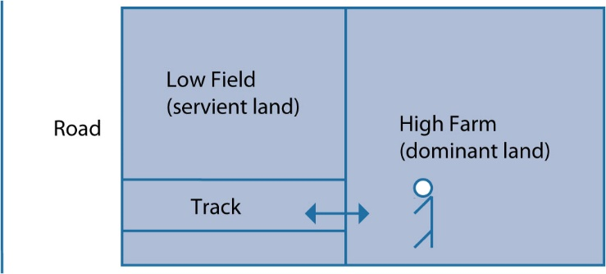
Diagram 17.2 High Farm and Low Field

Slide 5
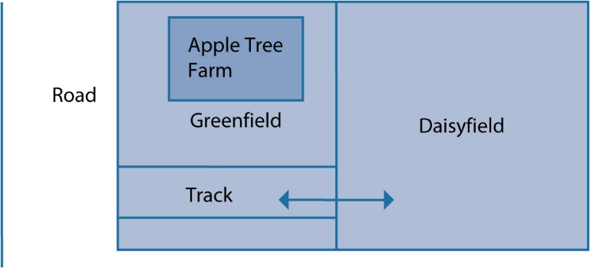
Diagram 17.3 Apple Tree Farm

Slide 6

Diagram 17.4 Small plot and large plot

Slide 7
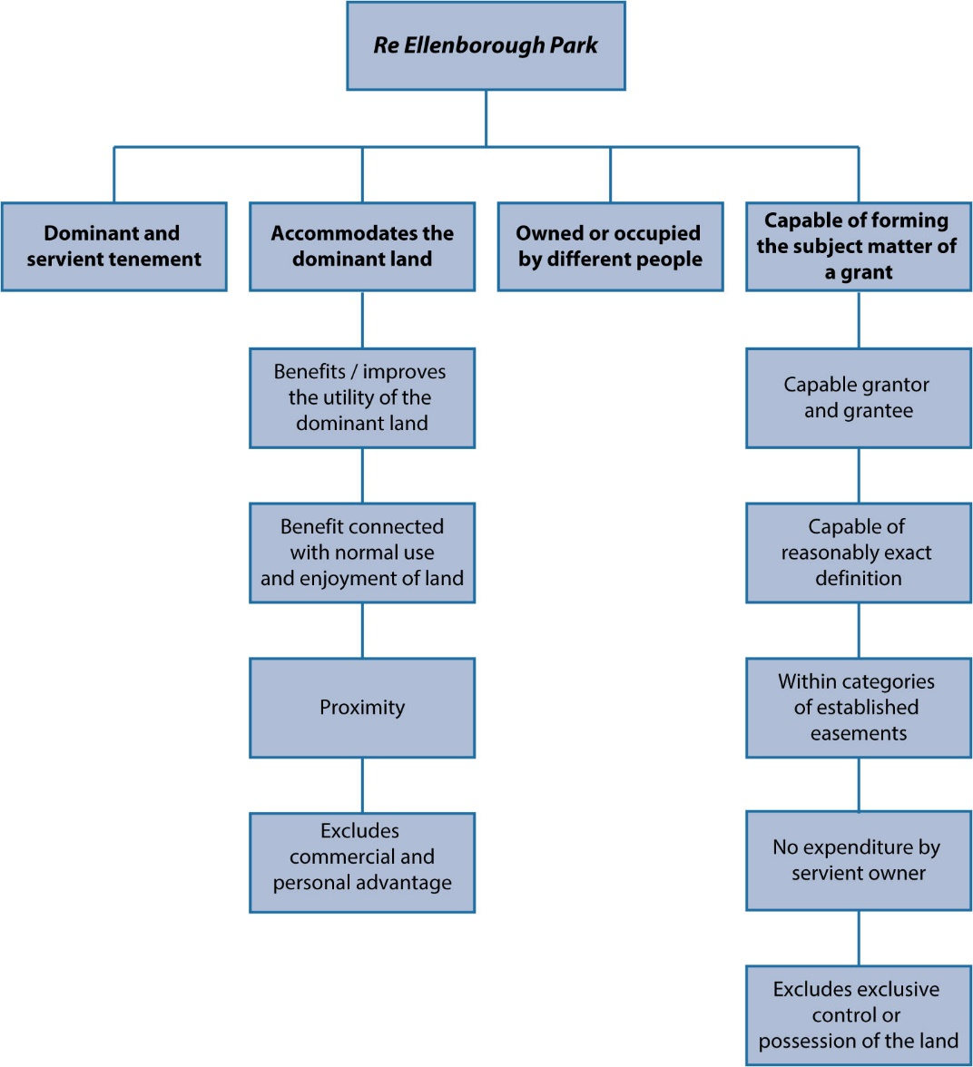
Diagram 17.5 Summary of Re Ellenborough Park characteristics

