Slide 1


AS THE ROMANS DID
A Sourcebook in Roman Social History
by Jo-Ann Shelton and Pauline Ripat

Slide 2
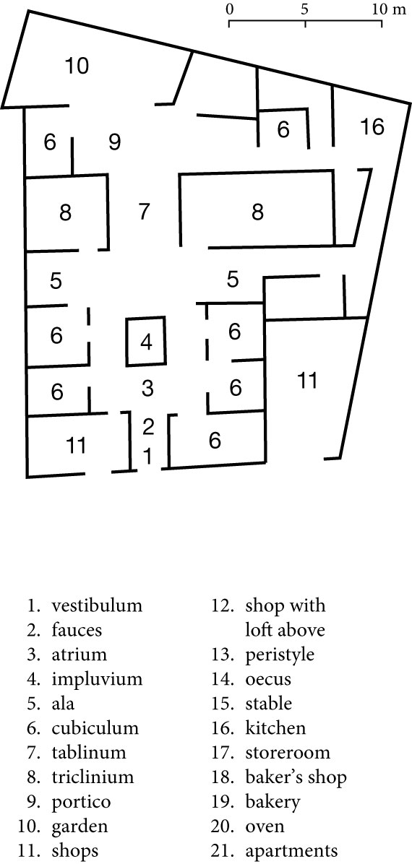
Figure 1 The House of the Surgeon, Pompeii:

Slide 3
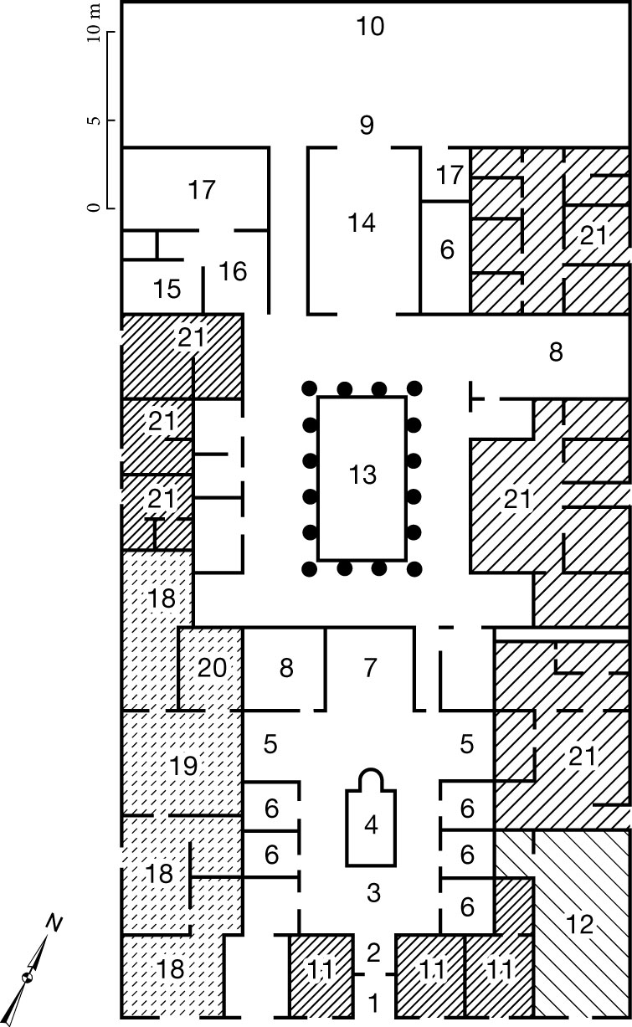
Figure 2 The House of Pansa, Pompeii:

Slide 4
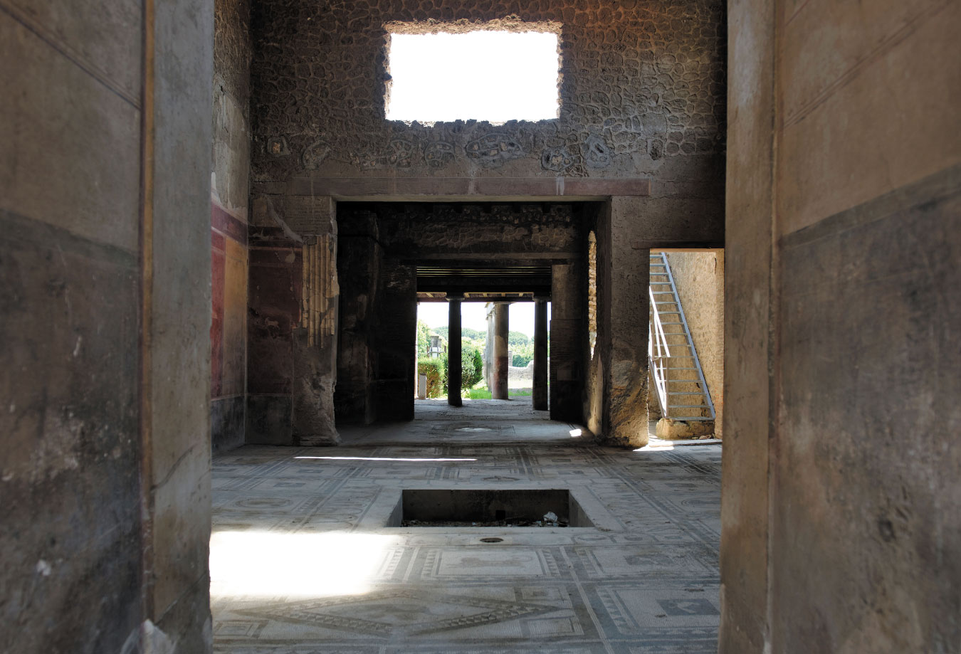
Image 4.1 House of Paquius Proculus, Pompeii:

Slide 5
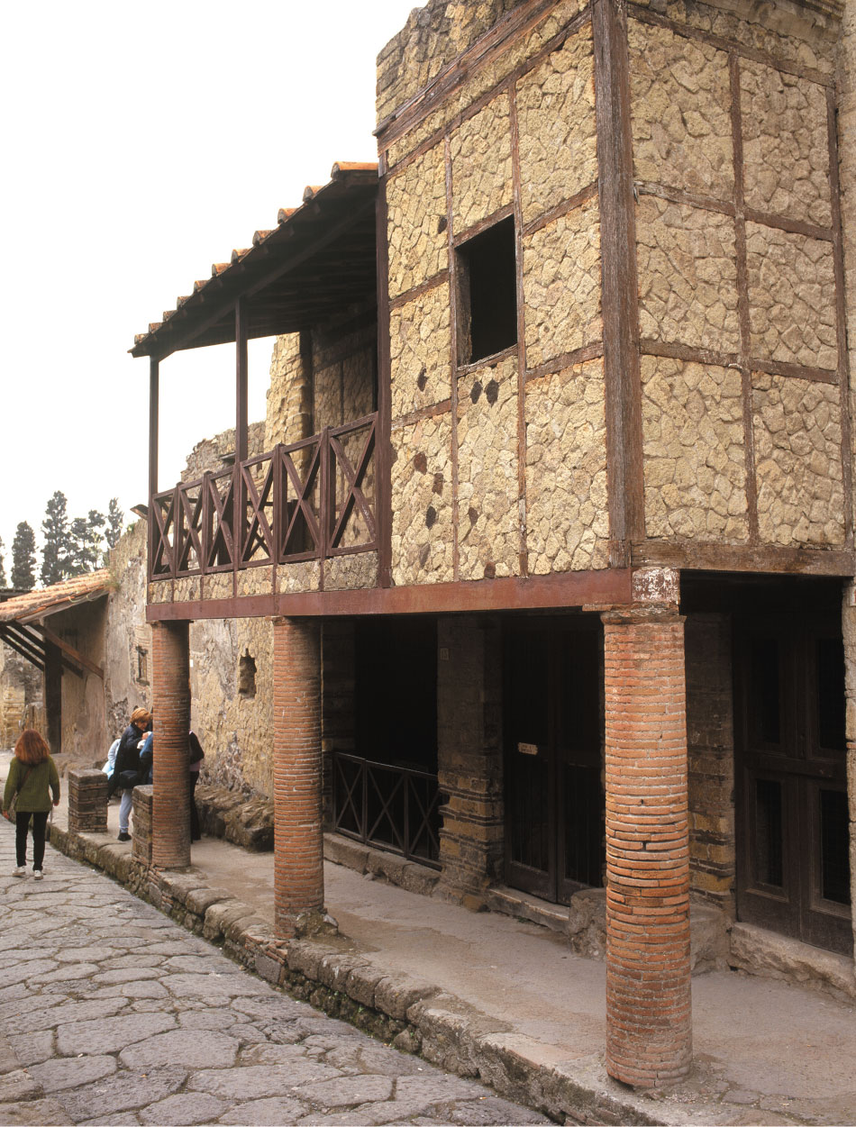
Image 4.2 The Trellis House, Herculaneum:

Slide 6
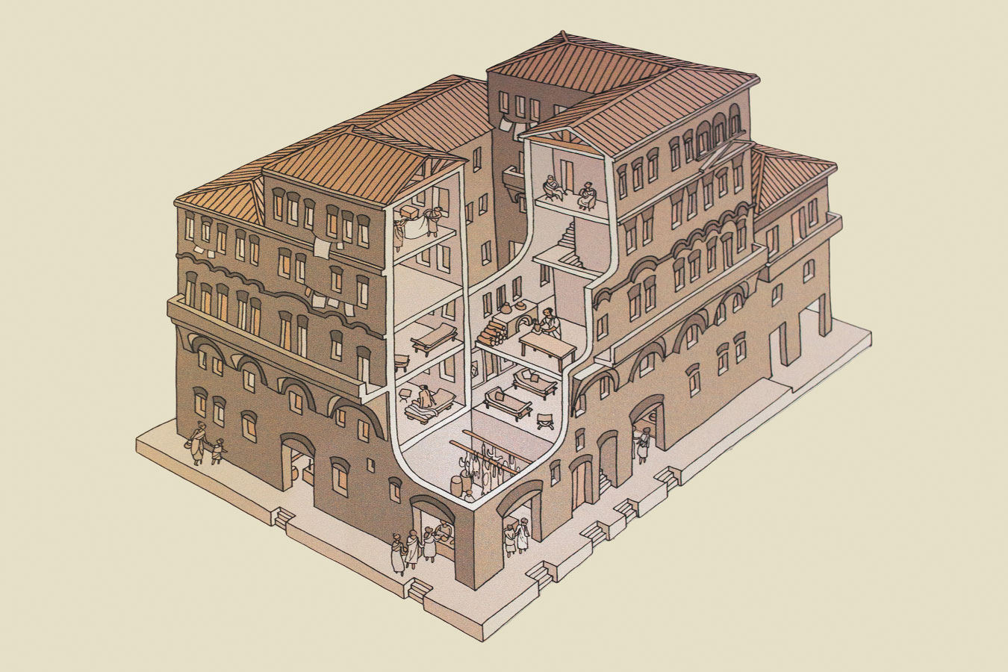
Image 4.3 Artist’s Rendition of a Roman Insula:

Slide 7
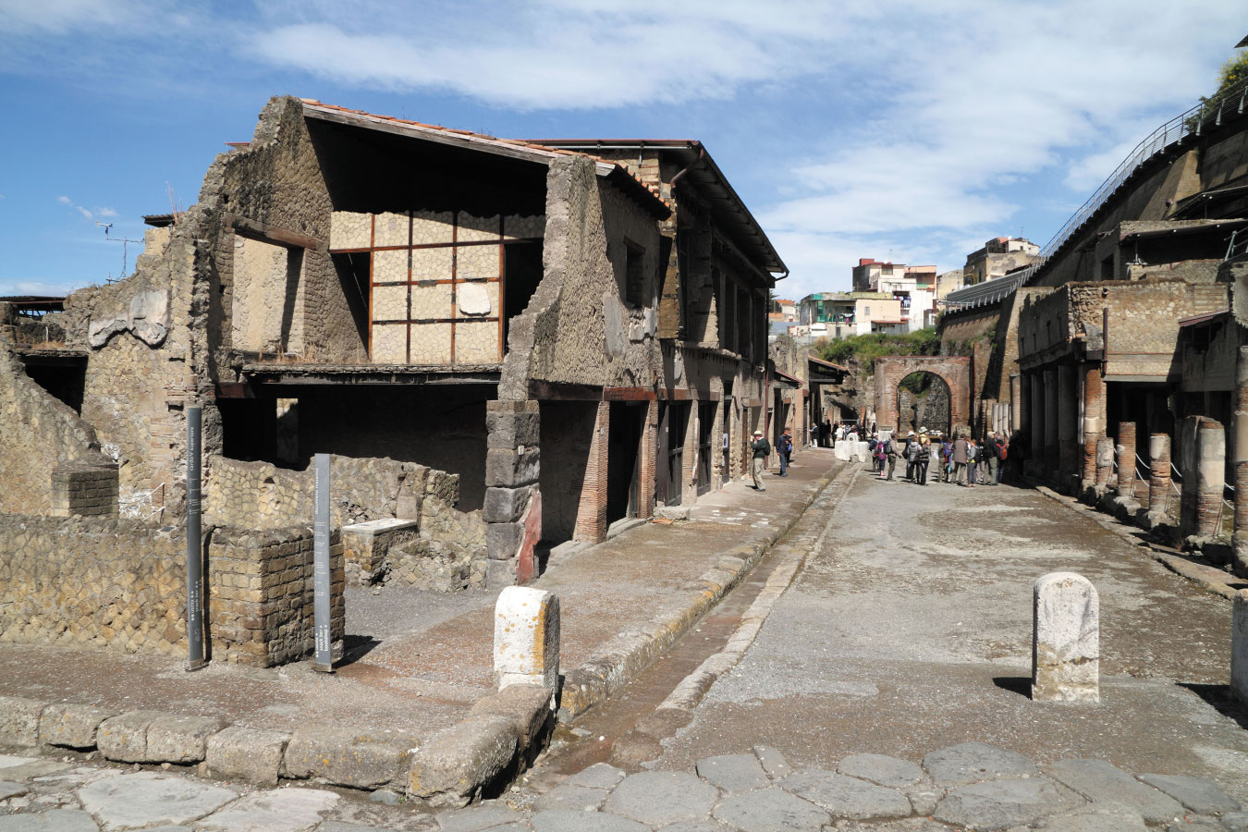
Image 4.4 Street Scene with the Insula Orientalis on the Decumanus Maximus, Herculaneum:

Slide 8
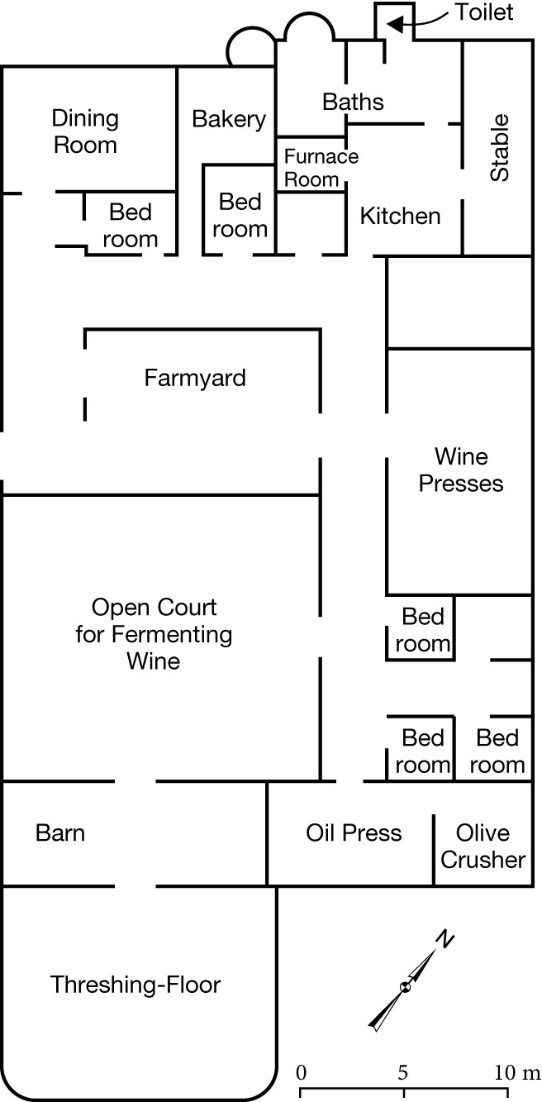
Figure 3 Plan of a Farm Villa, Boscoreale:

Slide 9
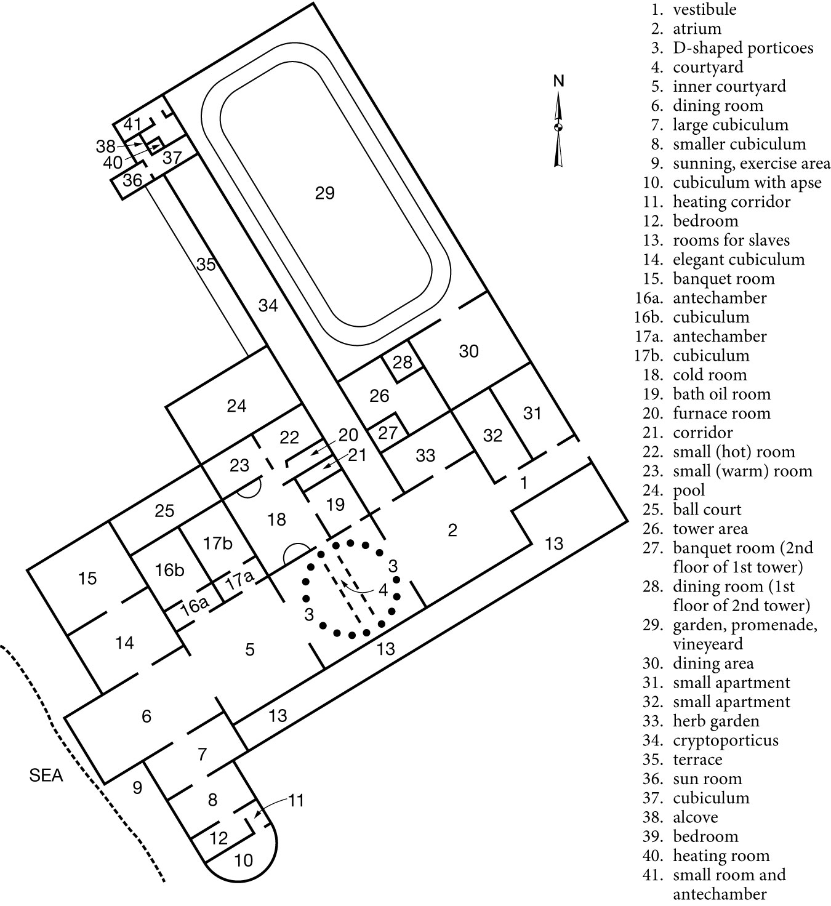
Figure 4 Reconstructed Plan of Pliny’s Villa, Laurentum

