Slide 1

Figures and Tables
The Australian Health Care System
Sixth Edition
Stephen Duckett
USER AGREEMENT
These slides include resources from The Australian Health Care System, sixth edition, and are made available for teaching use only to those using the book as a text in their courses. Users are free to copy and modify the material as needed for teaching purposes (e.g. incorporating them into lecture notes/slides or student handouts), provided that the authors are acknowledged. The slides can be placed on university-controlled unit or subject-related websites (that are password protected), as long as these are restricted to student use and not accessible to the public at large. Permission from the publisher should be sought to use the slides in any other manner.
© Oxford University Press 2022

Slide 2
CHAPTER 2
THE AUSTRALIAN POPULATION AND ITS HEALTH

Slide 3
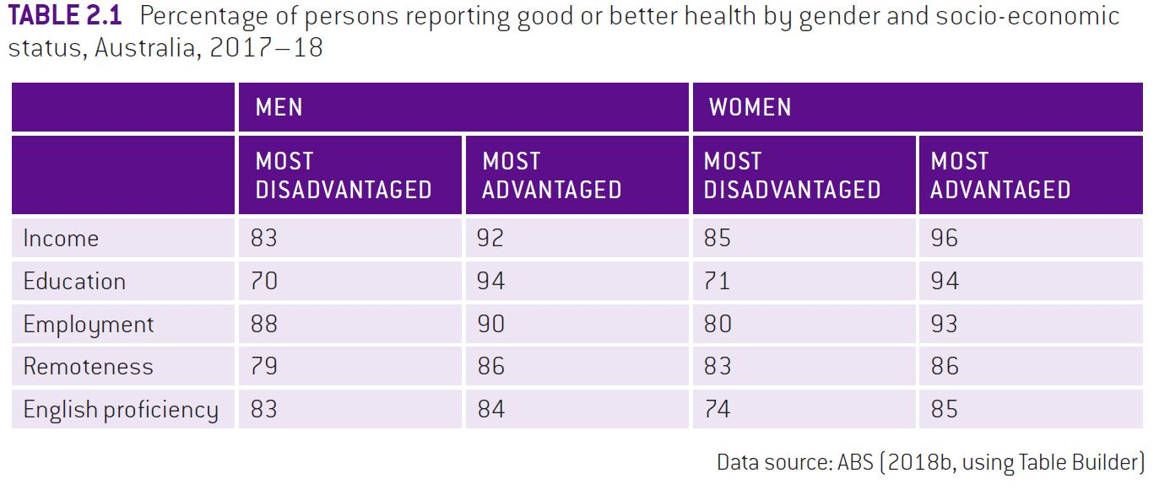

Slide 4
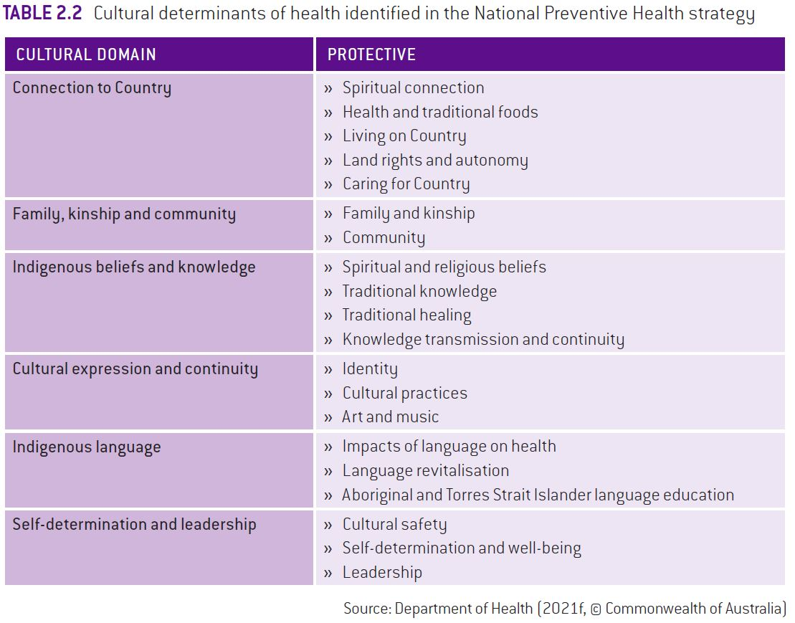

Slide 5
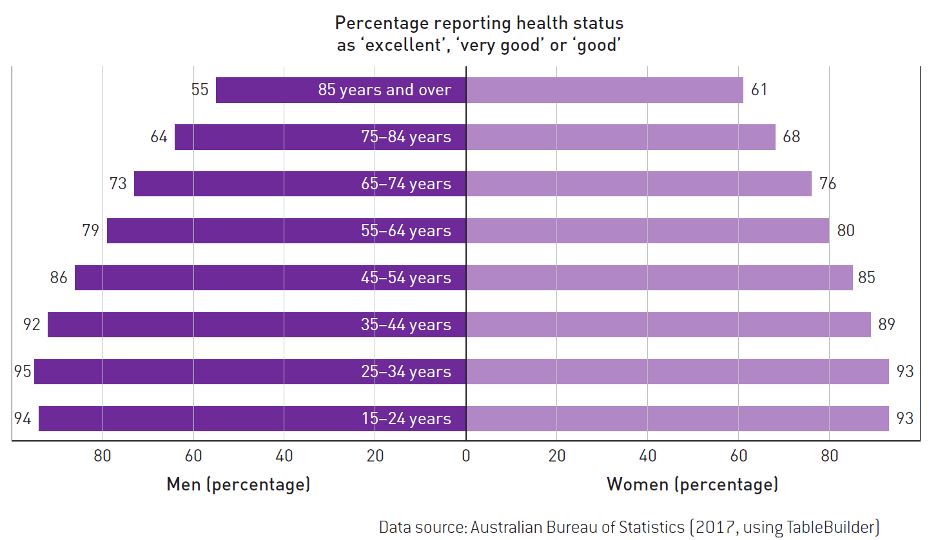
FIGURE 2.1 Self-reported health status, Australia, 2016–17

Slide 6
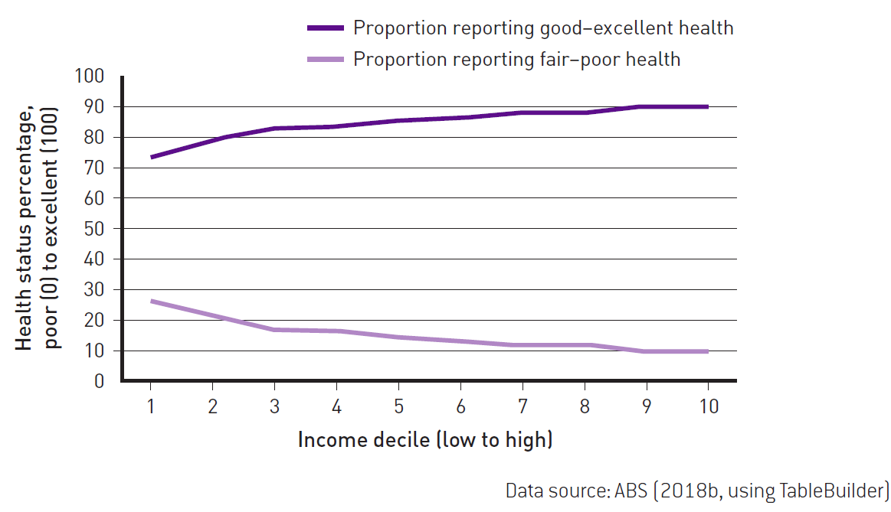
FIGURE 2.2 The effect of income on reported health status

Slide 7
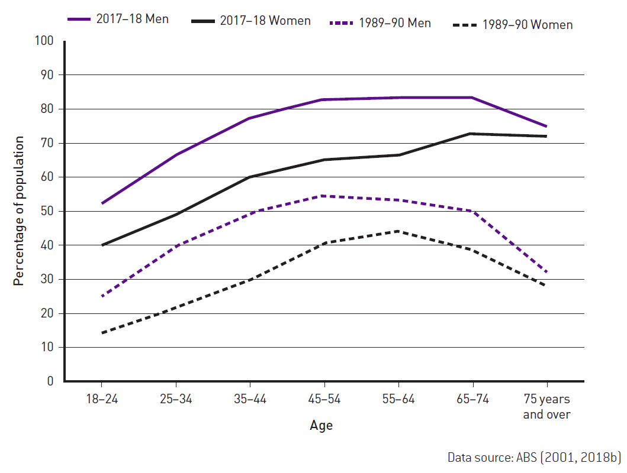
FIGURE 2.3 Prevalence of overweight and obesity by age and gender, Australia, 1989–90 to
2017–18

Slide 8
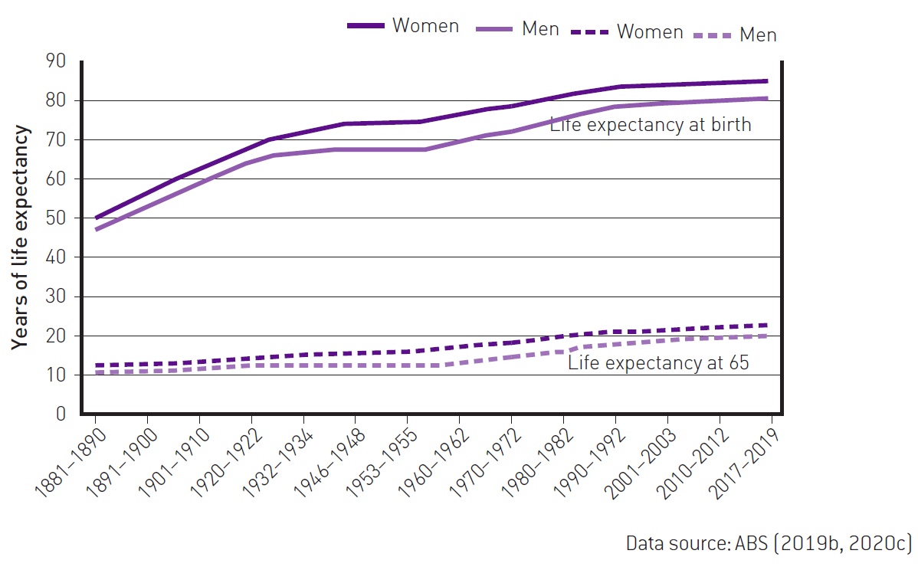
FIGURE 2.4 Trend in life expectancy in years, by gender, Australia, 1881–2019

Slide 9
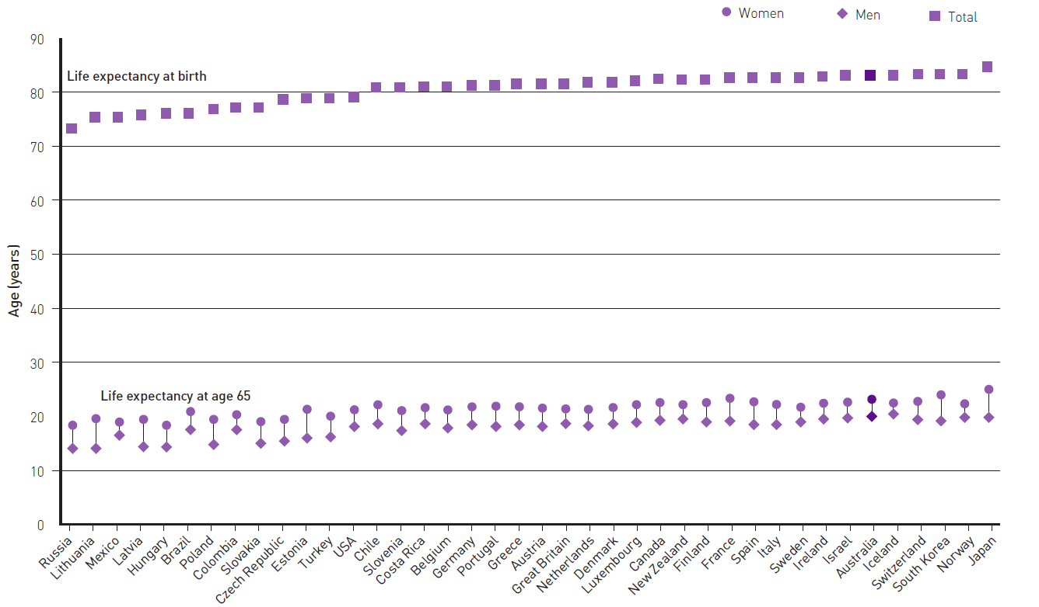

FIGURE 2.5 Comparative expectation of life, years, selected countries, 2020 or nearest year

Slide 10
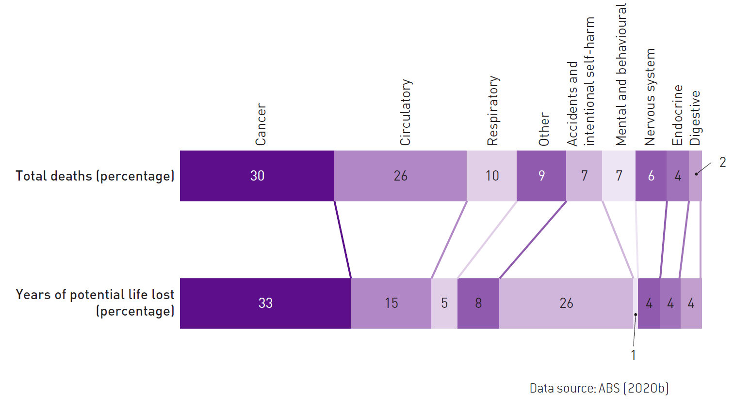
FIGURE 2.6 Percentage of total deaths and years of potential life lost for causes of death by
diagnostic category, Australia, 2019

Slide 11
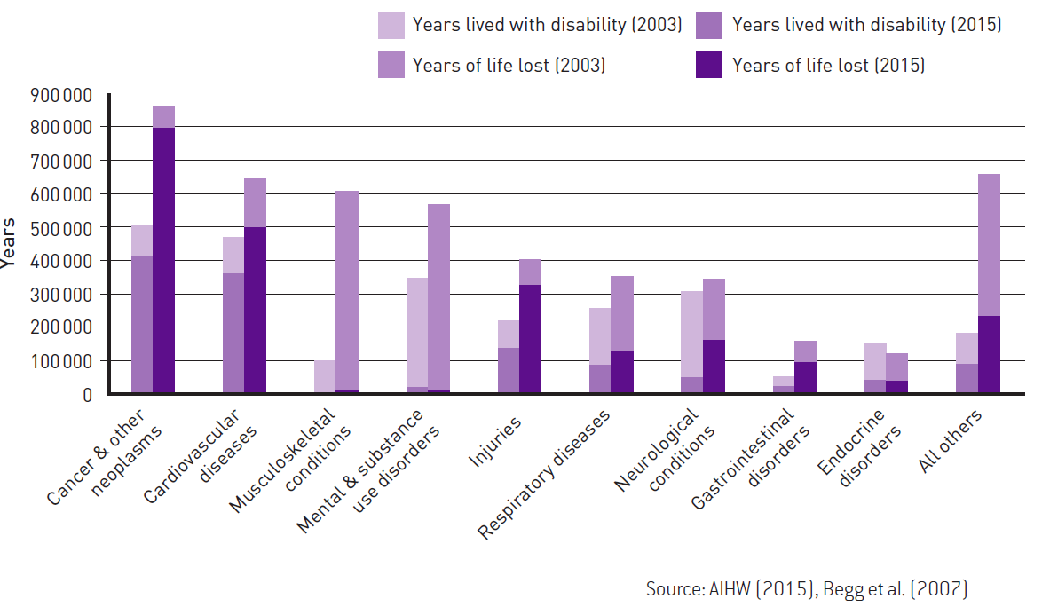
FIGURE 2.7 Burden of disease by years of life lost and years lived with a disability, Australia,
2003 and 2015

Slide 12
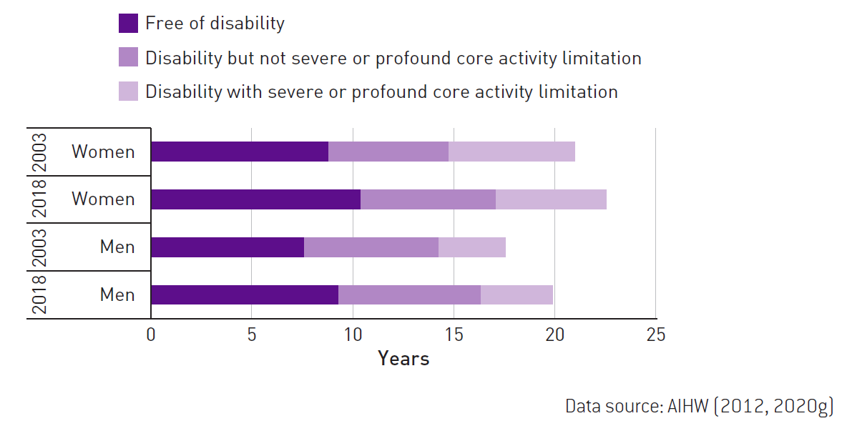
FIGURE 2.8 Trends in health expectancies by gender, Australia, 2003–18

Slide 13
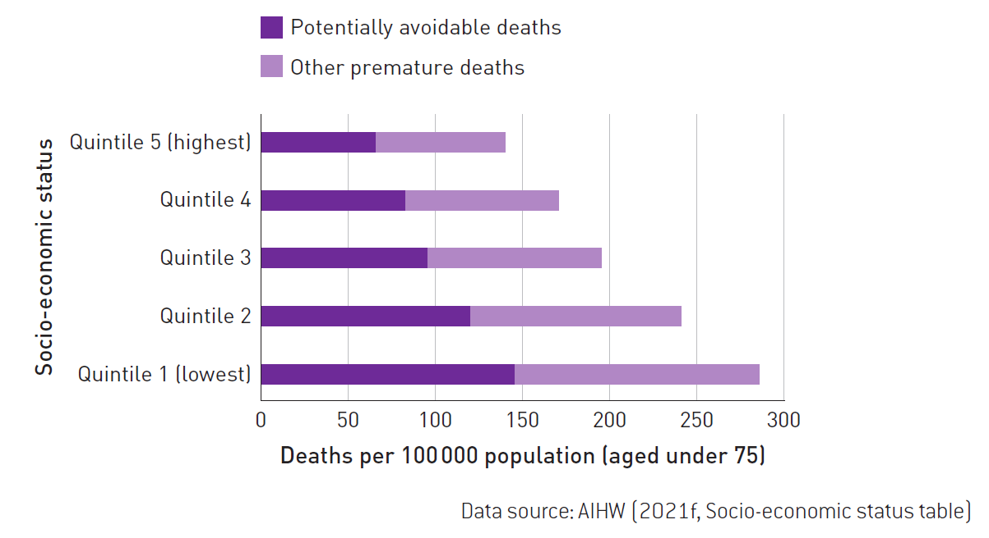
FIGURE 2.9 Rates of age-standardised potentially avoidable deaths by socio-economic status of
area, Australia, 2015–19

Slide 14
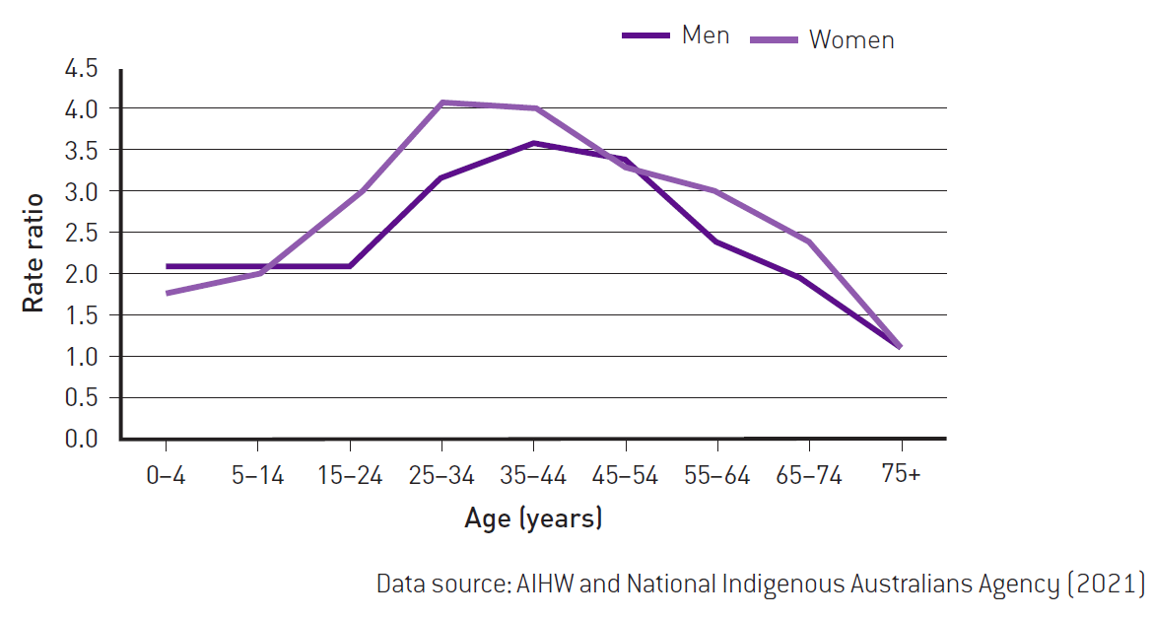
FIGURE 2.10 Rate ratio of age-specific death rates, First Nations Australians compared to all
other Australians by gender (New South Wales, Northern Territory, Queensland, South Australia
and Western Australia), 2014–18

Slide 15
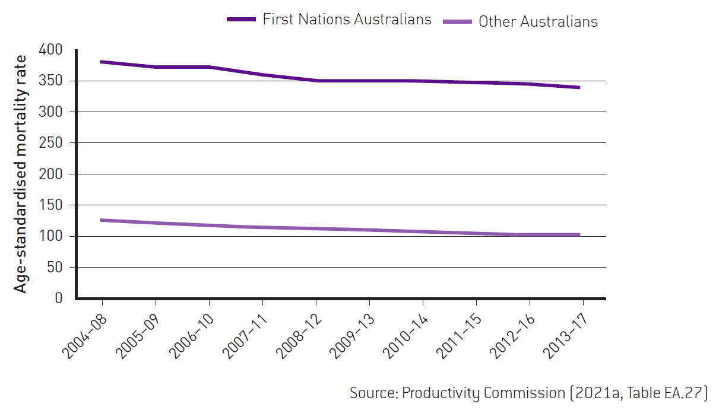
FIGURE 2.11 Age standardised mortality rates of potentially avoidable deaths, under 75 years,
by Indigenous status (New South Wales, Northern Territory, Queensland, South Australia and
Western Australia), 2004–08 to 2013–17

Slide 16
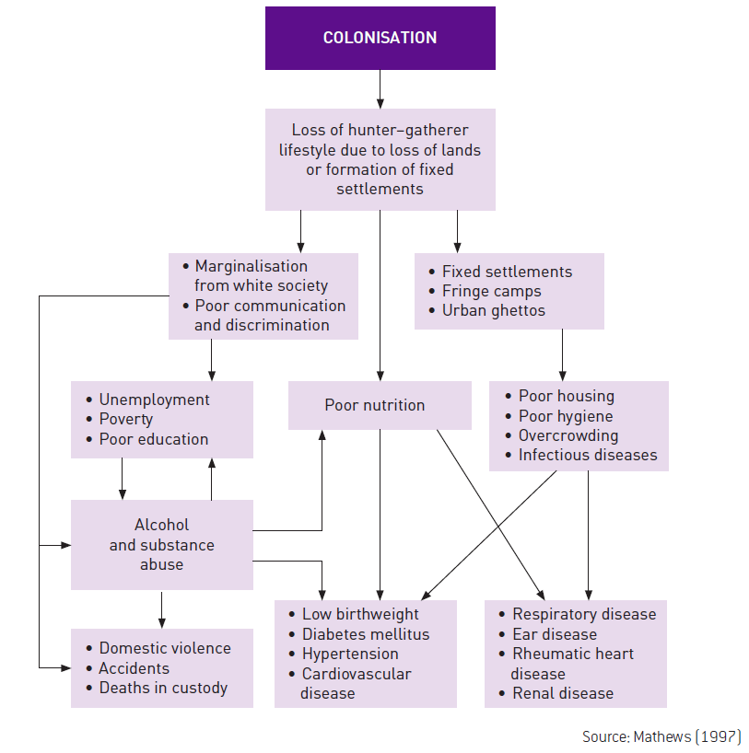
FIGURE 2.12 Impact of historical factors on the current health status of First Nations Australians

Slide 17
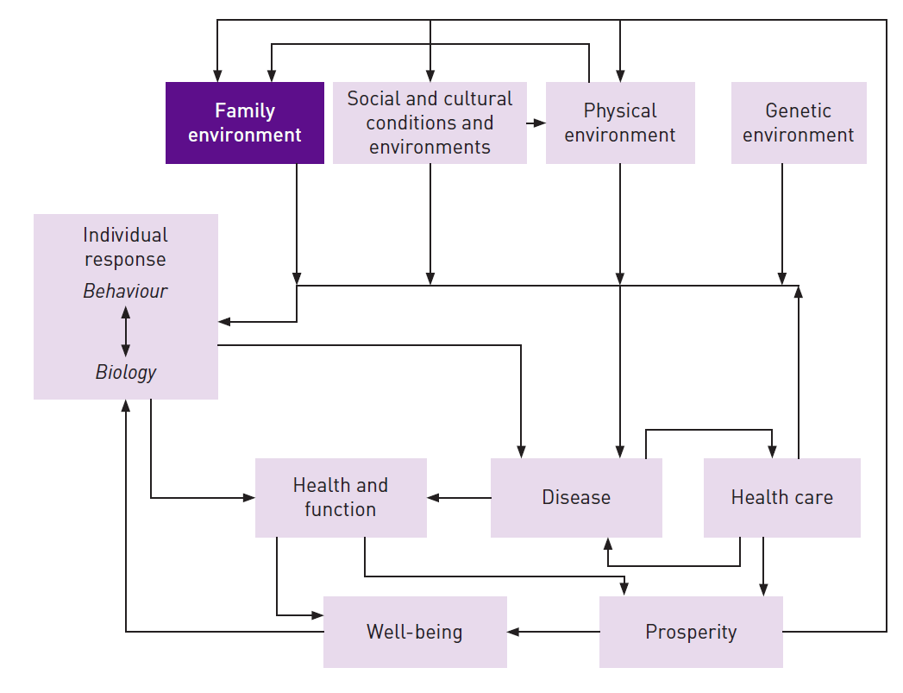
FIGURE 2.13 Factors influencing the development of disease and healthy functioning

