Slide 1

Figures and Tables
The Australian Health Care System
Sixth Edition
Stephen Duckett
USER AGREEMENT
These slides include resources from The Australian Health Care System, sixth edition, and are made available for teaching use only to those using the book as a text in their courses. Users are free to copy and modify the material as needed for teaching purposes (e.g. incorporating them into lecture notes/slides or student handouts), provided that the authors are acknowledged. The slides can be placed on university-controlled unit or subject-related websites (that are password protected), as long as these are restricted to student use and not accessible to the public at large. Permission from the publisher should be sought to use the slides in any other manner.
© Oxford University Press 2022

Slide 2
CHAPTER 12
POLICY CHALLENGES FOR THE AUSTRALIAN HEALTH CARE SYSTEM

Slide 3
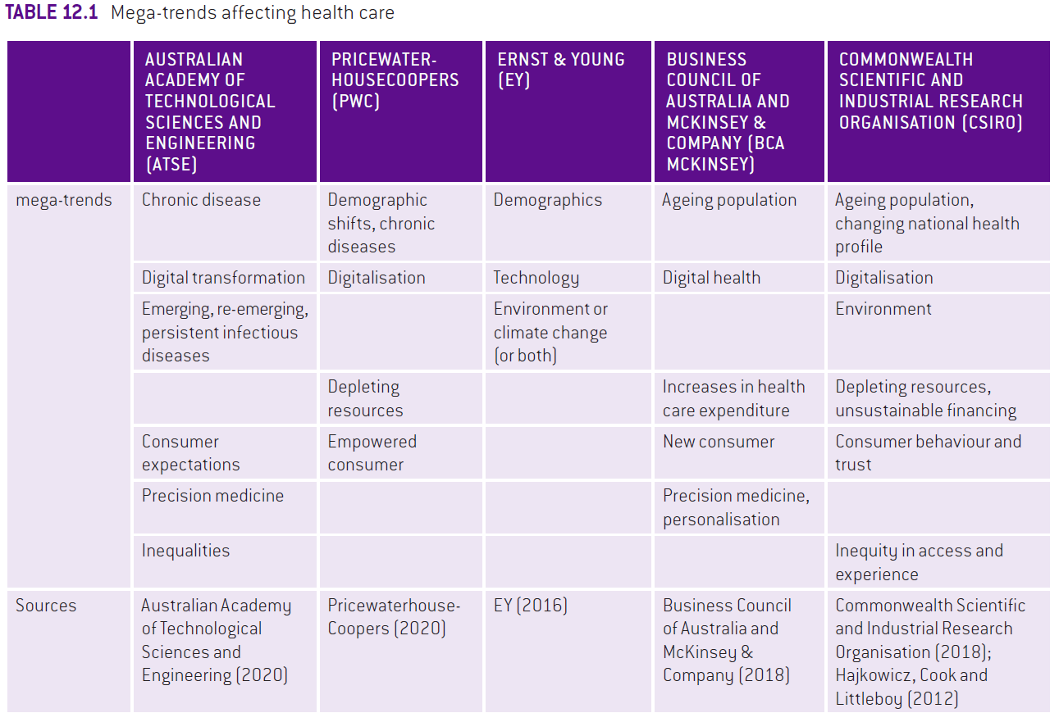

Slide 4
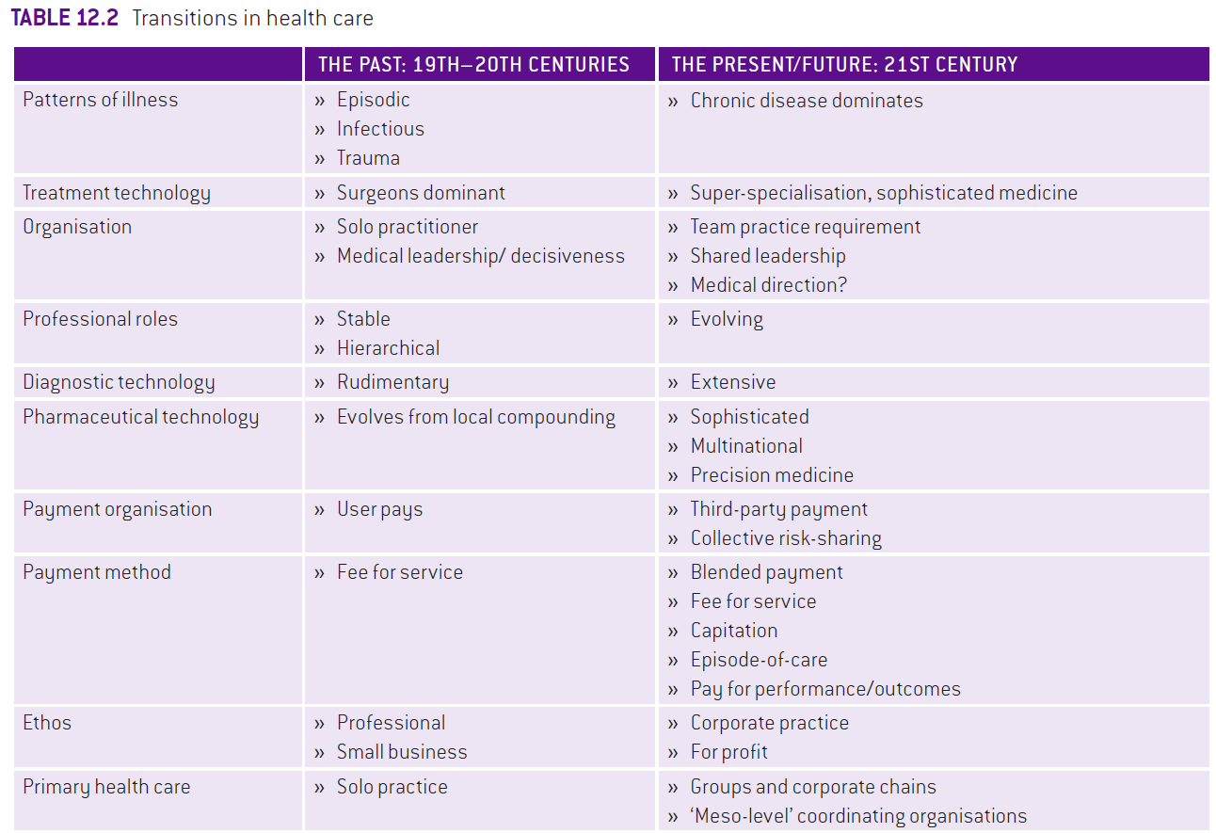
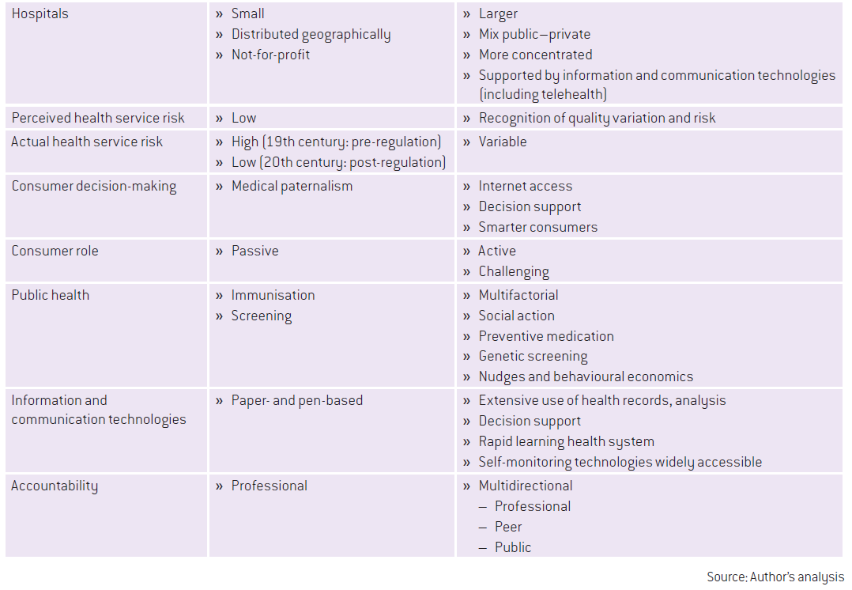

Slide 5
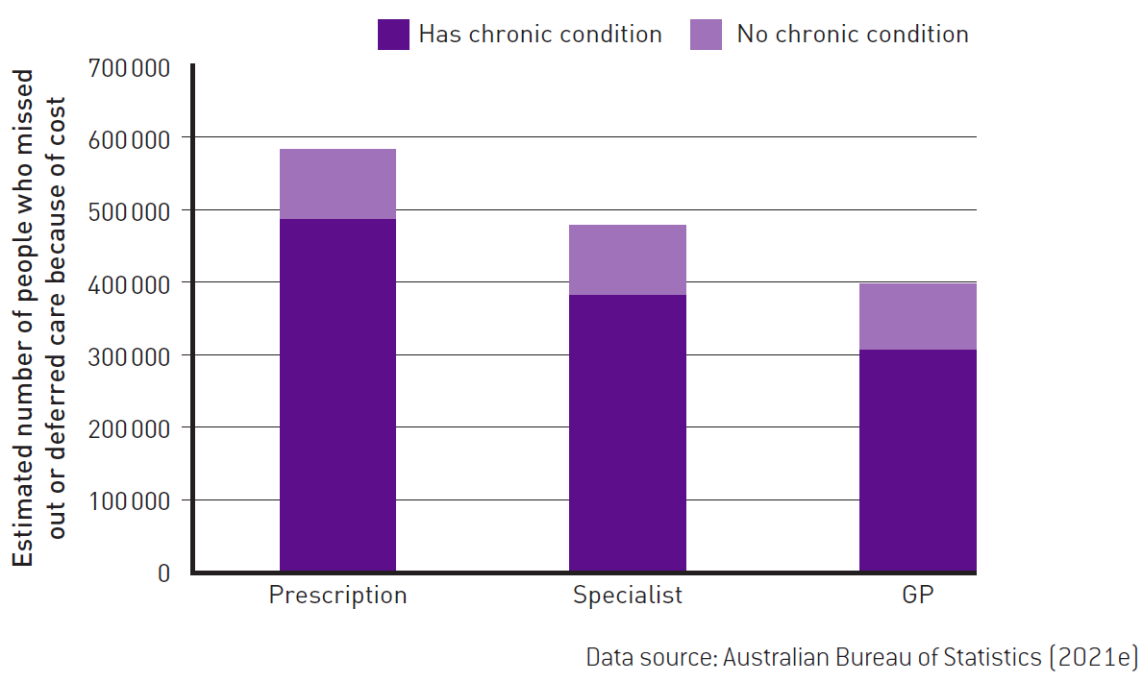
FIGURE 12.1 Adult Australians who missed a prescription or skipped care in the past 12 months because of cost, 2020–21

