Slide 1
Chapter 5: Elements of 4D Art and Design

Slide 2
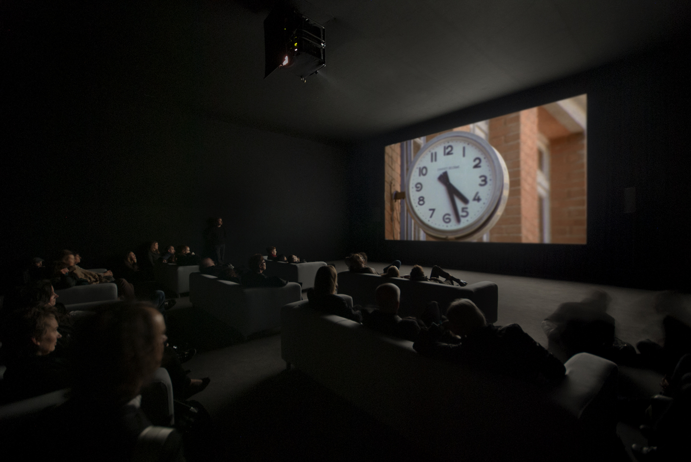
Fig. 5-1. Christian Marclay, installation view of The Clock (2010), single-channel video with sound; 24 hours. White Cube Mason’s Yard, London (October 15–November 13, 2010). © Christian Marclay. Courtesy Paula Cooper Gallery, New York and White Cube, London. Photo: Todd-White Photography.

Slide 3
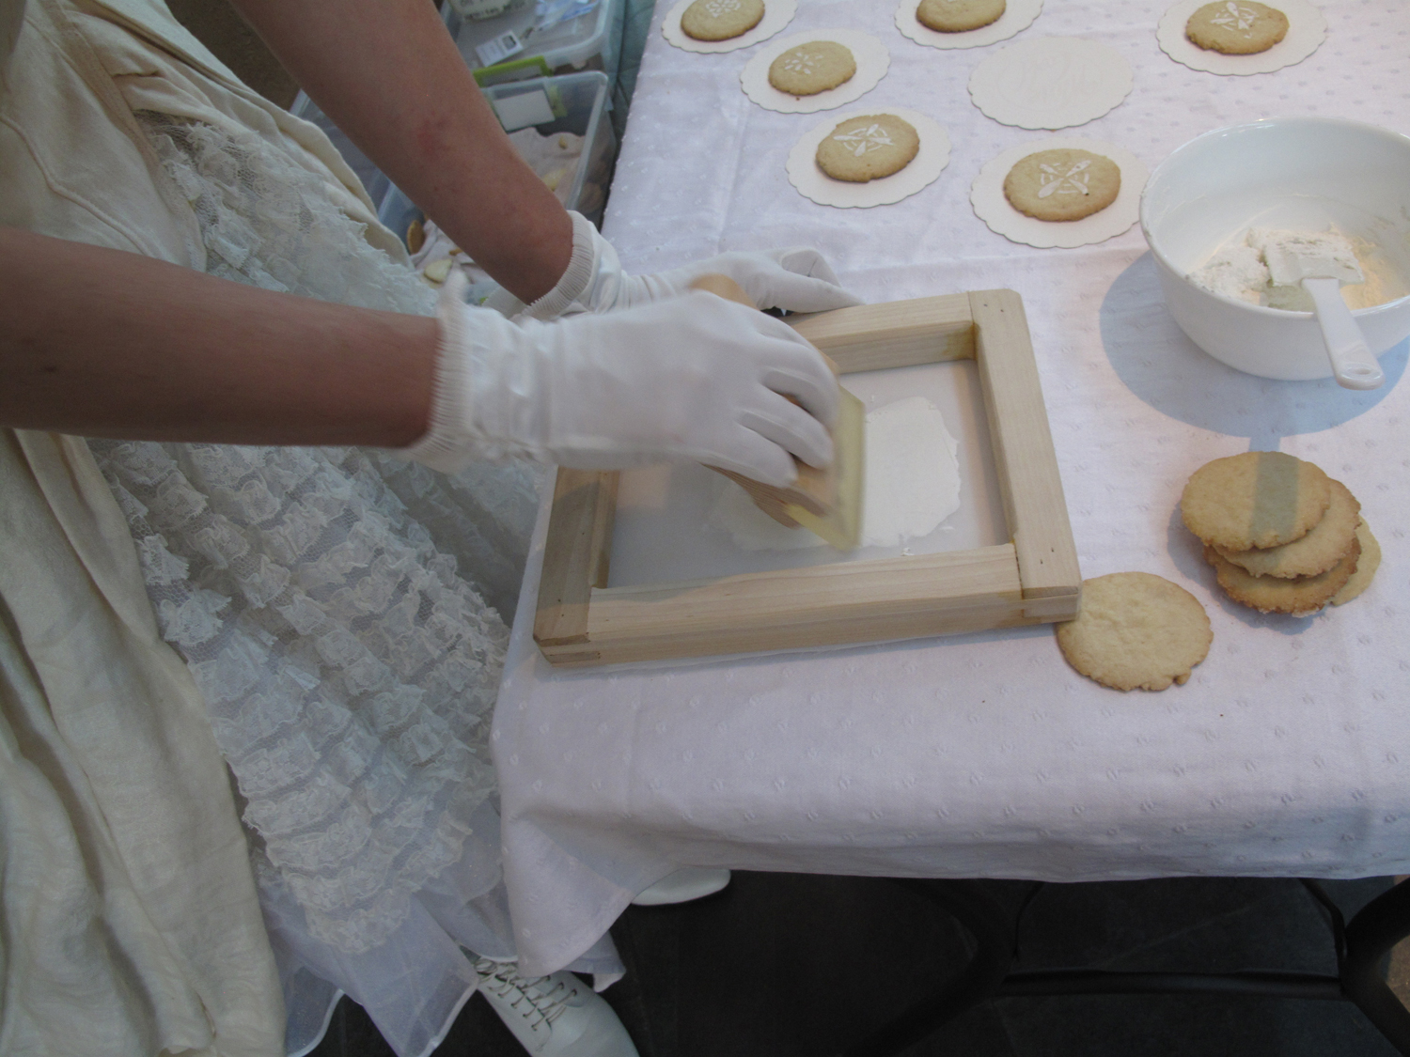
Fig. 5-3. Melissa Haviland, White Gold (2012), cookies, frosting, interactions, dimensions variable. Courtesy of the artist.

Slide 4
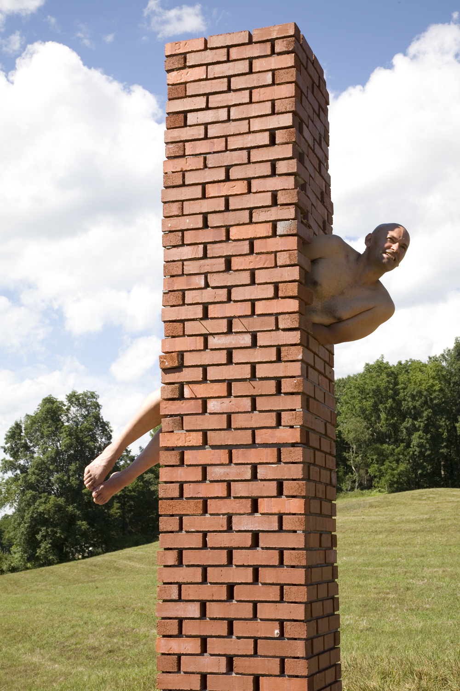
Fig. 5-5. Cesar Cornejo, Public Sculptor (2010), bricks, cement, wood, sculptor, 2 hours. Courtesy of the artist. Photographer: Felicity Hogan.

Slide 5
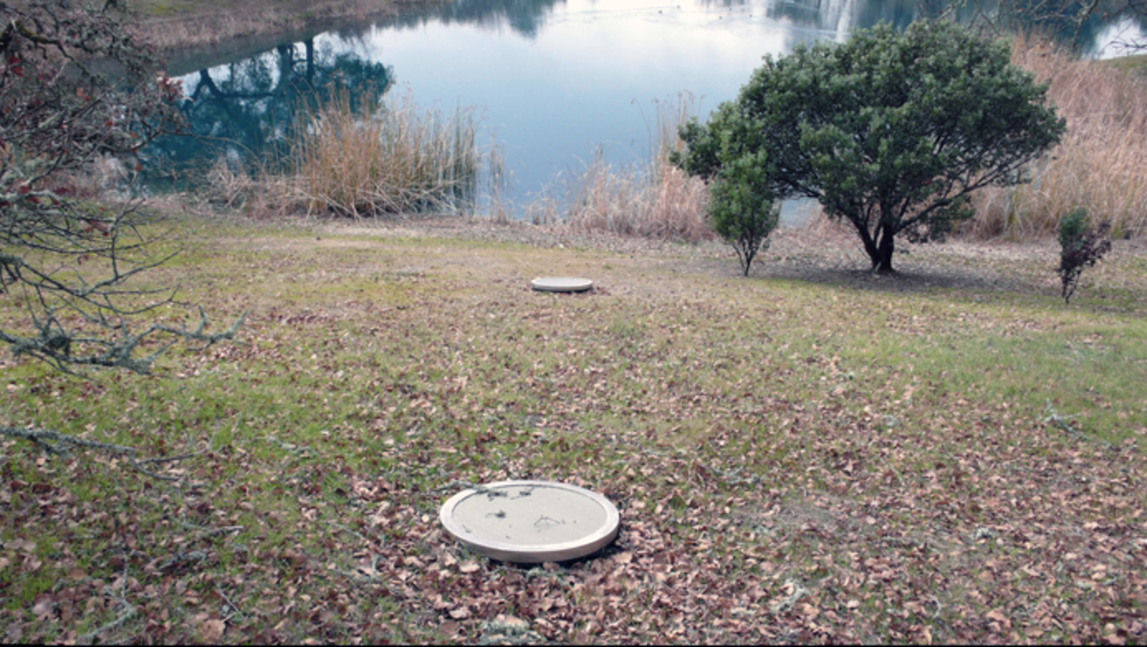
Fig. 5-6. Bill Fontana, Earth Tones (1992), six large, low-frequency loudspeakers buried at the Oliver Ranch in Northern California. Courtesy of the artist.

Slide 6
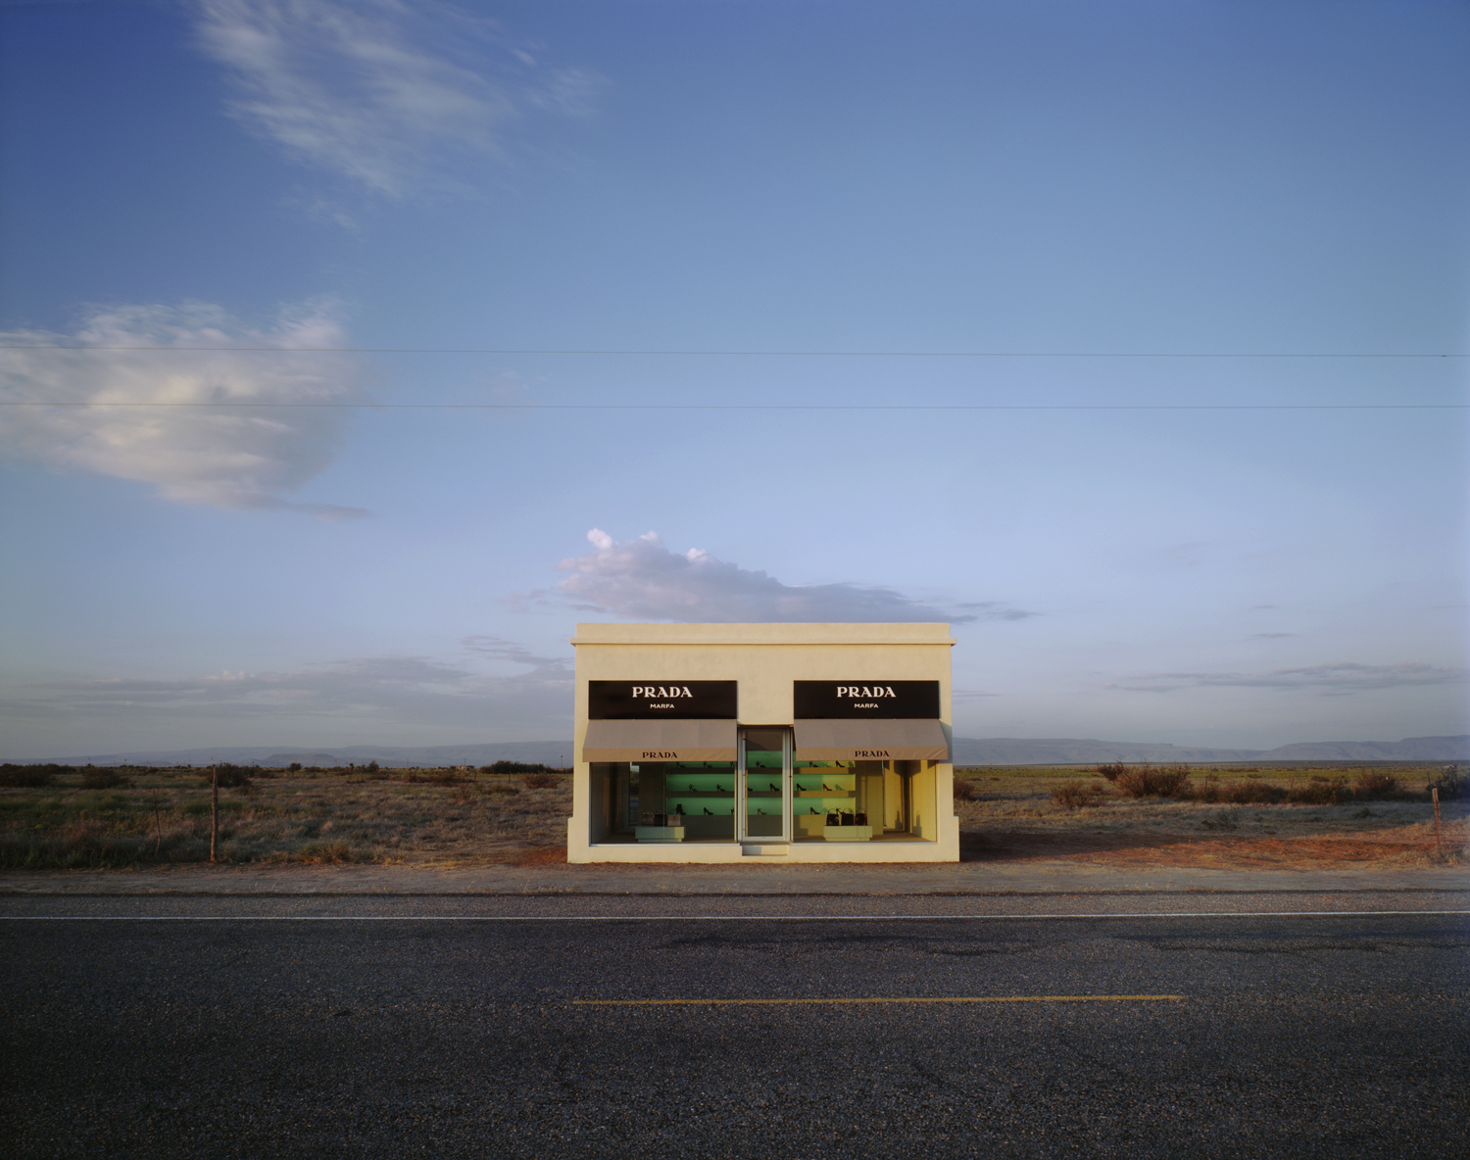
Fig. 5-8. Elmgreen and Dragset, Prada Marfa (2005), adobe bricks, plaster, aluminum frames, glass panes, MDF, paint, carpet, Prada shoes and bags, 760 cm × 470 cm × 480 cm. Courtesy: Art Production Fund, New York; Ballroom Marfa, Marfa; the artists. Photograph by James Evans.

Slide 7
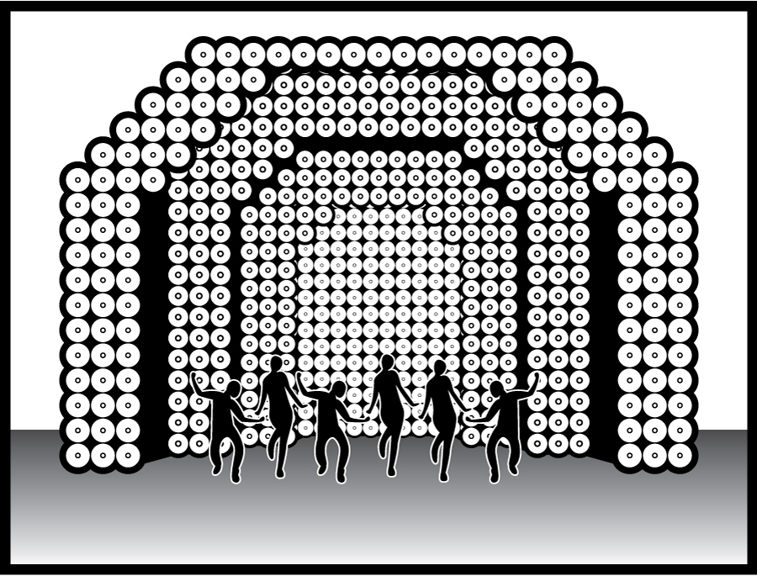
Fig. 5-13. Illustration of lighting plan for Francis Picabia’s ballet Rêlache (1924) © Phil McCollam.

Slide 8
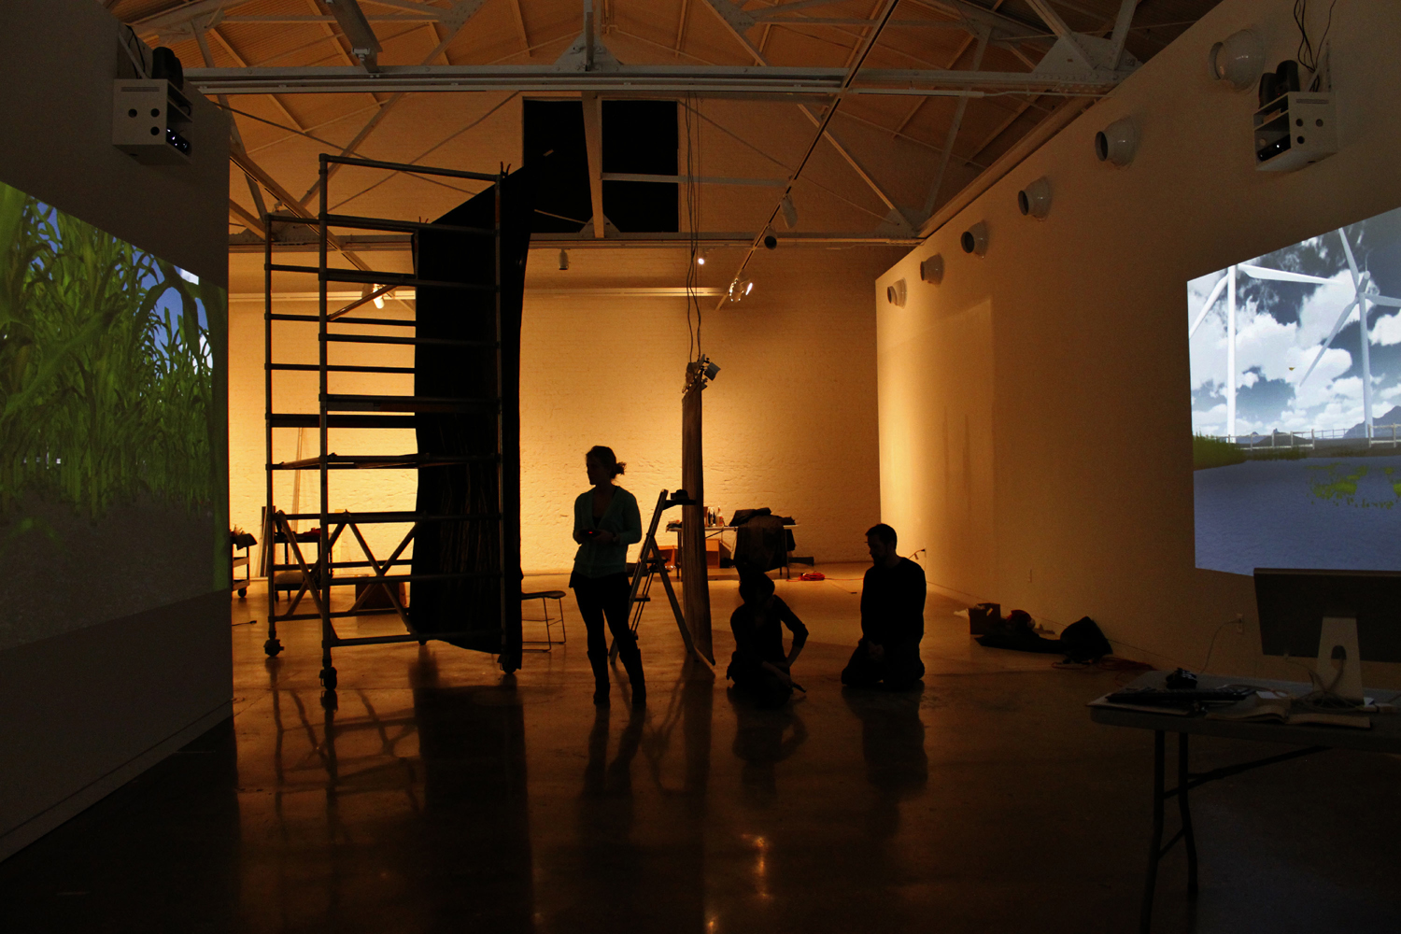
Fig. 5-16. Channel tWo, FIND EACH OTHER. Begin There. (2012), two-channel, networked, interactive landscape, dimensions variable. © Channel tWo.

Slide 9

Fig. 5-17. Sarah Johnson, Ordinary Batman (2012–ongoing), animated GI F, 575 × 500 pixels. Courtesy of the Artist.

Slide 10
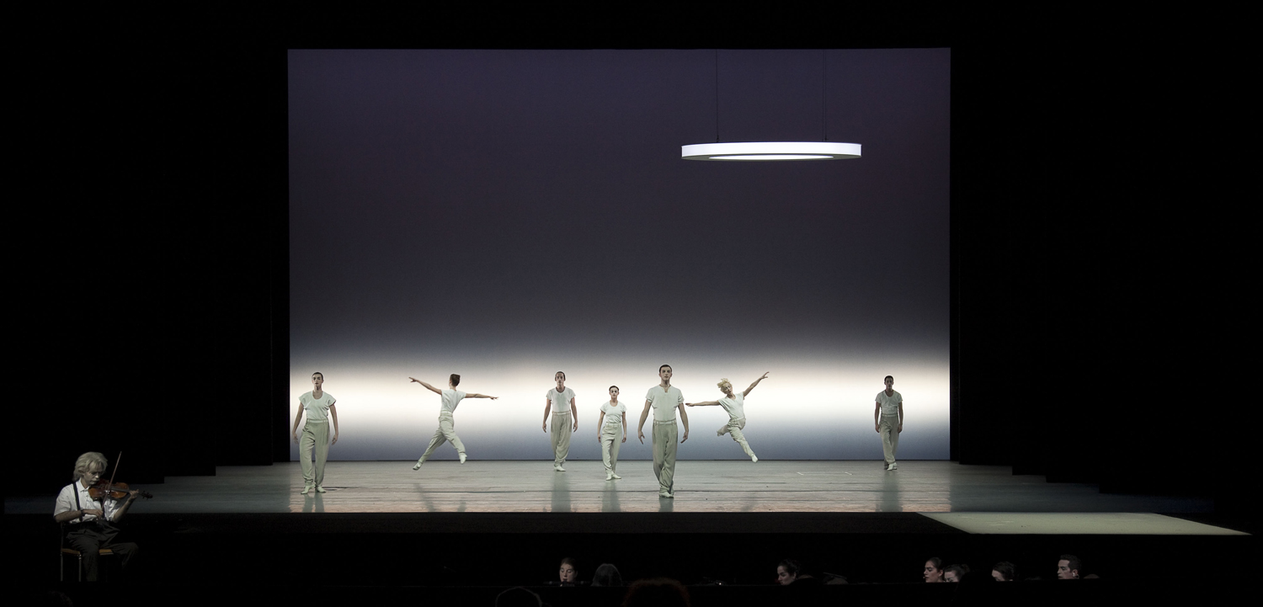
Fig. 5-18. Robert Wilson, Einstein on the Beach (2012), performance, 5 hours. Photo Credit: Lesley Leslie-Spinks.

Slide 11
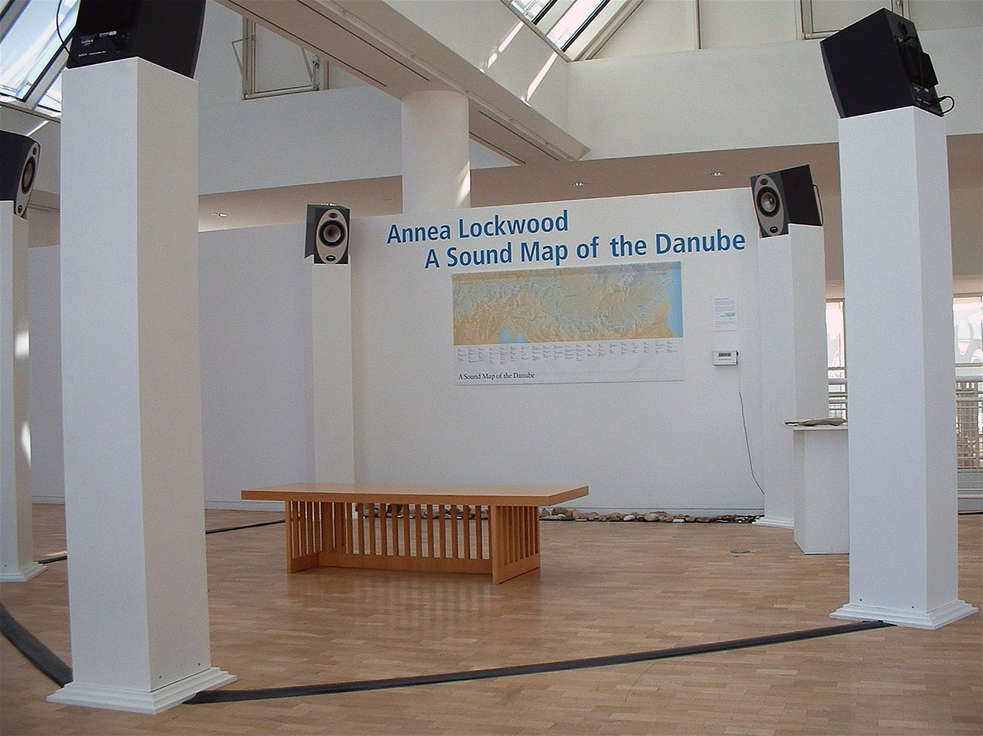
Fig. 5-19. Annea Lockwood, A Sound Map of the Danube (2005), six-channel surround sound installation, 2:47:00 hours. Courtesy of the Artist.

